Slide 1

Relativistic Electron Alert System for Exploration (REleASE) and the UMASEP forecasting schemes
Prof. Dr. Bernd Heber, Christian-Albrechts-Universität zu Kiel, Deutschland.

Slide 2
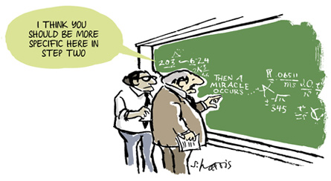
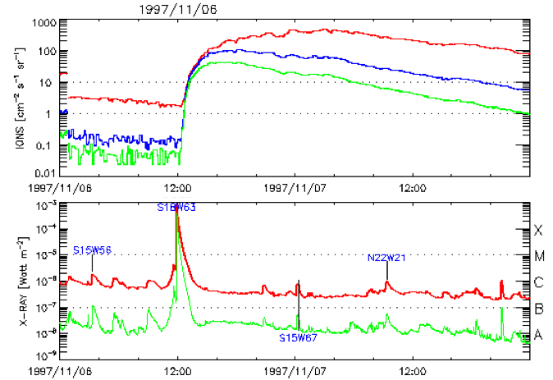

The Physics behind …
E > 10 MeV
E > 50 MeV
E > 100 MeV
hν = 0.1-0.8 nm
hν = 0.05-0.4 nm
© cdaw.gsfc.nasa.gov/CME_list
http://cafehayek.com/2014/03/then-a-miracle-occurs.html
Parker (1963)

Slide 3
Overview
Repetition from previous lecture:
  Solar flares (Lecture Ludwig Klein)
UMASEP: the basic idea
Repetition from previous lecture:
  Particle transport (Neus Agueda)
RELEASE: the basic idea

Slide 4
Overview
Transperency 7 from Neus

Slide 5
The Sun as a Particle Accelerator:
Energetic photons, neutrons and particles
Detection of energetic protons from the Sun with ground based neutron monitors (~1942) in association with solar flares.

Slide 6
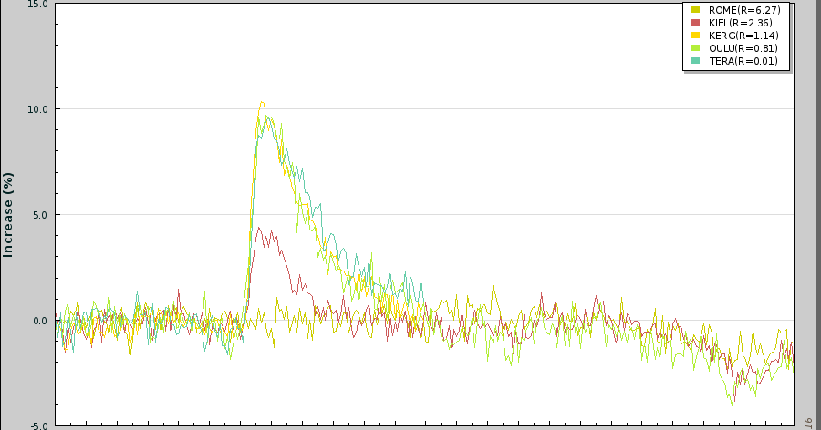
E > 450 MeV
© www.nmdb.eu
E > 10 MeV
E > 50 MeV
E > 100 MeV
hν = 0.1-0.8 nm
hν = 0.05-0.4 nm
© cdaw.gsfc.nasa.gov/CME_list

Slide 7
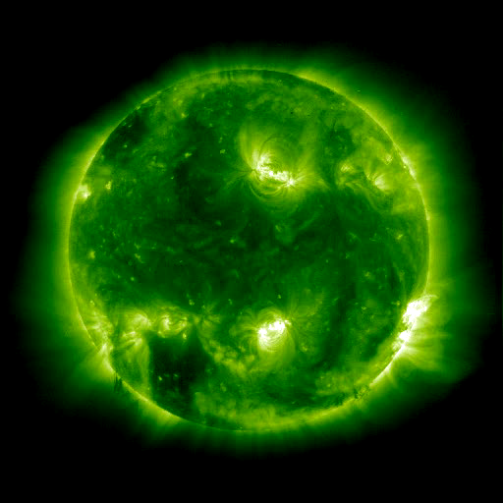
Solar flares
What is a solar flare ?
What is a solar flare ?
  temporary brightening across the EM spectrum
  limited volume of the corona and the underlying atmosphere
What are the physical processes behind this phenomenology?
  plasma heating to T > 10⁷ K
  acceleration of charged particles (electrons, protons, ions), sometimes to relativistic energies
© SoHO/EIT (ESA/NASA)

Slide 8
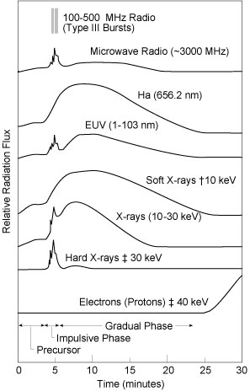
Solar flares
Electromagnetic (EM) emissions
Gross distinction:
  short & spiky (radio, microwaves¹, HXR)
  long-lasting, smoothly evolving (Hα, SXR)
Phases of a flare:
  impulsive phase
  main phase/gradual phase
https://ase.tufts.edu/cosmos/print_images.asp?id=27
(1) ν ≥ 1 GHz

Slide 9
Solar flares
Electromagnetic (EM) emissions
What is causing these time profile?
  Suprathermal electrons
https://ase.tufts.edu/cosmos/print_images.asp?id=27
(1) ν ≥ 1 GHz

Slide 10
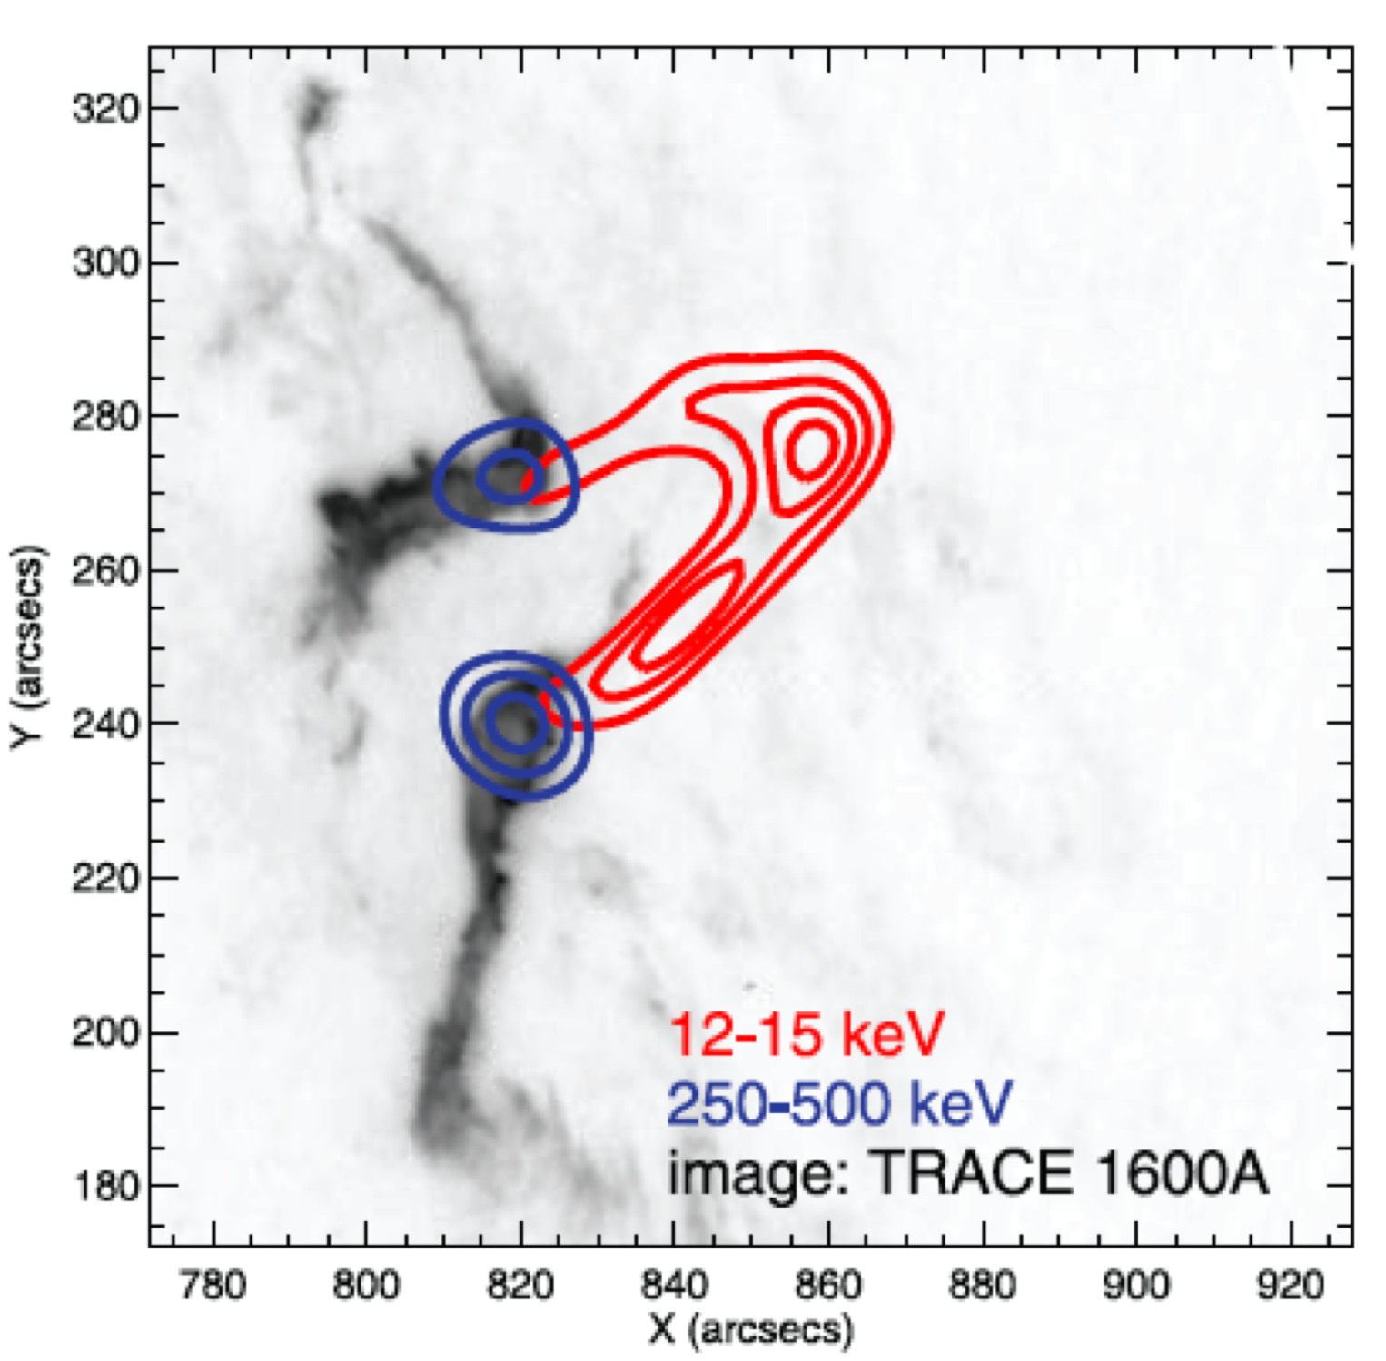
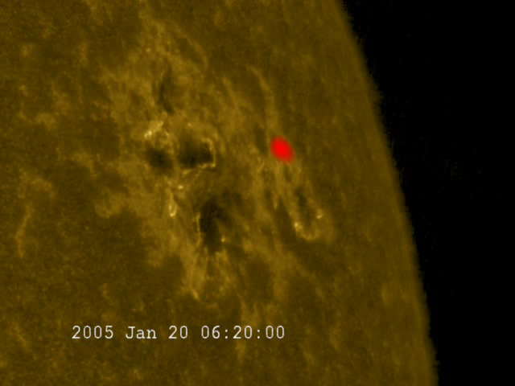
Solar flares
Electromagnetic (EM) emissions
Where does the radiation comes from?
https://ase.tufts.edu/cosmos/print_images.asp?id=27
(1) ν ≥ 1 GHz

Slide 11
Solar flares
Electromagnetic (EM) emissions
What is causing these time profile?
  Heated plasma
What about ions?
https://ase.tufts.edu/cosmos/print_images.asp?id=27

Slide 12
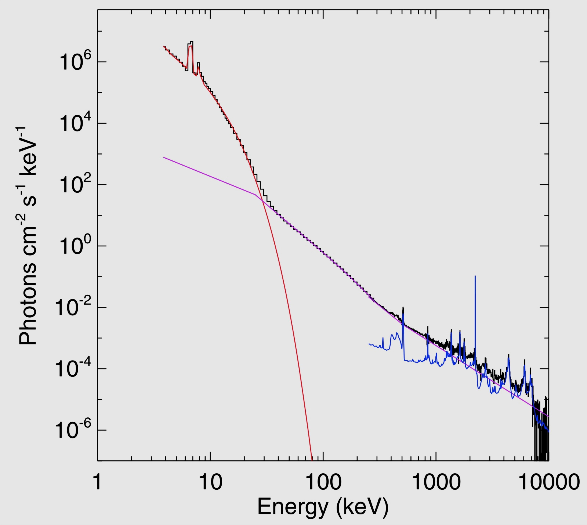
Solar flares – proton acceleration
Nuclear gamma-ray lines
What does the spectrum tells us?
Accelerated ions impinging on atmospheric ions: (narrow) de-excitation lines
Accelerated ions impinging on atmospheric protons: broad de-excitation lines
Neutron capture line:
???
  p(> 30 MeV)+X -> X’+n
  n (thermalised) + p -> ²H* -> ²H + γ (2.223 MeV)
T ≈ 40 MK
?
R.P. Lin 2011 Spa Sci Rev 159, 421

Slide 13
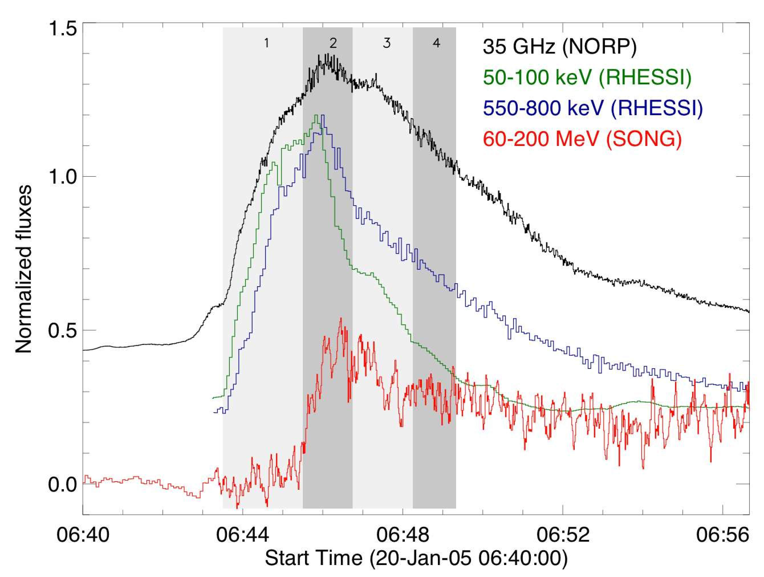
Solar flares – proton acceleration
Pion-decay gamma rays
At even higher ion energies: Gamma rays hν > 60 MeV: π⁰ decay from p>300 MeV
Protons (ions) > 300 MeV/nuc ->
  π^{+/-} -> μ^{+/-} -> e^{+/-}
  π⁰ -> 2γ (67 MeV)
Masson et al. 2009 Solar Phys. 257, 305
5 min
Notes:
So far only electron-related radiative diagnostics – real bias, since observational bias towards the lighter electrons – see Larmor formula
Show time history Masson et al 2009 of 2005 Jan 20, including photons above 60 MeV; show spectrum (SONG); discuss pion-decay radiation (see Vilmer et al. 20011; Vilmer et al. 2003). Consequence: acceleration of relativistic protons.
Nuclear gamma-ray lines: which energies ? abundances ?
Strong correlation between electron acceleration (relativistic) and relativistic proton acceleration (Shih et al. 2009). But differences in detail (Kiener et al 2006) in the course of an event
Location of the gamma-ray sources (RHESSI – see Vilmer et al. 2011): new challenge for understanding the acceleration process
Overview: the highest particle energies seen through the radiative signatures = the eneries that flare-related acceleration processes have to achieve in certain extreme cases

Slide 14
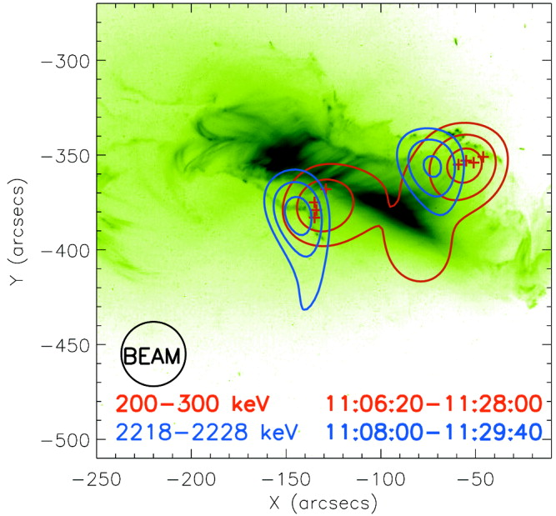
Solar flares – proton acceleration
Imaging observations
electrons
20″≈14 000 km
Imaging of the 2.223 MeV line (p≥30 MeV) and of HXR bremsstrahlung (e⁻≥200 keV): consistently (4/5 cases) different sources (see Vilmer et al. 2011, Spa Sci Rev).
Different acceleration regions ?
Hurford et al., 2006 ApJ 644, L93
protons

Slide 15
Solar flares
Electromagnetic (EM) emissions
Remember:
Free magnetic energy is partially converted into acceleration of particles.
Electrons and ions interact in the chromosphere /lower corona => Hard X-rays
Ions need a minimum energy to be visible in gamma rays!
Ohmic heating by electrons of the coronal plasma
https://ase.tufts.edu/cosmos/print_images.asp?id=27

Slide 16
Solar flares (first aspects)
All radiation investigated so far comes from closed magnetic regions in the chromosphere and corona
Parker (1963)

Slide 17
Overview
Repetition from previous lecture:
  Solar flares (Lecture Ludwig Klein)
UMASEP: the basic idea
Repetition from previous lecture:
  Particle transport (Neus Agueda)
RELEASE: the basic idea

Slide 18
Solar flares (first aspects)
What about interplanetary space?
How to get from X-rays to Protons?
E > 10 MeV
E > 50 MeV
E > 100 MeV
hν = 0.1-0.8 nm
hν = 0.05-0.4 nm
© cdaw.gsfc.nasa.gov/CME_list
Parker (1963)

Slide 19
The UMASEP scheme (Núñez 2011, 2015)
The UMASEP scheme infer a magnetic connection along which energetic protons are arriving near Earth, by investigating the solar electromagnetic (EM) flux and the particle flux at near-earth.
.
Refs. Núñez, M. 2011, Space Weather, 9
Núñez, M., 2015, Space Weather, 13
Solar EM flux
(Soft X-rays – thermal)
Particle flux
(Near-Earth)
UMASEP
scheme
d /dt ?
SEP event
predictions

Slide 20
The Neupert Effect
The time integral of the hard X-ray emission closely matches the temporal variation of the soft X-ray emission.
Implies that accelerated electrons that produce the hard X-rays also heat the plasma that produces the soft X-rays.

Slide 21
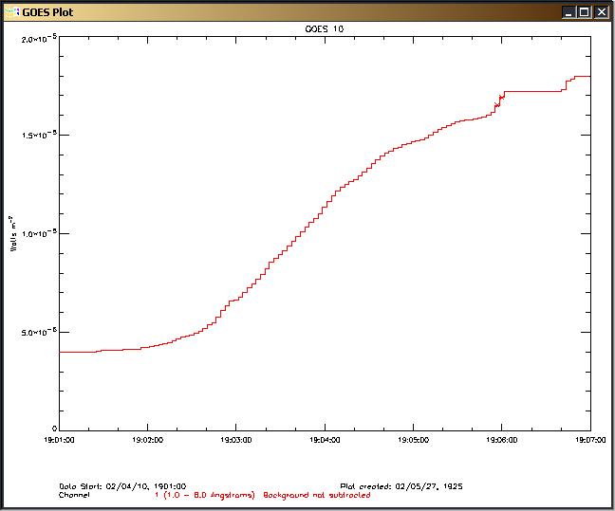
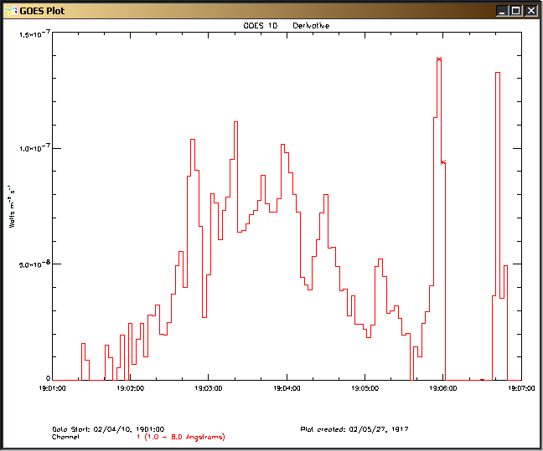
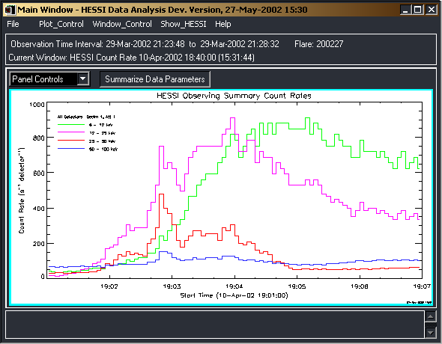
10 April 2002
GOES 10 1 - 8 Å
Time derivative GOES 1 - 8 Å
RHESSI Light Curves
6 – 12 keV
12 – 25 keV
25 – 50 keV
50 – 100 keV

Slide 22
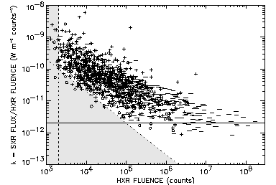
SXR:HXR Ratio vs. Flare Size
A. Veronig et al. A&A, in press (2002)

Slide 23
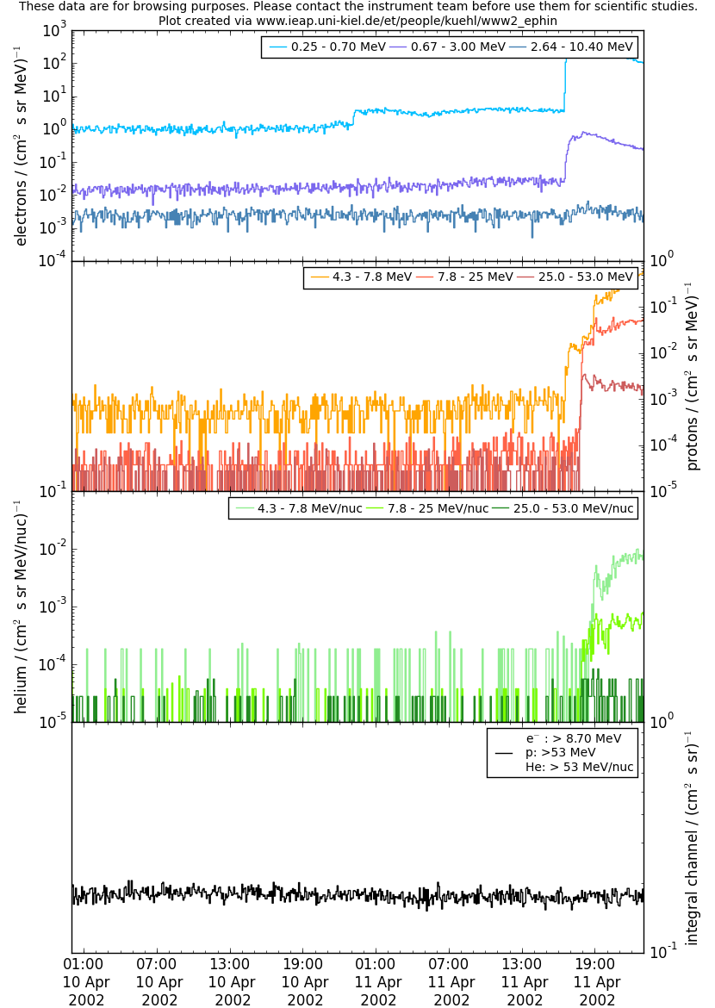
From remote sensing to in-situ observations?
No event!

Slide 24
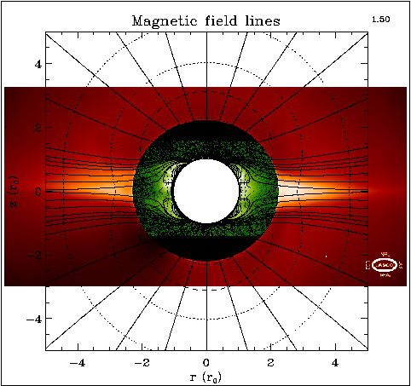
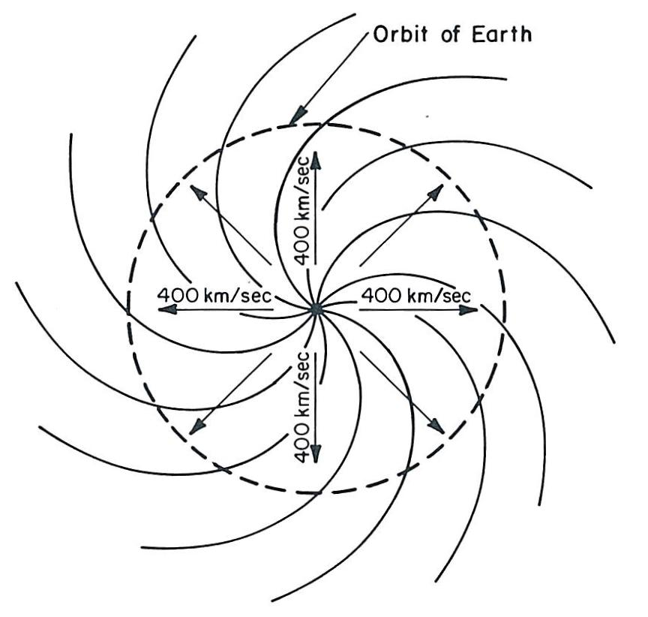
What is the problem?

Slide 25
The Physics behind …
How do we know that particles leave the corona?
http://cafehayek.com/2014/03/then-a-miracle-occurs.html
Parker (1963)

Slide 26
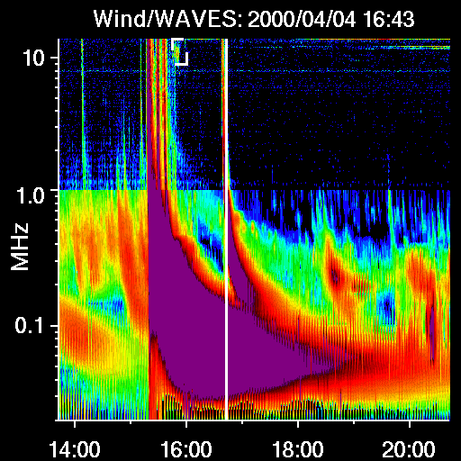
Injection into the IPM
This is a radio spectogram.
What does it show?
What is causing this features?
Type II
f_{p}(kHz) = 9 √n_{e}(cm^{–3})

Slide 27
Solar flares – energy release and particle acceleration
Why not using radio emission from electron beams
e beam
e beam rising through corona → Langmuir waves at decreasing ν
Coupling with ion sound waves
(ν_{S}<<ν_{L}) or Langmuir waves
→ EM waves (T=transverse) at
  ν_{T} = ν_{L} + ν_{S}≈ ν_{L} ≈ ν_{pe} ~ √n_{e} “fundamental”
  ν_{T} = ν_{L} + ν_{L}= 2ν_{L} ≈ 2ν_{pe} “harmonic”
Short burst that drifts from high to low ν (“type III” burst); lower ν → greater height
Radio image: ν-dependent height
low n_{e}
high n_{e}
low ν
Frequency
high ν
Height (time)

Slide 28
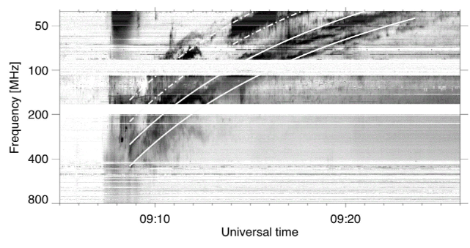
Coronal mass ejections
Why not using radio emission from a shock wave
low n_{e}
Shock wave rising through corona → e-reflection → Langmuir waves at decreasing ν
Coupling with ion sound waves
(ν_{S}<<ν_{L}) or Langmuir waves
→ EM waves (T=transverse) at
  ν_{T} = ν_{L} + ν_{S}≈ ν_{L} ≈ ν_{pe} ~ √n_{e} “fundamental”
  ν_{T} = ν_{L} + ν_{L}= 2ν_{L} ≈ 2ν_{pe} “harmonic”
Burst that drifts from high to low ν more slowly than type III (“type II” burst); lower ν → greater height
Shock wave
high n_{e}
low ν
Frequency
high ν
Height (time)

Slide 29
The Physics behind …
But radio data are not available in real time
http://cafehayek.com/2014/03/then-a-miracle-occurs.html
Parker (1963)

Slide 30
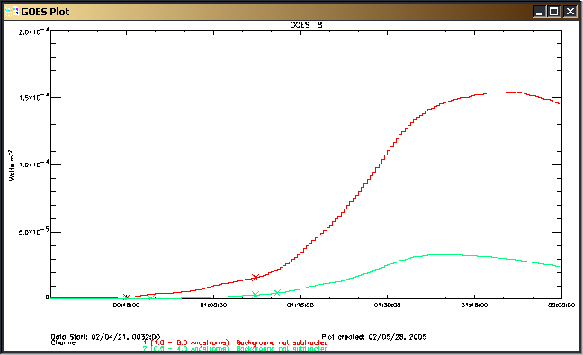
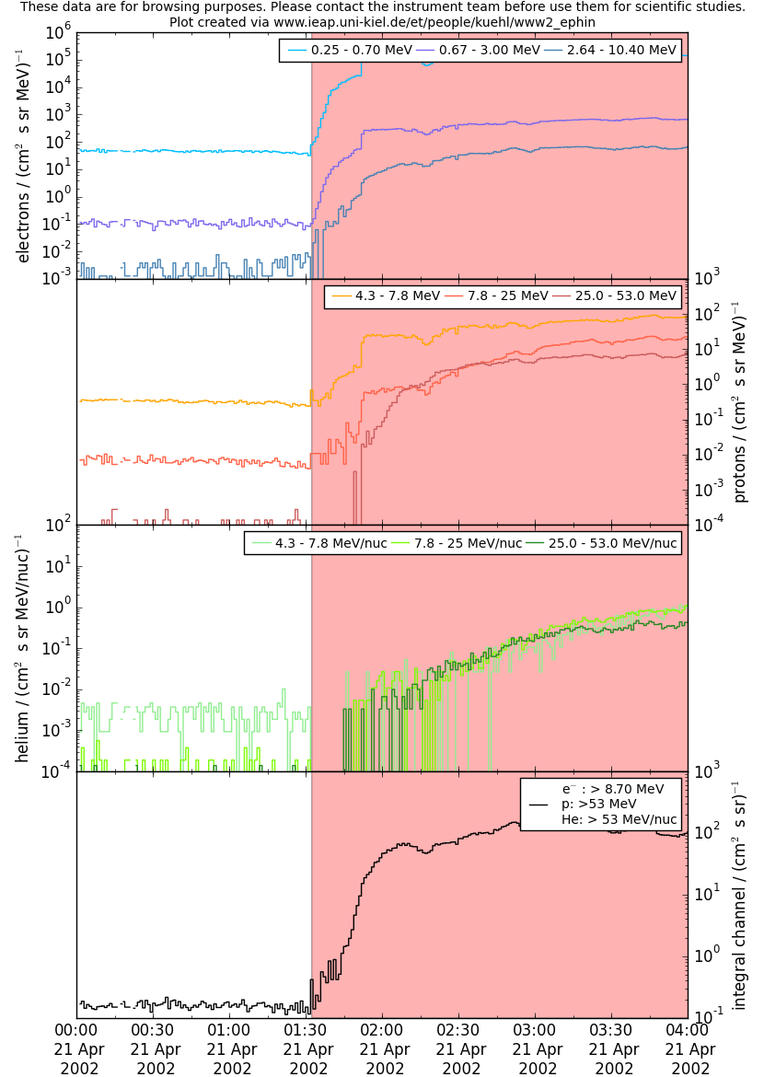
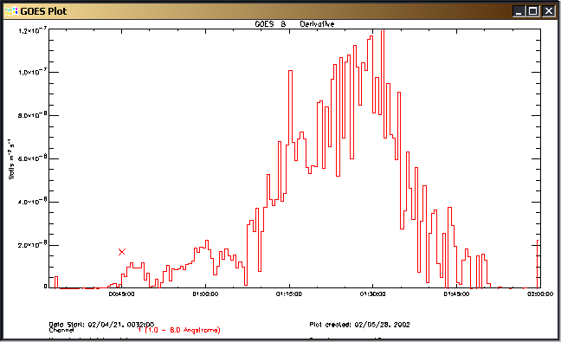
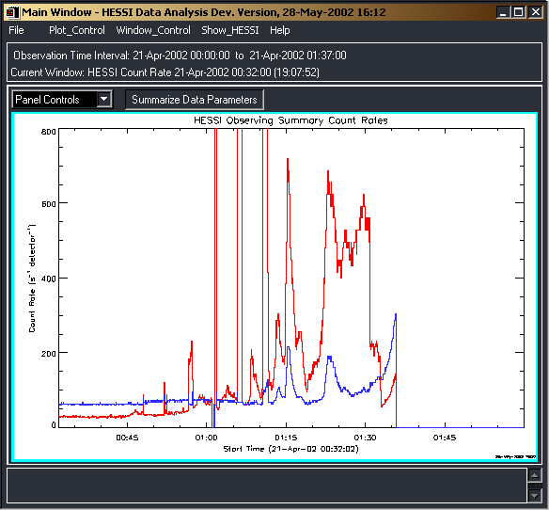
From remote sensing to in-situ observations?

Slide 31
The UMASEP scheme (Núñez 2011, 2015)
The UMASEP scheme infer a magnetic connection along which energetic protons are arriving near Earth, by correlating solar electromagnetic (EM) flux with the particle flux at near-earth.
If the correlation is high and the associated solar flare is also strong, then the UMASEP scheme issues a SEP prediction.
Refs. Núñez, M. 2011, Space Weather, 9
Núñez, M., 2015, Space Weather, 13
Solar EM flux
(Soft X-rays – thermal)
Particle flux
(Near-Earth)
UMASEP
scheme
d /dt
Correlation and associated flare analyses
SEP event
predictions
d /dt

Slide 32
UMASEP Models
Well-connected SEP
Forecasting Model
(UMASEP-10/100/500)
Preliminary forecast of
a well-connected SEP
Soft X-ray flux
Differential flux
Proton flux
Poorly-connected SEP
Forecasting Model
(only UMASEP-10)
Preliminary forecast of
a poorly-connected SEP
For the case of UMASEP-10, this dual-model was calibrated by using 27 years of SXR/proton data (updated every year)

Slide 33
UMASEP Models
Well-connected SEP
Forecasting Model
Test 1
Symptoms of a magnetic connection?
Yes
Yes
Preliminary forecast of
a well-connected SEP
Soft X-ray flux
Differential flux
Proton flux
Poorly-connected SEP
Forecasting Model

Slide 34
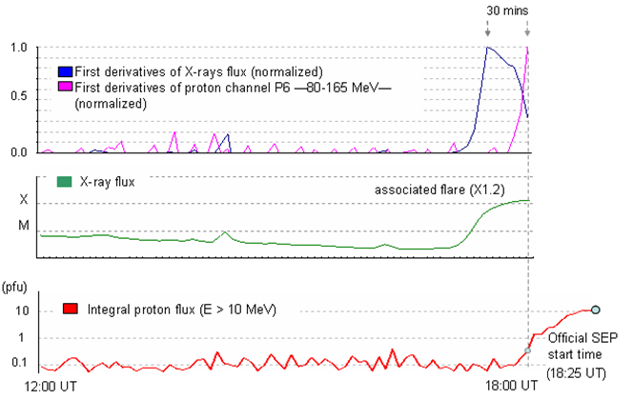
UMASEP Models
Well-connected SEP
Forecasting Model
Test 1
Symptoms of a magnetic connection?
Test 2
the associated flare > C4 ?
Yes
Yes
Preliminary forecast of
a well-connected SEP
Soft X-ray flux
Differential flux
Proton flux
Oct 26/2003 (18:00)
OK
Poorly-connected SEP
Forecasting Model

Slide 35
UMASEP Models
Well-connected SEP
Forecasting Model
Test 1
Symptoms of a magnetic connection?
Test 2
Flare ≥ C4 (for E> 10 MeV)?
Yes
Yes
Preliminary forecast of
a well-connected SEP
≥ M3 for 100 MeV
Soft X-ray flux
Differential flux
Proton flux
Oct. 26/2003 (18:00)
OK
?
Poorly-connected SEP
Forecasting Model

Slide 36
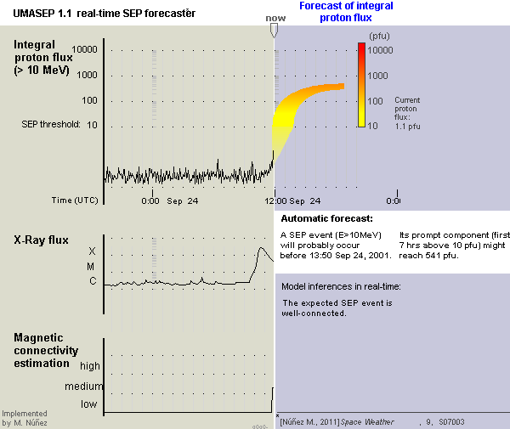

UMASEP Models
Well-connected SEP
Forecasting Model
Test 1
Symptoms of a magnetic connection?
Test 2
Flare ≥ C4 (for E> 10 MeV)?
Yes
Yes
Preliminary forecast of
a well-connected SEP
Soft X-ray flux
Differential flux
Proton flux
Oct. 26/2003 (18:00)
OK
OK

Slide 37
UMASEP Models
Well-connected SEP
Forecasting Model
Test 1
Symptoms of a magnetic connection?
Test 2
Flare ≥ C4 (for E> 10 MeV)?
Yes
Yes
Preliminary forecast of
a well-connected SEP
Soft X-ray flux
Differential flux
Proton flux
Oct. 26/2003 (18:00)
OK
OK

Slide 38
Overview
Repetition from previous lecture:
  Solar flares (Lecture Ludwig Klein)
UMASEP: the basic idea
Repetition from previous lecture:
  Particle transport (Neus Agueda)
RELEASE: the basic idea

Slide 39
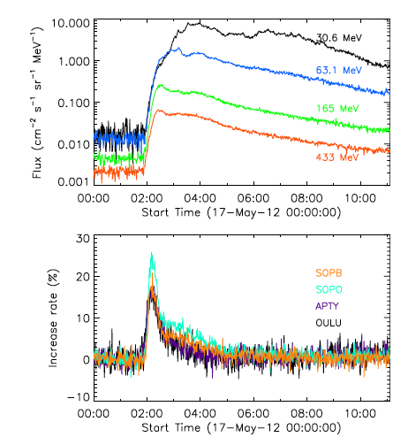
Scatter free transport
Protons

Slide 40
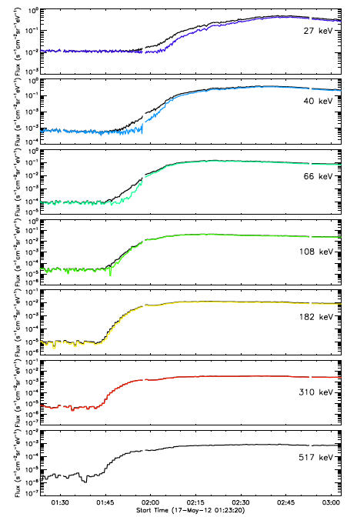
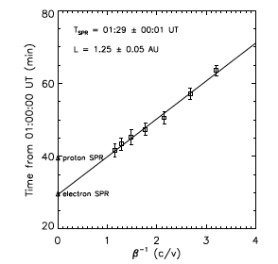
Protons
Electrons

Slide 41
Overview
Repetition from previous lecture:
  Solar flares (Lecture Ludwig Klein)
UMASEP: the basic idea
Repetition from previous lecture:
  Particle transport (Neus Agueda)
RELEASE: the basic idea

Slide 42

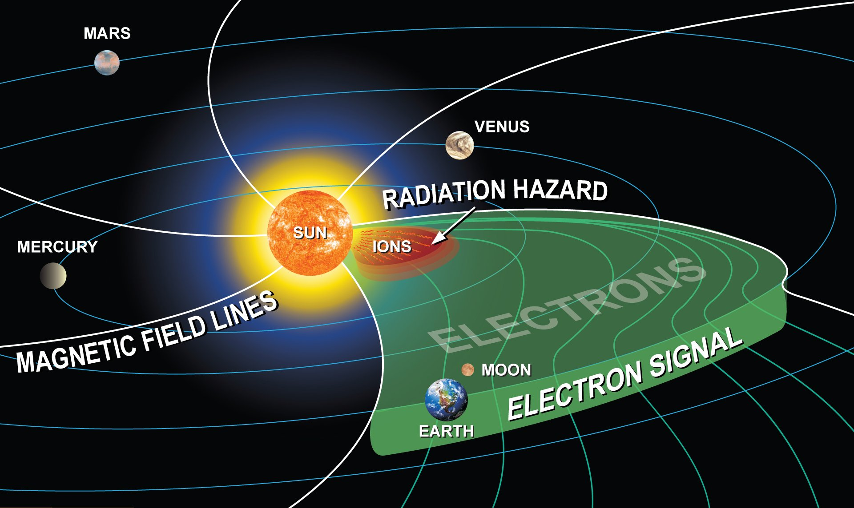

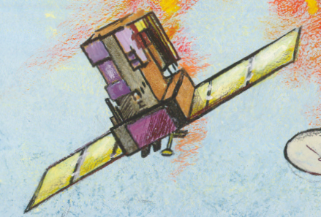

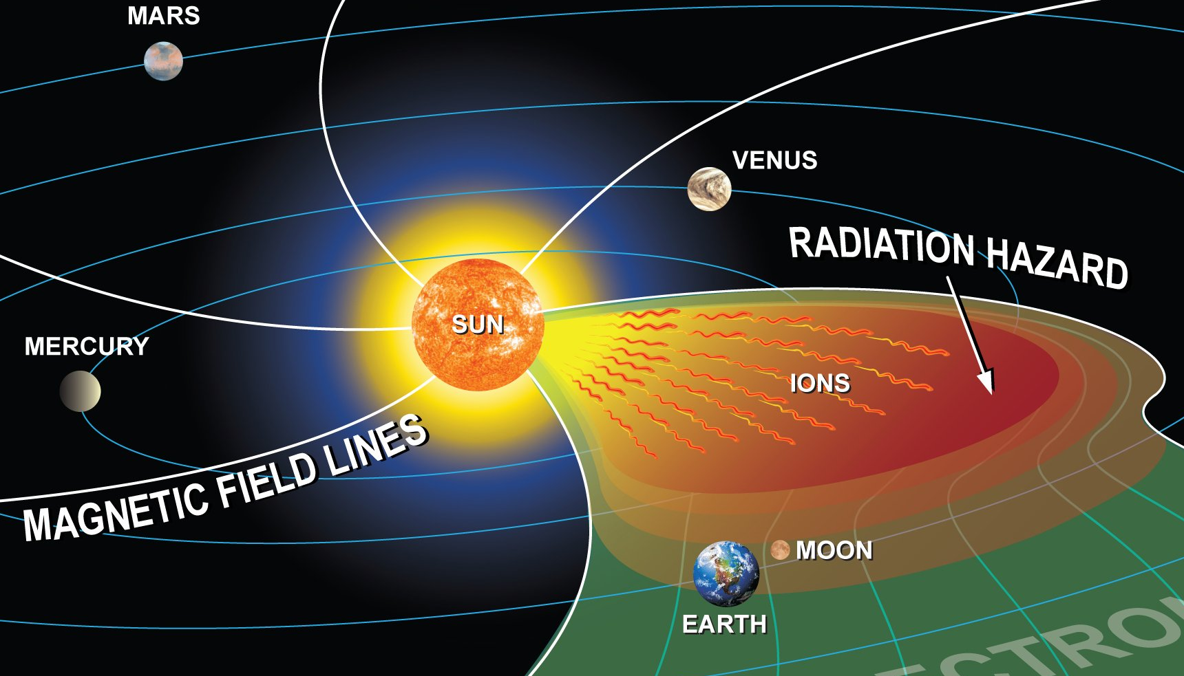

D ~ 1.2 AU
v_{el}(1 MeV) = 0.95 c
T_{el} (1 MeV) =10.5 min
Notes:
Astronauts venturing beyond the protective magnetic field of Earth face the direct effects of the Sun.
Within even one hour, explorers can be engulfed with particles that cause harmful long- or short-term health effects and put missions at risk. Although the inside of a spacecraft or lunar base or Martian moon can be made relatively safe, “Staying Inside” hampers productivity. “Going Outside” requires a space weather warning system.
The top sketch depicts an artists‘ view of the radiation field in the inner heliosphere ten minutes after release of solar energetic particles from the Sun. Relativistic electrons have reached 1 AU at the time when hazardous protons (~30 MeV) are still within 0.2 AU from the flare location. The fast-moving (test-) particles probe the magnetic field ahead of the protons for instantaneous magnetic connectivity, which would not otherwise be possible.

Slide 43
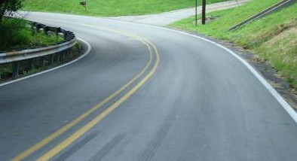
D ~ 1.2 AU
v_{p}(30 MeV) = 0.25 c
T_{p}(30 MeV) = 40 min
ΔT ~ 30 min
Notes:
Magnetic field lines form the guard rails of the „road“ that leads charged energetic particles from the Sun to the Earth-moon system. Assuming no pitch angle, the delay of harmful ions over the fast electrons fpropagating along the (curved) Parker magnetic field can be derived.
Thirty minutes after a warning can be issued, the hazardouis protons arrive in the Earth-moon system. Depending on the time necessary for EVA abort, the exposure of astronauts to the bulk protons can be reduced substantially with the early warning technique.

Slide 44
The Physics behind …
Scatter free transport may be oversimplified. Are the propagation conditions the same?
http://cafehayek.com/2014/03/then-a-miracle-occurs.html
Parker (1963)

Slide 45

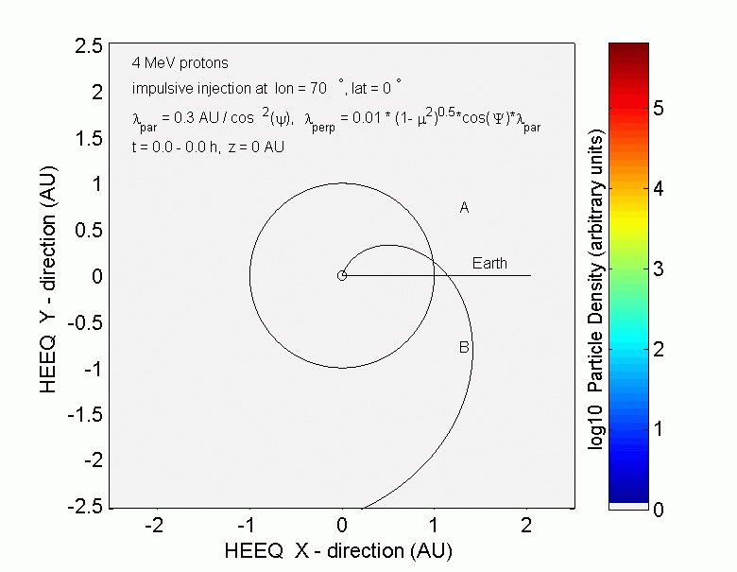
Mathematisch-Naturwissenschaftliche Fakultät
Transport in the IPM

Slide 46
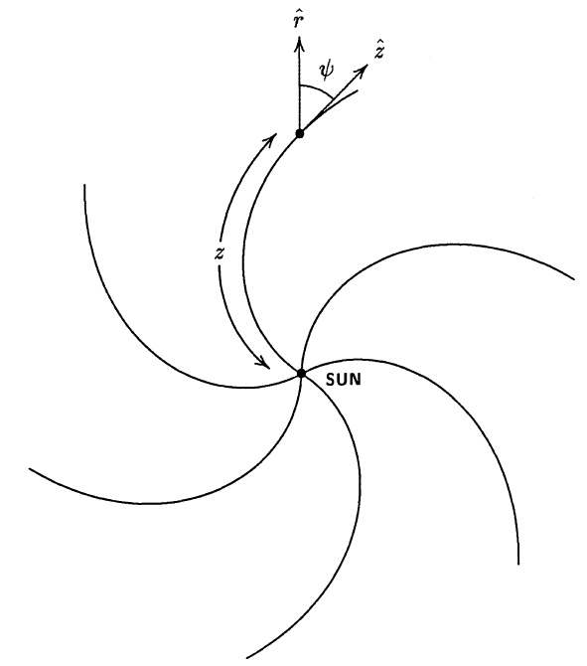



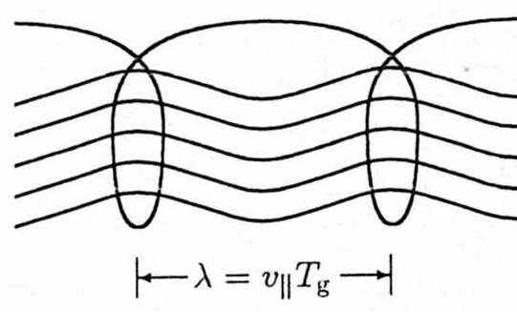

Transport in the IPM
The simplest model of transport applicable to the IPM conditions assumes static magnetic fluctuations superposed on a Parker IMF. In addition the effect of adiabatic
focusing (mirroring) has to be taken into account
Focused transport equation

Slide 47
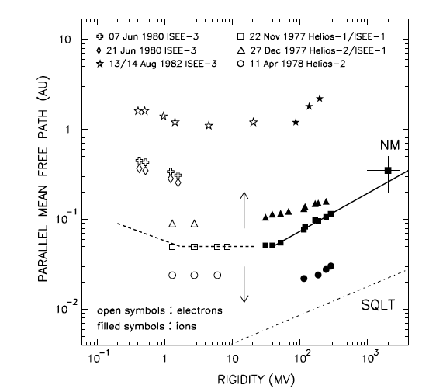
Diffusion coefficients
Does it work when taking into account a more complex particle transport?
Yes!

Slide 48
SEP events
CME driven shocks and flares accelerate particles
Impulsive events
  related to impulsive X-ray flares
  duration from hours to a day, low intensity
  electron, heavy-ion and ³He rich
  narrow longitude range
Gradual events
  related to CMEs and gradual X-ray flares
  duration from days to a week, high intensity → Space environment
  electron poor, normal ion abundances
  wide longitude range

Slide 49
SEP events
CME driven shocks and flares accelerate charged particles
→ solar energetic particle events
Gradual events
  related to CMEs and gradual X-ray flares
  duration from days to a week, high intensity → Space environment
  electron poor, normal ion abundances
  wide longitude range

Slide 50
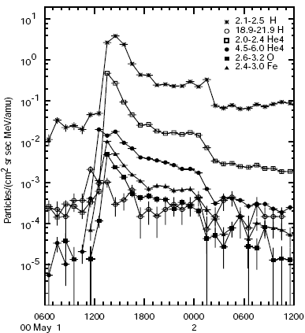
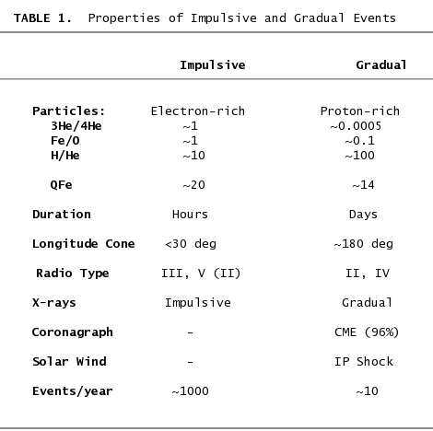

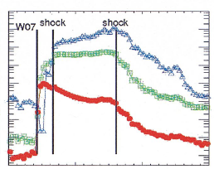

- 0.05

Slide 51
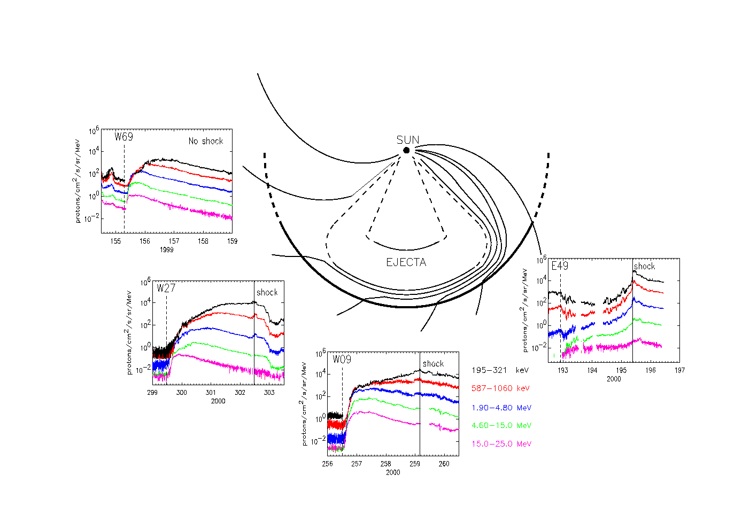
Longitude distribution: gradual events as a function of energy

Slide 52
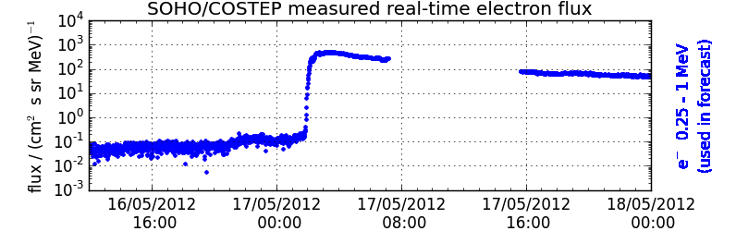
Starting points
Measurement of MeV electrons by EPHIN

Slide 53
Relativistic electrons always arrive at 1 AU ahead of non-relativistic SPE ions allowing their forecasting.
Coming from one source with “identical” propagation conditions, significant correlations between electron and proton time-profiles exist.
Therefore, a matrix to forecast proton intensities was developed.
Posner, Space Weather J., 2007
Labrenz, Heber, Kühl, Sarlanis, Malandraki & Posner
Annapolis, Apr. 14, 2016
Notes:
Findings from 2007.

Slide 54
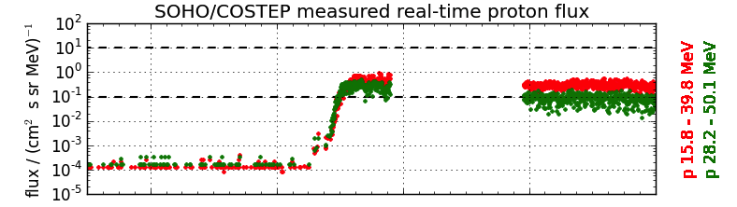
The task
REleASE

Slide 55
Use data from 1998 to 2005 and find correlation between the maximum intensities of electrons and protons:

Slide 56
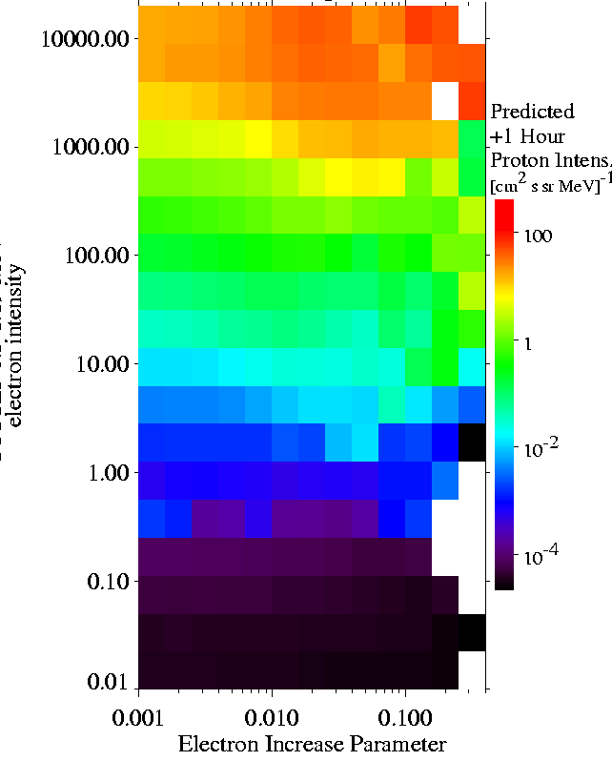
A matrix is the foundation of this forecasting technique. It combines continuous minute-by-minute observations through the main phase of solar cycle 23 (“learning phase”, 1998-2002). The matrix spans across electron intensities and rise times and any time the electron intensity increases, a value is added at the locus given by the two parameters. The value that is filled in is the proton intensity observed one hour later.
At any one time, a forecast simply pulls the average matrix proton value for the given electron locus and turns it into a near-term proton intensity prediction.
From Posner, Space Weather J., 2007
Labrenz, Heber, Kühl, Sarlanis, Malandraki & Posner
Annapolis, Apr. 14, 2016
Notes:
Electron minute-by-minute observations used for matrix. Phi and intensity define location in matrix. Filled with proton intensity measured one hour later. Self-learning matrix as key for forecasting method.

Slide 57
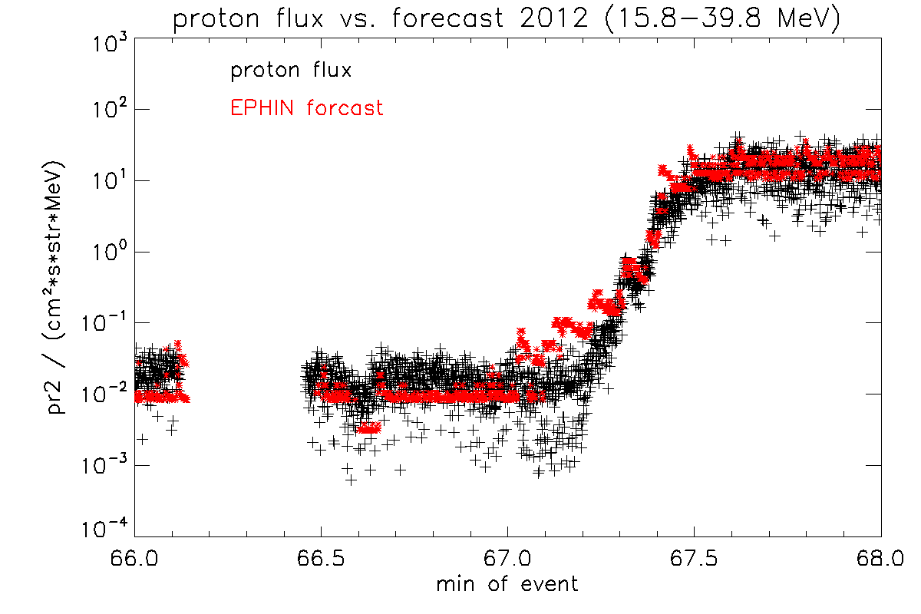
Release

Slide 58
Summary
Acceleration of ions and electrons at the SUN
Remote sensing signals from the lower corona (x and γ-rays)
8 min
? min
Injection into the interplanetary medium (radio signal)
Interplanetary transport
Measurements in space and on ground
Energy dependent

Slide 59
Summary (UMASEP)
Acceleration of ions and electrons at the SUN
Remote sensing signals from the lower corona (x and γ-rays)
8 min
Measurements in space and on ground
Hard X-rays from soft X-rays (Neupert effect)
Correlation
Forecast scheme

Slide 60
Summary (RELEASE)
Acceleration of ions and electrons at the SUN
Remote sensing signals from the lower corona (x-rays and µ-waves)
8 min
Electrons and Ions injected at same region
From electromagnetic radiation ions are predicted
Correlation

Slide 61
Project exercise
Make yourself familiar with the tempoaral and physical difference and common things between electromagnetic radiation and particles.
UMASEP forecast is based on the fact that particles are injected into the IPM in correlation with the hard X-ray.
RELEASE relies on the fact that electrons and ions are injected at the same time and that the propagation as well as the e/p-ratio is constant.

