Slide 1

Future Needs in understanding and forecasting extreme solar energetic particle events
Prof. Dr. Bernd Heber, Christian-Albrechts-Universität zu Kiel, Deutschland.

Slide 2
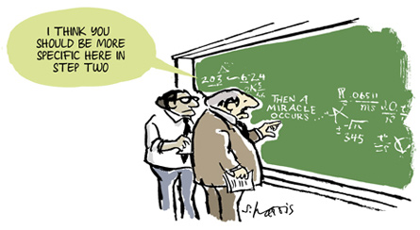
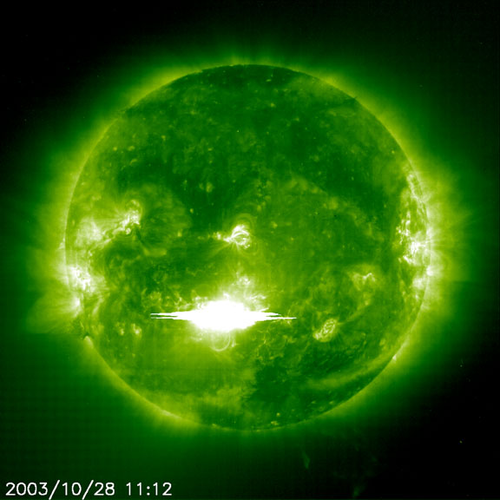
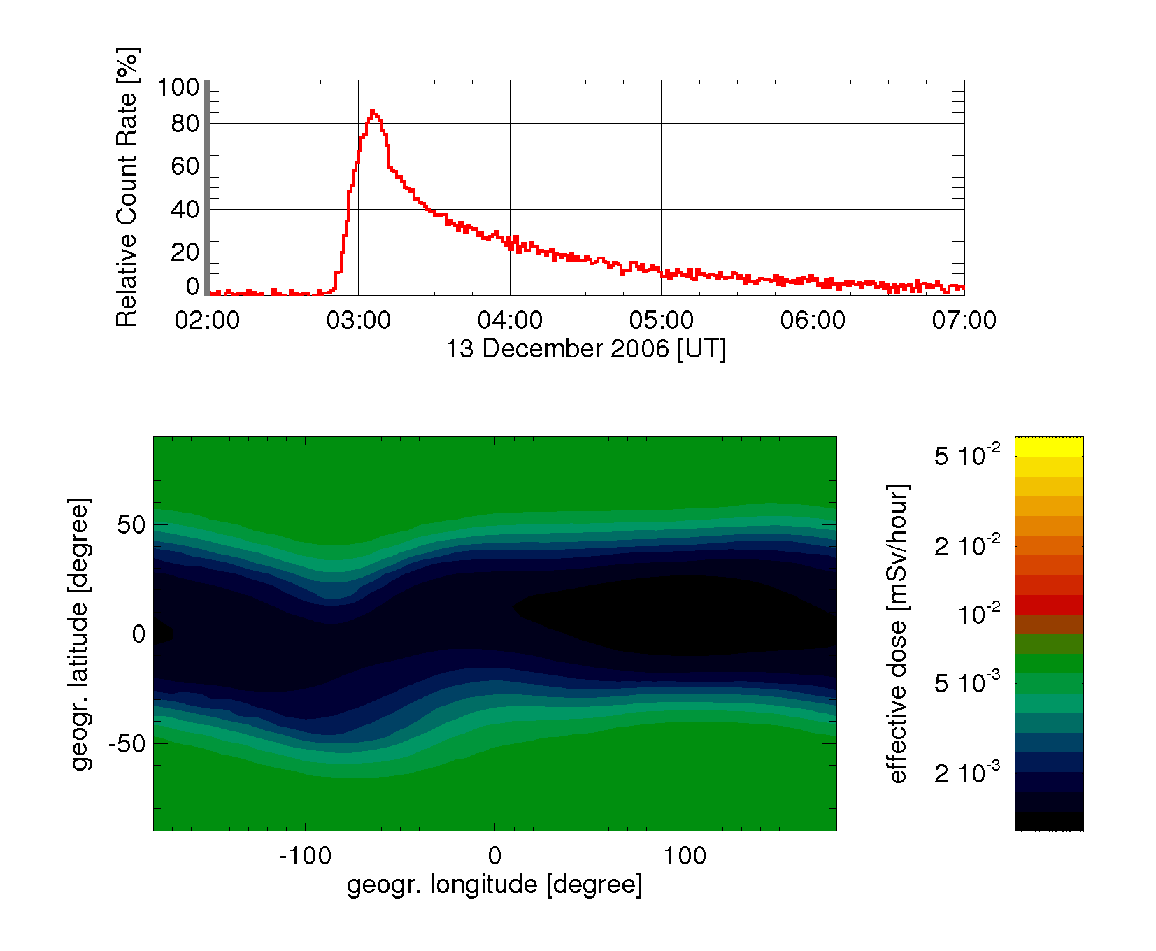

The Problem: Forecasting enhanced radiation dose due to SEP events
The Solution
http://cafehayek.com/2014/03/then-a-miracle-occurs.html
From Flückiger, ESWW

Slide 3
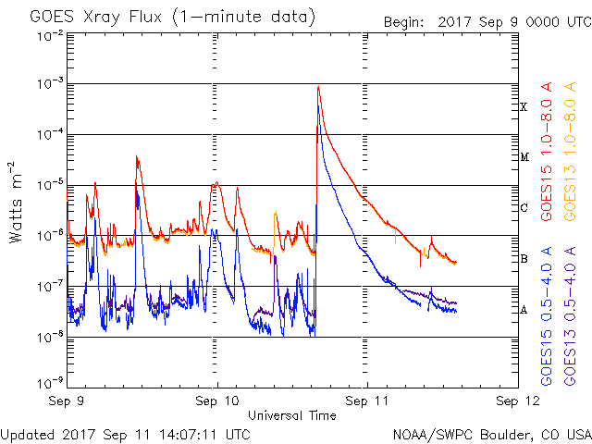

The X8.2 Flare on 10.09.2017 @ 16:06h
X8.2 solar flare occurred at 16:06 UT

Slide 4

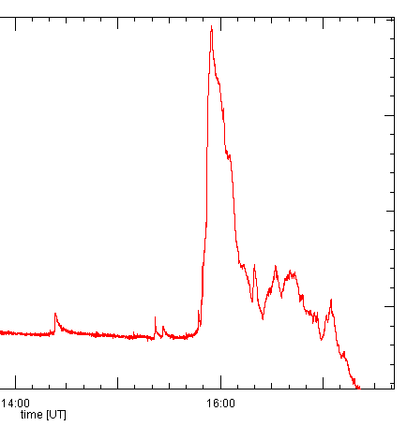
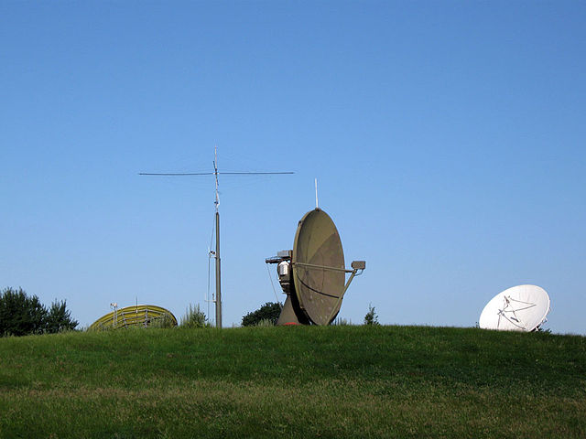
The X8.2 Flare on 10.09.2017 @ 16:06h
X8.2 solar flare occurred at 16:06 UT
Von Thorolf.de - Eigenes Werk, CC BY-SA 3.0, https://commons.wikimedia.org/w/index.php?curid=15706979

Slide 5
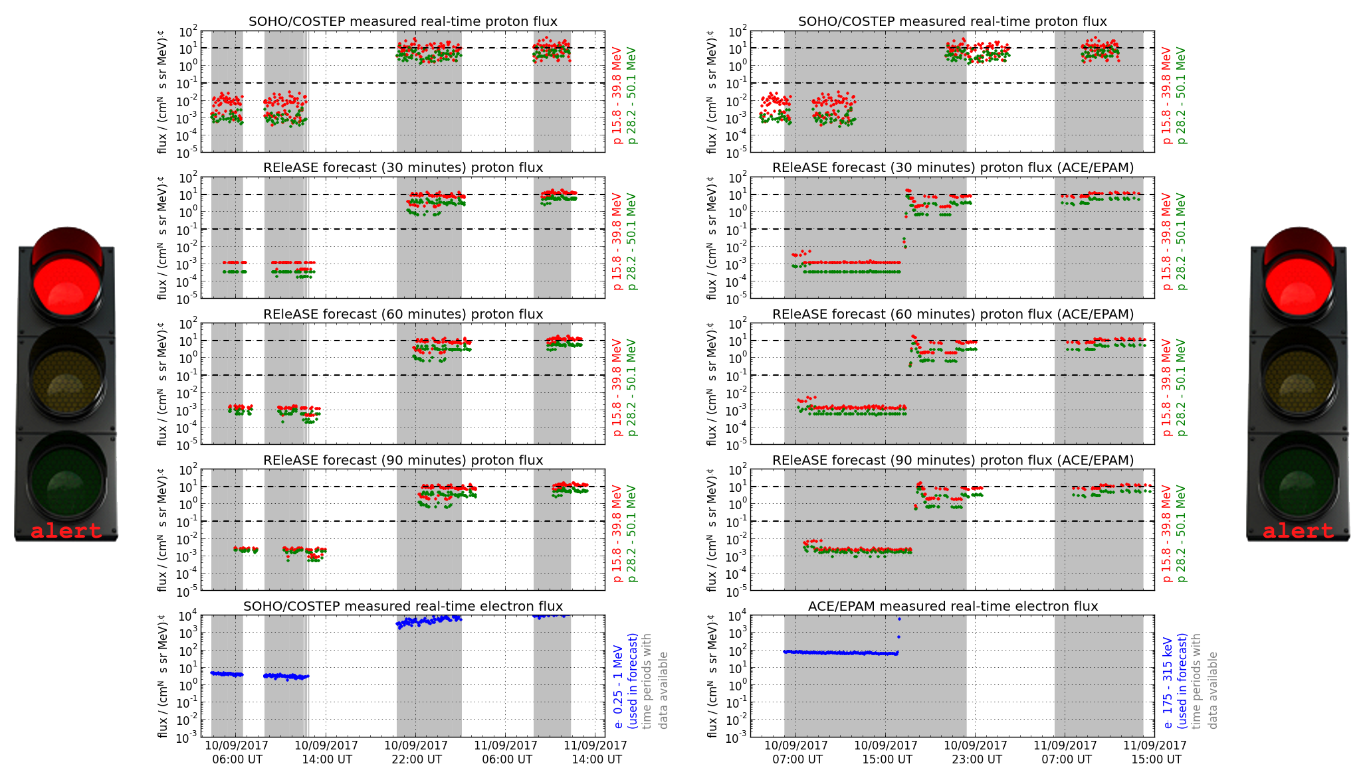
The Ground level event from 10.09.2017 @ 17:00h
REleASE Alert:
ACE EPAM at 16:18 UT
SOHO/EPHIN not tracked @ the time of the event

Slide 6
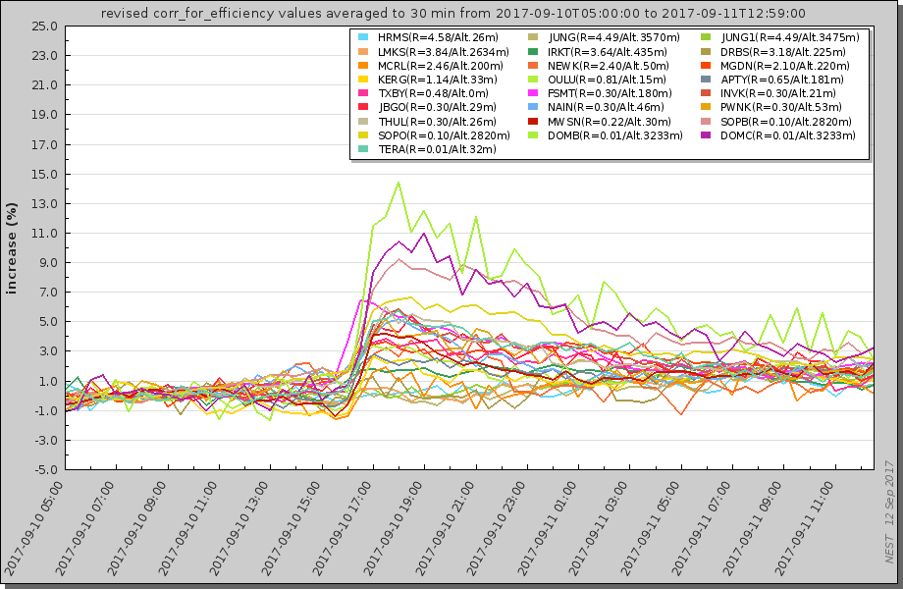
The Ground level event from 10.09.2017 @ 17:00h
Nowcast: 17:03 UT GLE-alert (Papaioannou private communication)

Slide 7
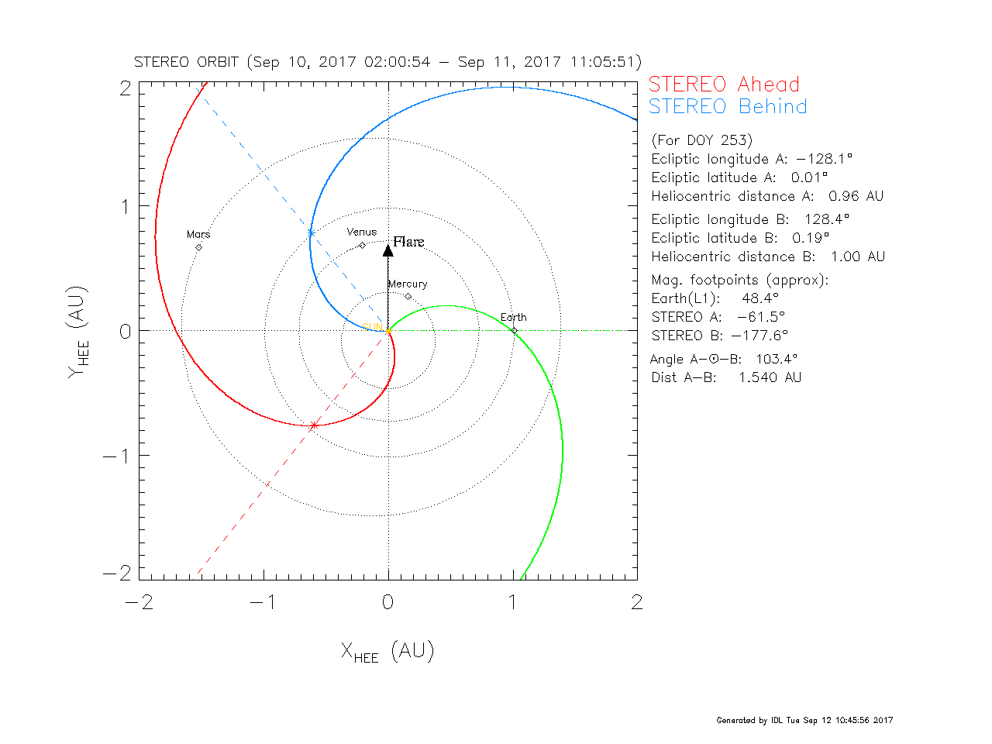
The Ground level event from 10.09.2017 @ 17:00h
The multispacecraft event

Slide 8
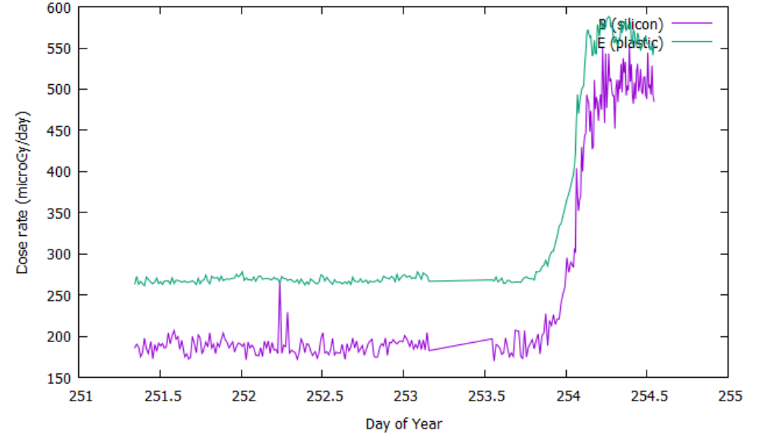
The Ground level event from 10.09.2017 @ 17:00h
The multispacecraft event
Seen @ MSL on Mars

Slide 9
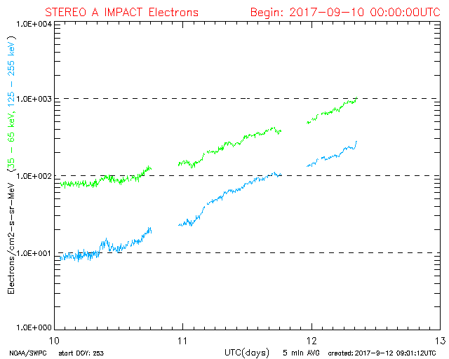
The Ground level event from 10.09.2017 @ 17:00h
?
The multispacecraft event
Seen @ MSL on Mars
Seen @STEREO A

Slide 10


Mathematisch-Naturwissenschaftliche Fakultät
What to recommend
Today: Only now-cast of Solar Energetic Particle (SEP) events causing an increased dose rate at flight altitudes.
Future Forecasting:
  Employ more fortune-teller with crystal balls.
  Understand the precursor development of the solar magnetic field.
Talk is based on the results from the EU funded HESPERIA project

Slide 11
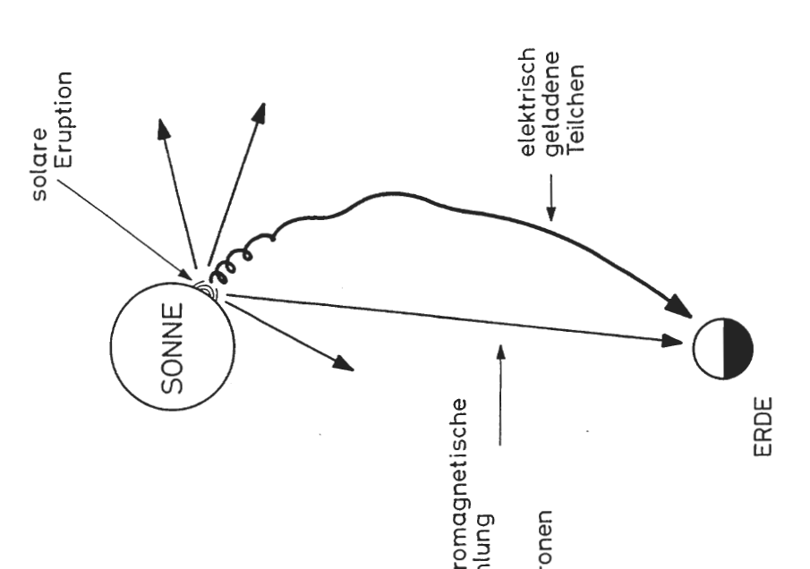
Now-cast: What can we expect?
Light versus particle radiation
Photon: 8 Min.
Electron: 10.5 Min. @ 1 MeV
~20 Min. @ 0.3 MeV
Protons: 10.5 Min. @ 2 GeV
~20 Min. @ 600 MeV
~40 Min. @ 30 MeV
Charged Particles
Solar Flare
Sun
Earth
Electromagnetic Radiation
& Neutrons

Slide 12
Overview
Repetition from previous talks
  Solar flares
  UMASEP: the basic idea
  Particle transport (Neus Agueda)
  RELEASE: the basic idea
Recommendation
  Instrumentation
  Modeling

Slide 13
Solar flare - Energetic Particles relataion
How is a solar flare defined?
  temporary brightening across the EM spectrum
  limited volume of the corona and the underlying atmosphere
What are the physical processes behind this phenomenology?
  acceleration of charged particles (electrons, protons, ions), sometimes to relativistic energies
© SoHO/EIT (ESA/NASA)

Slide 14
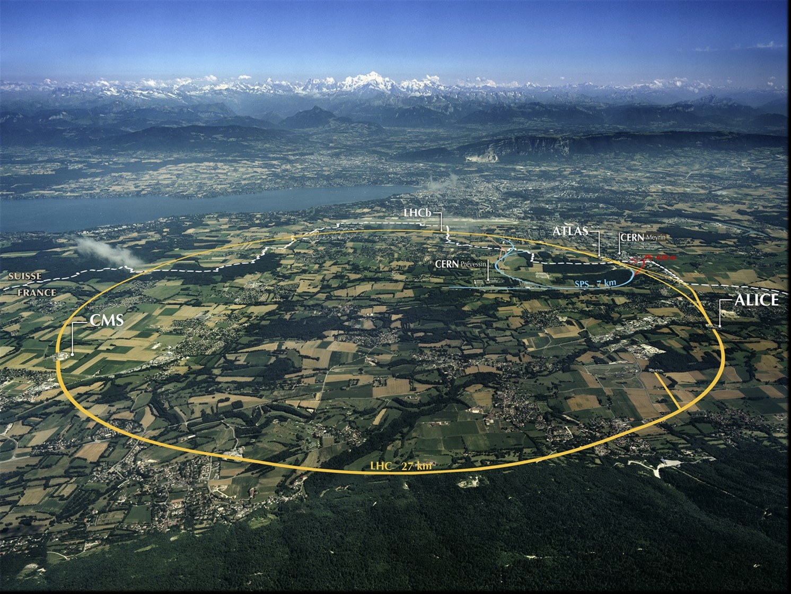
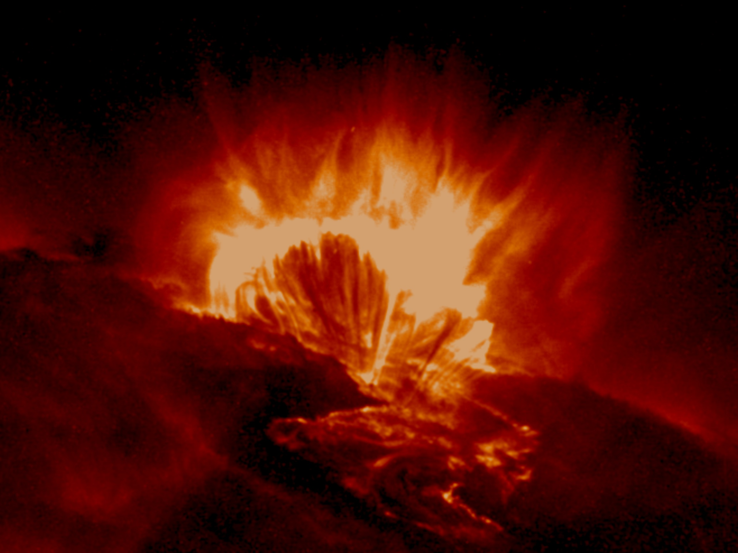
The Sun is a Particle Accelerator.
Large Hadron Collider
Active Region

Slide 15
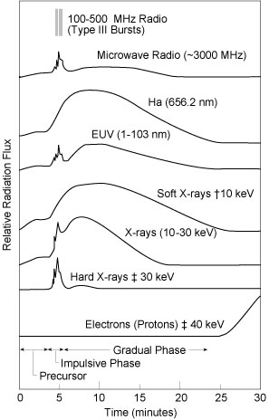
Solar flares
Electromagnetic (EM) emissions
Gross distinction:
  short & spiky (radio, microwaves¹, HXR)
  long-lasting, smoothly evolving (Hα, SXR)
https://ase.tufts.edu/cosmos/print_images.asp?id=27
(1) ν ≥ 1 GHz

Slide 16
Solar flares
Electromagnetic (EM) emissions
What is causing these time profile?
  Soft and Hard X-rays: accelerated electrons that produce the hard X-rays also heat the plasma that produces the soft X-rays
https://ase.tufts.edu/cosmos/print_images.asp?id=27

Slide 17
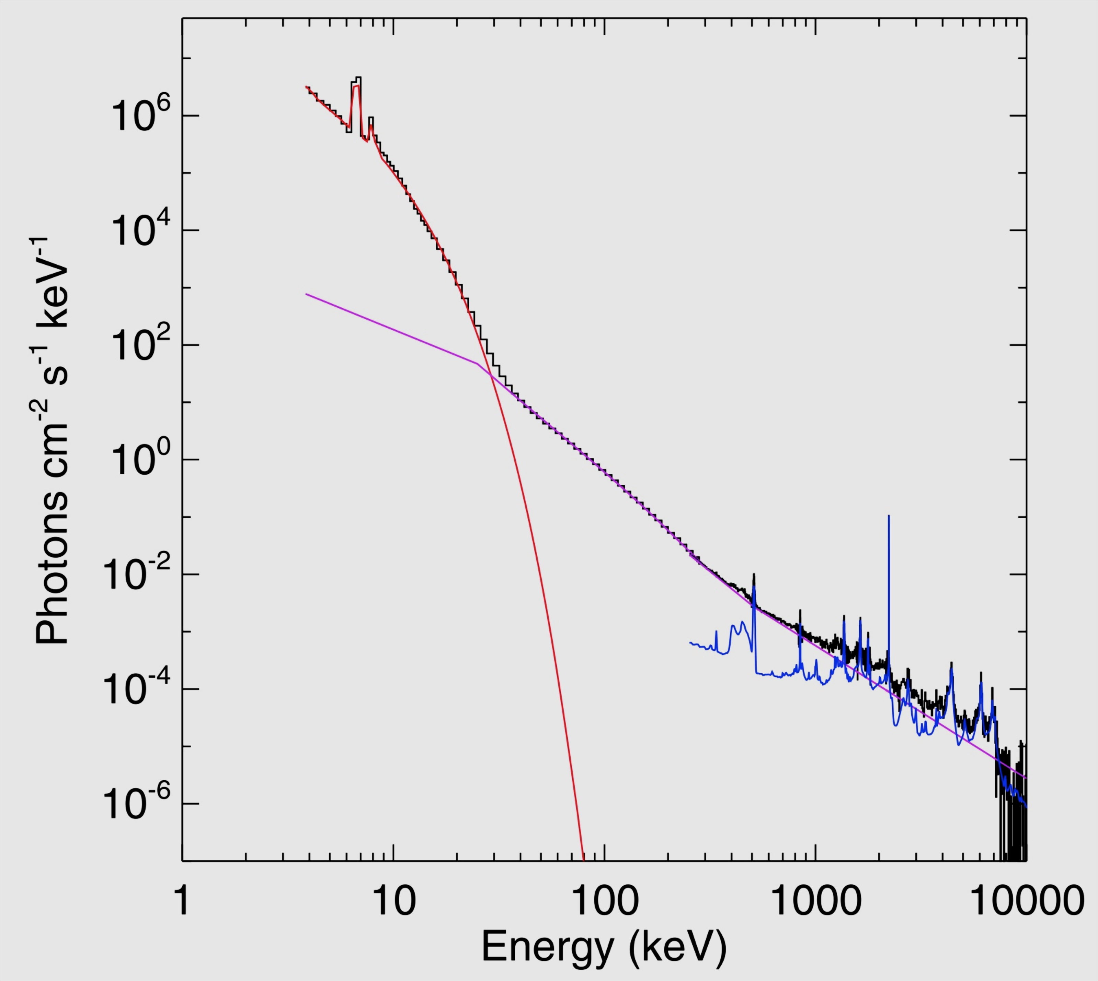
Proton acceleration: Nuclear gamma-ray lines
What does the electro-magnetic-spectrum tells us?
Accelerated ions impinging on atmospheric ions: (narrow) de-excitation lines
Neutron capture line.
T ≈ 40 MK
R.P. Lin 2011 Spa Sci Rev 159, 421

Slide 18
Solar flares
Electromagnetic (EM) emissions
Important to remember:
Free magnetic energy is partially converted into acceleration of particles.
Electrons and ions interact in the chromosphere /lower corona => Hard X-rays
Ions need a minimum energy to be visible in gamma rays!
Ohmic heating by electrons of the coronal plasma
https://ase.tufts.edu/cosmos/print_images.asp?id=27

Slide 19
Mathematisch-Naturwissenschaftliche Fakultät
UMASEP: Results and recommendation
Relies on remote sensing measurements of SXR, HXR or micro waves as well as above several hundred MeV protons.

Slide 20
Mathematisch-Naturwissenschaftliche Fakultät
UMASEP: Results and recommendation
Interacting particles are identified by their electro-magnetic signatures.
Continue soft x-ray measurements in real time
Setup real time hard x-ray measurements
Setup real time network of microwave station in different frequencies.
Investigate correlation of micro wave and proton spectra

Slide 21
Mathematisch-Naturwissenschaftliche Fakultät
UMASEP: Results and recommendation
Higher photon energies from protons.
Measure the gamma ray spectrum in real time

Slide 22
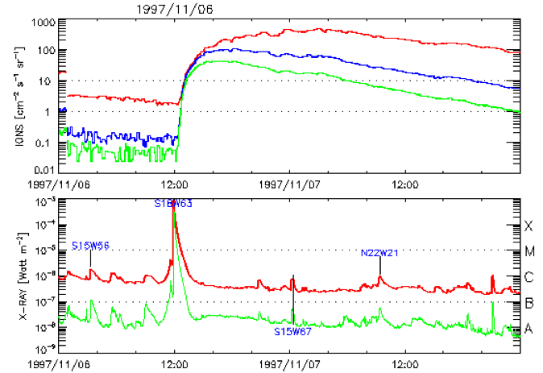
From particles in the corona to interplanetary space
What about interplanetary space?
How to get from e/m emission to protons in interplanetary space?
Two examples:
E > 10 MeV
E > 50 MeV
E > 100 MeV
hν = 0.1-0.8 nm
hν = 0.05-0.4 nm
© cdaw.gsfc.nasa.gov/CME_list
Parker (1963)

Slide 23
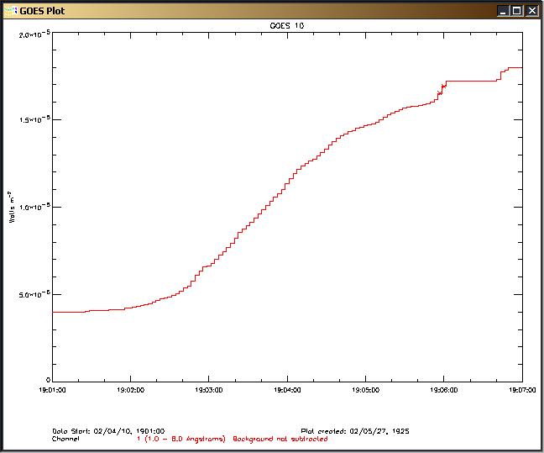
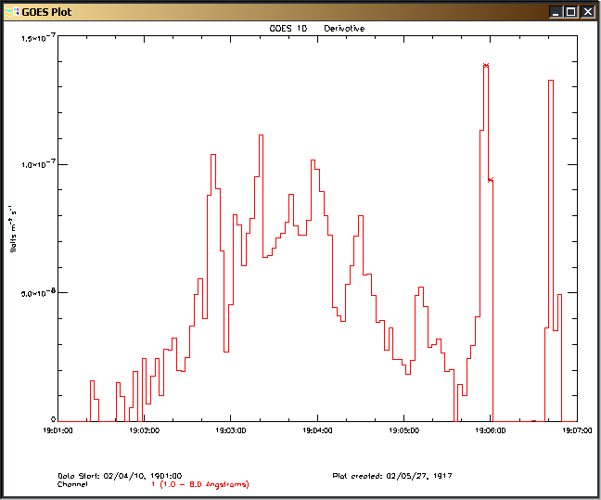
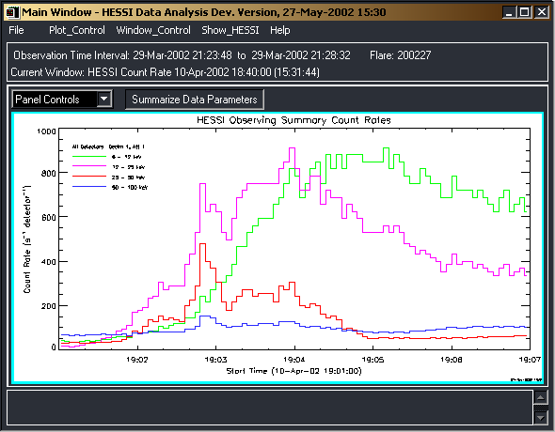
10 April 2002
GOES 10 1 - 8 Å
Time derivative GOES 1 - 8 Å
RHESSI Light Curves
6 – 12 keV
12 – 25 keV
25 – 50 keV
50 – 100 keV

Slide 24
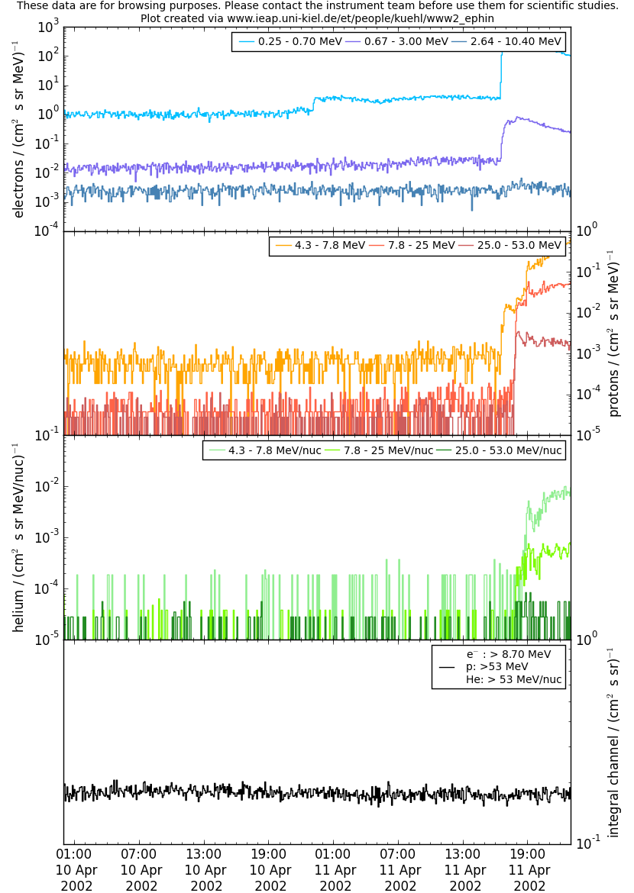
From remote sensing to in-situ observations?
No event!

Slide 25
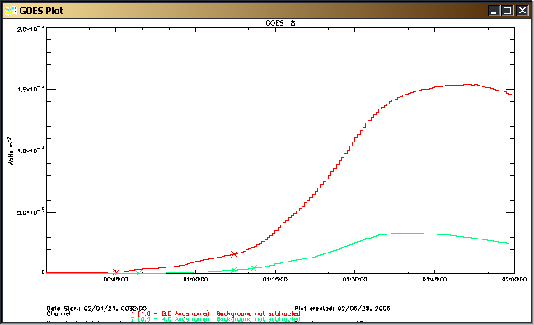
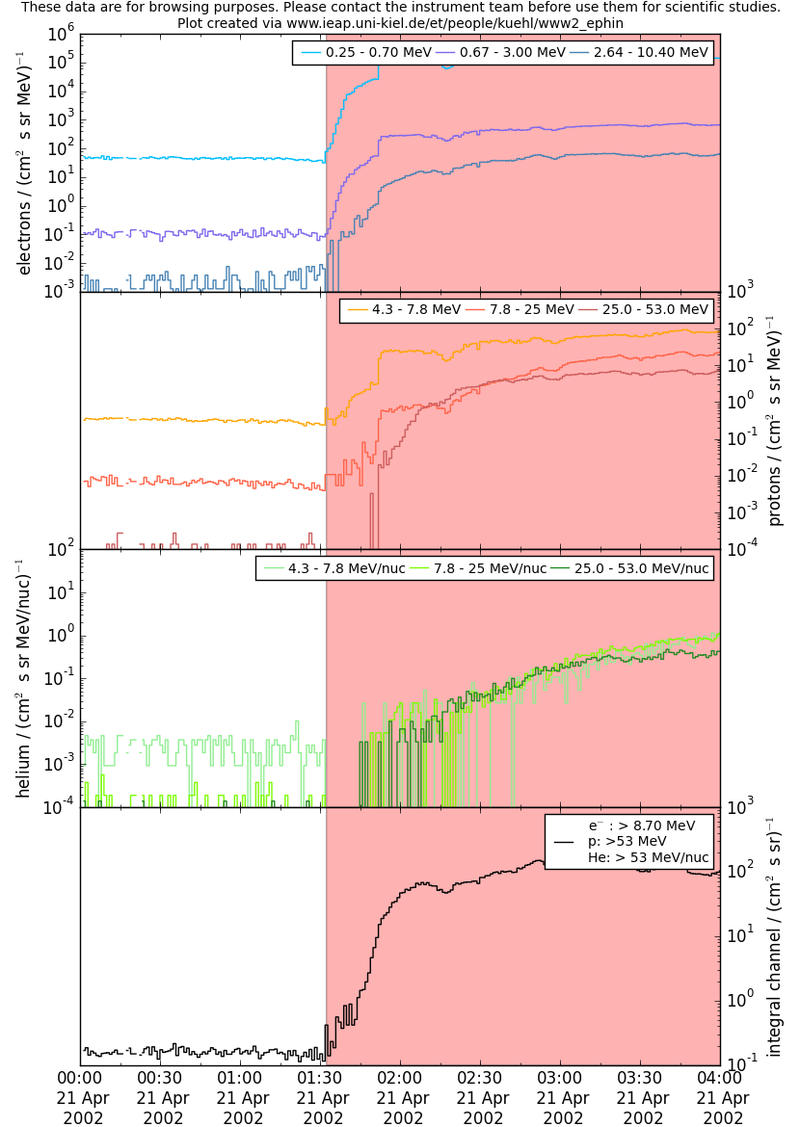
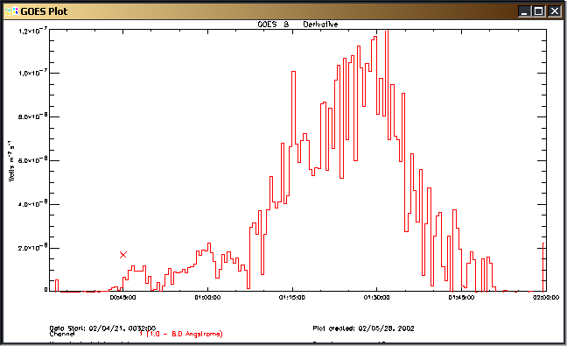
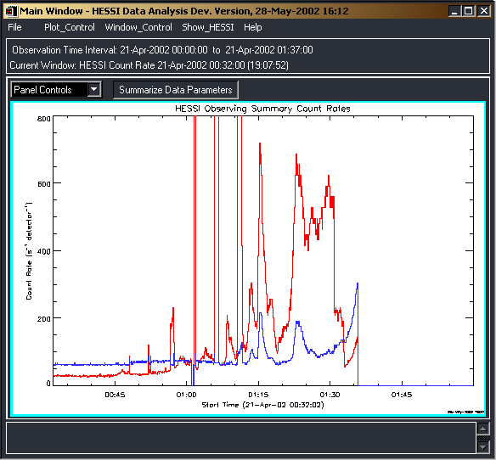

Slide 26
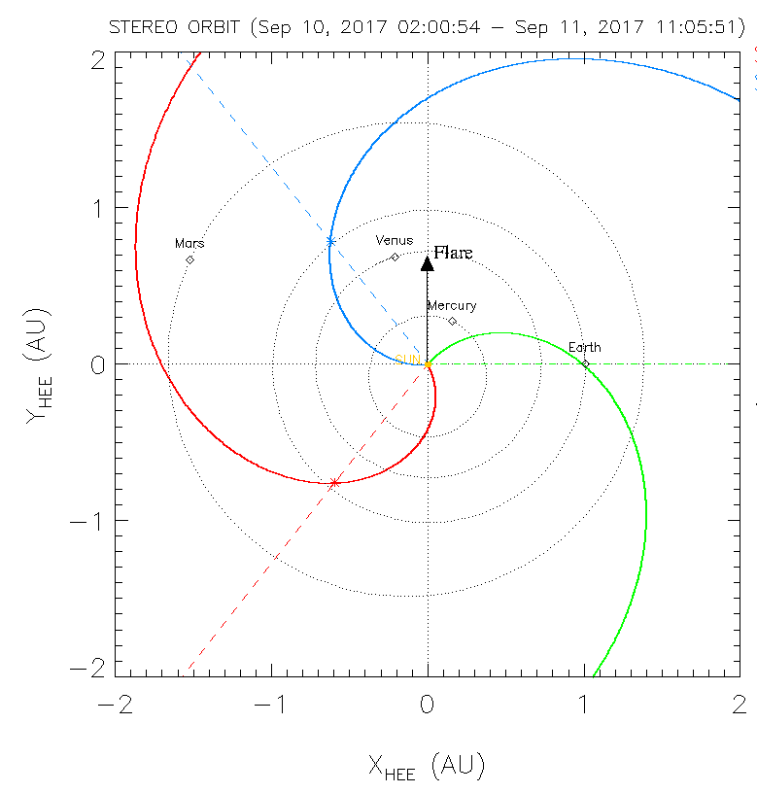
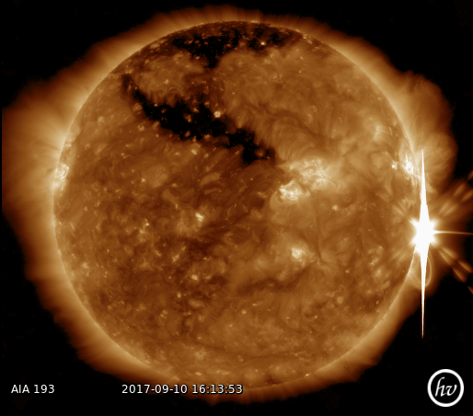
How do we know the connectivity between flare and Earth?
http://cafehayek.com/2014/03/then-a-miracle-occurs.html
Parker (1963)

Slide 27
Mathematisch-Naturwissenschaftliche Fakultät
UMASEP: Results and recommendation
Determine the position of the acceleration side in real time.

Slide 28
How do we know that particles leave the acceleration side?
The role of Coronal Mass Ejections
http://cafehayek.com/2014/03/then-a-miracle-occurs.html
Parker (1963)

Slide 29
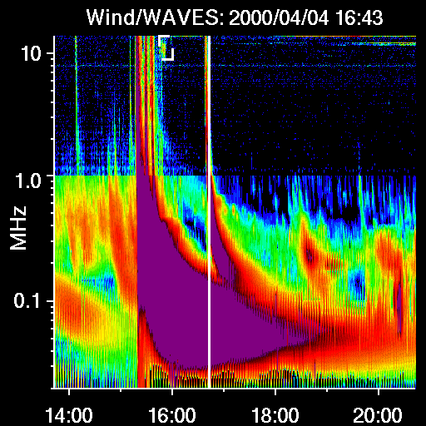
Injection into the IPM
Radio spectrograms from spacecraft are indicative for electrons leaving the corona!
Develop method to analyse such spectra in realtine!
Type II
f_{p}(kHz) = 9 √n_{e}(cm^{–3})

Slide 30
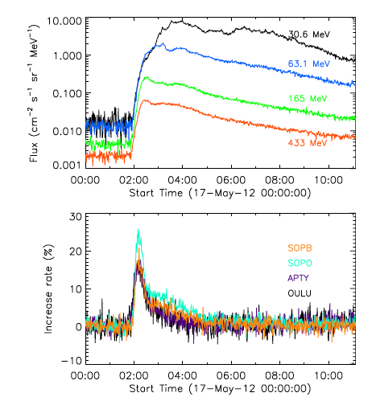
Particle transport
Use the particles themselves.
The idea behind REleASE

Slide 31

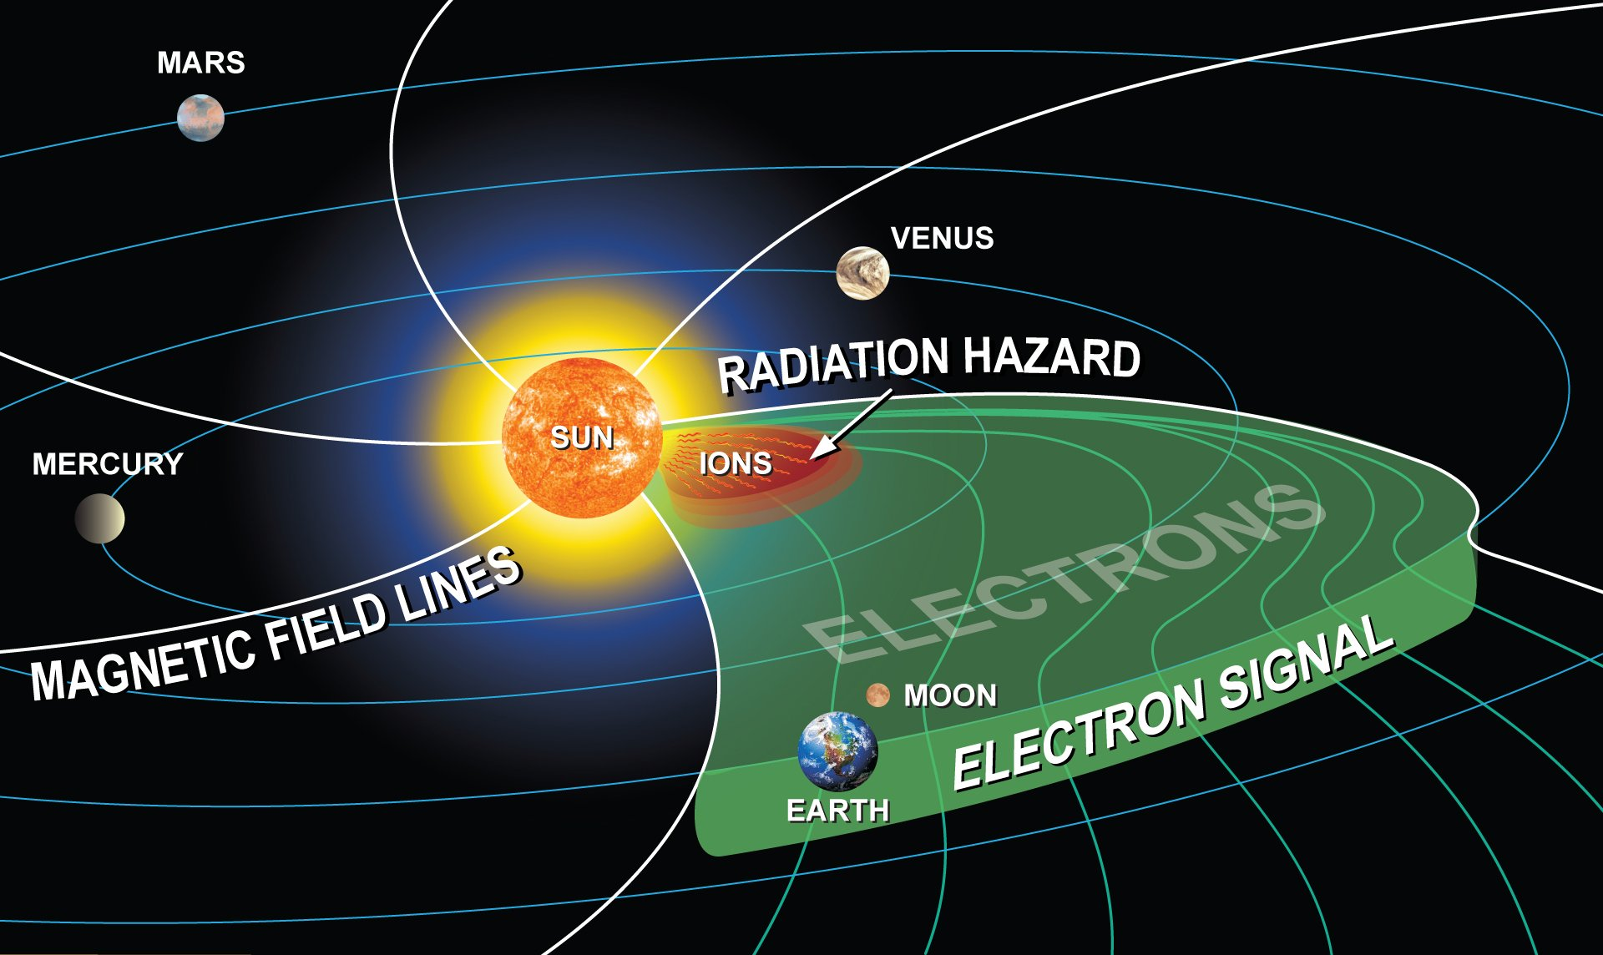

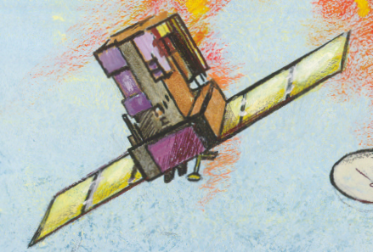

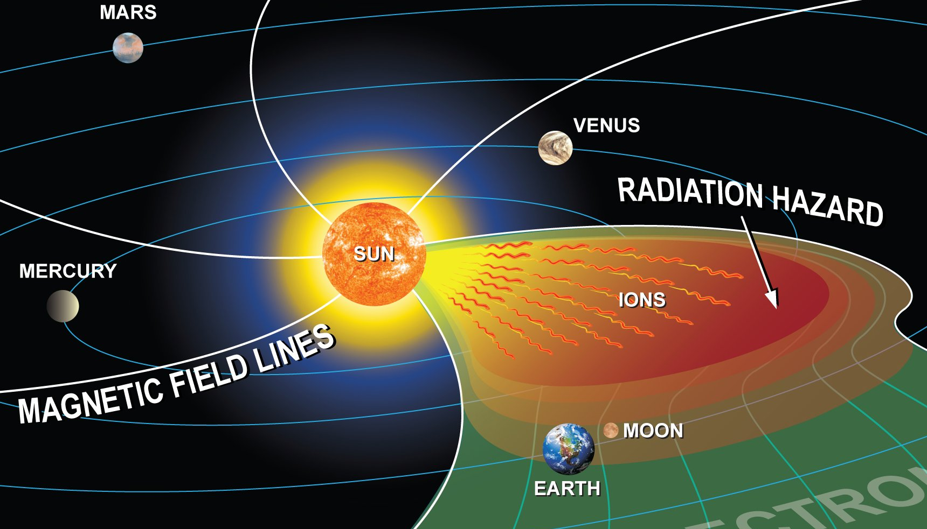

D ~ 1.2 AU
v_{el}(1 MeV) = 0.95 c
T_{el} (1 MeV) =10.5 min
Notes:
Astronauts venturing beyond the protective magnetic field of Earth face the direct effects of the Sun.
Within even one hour, explorers can be engulfed with particles that cause harmful long- or short-term health effects and put missions at risk. Although the inside of a spacecraft or lunar base or Martian moon can be made relatively safe, “Staying Inside” hampers productivity. “Going Outside” requires a space weather warning system.
The top sketch depicts an artists‘ view of the radiation field in the inner heliosphere ten minutes after release of solar energetic particles from the Sun. Relativistic electrons have reached 1 AU at the time when hazardous protons (~30 MeV) are still within 0.2 AU from the flare location. The fast-moving (test-) particles probe the magnetic field ahead of the protons for instantaneous magnetic connectivity, which would not otherwise be possible.

Slide 32
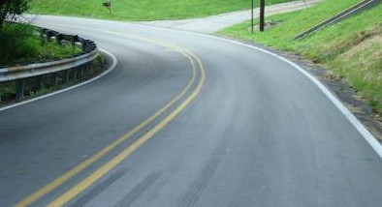
D ~ 1.2 AU
v_{p}(30 MeV) = 0.25 c
T_{p}(30 MeV) = 40 min
ΔT ~ 30 min
Notes:
Magnetic field lines form the guard rails of the „road“ that leads charged energetic particles from the Sun to the Earth-moon system. Assuming no pitch angle, the delay of harmful ions over the fast electrons fpropagating along the (curved) Parker magnetic field can be derived.
Thirty minutes after a warning can be issued, the hazardouis protons arrive in the Earth-moon system. Depending on the time necessary for EVA abort, the exposure of astronauts to the bulk protons can be reduced substantially with the early warning technique.

Slide 33
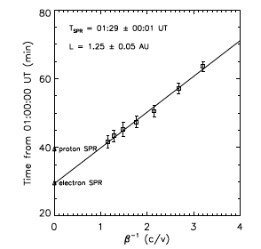
Protons
Electrons

Slide 34
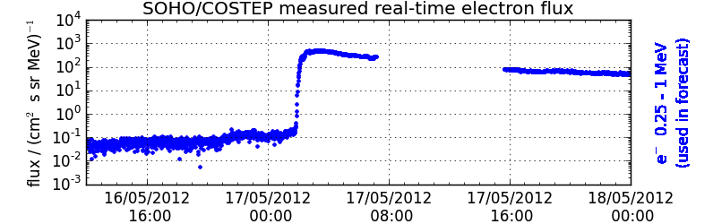
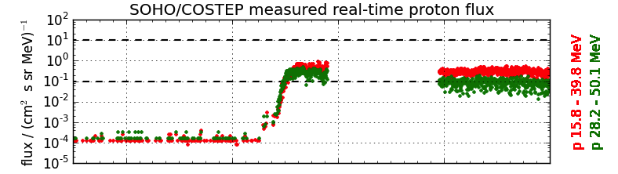
The task
REleASE

Slide 35
Relativistic electrons always arrive at 1 AU ahead of non-relativistic SPE ions allowing their forecasting.
Coming from one source with “identical” propagation conditions, significant correlations between electron and proton time-profiles exist.
Therefore, a correlation function to forecast proton intensities was developed.
Posner, Space Weather J., 2007
Labrenz, Heber, Kühl, Sarlanis, Malandraki & Posner
Annapolis, Apr. 14, 2016
Notes:
Findings from 2007.

Slide 36
Summary
Acceleration of ions and electrons at the SUN
Remote sensing signals from the lower corona (x and γ-rays)
8 min
? min
Injection into the interplanetary medium (radio signal)
Interplanetary transport
Measurements in space and on ground
Energy dependent

Slide 37
It works

Slide 38
Mathematisch-Naturwissenschaftliche Fakultät
REleASE: Recommendation
Provide real time measurements of (near) relativistic electrons and above 30 MeV protons @ L1

Slide 39
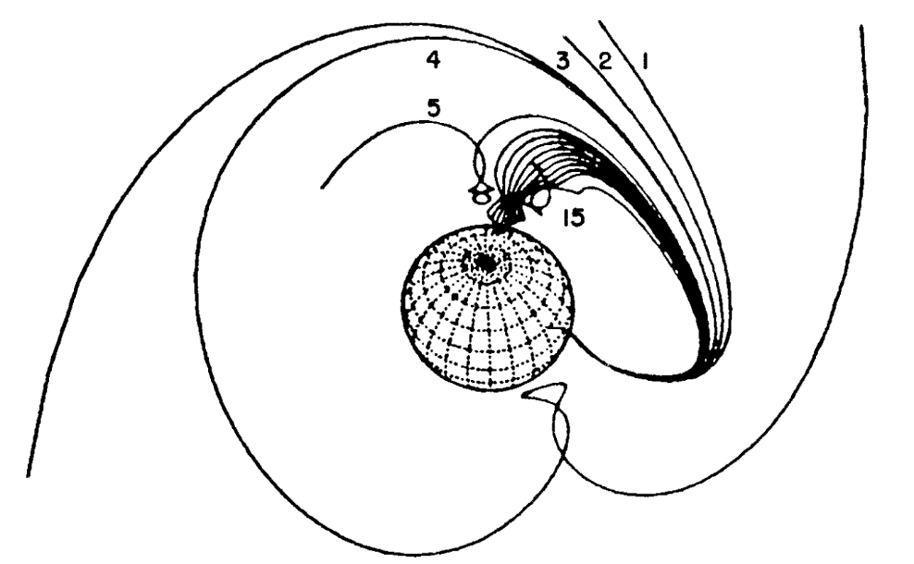
Cosmic ray transport in the geomagnetic field
Cutoff rigidity (R_{c}): Lowest rigidity reaching the top of the atmosphere in vertical direction at a given location.
Asymptotic direction: Direction of particle incidence prior to entry in the geomagnetosphere. It depends on NM location, particle R, time and K_{p}.
Notes:
Cutoff rigidity (R_{c}): Lowest rigidity reaching the top of the atmosphere in vertical direction at a given location.
Asymptotic direction: Direction of particle incidence prior to entry in the geomagnetosphere. It depends on NM location, particle R, time and K_{p}.

Slide 40
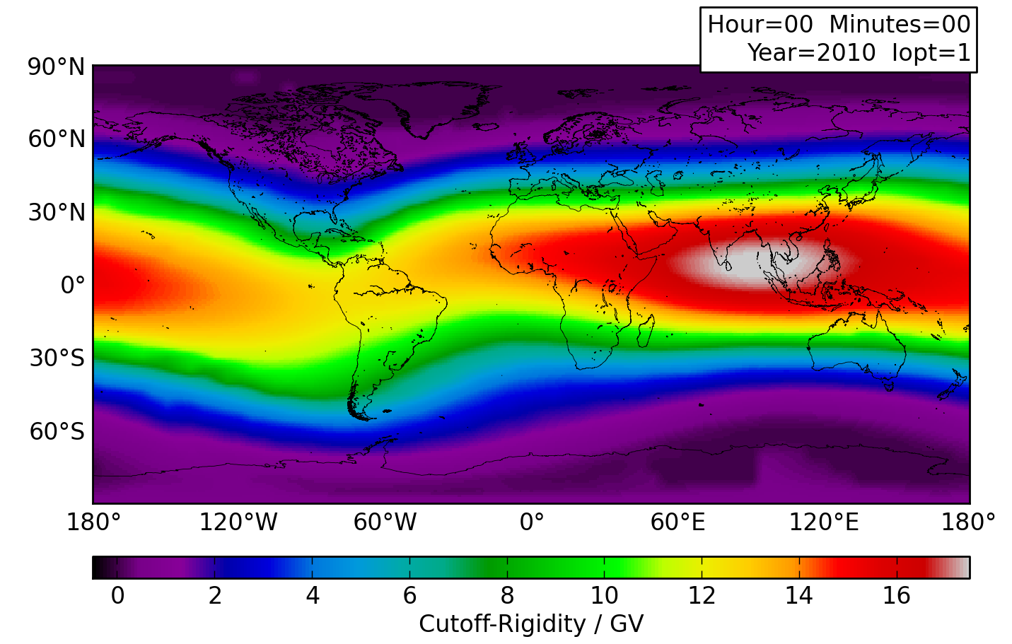
The magnetospheric filter
Maximum shielding
No shielding
Notes:
Rigidity discribes the magnetic behaviour of a particle, inculding energy, mass and charge
Cutoff Rigidity nessessary energy to reach position
To take it easy, you can roughly say:
Same Cutoff position same behaviour
Bild in Backup

Slide 41
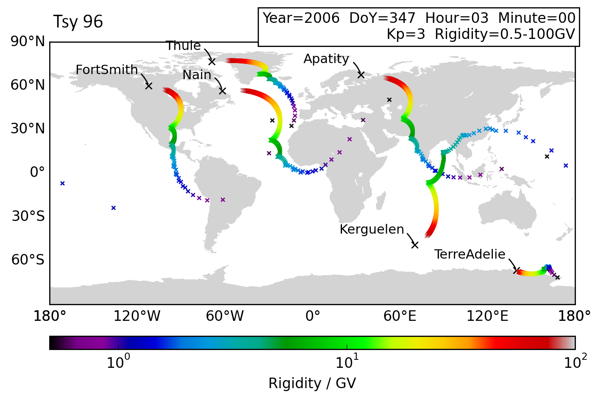
Asymptotic directions
Notes:
GLE70 event
Neutronen monitore

Slide 42
Asymptotic Directions
Notes:
GLE hits somewhere here
I mean the direction
GLE size is wrong
To size it right: it is more like this

Slide 43
Asymptotic Directions
Notes:
GLE hits somewhere here
I mean the direction
GLE size is wrong
To size it right: it is more like this

Slide 44
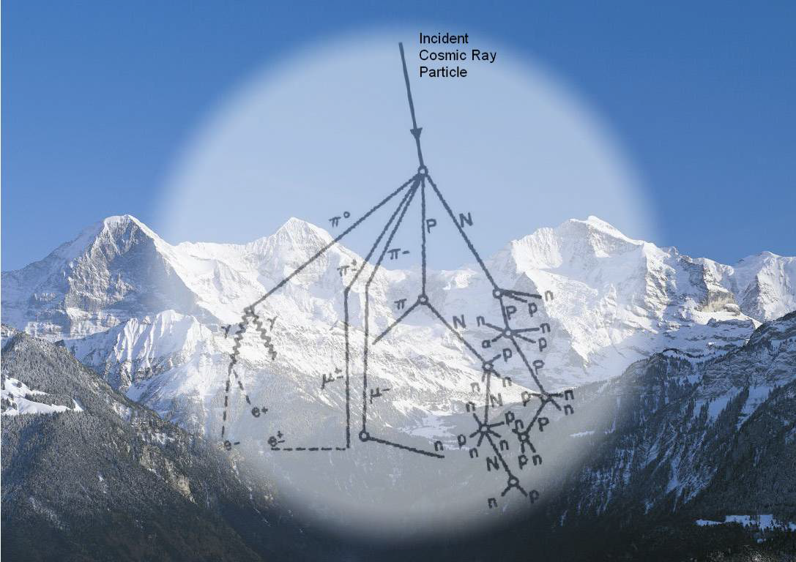
Particle transport in the atmosphere

Slide 45
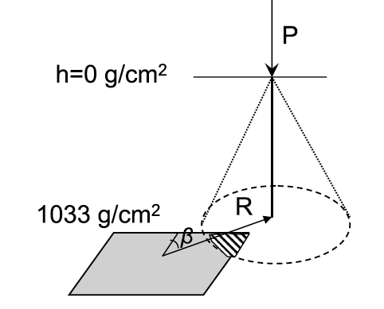
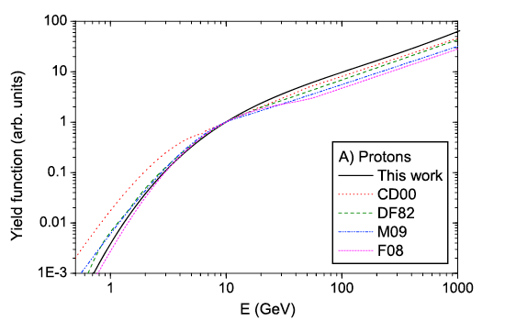
Mathematisch-Naturwissenschaftliche Fakultät
Zusammenfassung
Understanding neutron monitor count rates
Neutron monitor yield function as given by Mishev et al. (2013)

Slide 46
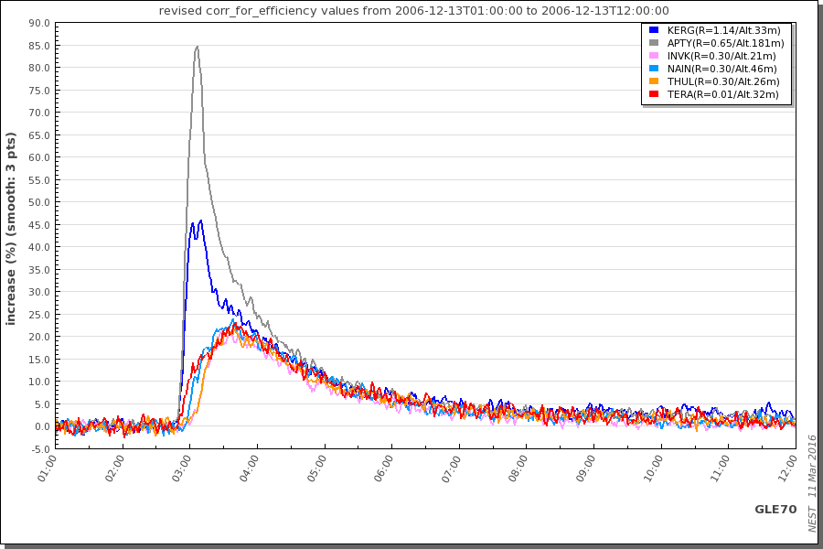
NM: low Cutoff Rigidity
data retrieved from http://nest.nmdb.eu
Notes:
Sharp peak but some monitors see it earlier
Now look in low rigidity NM
Reason different cutoff rigidity:
Lower rigidity: They see the same as mediun and more
So reason can‘t be in energy of particle (if we speak of protons)
But in direction! No question of energy

Slide 47
Mathematisch-Naturwissenschaftliche Fakultät
Advanced model chain developed in HESPERIA
To describe the transport of energetic particles through the helio-, Earth magneto- and atmosphere.

Slide 48
Mathematisch-Naturwissenschaftliche Fakultät
Advanced model chain developed in HESPERIA

Slide 49
Mathematisch-Naturwissenschaftliche Fakultät
Advanced model chain developed in HESPERIA

Slide 50
Mathematisch-Naturwissenschaftliche Fakultät
Advanced model chain – missing module
Module that connects the evolution of the proton spectrum with the expected dose rate @ flight altitudes
Further research
  Appropriate yield function @ different flight altitudes
  Further investigation, modeling and measurements are needed

Slide 51
Mathematisch-Naturwissenschaftliche Fakultät
Advanced model chain – recommendation
Improve and add models:
Focused transport in the IPM
Particle transport through the Earth magnetosphere.
and atmosphere
Dose rate calculation
Measurements of
the IP Magnetic field
Particles by Neutron monitors
and improved spacecraft instrumentation

Slide 52
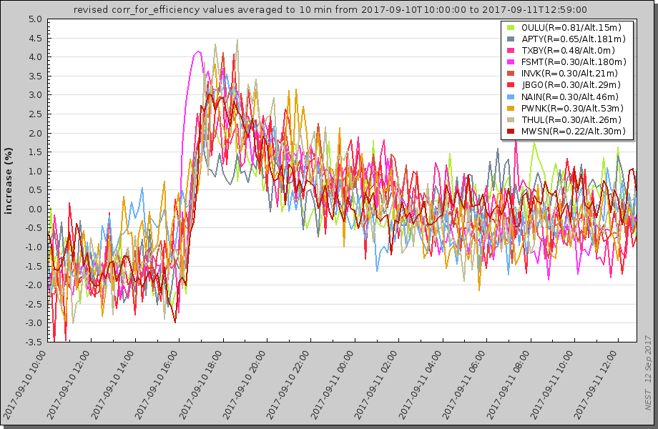
The Ground level event from 10.09.2017 @ 17:00h
Neutron monitors of the same response
Fort Smith first, because it scans the particles that come along the field line.

Slide 53
Mathematisch-Naturwissenschaftliche Fakultät
Advanced model chain – recommendation

Slide 54
Mathematisch-Naturwissenschaftliche Fakultät
Resulting Recommendation
Operations:
Improvement of the neutron monitor network
Set up of a full Sun radio network
Realization of a radiation monitor platform outside the magnetosphere

Slide 55
Mathematisch-Naturwissenschaftliche Fakultät
Resulting Recommendation
Research to improve understanding of space weather forecasting:
Advanced Remote Sensing Exploration
Advancing our understanding by sophisticated modeling

