Slide 1


Scientific targets at upcoming exploratory space missions in view of the DPG-association Extraterestrische Physik and Arbeitsgemeinschaft Extraterrestrischer Forschung
Mathematisch-Naturwissenschaftliche Fakultät
B. Heber on behalf of the AEF / DPG-EP team
Christian-Albrechts-Universität zu Kiel

Slide 2
Mathematisch-Naturwissenschaftliche Fakultät
Overview
Structure of the Fachverband Extraterrestrial Physics
5 Commissions of the EP
  Astrophysics
  Near Earth Environment
  Planets and small bodies
  Exo planets and astrobiology
  Sun and the heliosphere
  Interstellar probe
Challenges

Slide 3
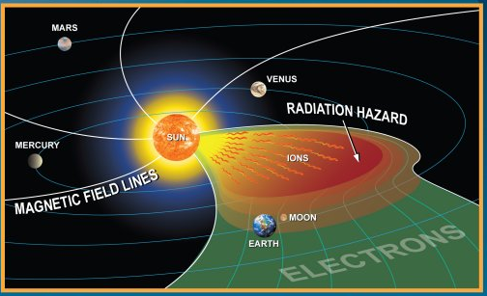
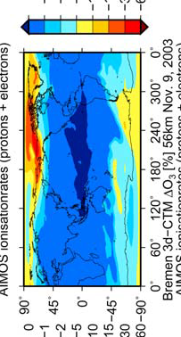
Mathematisch-Naturwissenschaftliche Fakultät
Overview

Slide 4
Mathematisch-Naturwissenschaftliche Fakultät
Arbeitsgemeinschaft
Extraterrestrische Forschung
Aims:
Organization of conferences and meetings
Publishing of scientific papers (ASTRA)
Archiving of scientific data
Networking in the field of space sciences

Slide 5
Mathematisch-Naturwissenschaftliche Fakultät
Kommissionen im Fachverband EP
und der AEF
Divided into five commissions
Astrophysics
Near Earth Space
Exoplanets and Astrobiology
Planets and Small Bodies
Heliophysics

Slide 6
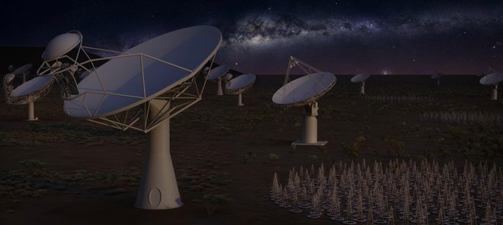
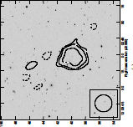
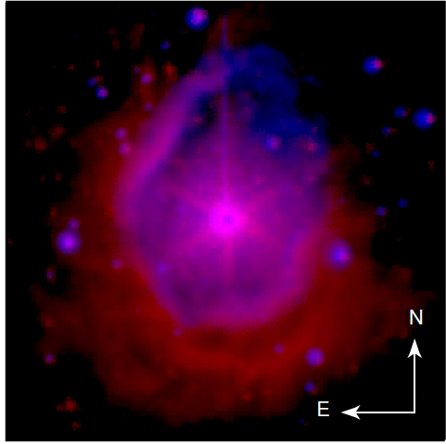
Mathematisch-Naturwissenschaftliche Fakultät
Astrophysics

Slide 7
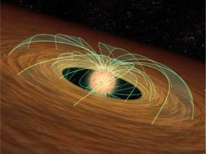
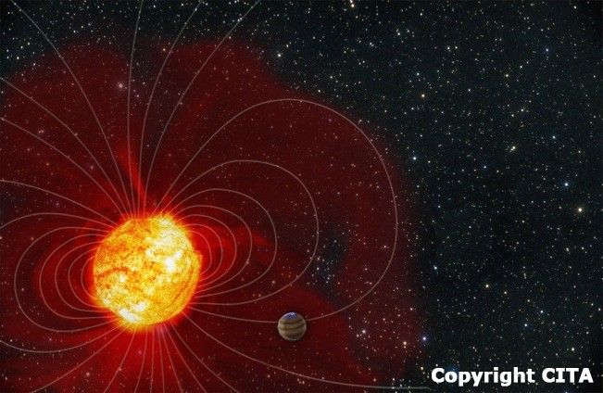
Science Objectives
What is the life cycle of matter in the Milky Way?
– What are the 3D structure, geometry, and dynamics of stellar environments across the evolution?
→ Accretion and decretion disks
→ Stellar winds
→ Chromospheres
– What is the nature of the ISM and the building blocks of stars and planets?
→ Magnetic fields in the ISM
→ Physics of grain alignment
→ The dynamics of the Local ISM and beyond
Key question 2: How do stars affect their planets and the emergence of life?
– What are the interactions between stars and planets ?
→ Characteristics of exoplanetary upper atmospheres in transiting exoplanets
→ Tidal and magnetic interactions between stars and their planets
→ Bulk chemical composition of exo-planetary systems
– What are environmental conditions for the emergence of life on rocky planets?
→ Space weather
→ Irradiation and biomarkers
→ Young suns
→ Exoplanetary magnetic fields

Slide 8
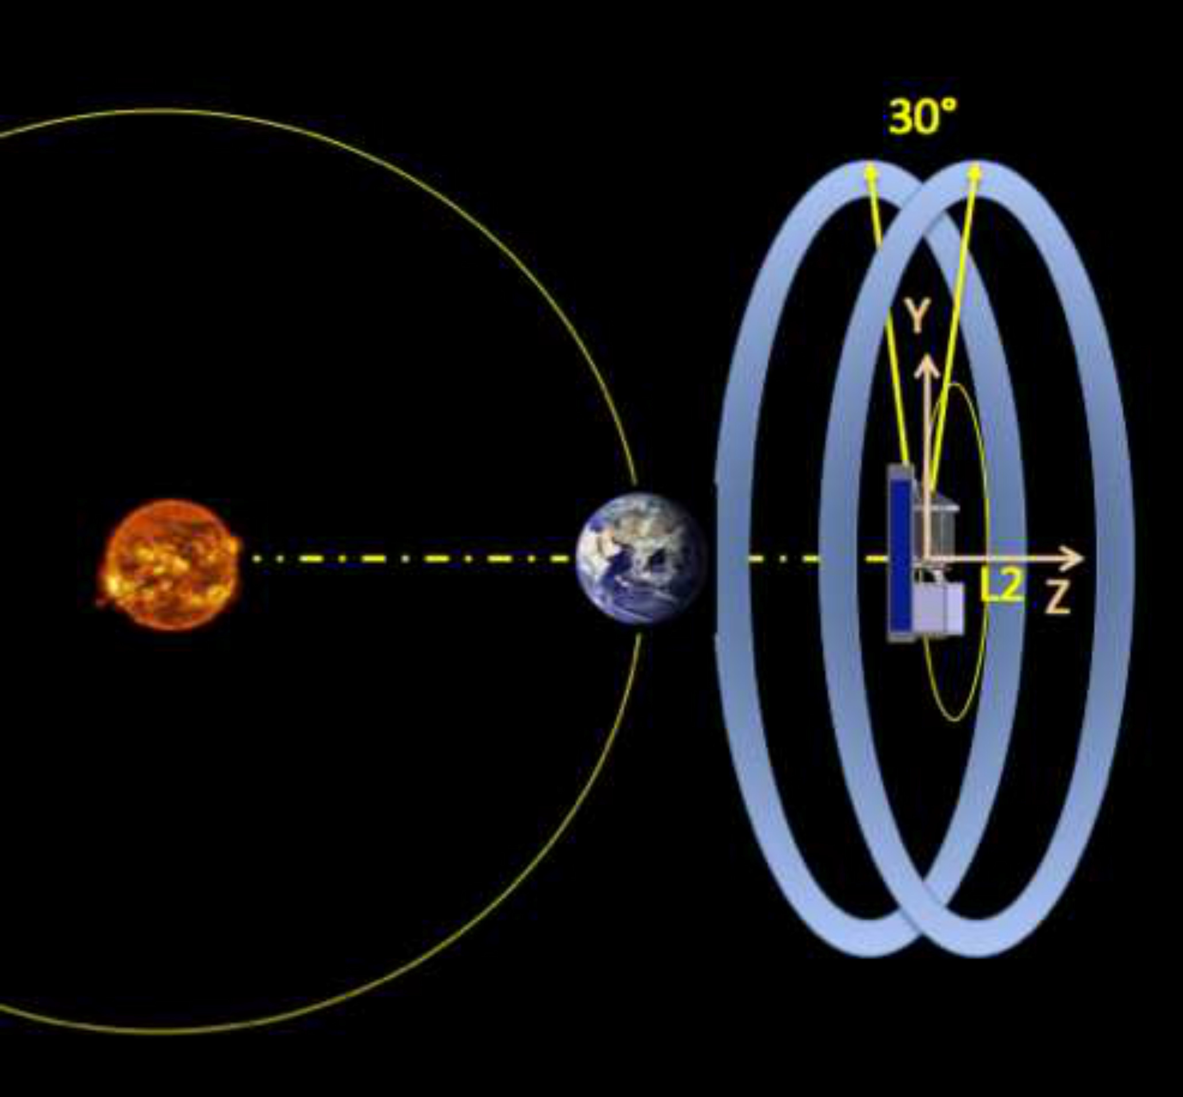
PI: Coralie Neiner see http://arago-mission.obspm.fr/index.php
ARAGO Instrumentation:
1.3m Cassegrain telescope, polarimeter,
two spectrographs
providing:
Simultaneous UV and optical spectroscopy
Circular and linear spectropolarimetry (IQUV)
●
●
Orbit profile for ARAGO
Data Volume: Total average telemetry is 38.7 Gb/d (6 to 91 Gb/d)
Autonomous; Digital Processing Unit
●
●
Illustration of Doppler Imaging technique

Slide 9
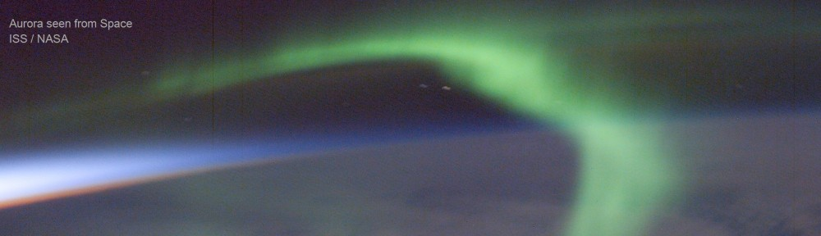
Mathematisch-Naturwissenschaftliche Fakultät
Near Earth Space

Slide 10
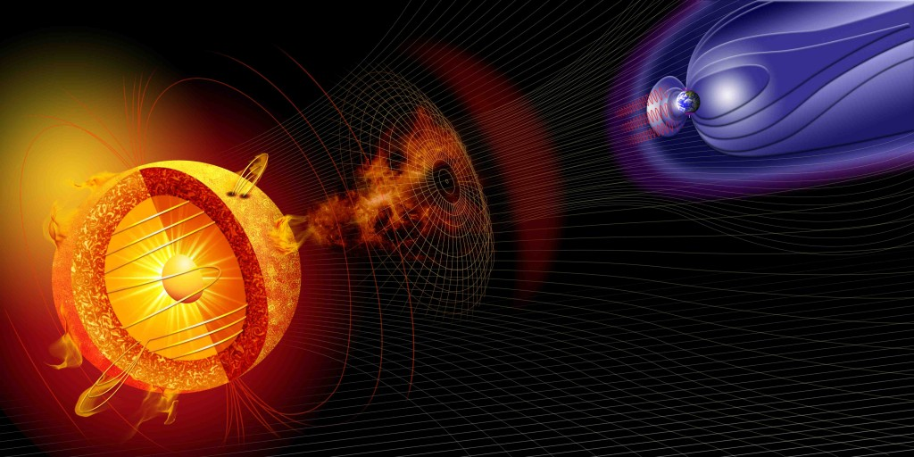
Properties and processes that control coronal dynamics
and geo-effectiveness
Innovative solar and heliospheric science and space weather from L5
Lagrangian
L1 point
Anti-parallel fields = more geo-effective
Among all unknowns, coronal magnetic field magnitude and orientation is most elusive

Slide 11
Science objectives of a L5 Mission
Key objectives:
1. What is the magnetic field magnitude and topology in the corona?
2. How does the magnetic field reconfigure itself during CME eruptions?
3. How do CMEs accelerate and interact in the interplanetary medium?
4. What are the sources of and links between slow and fast solar winds?
5. Where do shocks form and how do they accelerate particles?
Crucial space weather capabilities:
6. 3-days advance knowledge of CIR properties that reach Earth
7. Twelve hours to 2 days advance warning of Earth-directed CMEs
8. Twelve hours to 2 days advance warning of CME-driven SEPs
9. Unprecedented ability to reconstruct the magnetic field magnitude
and orientation of Earth-bound CMEs early in the corona

Slide 12
→ How do CMEs accelerate and interact in the interplanetary medium?
High cadence white light imaging
in low corona (1.15 – 4 Rs) for
CME acceleration
Wide angle heliospheric
imagers to track CME/CIR
interactions in heliosphere
Polarization information
for accurate trajectory
Off-Sun-Earth line
location for tracking of
Earth-bound CMEs
Sun
Field of view
CME
Line of sight
Thomson
sphere
Earth
→ Also key measurements to address objectives 4, 5, 7
L5

Slide 13
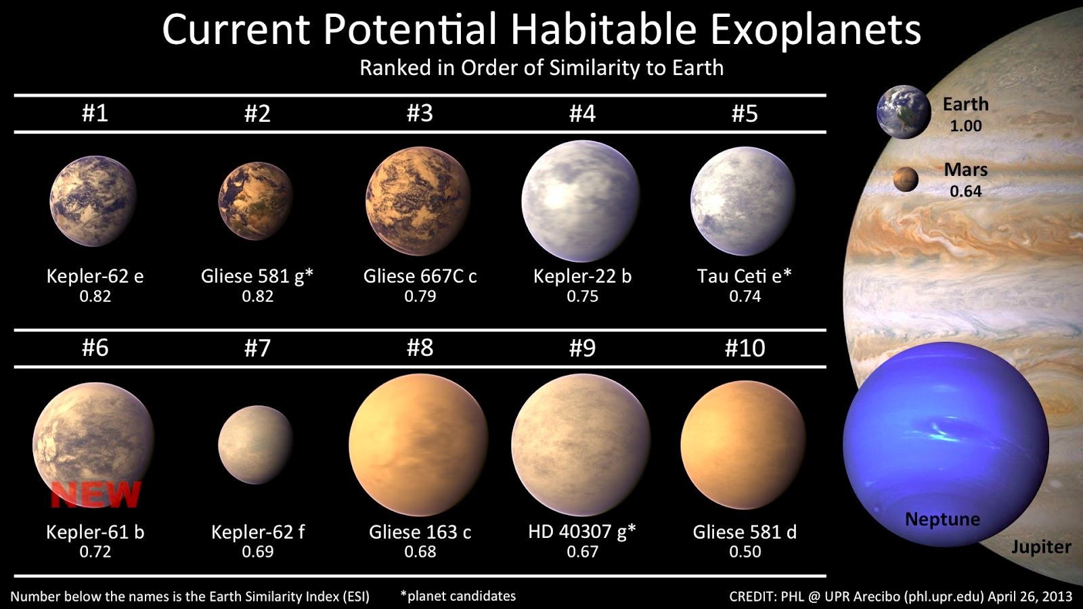
Mathematisch-Naturwissenschaftliche Fakultät
Exoplanets and Astrobiology

Slide 14
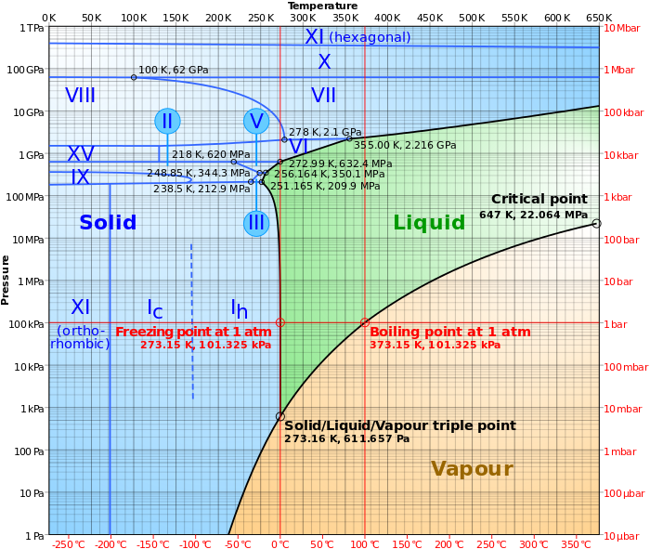
Defining Habitability
Habitability = the potential of an environment to sustain life
Habitability ≠ the potential for life to originate
Habitability ≠ life is present
Life as we know it needs:
Energy
Complex molecular chains
Nutrients
Liquid water
Liquid water is the key factor,
depends on (T,p)
Cockell et al. (2016); Horneck et al. (2016); Schulze-Makuch et al. (2011)

Slide 15
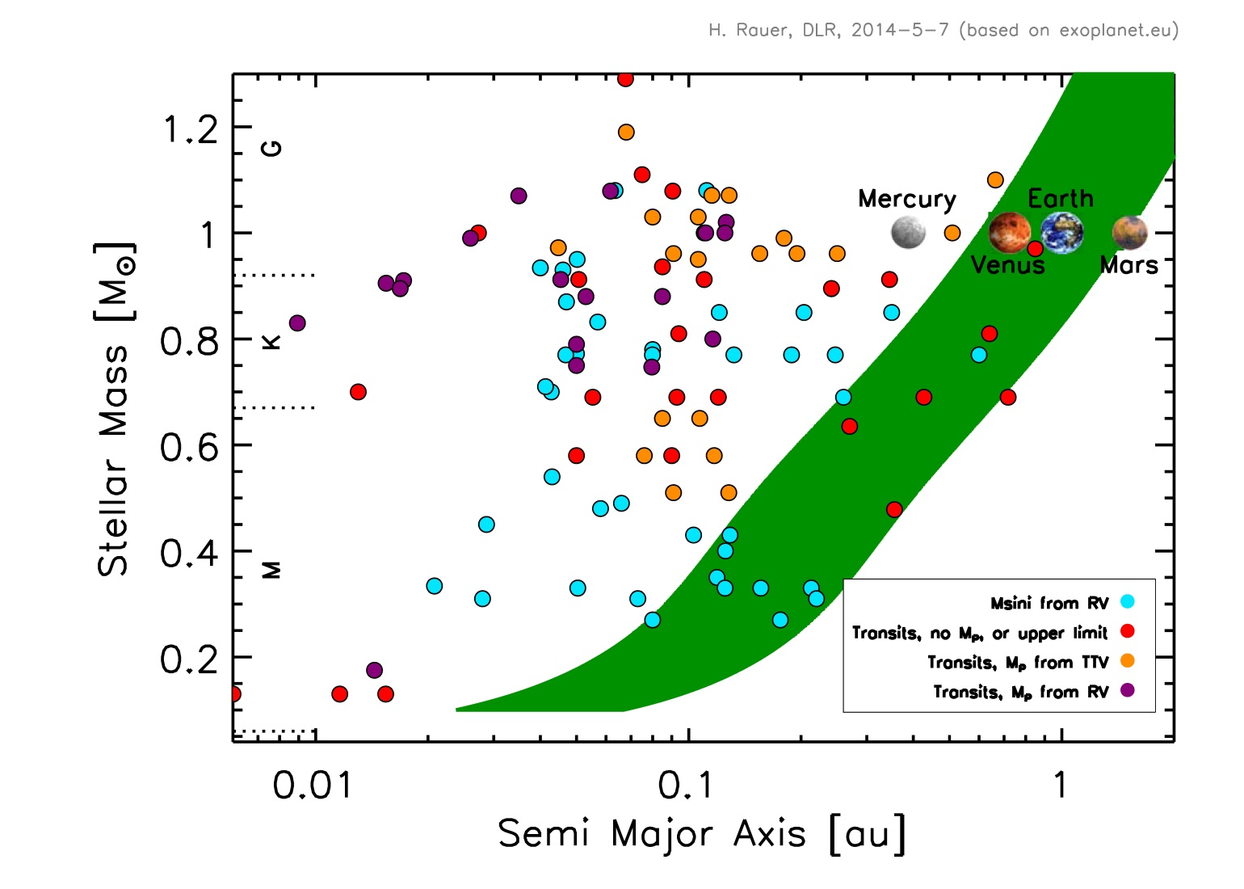
Exoplanets in the “Habitable Zone”
LHS 1140
Trappist-1

Slide 16
(Some) Biosignatures
In-Situ
Remote
SETI
Fossils
Isotopic
Spectral
Carbon
number
Chirality
Red edge
Atmospheric
Chemical/physical
Disequilibrium

Slide 17
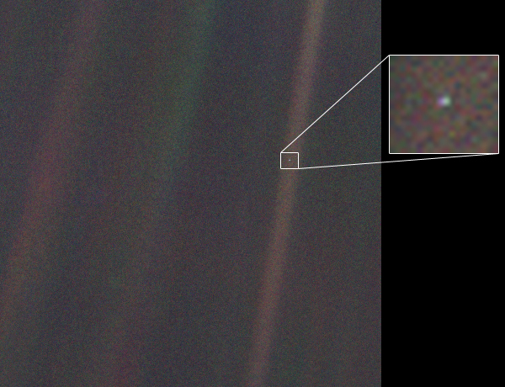
Earth as a Pale Blue Dot
“On (that dot) everyone you love, everyone you know, everyone you ever heard of, every human being who ever was…”
Carl Sagan
Earth ~6 billion km away http://voyager.jpl.nasa Feb 4 1990
Notes:
If someone asks - the light brown (and green) stripe(s) arise due to data processing

Slide 18
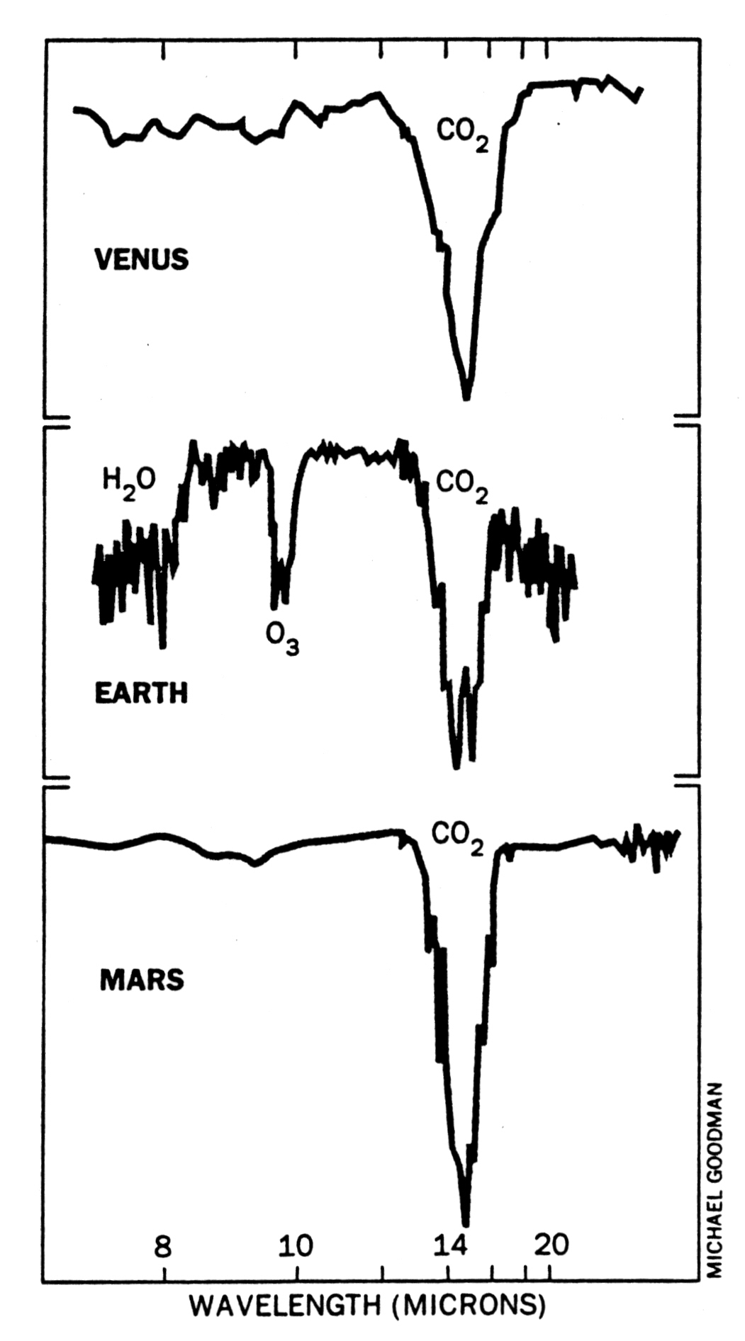
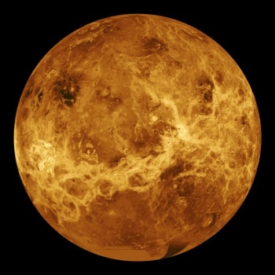
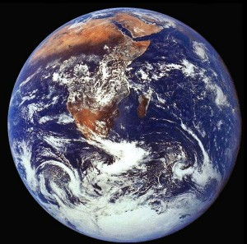
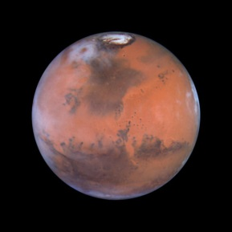
Atmospheric Biosignatures
CO₂
Radiation Flux
O₃
CO₂
CO₂
Source: R. Hanel NASA GSFC

Slide 19
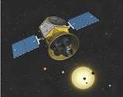

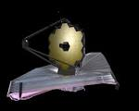




(Some) Exoplanet Missions: the next 50 years
2015-6 2017-19 2017-20 2018-20? 2020s
NGTS
Hot SEs
MGPs
ESPRESSO
TESS (NASA)
Hot SEs, LMLDs
Bright Stars
radius, orbit (ρ)
CHEOPS (ESA)
radii to 10%
Hot SEs
LMLDs (ρ)
JWST (NASA)
Atm. Spect.
Hot SEs
LMLDs
PLATO (ESA)
Rocky HZ
Bright Stars
radius, age
orbit, (ρ)
E-ELT
Atm. Spect.
Rocky HZ
Isotopes?
2030s 2040 s 2050s 2060s
STARSHADE
Direct imaging
Rocky Earth-like
Space IR interferometry
Earth-like Biosignatures
Post-Darwin/TPF
Space Missions

Slide 20
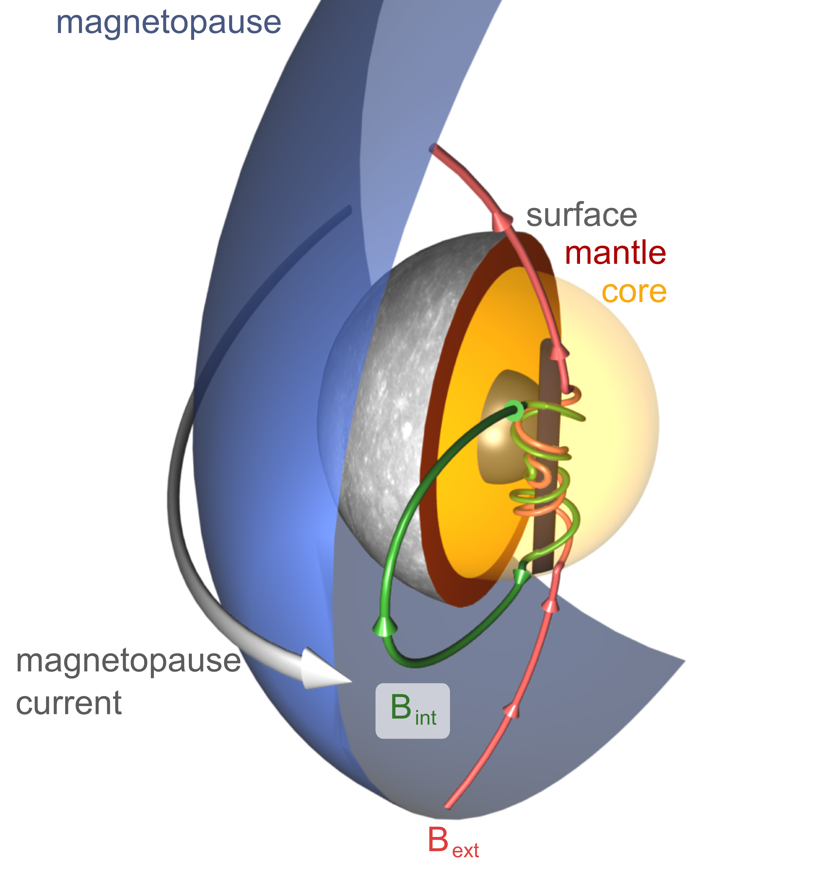
Mathematisch-Naturwissenschaftliche Fakultät
Planeten und kleine Körper

Slide 21
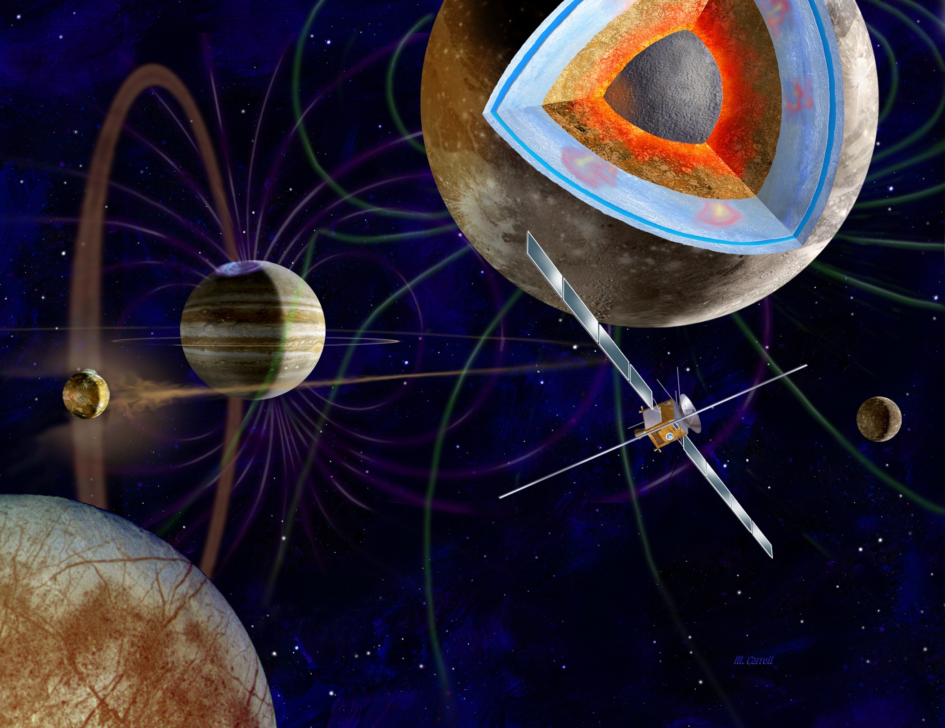
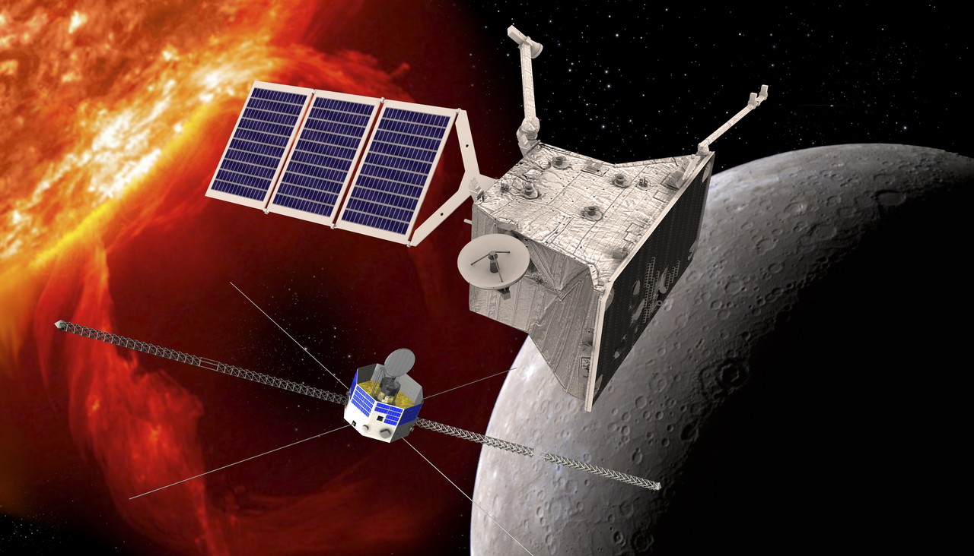
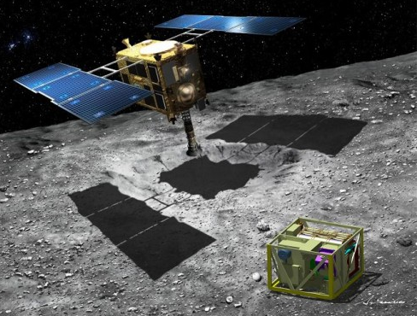
Mathematisch-Naturwissenschaftliche Fakultät
Magnetic fields of planets and small bodies
IGEP
JUICE / Jupiter and Galilean Moons
Bepi Colombo /
Mercury
Asteroid (162173) Ryugu / Hayabusa 2
Scientific Objectives:
Magnetic field measurements as basis
to study interior geophysical structure
and interaction with surrounding plasma.

Slide 22
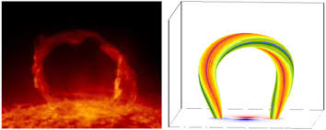
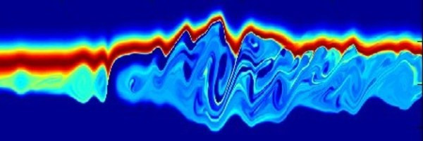
Mathematisch-Naturwissenschaftliche Fakultät
Sonne und Heliosphäre

Slide 23
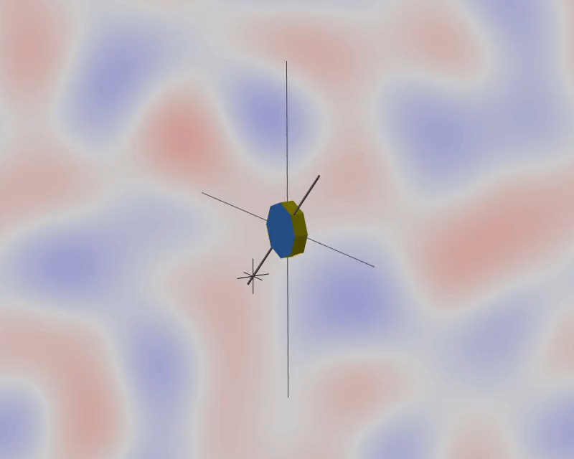

THOR
Turbulence Heating ObserveR
Notes:
Pdf frame, use 0:14,62
Color scale is +- 0.15, <T>=0.5
Team organization slide

Slide 24
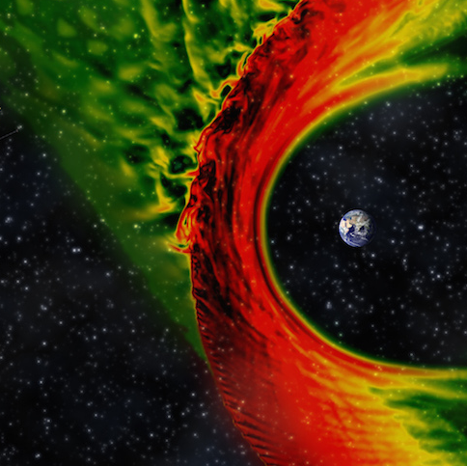
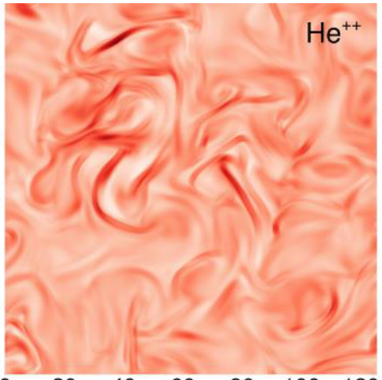

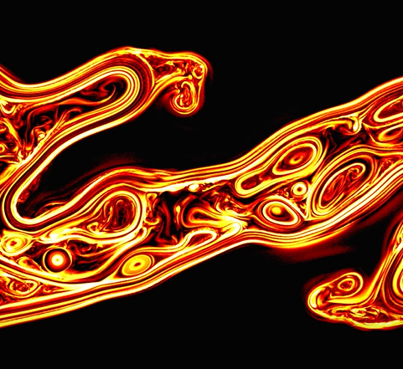
Kinetic numerical simulations
Global
Eulerian – Vlasov
Local
Particle in Cell
Simulations allow to explore part of the physics beyond the current observational capabilities. THOR requires and has a strong Numerical simulation team.
Notes:
!!! POPUP !!!

Slide 25
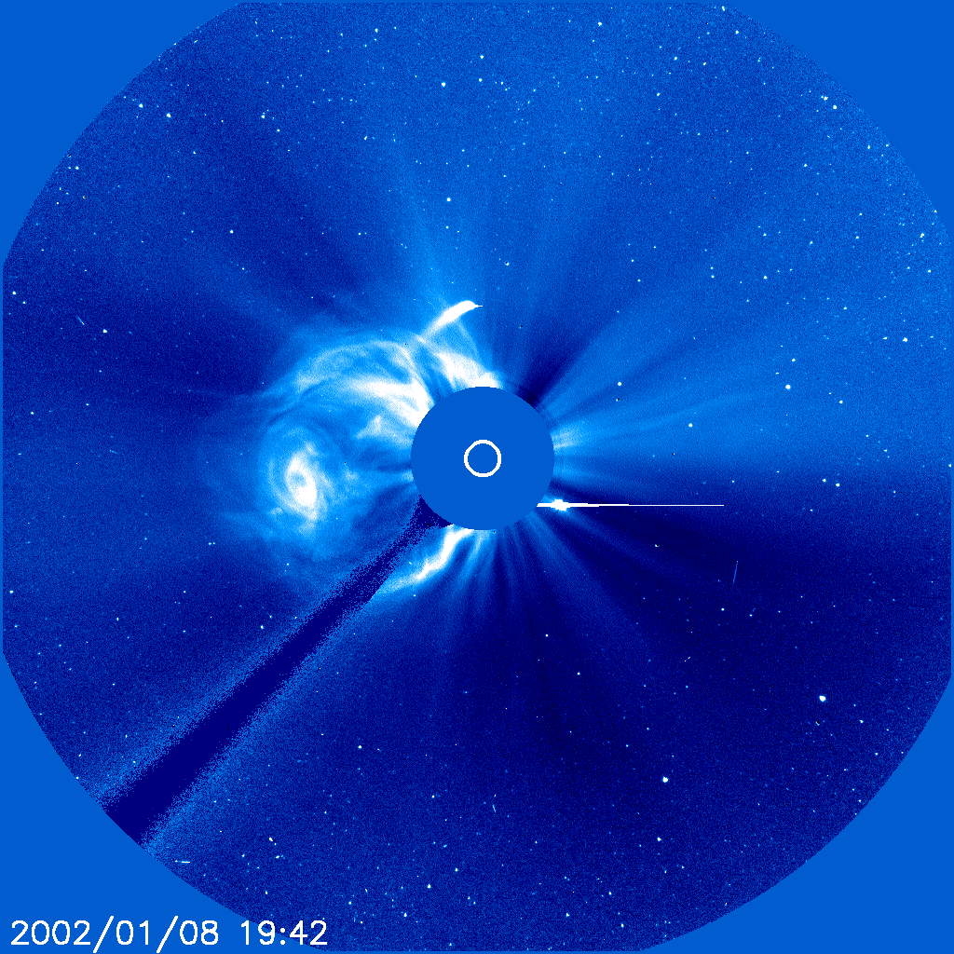
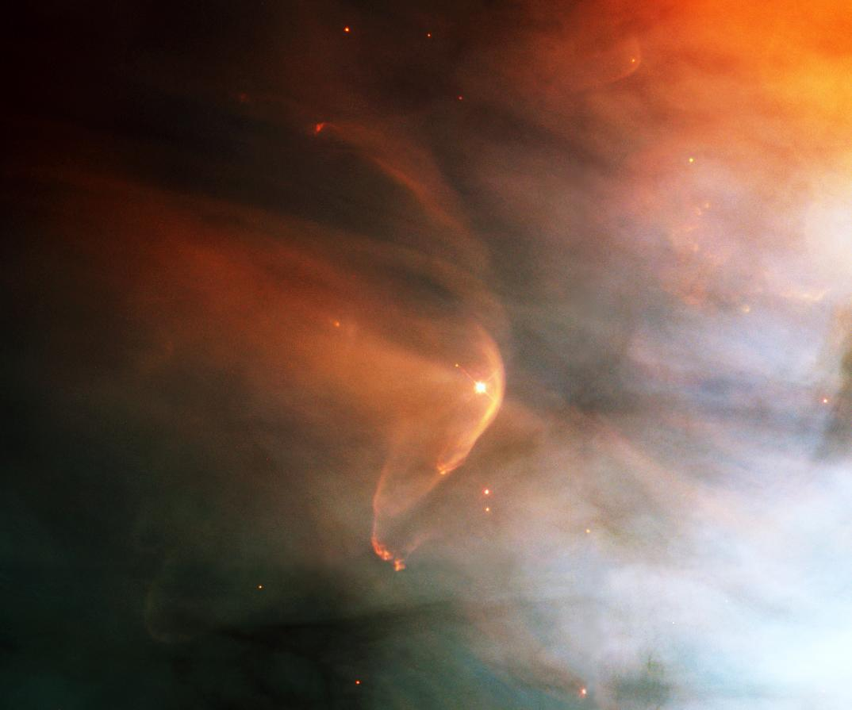
Mathematisch-Naturwissenschaftliche Fakultät
Sonne und Heliosphäre

Slide 26
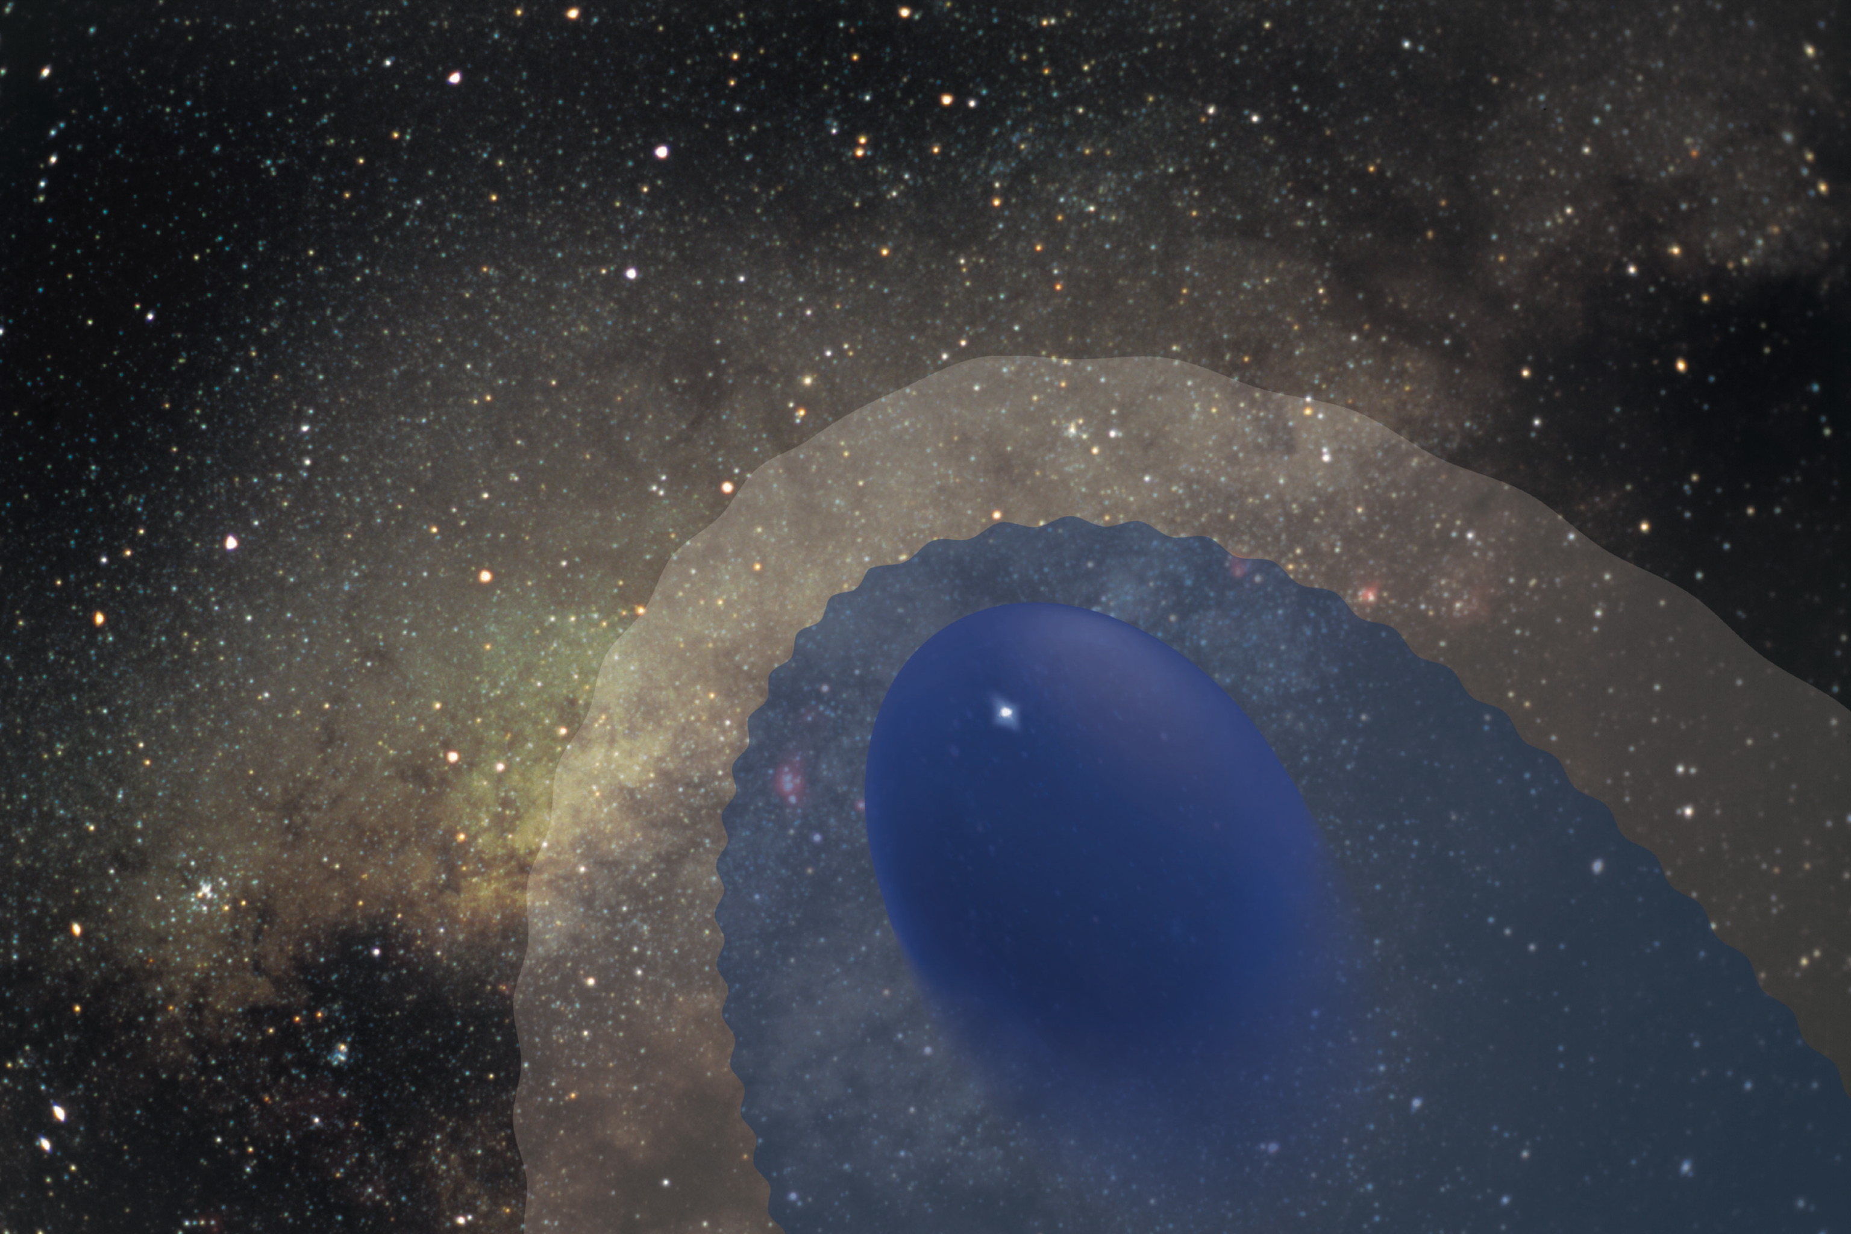
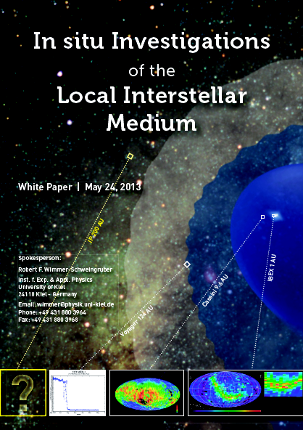






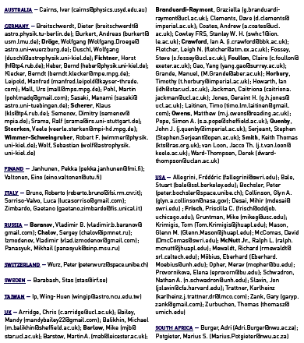





·Science
·Mission
·Technology, TRL

Slide 27
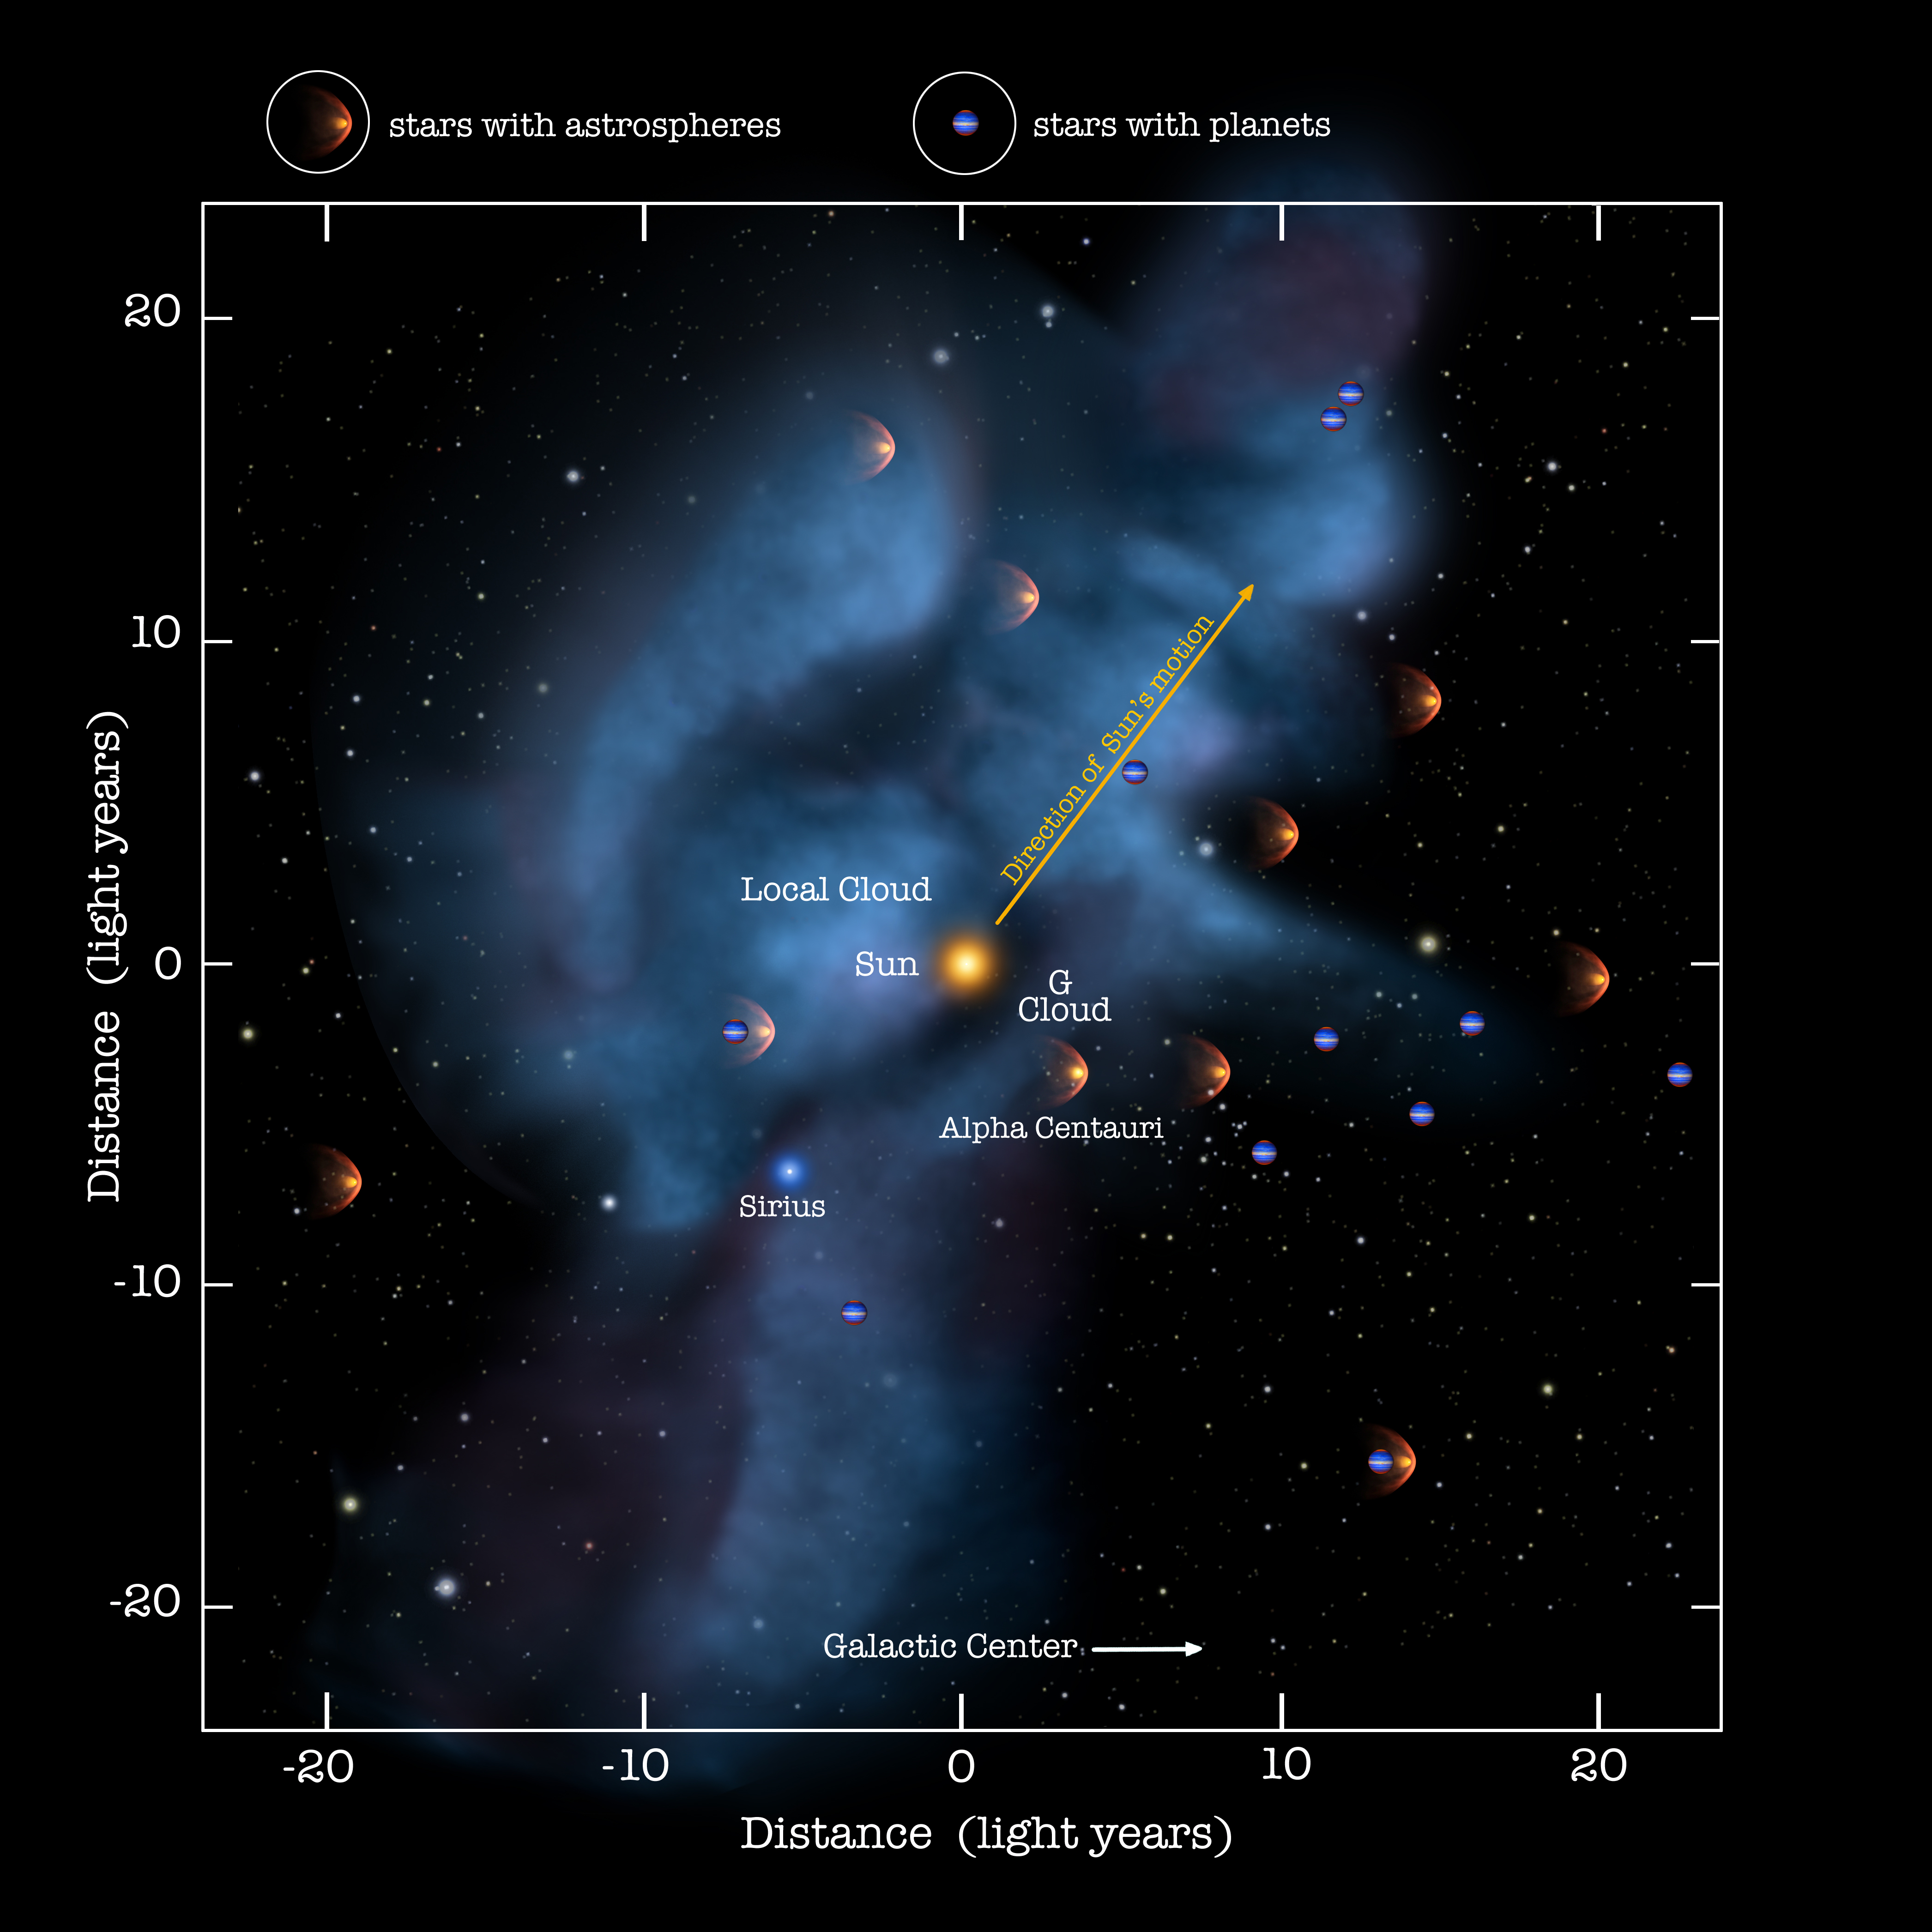
Introduction
Astrospheres are a ubiquitous phenomenon. They protect their stellar systems, some with planets, from the interstellar medium.
How do they form?
How do they work?
Need to address three complexes of questions:

Slide 28
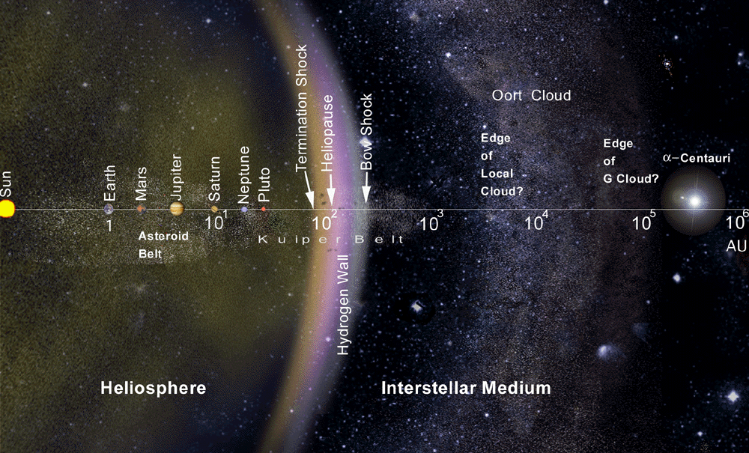
Science Objectives

Slide 29
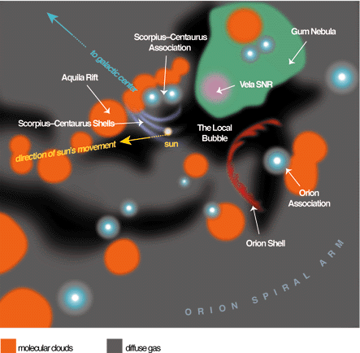
Science Objectives
In situ Investigations of the Local Interstellar Medium
Science Objectives:
Heliophysics: How do solar wind and interstellar medium interact to form the heliosphere and how does this relate to the universal phenomenon of the formation of astrospheres?
Astrophysics: What are the properties of the very local ISM and how do they relate to the typical ISM?
Fundamental Physics: How do plasma, neutral gas, dust, waves, particles, fields, and radiation interact in extremely rarefied, turbulent and incompletely ionized plasmas?
This requires an interstellar probe (IP)
Bonus Science: Extragalactic background light, soft-X-ray background, multi-spacecraft studies
1000 pc

Slide 30
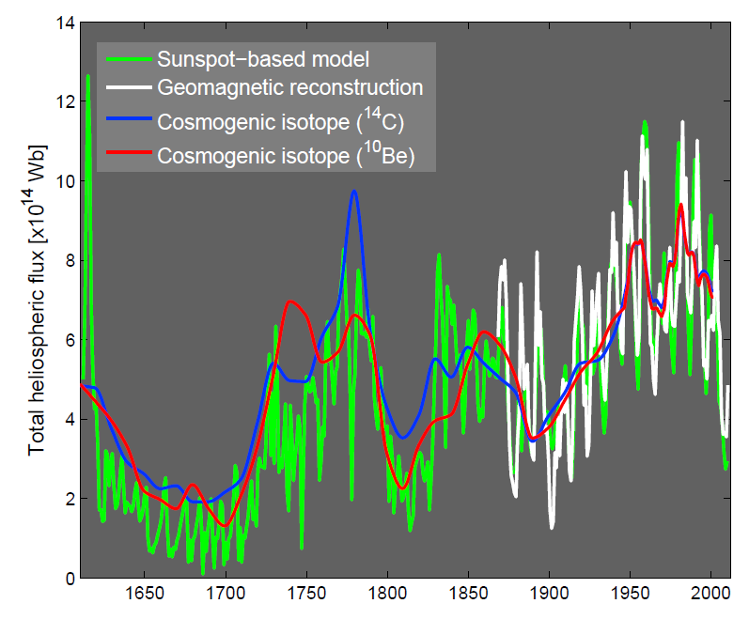
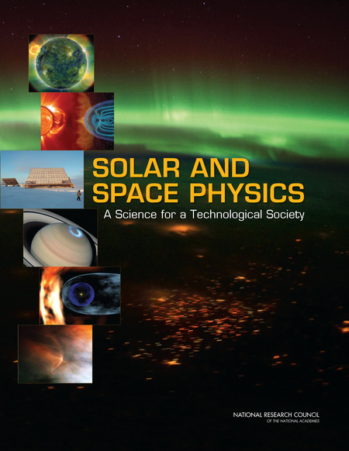
Science Objectives
Why Now?
The Sun appears to be exiting its 'Grand Solar Maximum':
  Leads to a smaller heliosphere
  Leads to shorter travel time
  Catch dynamics 'in the act’
  Compare with IMAP
Only new, innovative instruments on an interstellar probe will provide required measurements.

Slide 31
Mission
Mission Requirements
M1 spacecraft to arrive within a ~25° cone of the heliospheric 'nose' (+7°, 252° Earth ecliptic coordinates) or a similarly interesting region (based on IBEX results). This aims at the scientifically most compelling region and minimizes travel time.
M2 Provide data from ~5 AU out to at least 200 AU
M3 Arrive at 200 AU 'as fast as possible', ideally within 25-30 years

Slide 32
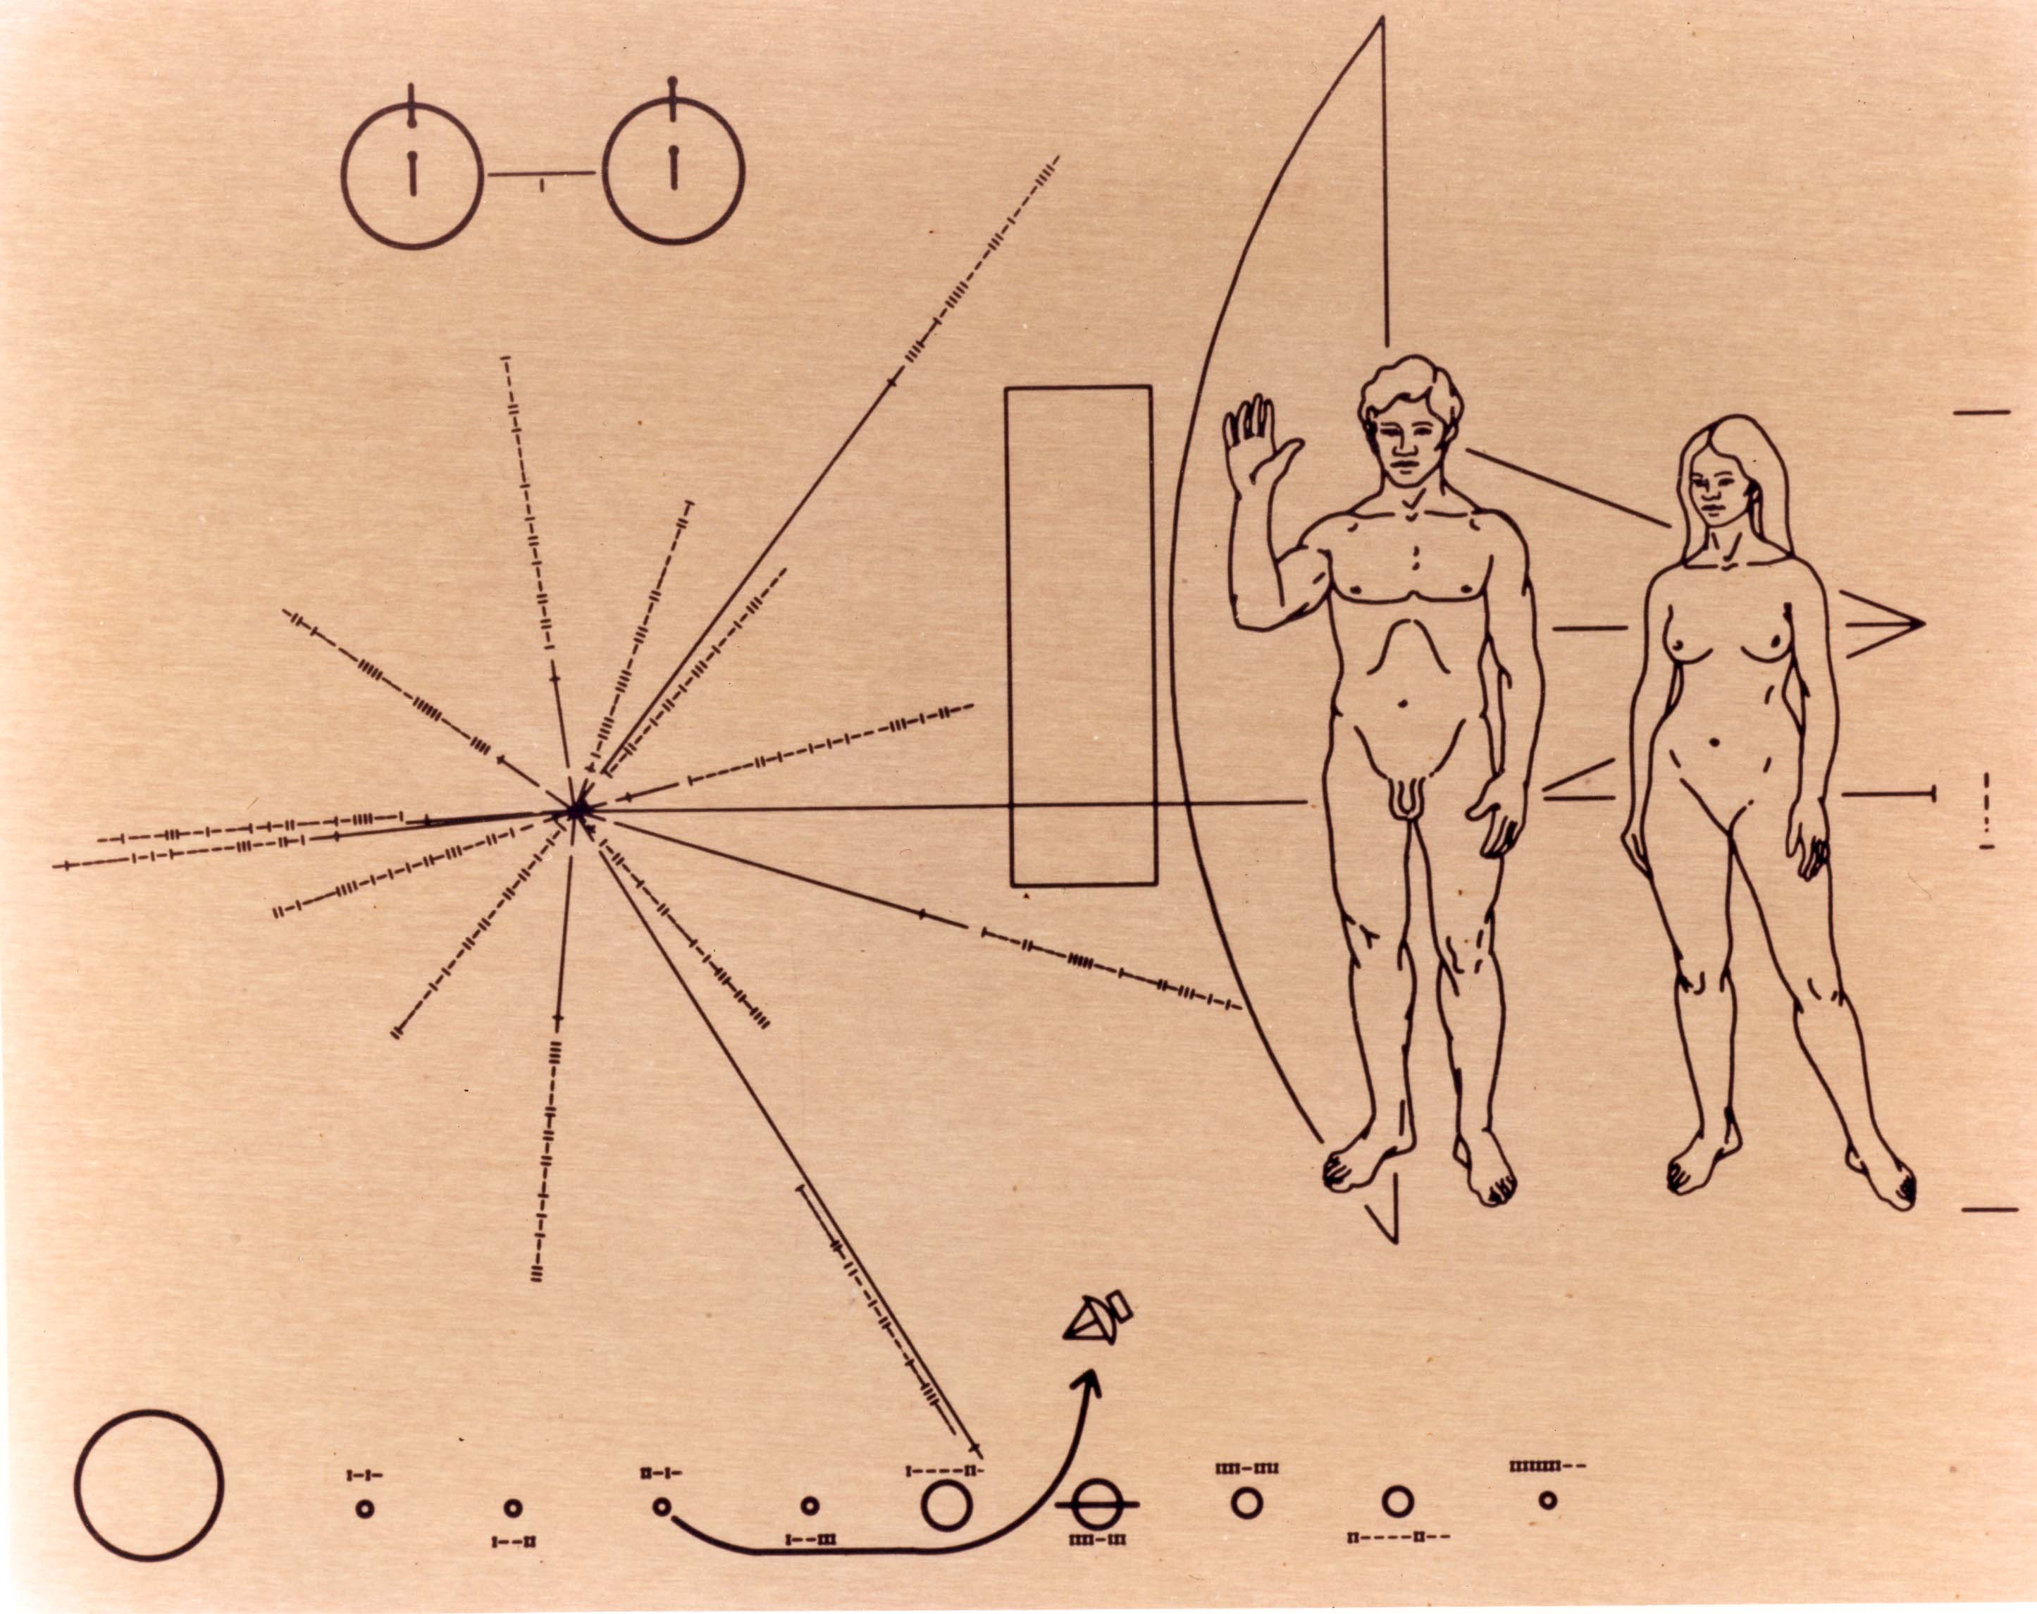
Conclusions
Summary & Conclusions
Science:
Interstellar Probe addresses key problems in three major fields:
Heliosphysics: Complex dynamics of the heliosphere
Astrophysics: In situ investigation of the local ISM
Fundamental Physics: Physics of truly complex plasmas
IP addresses all four CV 2015-2025 science themes.
Technology:
Propulsion:
Solar or electric sails
Nuclear electric
Commercial launcher?
Power:
European development
Use US RTGs?
Whichever is chosen, it will be enabling technology for other missions.
Interstellar Probe Team is ready to go!
Thanks to the IBEX, Voyager, Cassini & IP teams

Slide 33
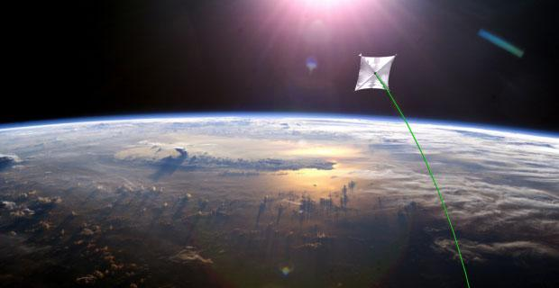
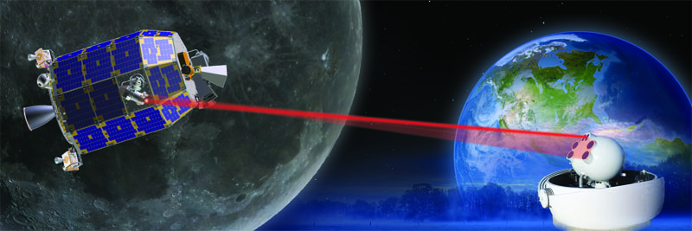
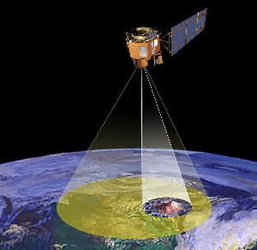
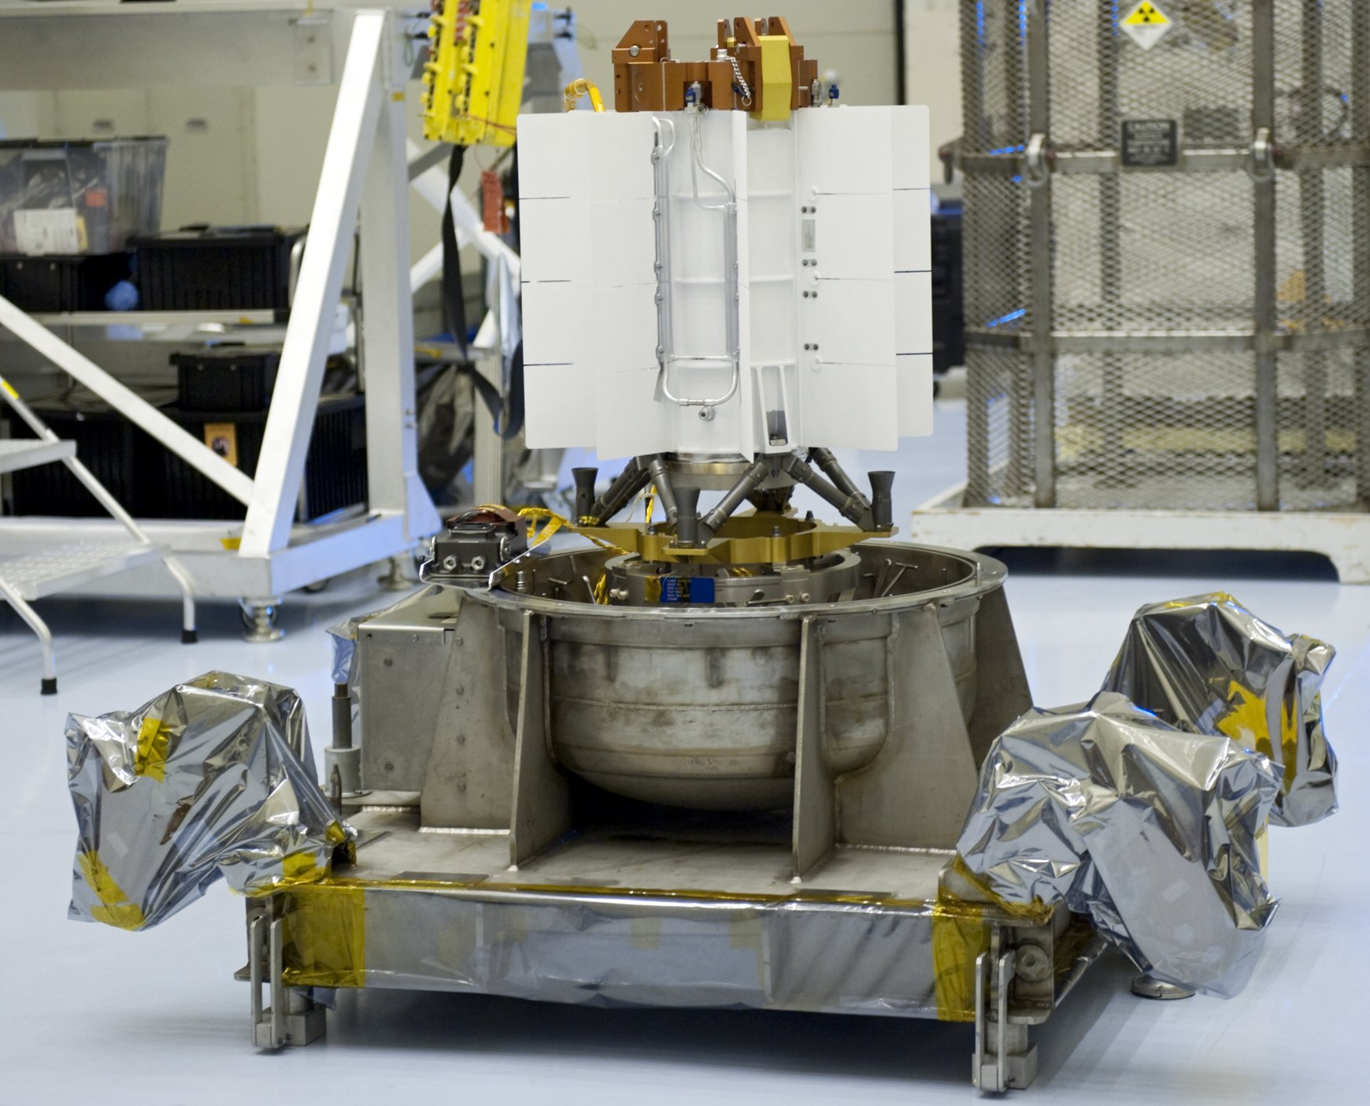
Mathematisch-Naturwissenschaftliche Fakultät
Mathematisch-Naturwissenschaftliche Fakultät
Exoplaneten und Astrobiologie
Challenges
Propulsion
Data transmission
Spacecraft
autonomous
Power

Slide 34
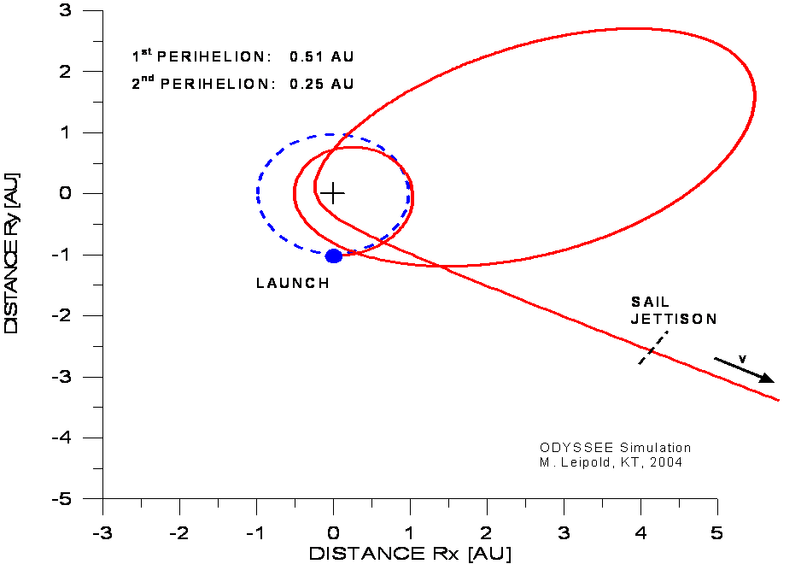
Mathematisch-Naturwissenschaftliche Fakultät
Mathematisch-Naturwissenschaftliche Fakultät
Exoplaneten und Astrobiologie
Challenges
Propulsion
Solar Sail
Electric Sail
Radioisotope Electric
Heavy Launcher

Slide 35
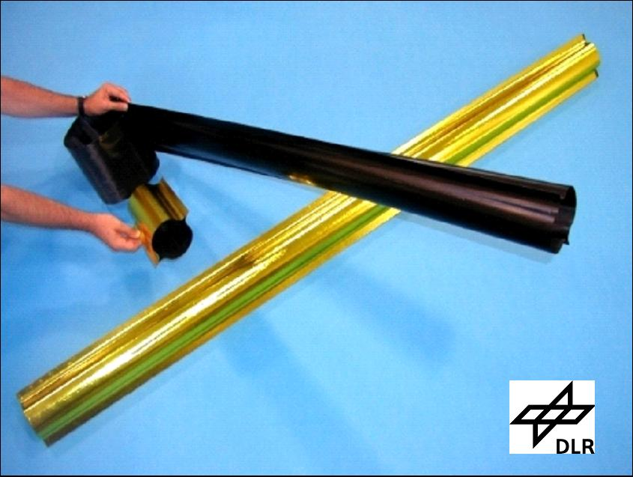
Mathematisch-Naturwissenschaftliche Fakultät
Mathematisch-Naturwissenschaftliche Fakultät
Exoplaneten und Astrobiologie
Challenges
Solar Sail
European commitment can readily be revived.

Slide 36
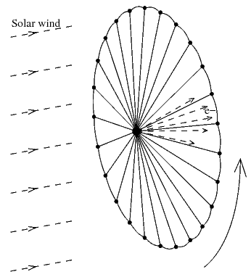
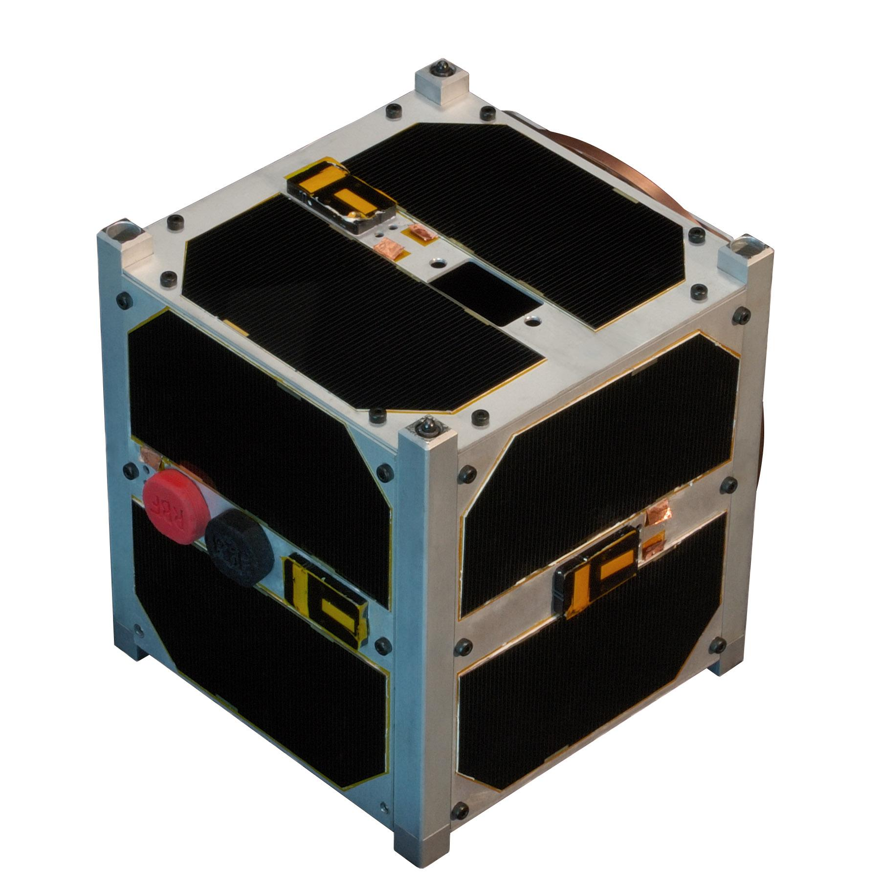
Mathematisch-Naturwissenschaftliche Fakultät
Mathematisch-Naturwissenschaftliche Fakultät
Exoplaneten und Astrobiologie
Challenges
Electric Sail
Deflect solar wind protons with charged wires
HV penetration depth ~ 10 r_{Debye}, i.e., ~100m @ 1 AU
Requires HV (20-40 kV) and ~700 W

Slide 37
Mathematisch-Naturwissenschaftliche Fakultät
Mathematisch-Naturwissenschaftliche Fakultät
Exoplaneten und Astrobiologie
Challenges
Propulsion
Data transmission
Power
Spacecraft
autonomous

Slide 38
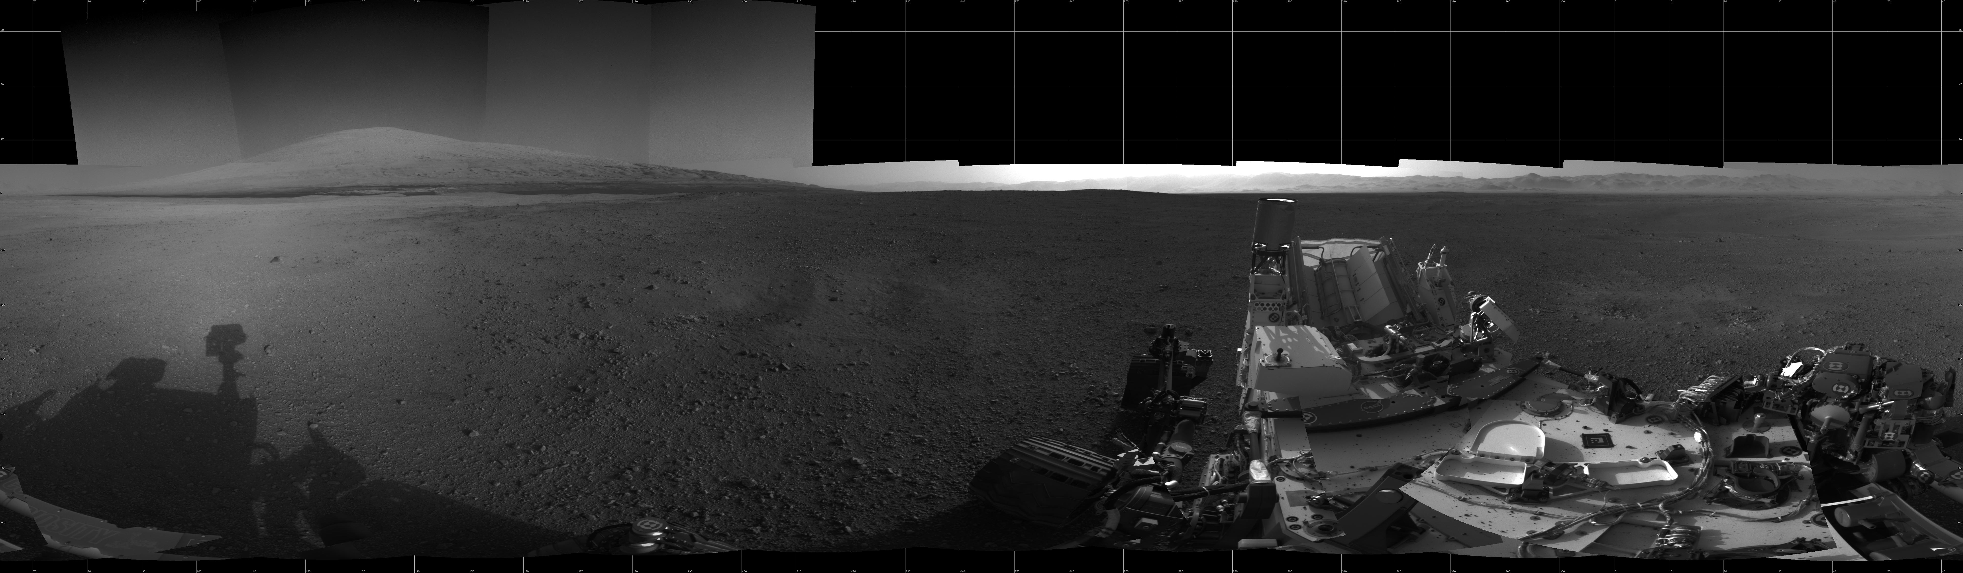
Mathematisch-Naturwissenschaftliche Fakultät
Mathematisch-Naturwissenschaftliche Fakultät
Exoplaneten und Astrobiologie
Power

Slide 39
Mathematisch-Naturwissenschaftliche Fakultät
Mathematisch-Naturwissenschaftliche Fakultät
Exoplaneten und Astrobiologie
Challenges
Data transmission and spacecraft pointing
Propulsion
Data transmission
Power
Spacecraft
autonomous

Slide 40
Mathematisch-Naturwissenschaftliche Fakultät
Mathematisch-Naturwissenschaftliche Fakultät
Exoplaneten und Astrobiologie
Telemetry – Radio vs. Laser
Low bit rate is ok since changes are also slow
5000 bps baseline
2x8 hours weekly passes
58 kbps also at 200 AU
Radio: 6 kbps requires 35m antenna initially, but 70m antenna needed in later mission stages.
Laser com would be better/more efficient
Attitude control for Laser com! → Needs to be tested

Slide 41

Mathematisch-Naturwissenschaftliche Fakultät
Mathematisch-Naturwissenschaftliche Fakultät
Exoplaneten und Astrobiologie
Challenges (Pointing)
Pointing issues
Stabilized platforms (small and/or large) telescope pointing to arc seconds, even sub arcsec accuracy

Slide 42
Mathematisch-Naturwissenschaftliche Fakultät
Challenges
Data transmission
Propulsion
Power
Spacecraft
autonomous

Slide 43

Mathematisch-Naturwissenschaftliche Fakultät
Challenges
  significant local storage and data processing
  Support for appropriate instrumentation
  Radiation environments

Slide 44
Mathematisch-Naturwissenschaftliche Fakultät
Spare

Slide 45

Charged particle flux and radiation dose equatorial profiles at Jupiter
Equatorial profiles of radiation doses under 0.27, 1, 2.2 and 5 g/cm² shielding near Jupiter.

Slide 46
Calculated radiation doses in Europa orbit: high hazard
Total 2-month doses in Europa orbit (at 9.5 R_{J})
g/cm² | rad | g/cm² | rad
0.00 | 8.5·10⁸ | 1.0 | 2.2·10⁶
0.01 | 1.0·10⁸ | 2.2 | 8.8·10⁵
0.10 | 1.5·10⁷ | 5.0 | 2.4·10⁵
0.27 | 7.4·10⁶ | 10.0 | 4.5·10⁴

Slide 47


Requirements for objective 5
→ Where do shocks form and how do they accelerate particles?
Shock surface
reconstruction
Early imaging of shock formation in low corona (up to 4 Rs)
Magnetic field and density imaging for shock properties
Multipoint, off-Sun-Earth line measurement
of energetic particles
→ Key measurements to
address objectives 3, 4, 5, 6, 8

Slide 48


2026 6x15Re
2027 6x26Re
Foreshock
Bow shock
2028 6x45Re
Pristine solar wind
Systematic exploration of solar wind and shocked solar wind regions reflecting different
types of turbulent environments leads to knowledge of astrophysical importance.
Magnetosheath
Notes:
!!! POPUP !!!
Systematic exploration of solar wind and shocked solar wind regions reflecting different types of turbulent environments leads to knowledge of astrophysical importance.

Slide 49


Fields instrument consortium
SCM
B field 3D AC
MAG
B field 3D DC
50m
EFI-HFA
E field 3D AC
FWP
Fields & Waves Processor
EFI-SDP
E field 2D DC/AC

Slide 50






Particle instrument consortium
CSW
Cold Solar Wind
TEA
Turbulence
Electron Analyser
FAR
Faraday Cup
EPE
Energetic
Particle Experiment
PPU
Particle
Processing Unit
IMS
Ion Mass Spectrometer

Slide 51
Magnetosphere and charged particles satellite measurements at Jupiter
mission | time | orbit | experiments | doses
Pioneer 10 | Dec. 1973 | Fly-by at 130 ths. km from Jupiter (2.8 R_{J}) | Magnetic field, electrons: 0.06 to >35 MeV, protons: 0.6 to >80 MeV | 1.5·10⁶ rad on the surface, 4.5·10⁵ rad at 3 mm Al
Pioneer 11 | Dec. 1974 | Fly-by at 43 ths. km (1.6 R_{J}), high incl. orb. |  | 4.3·10⁵ rad on the surface, 1.2·10⁵ rad at 3 mm Al
Voyager 1 | March 1979 | Fly-by at 207 ths. km (4 R_{J}) | Magnetic field, low-energy particles, electrons: 3–110 MeV, ions: 1–500 MeV/nuc | ≈ 5·10⁵ rad
Voyager 2 | July 1979 | Fly-by at 570 ths. km (9 R_{J})
Ulysses | Feb. 1992 | Fly-by at 378 ths. km (6.3 R_{J}), high incl. orb. | Magnetic field, electrons: 0.03 to >170 MeV Ions: 0.05–75 MeV/nuc | estim. 60 krad =600 GY(inside?)
Galileo | 1995–2003 | 35 highly elliptical orbital segments with r_{π} typically 6–11 R_{J} | Magnetic field, electrons: 15 keV to >11 МeV, Ions: 10 keV to 200 MeV/nuc | Designed for 150 krad at 2.2 g/cm², sustained >650 krad = 6.5 kGy; (Damaged of some electronic systems)
Cassini | Nov. 2000 | Fly-by at 10 mln. km (140 R_{J}) | Magnetic field sync. w/Galileo, high-energy electrons (radiation spectrometer)
New Horizons | Feb. 2007 | Fly-by at 2.3 mln. km (32 R_{J}) | Local and remote (radio-spectrometer) magnetic field and charged particle measurements

Slide 52








Which Exoplanets could host Life?
Earth
Snowball Earth
Super-Earth
Venus
-like
Mars
-like
Jungle-
world
Water-world
Desert-
world

Slide 53



Earth as an „exoplanet“
The spectrum of Earth observed during lunar eclipse
Absorption bands from:
O₂ and O₃
H₂O
CO₂
CH₄
Observed transmission spectrum:
Blue: reflection spectrum
→ This is what we would like to have for exoplanet XYZ!
Pallé et al. (2009)
Notes:
a) The observed Earth's transmission spectrum, with some of the major atmospheric constituents marked. b) A comparison between the Earth's transmission (black) and reflection (blue) spectra. It is readily seen from the figure that the reflection spectrum shows increased Rayleigh reflectance in the blue. It is also noticeable how most of the molecular spectral bands are weaker, and some non-existent, in the reflection spectrum. Adapted with permission from Macmillan Publishers Ltd: Nature (E. Pallé et al., 459, 814), copyright 2009. [ JPEG ].

Slide 54



Signal-to-Noise ratios for JWST and E-ELT
An example: „Earth“ orbiting a G2V star at 10pc
SNR: integrated in NIRCam and MIRI filter bandpasses for JWST and same bandpasses for E-ELT for comparison of performances.
Near-IR (and optical) wavelengths range more suitable for primary transit spectroscopy.
But: For ground-based telescopes telluric lines are a problem
CH₄
O₃
CO₂
H₂O, CO₂
O₃
Caution: assumes idealized conditions and a transiting planet around G type star at 10 pc
Near-IR with JWST and E-ELT can provide detections for very nearby Earths (tbc).
Hedelt et al. (2013)
See also e.g. Irwin et al. (2014), Barstow et al. (2015), Snellen et al. (2015)…
Notes:
Co2 impossible from ground, as expected. Difficult with jwst. Near-ir better for transmission spectra.
Emission transit sepctroscopy more poor.

Slide 55


Science Objectives
Heliophysics:
How do solar wind and interstellar medium interact to form the heliosphere and how does this relate to the universal phenomenon of the formation of astrospheres?

Slide 56

Science Objectives
Astrophysics:
What are the properties of the very local ISM and how do they relate to the typical ISM?

Slide 57



Science Objectives
Fundamental Physics:
How do plasma, neutral gas, dust, waves, particles, fields, and radiation interact in extremely rarefied, turbulent and incompletely ionized plasmas?

