Slide 1
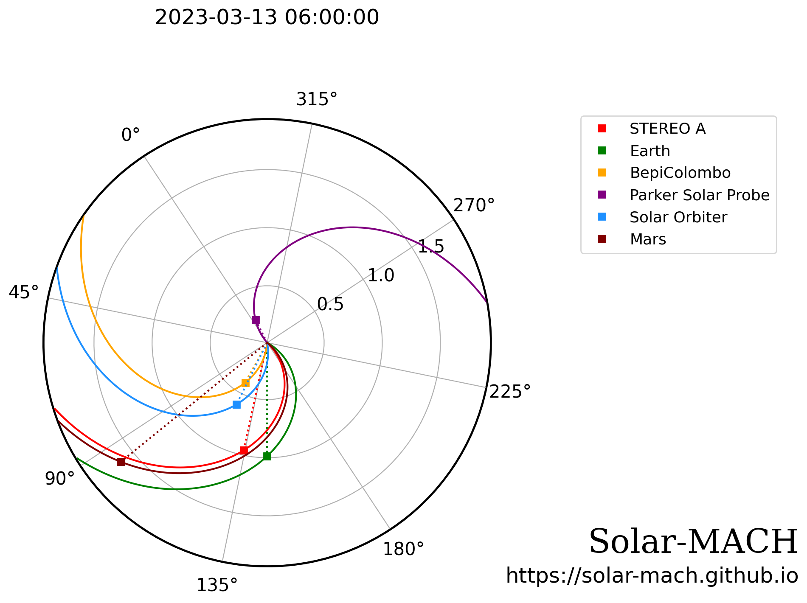
The March 13, 2023 solar particle event,
… or a lesson in apophenia?

Slide 2
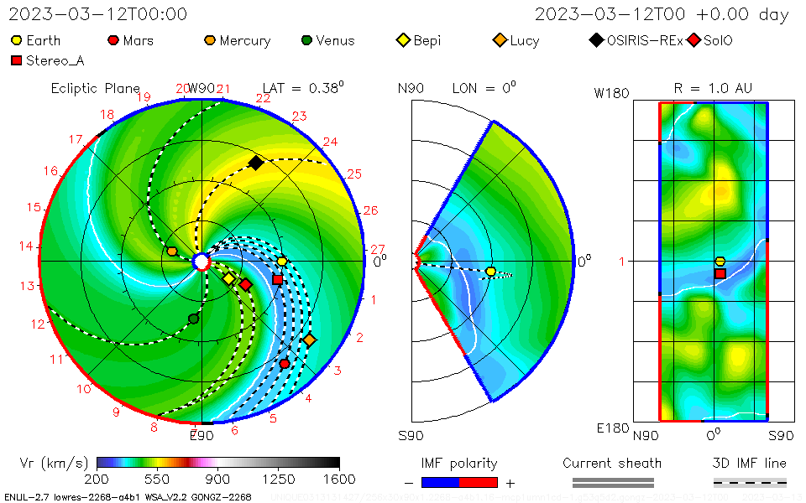

Slide 3
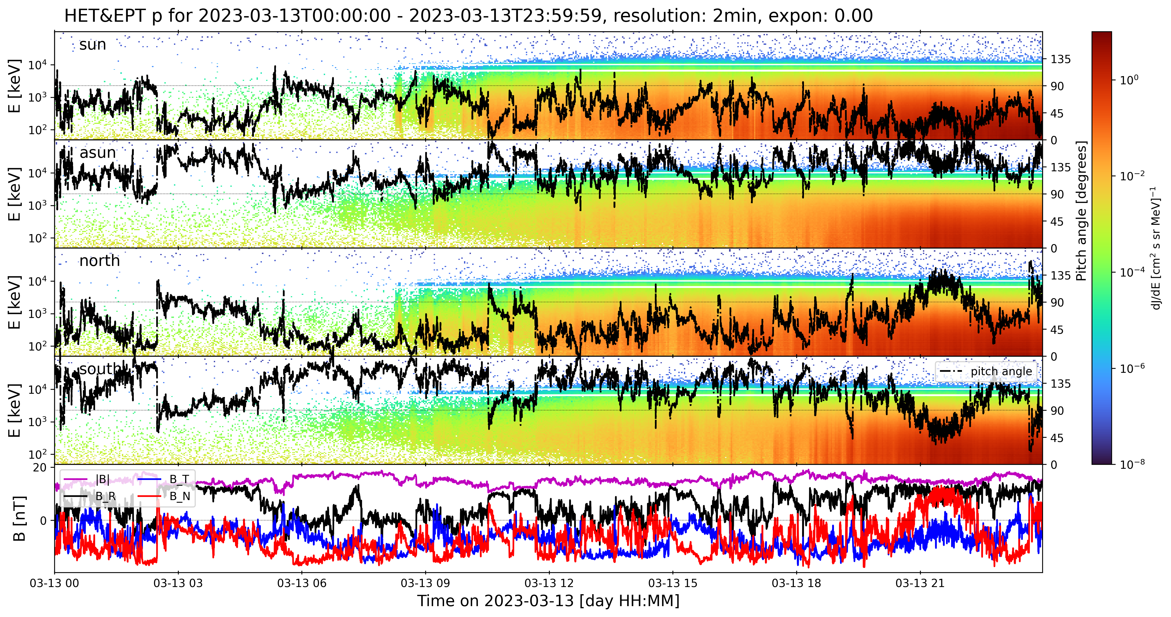

Slide 4
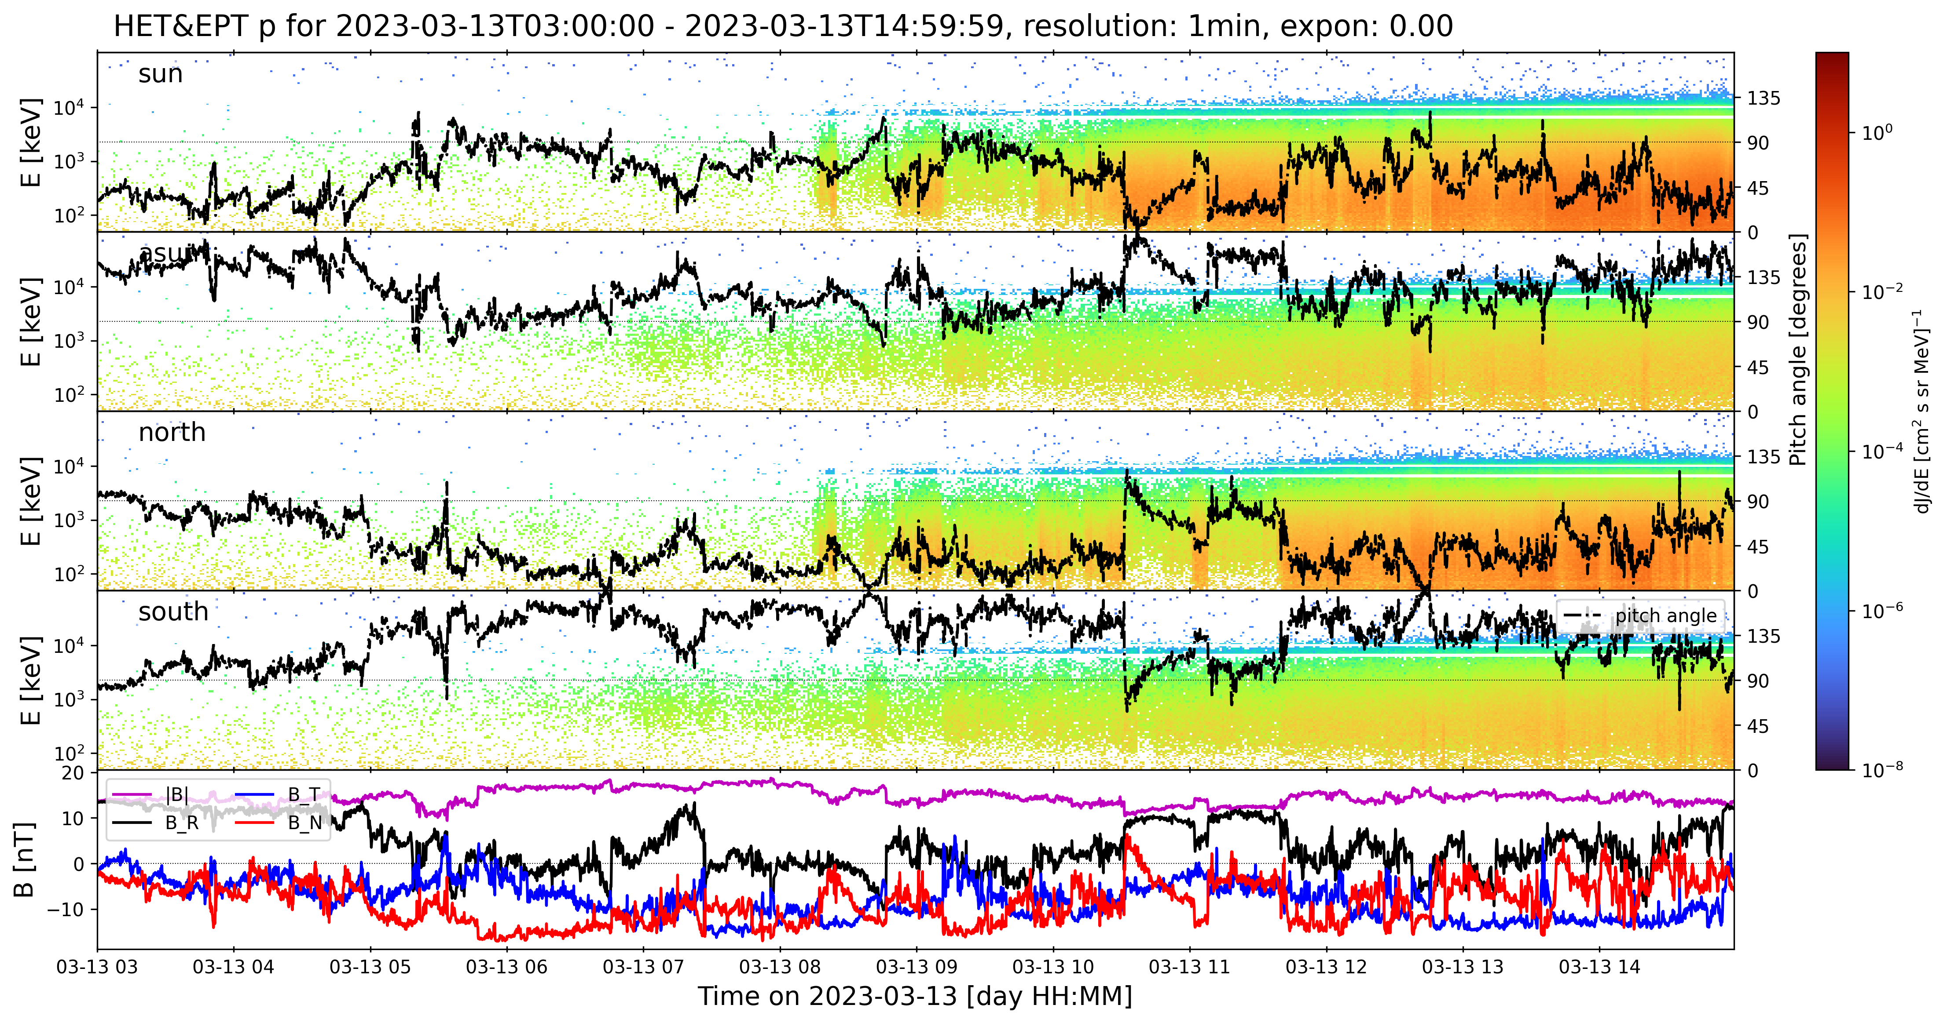

Slide 6
13 March 2023 solar particle event unusual:
velocity dispersion (not unusual)
Although the earliest particles arrive form the asun and south directions, VDA gives earlier results for sun and north direction. But these are very intermittent and only seen later on during the event.
Sun and north direction also see higher intensities, so that may explain why they appear to see the onset earlier.
Intermittent periods of highly anisotropic fluxes.
Moreover, we see some very interesting fine structures at high time resolution later on in the event, see following slides. Similar to what we saw in September 2023 event. These fine structures are seen in one second data, but also in rebinned 4- and 5-second data, so this is no “beat-like” phenomenon with some instrumental setting.

Slide 7
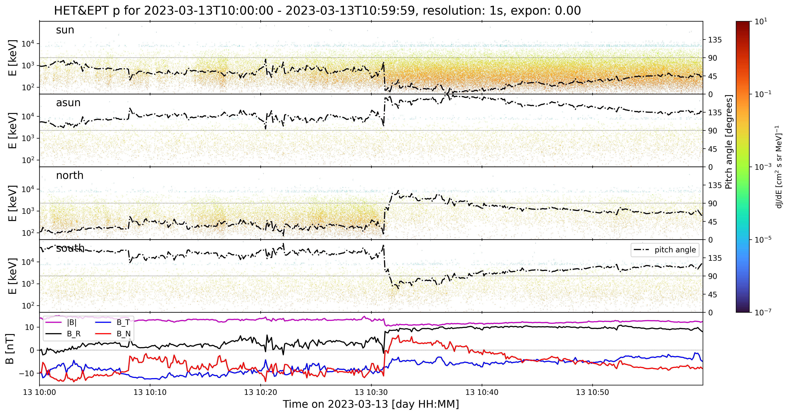

Slide 8
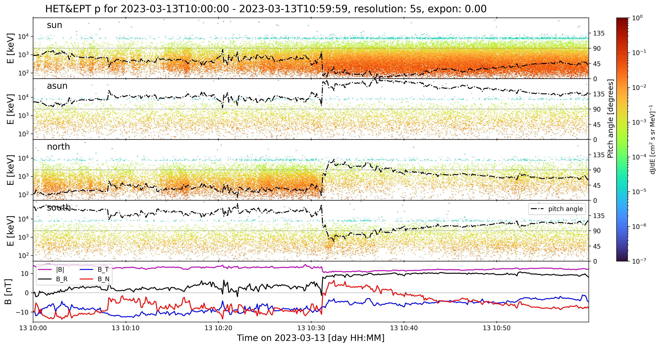

Slide 9
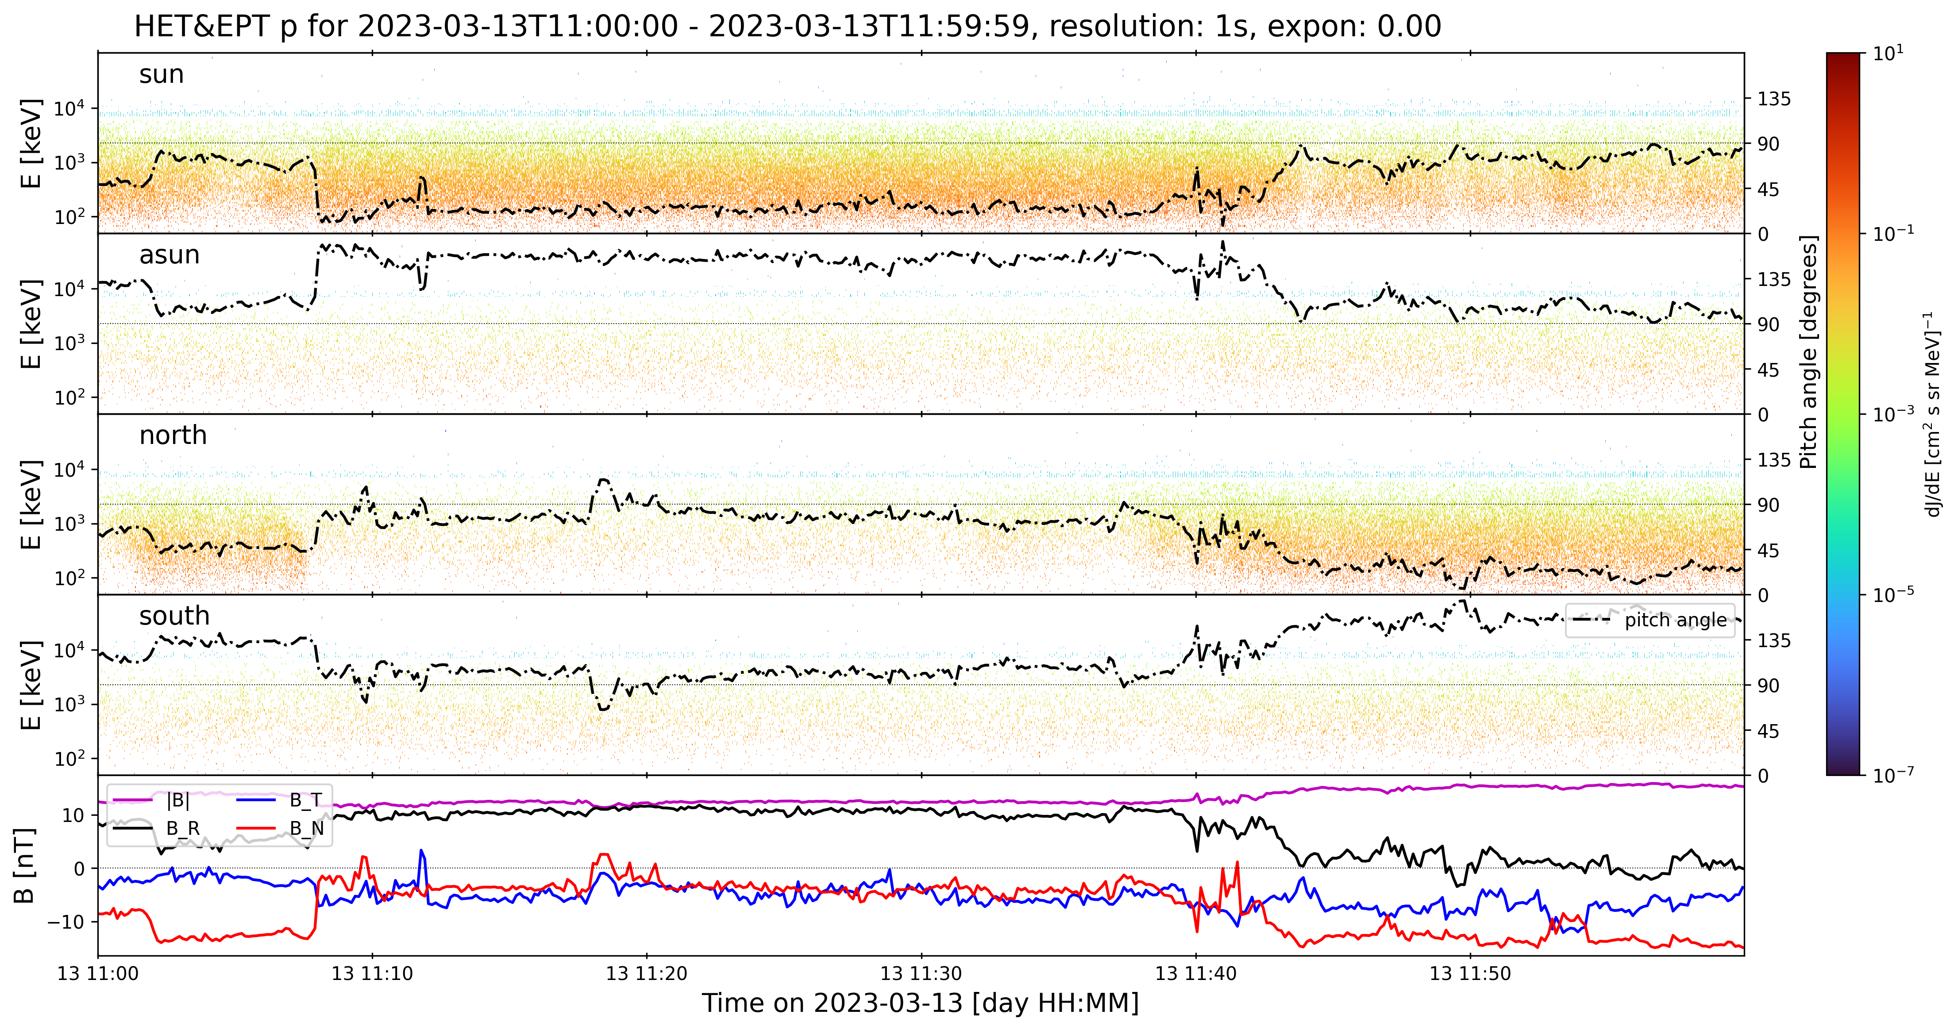

Slide 10
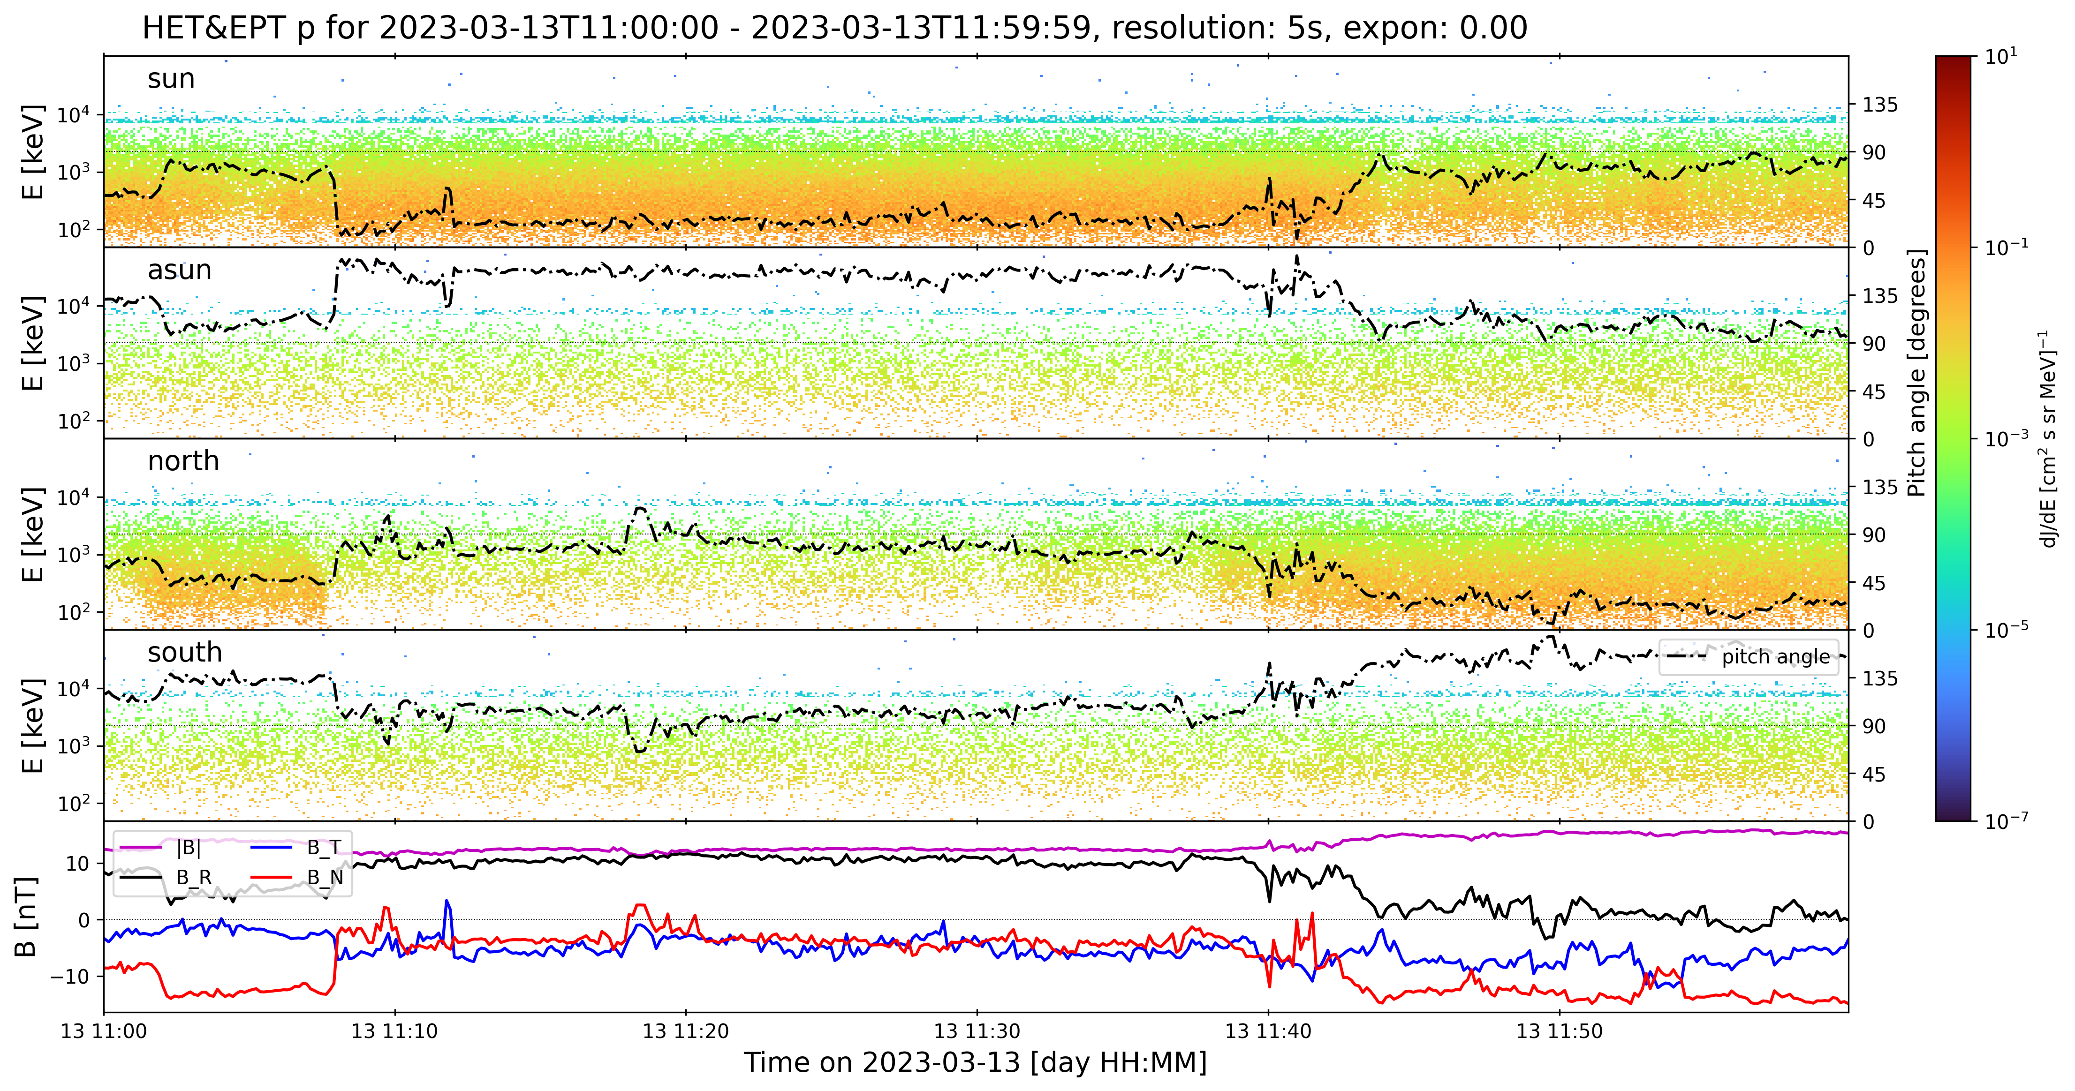

Slide 11
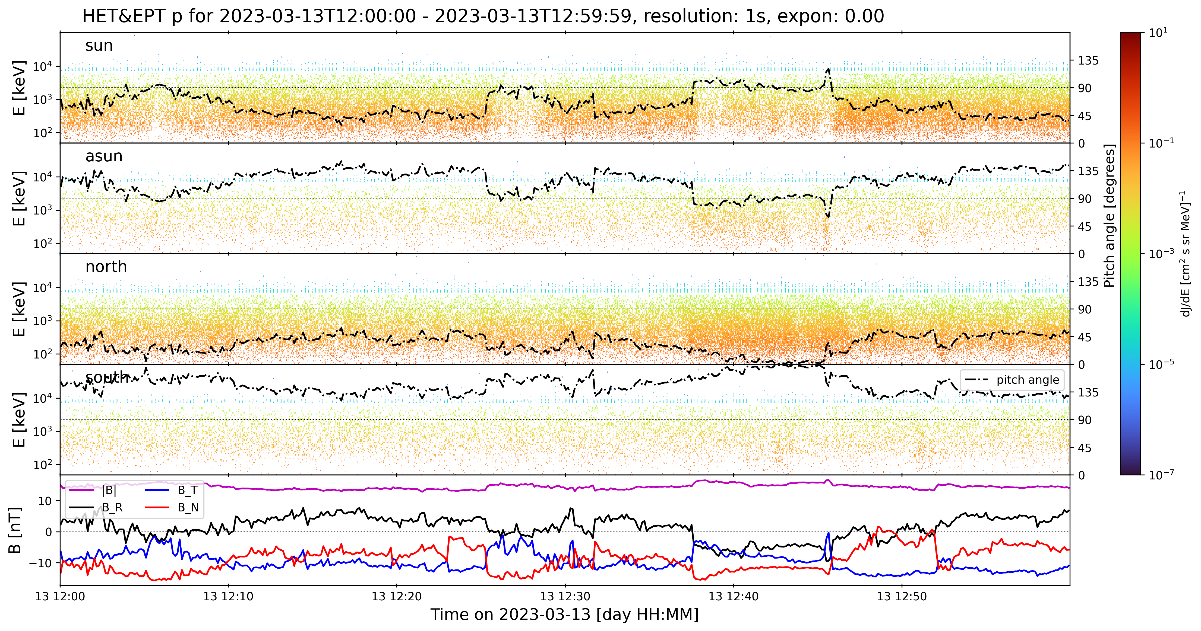

Slide 12
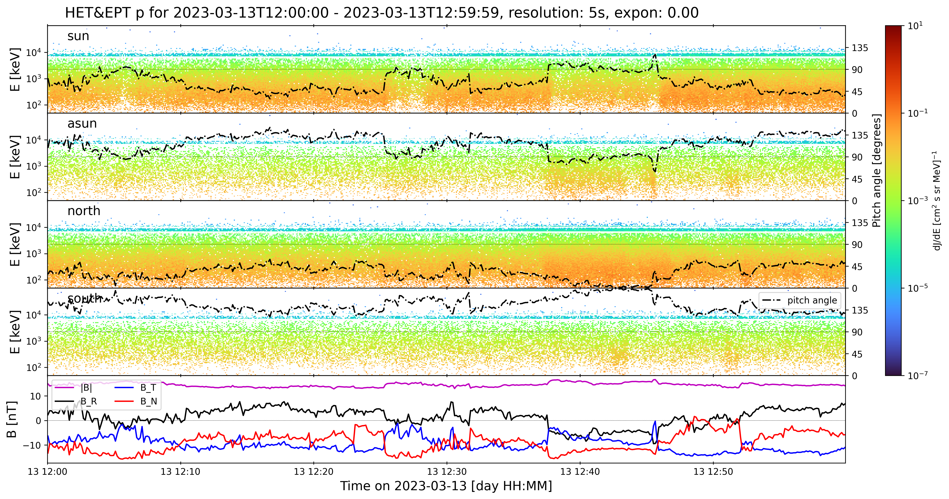

Slide 13
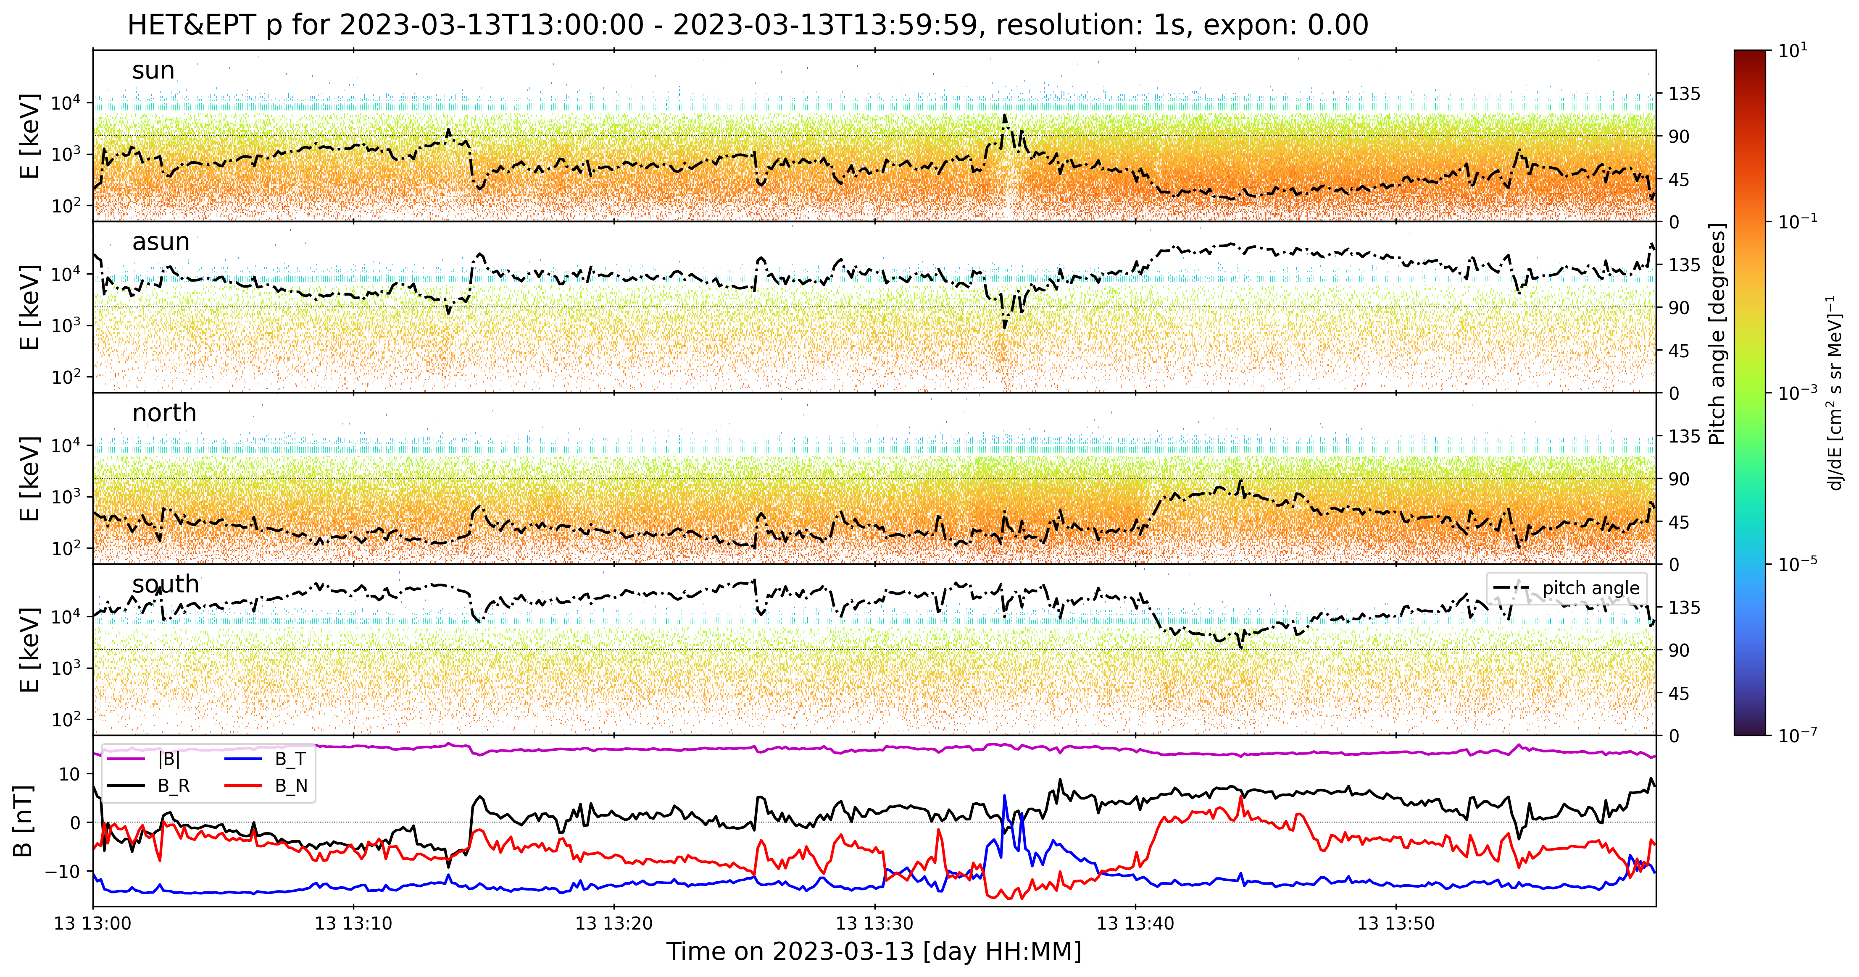

Slide 14
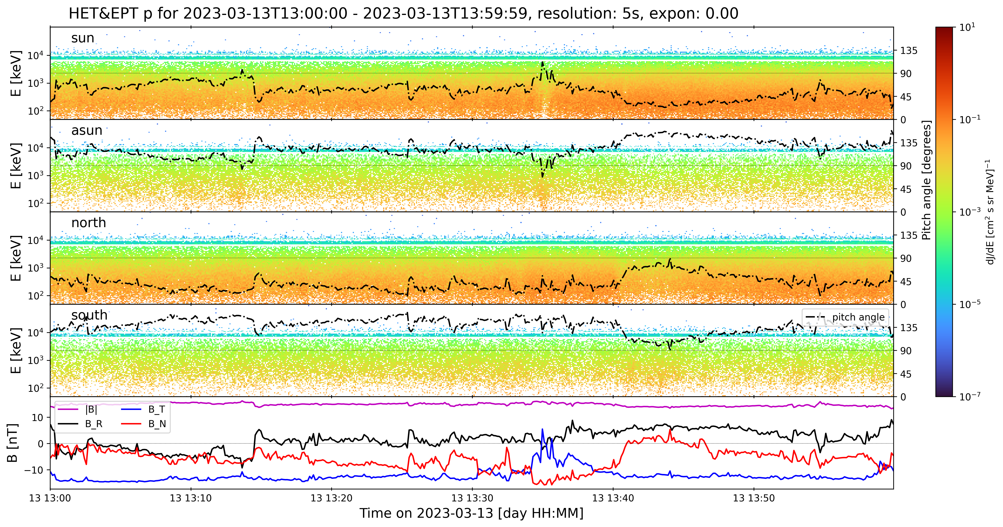

Slide 15
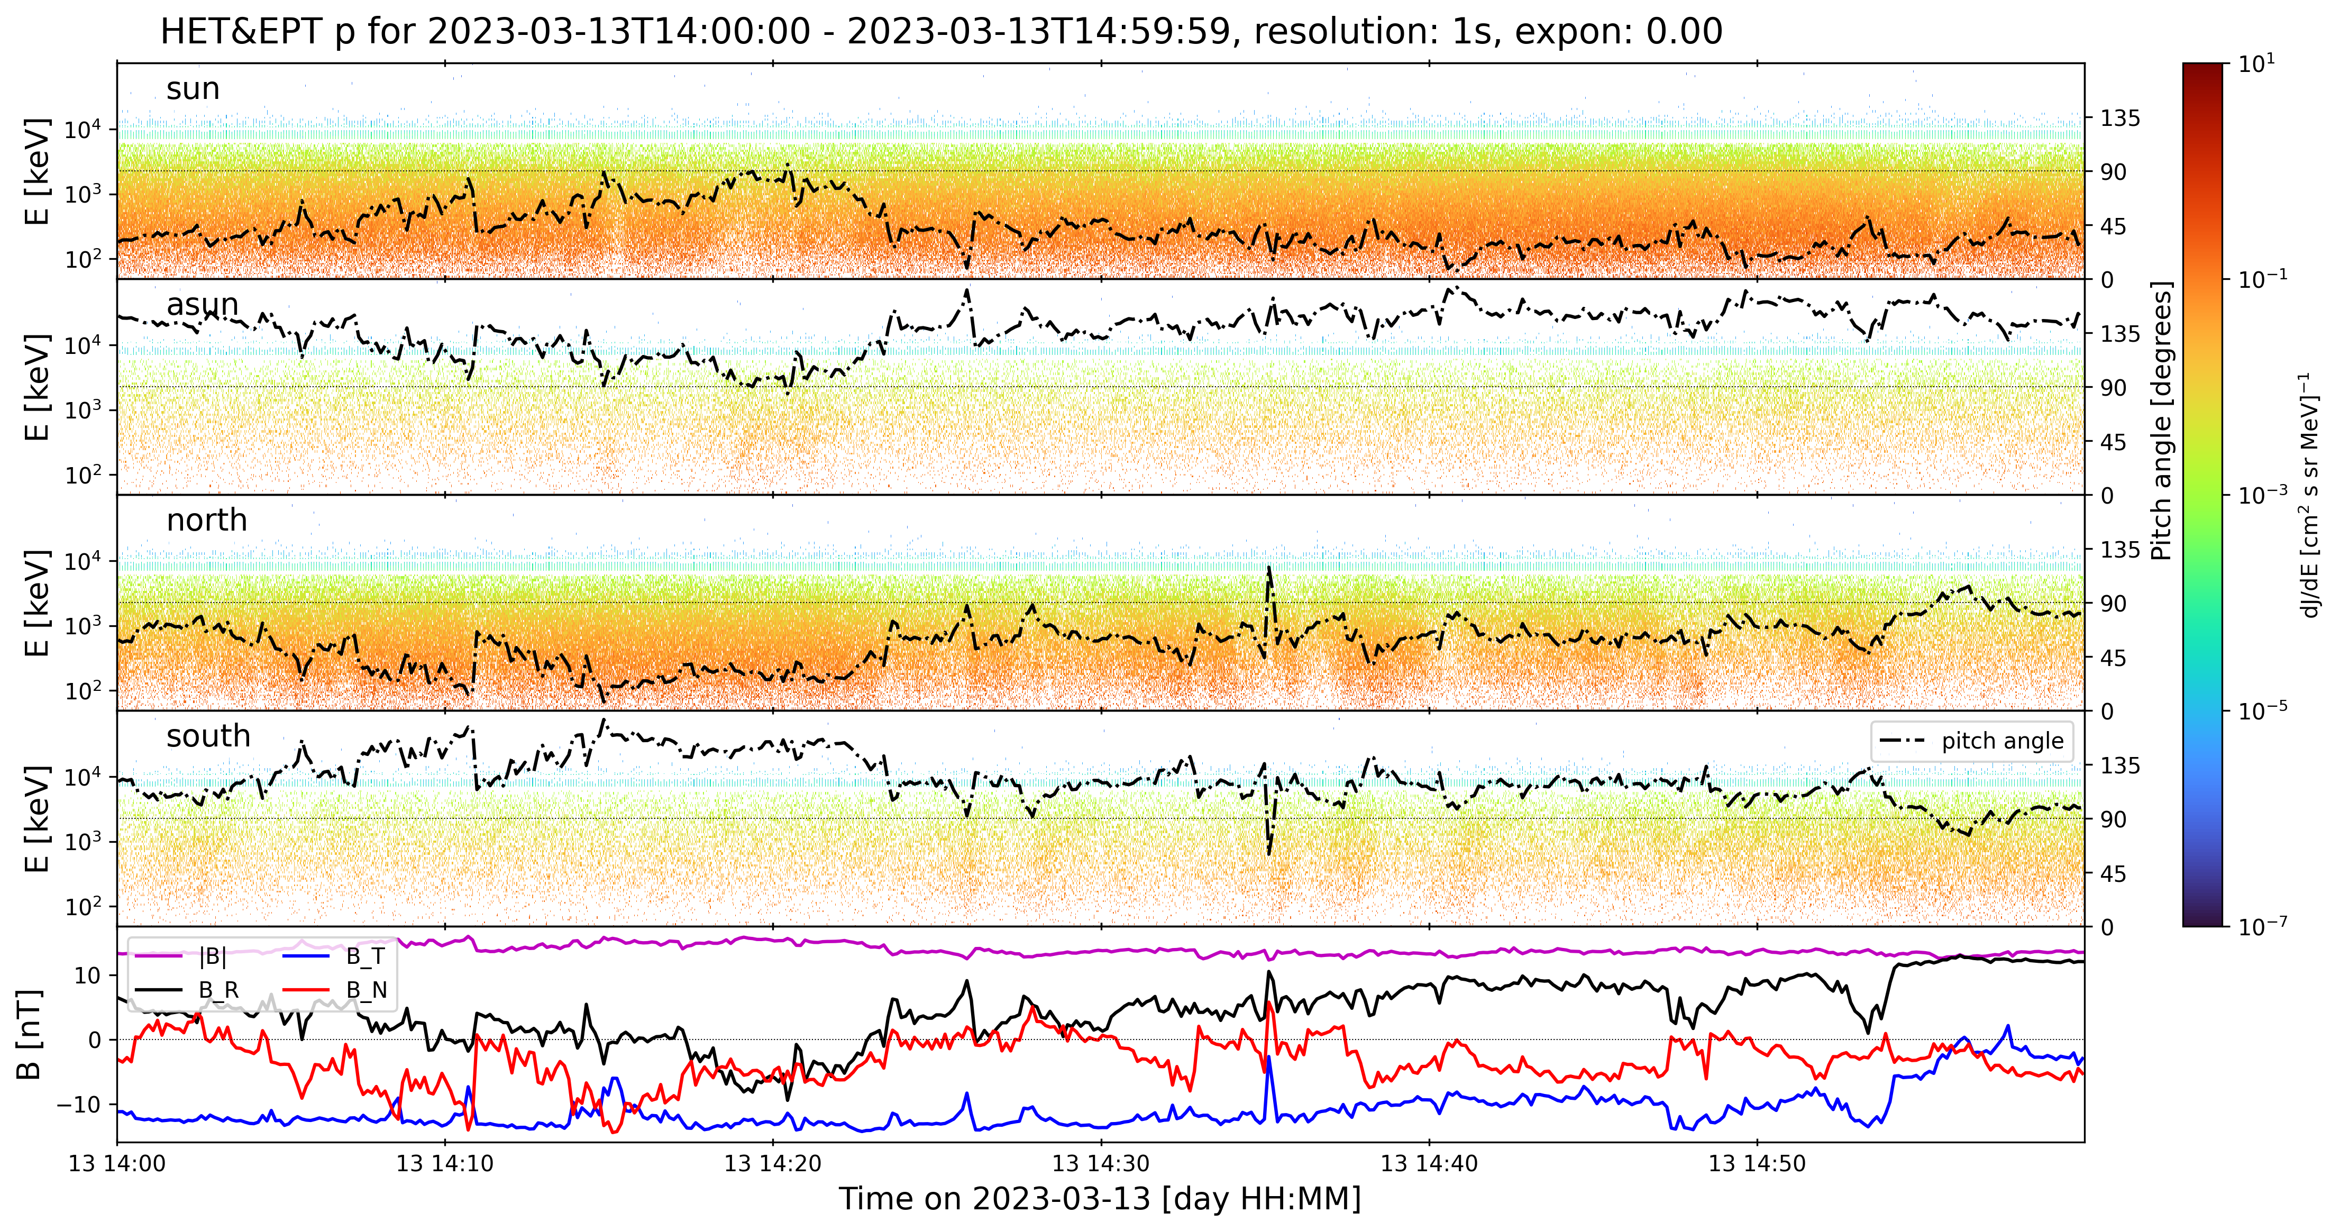

Slide 16
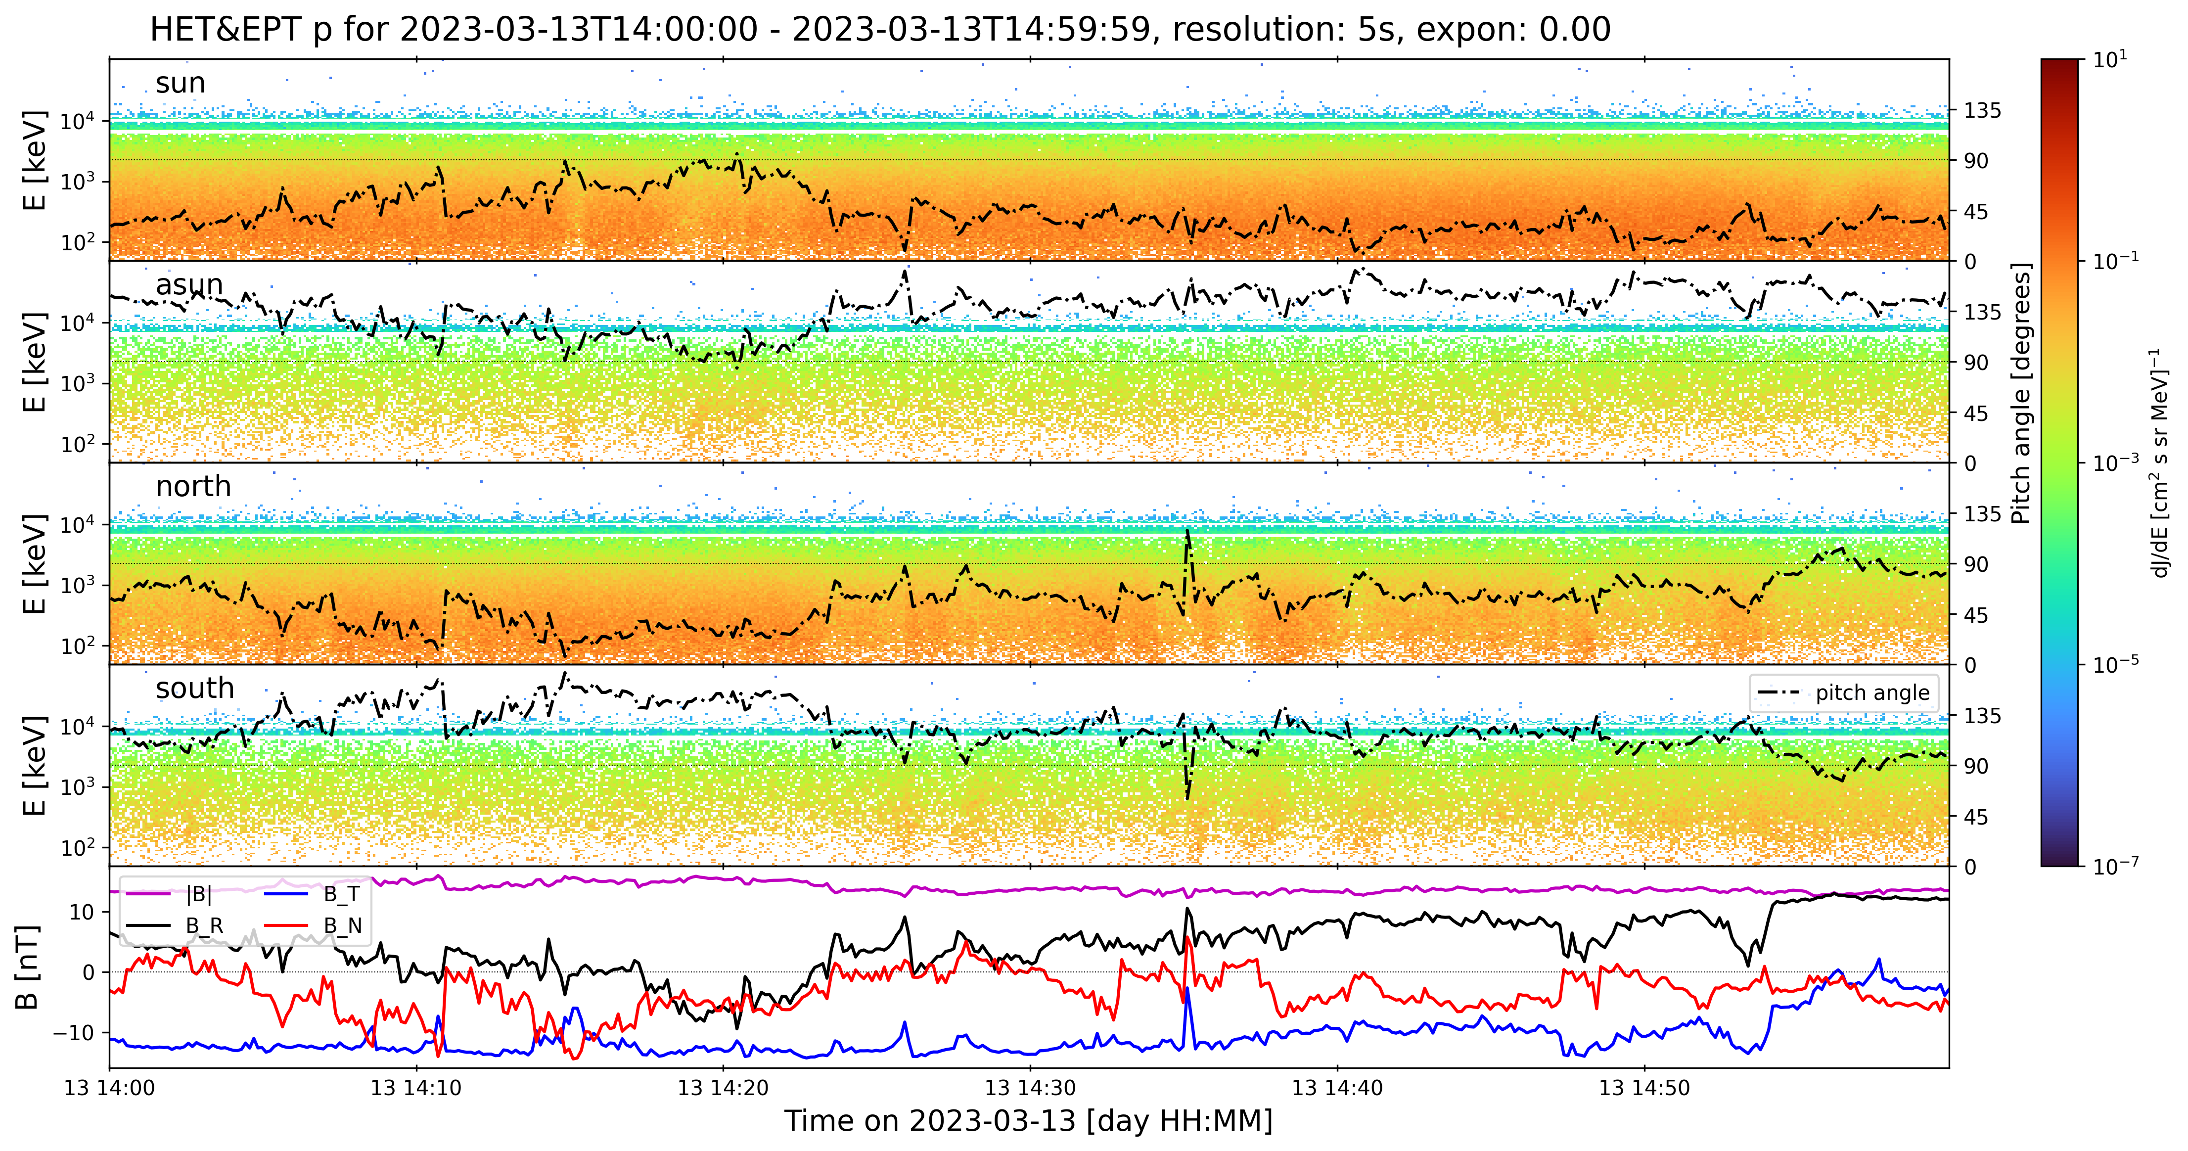

Slide 17
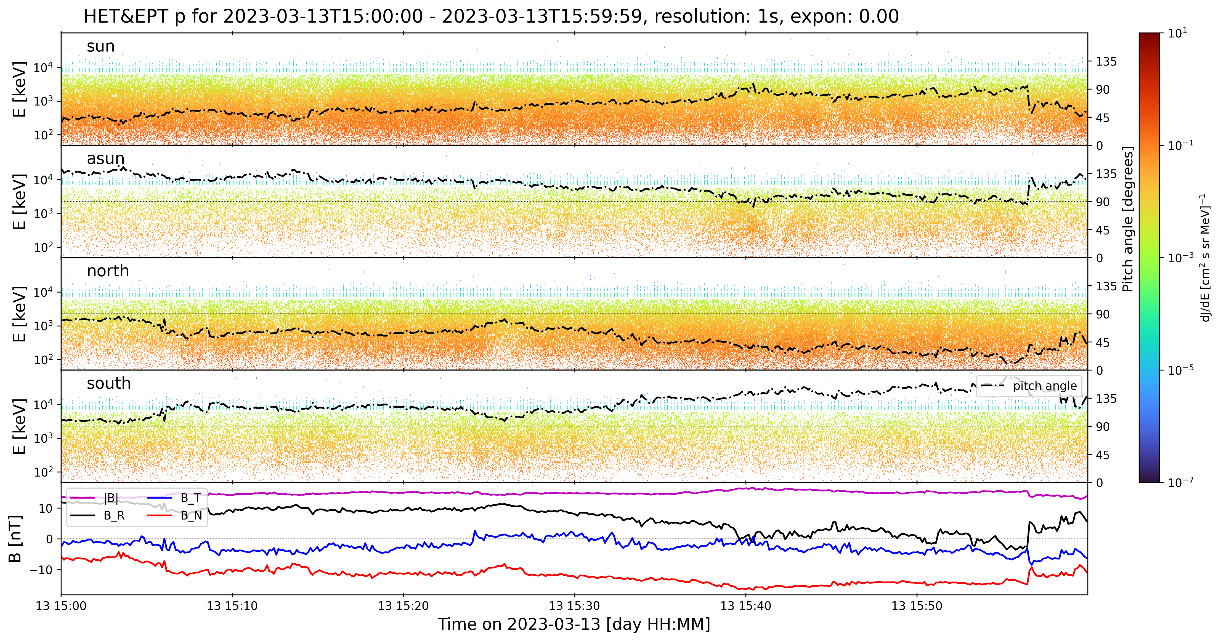

Slide 18
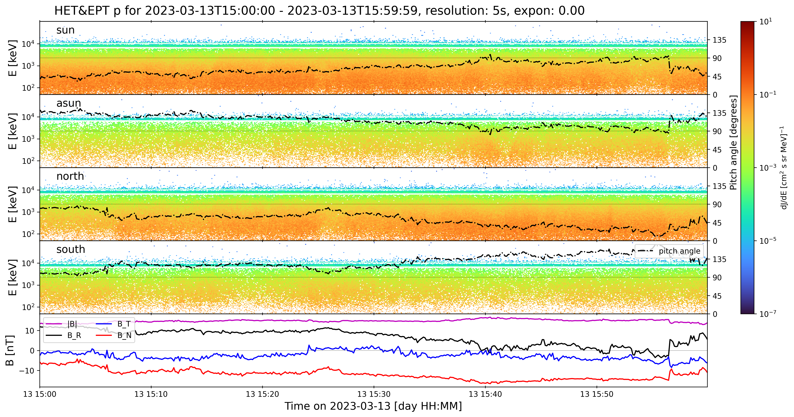

Slide 19
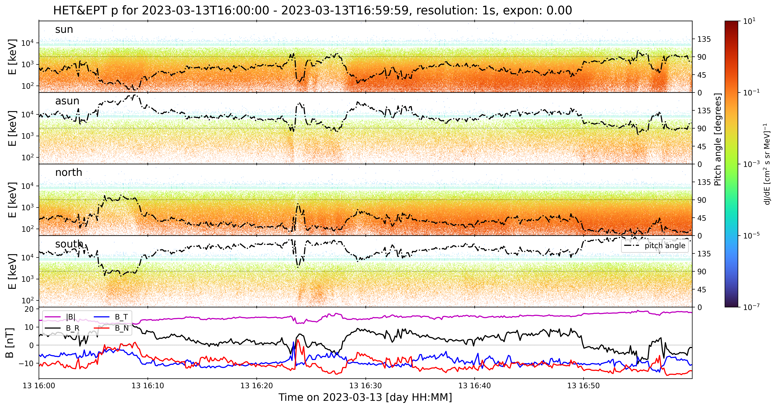

Slide 20
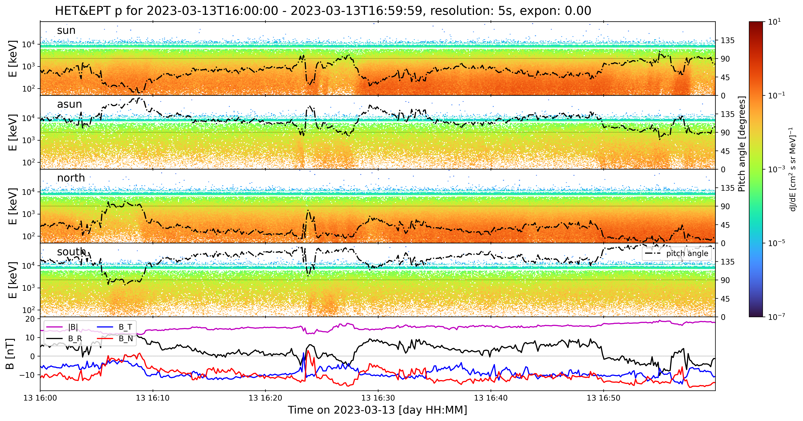

Slide 21
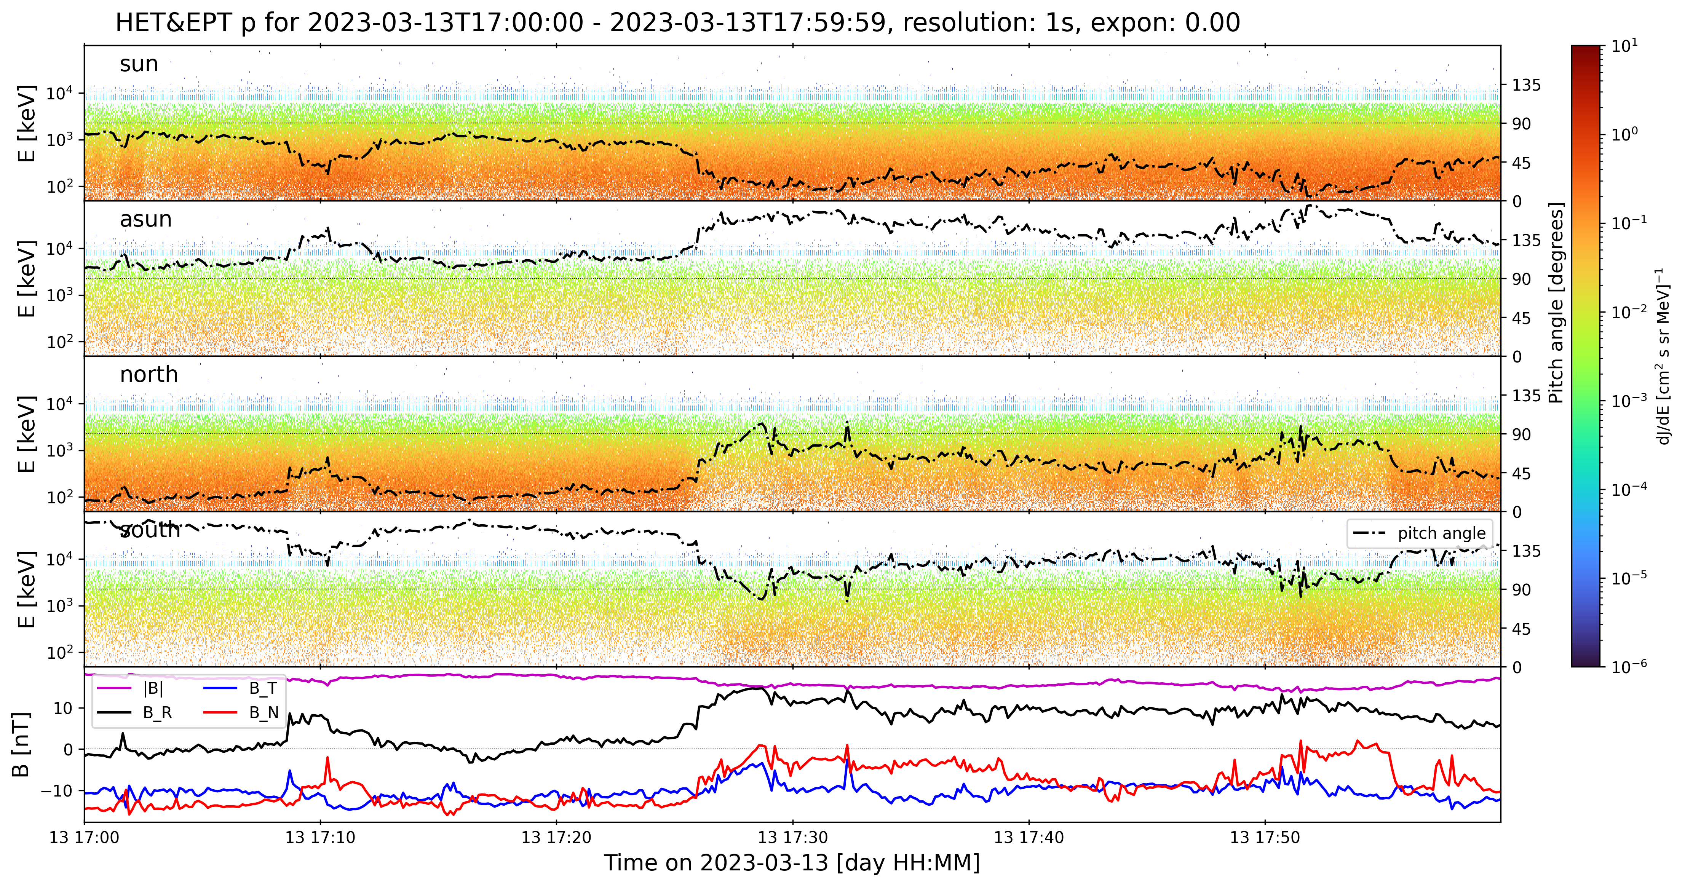

Slide 22
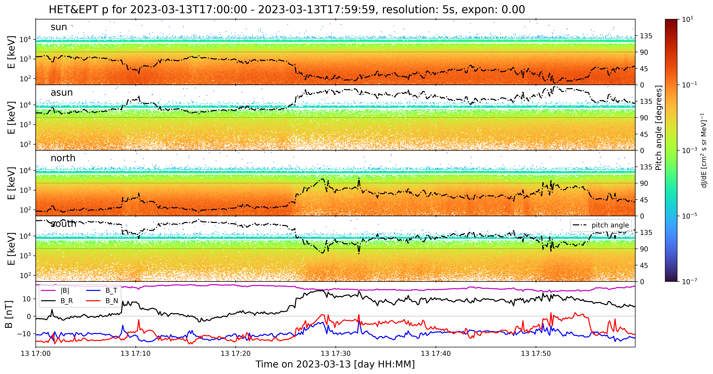

Slide 23
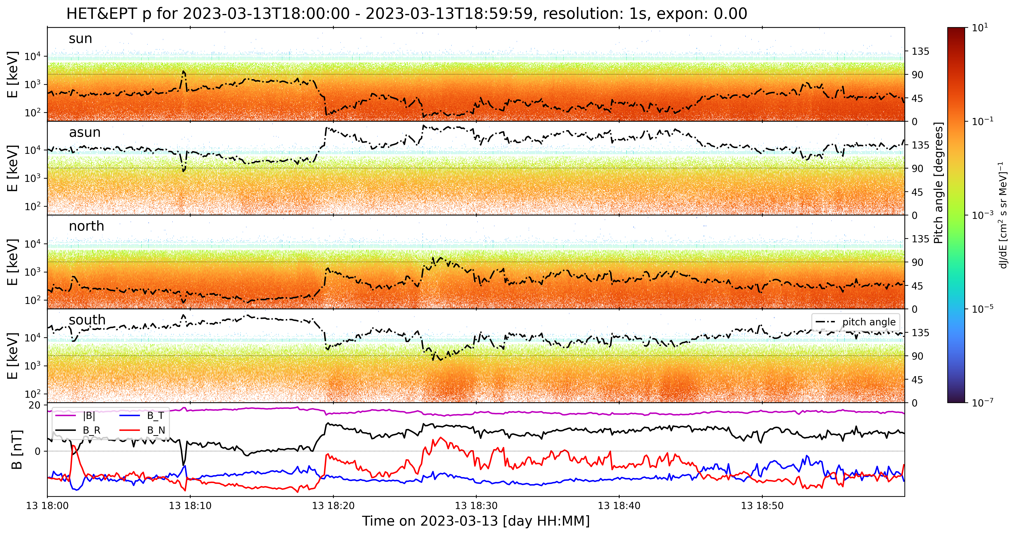

Slide 24
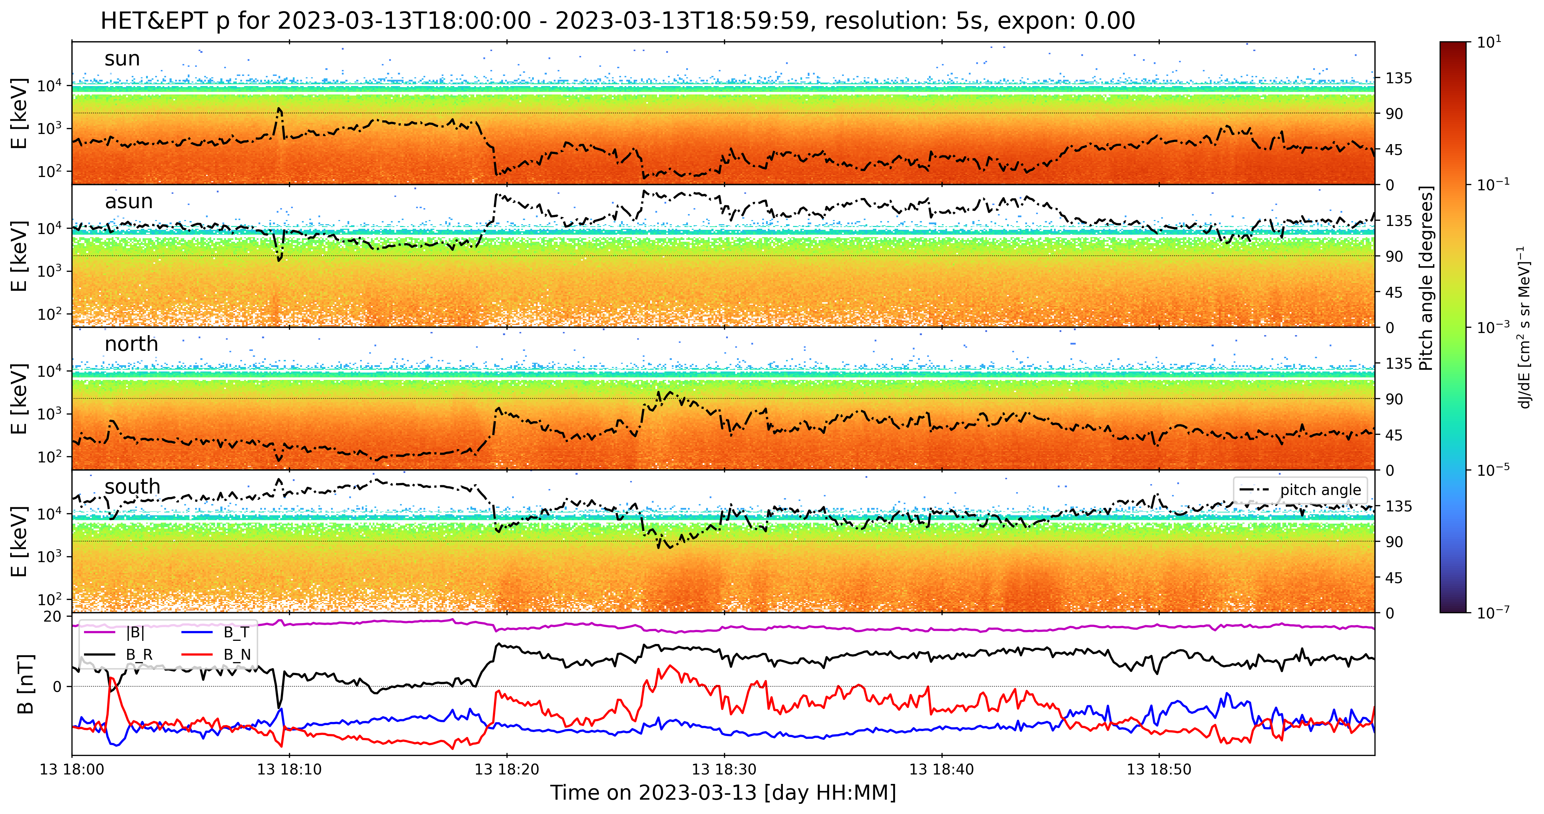

Slide 25
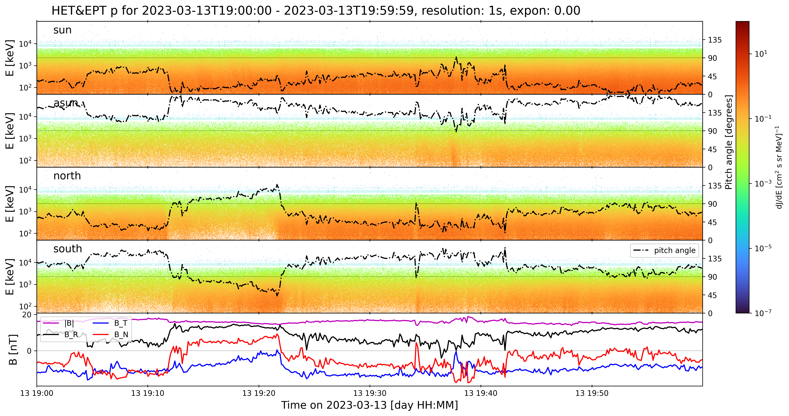

Slide 26
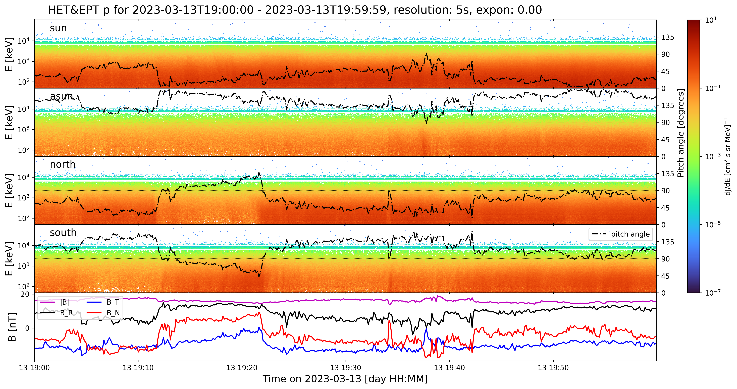

Slide 27
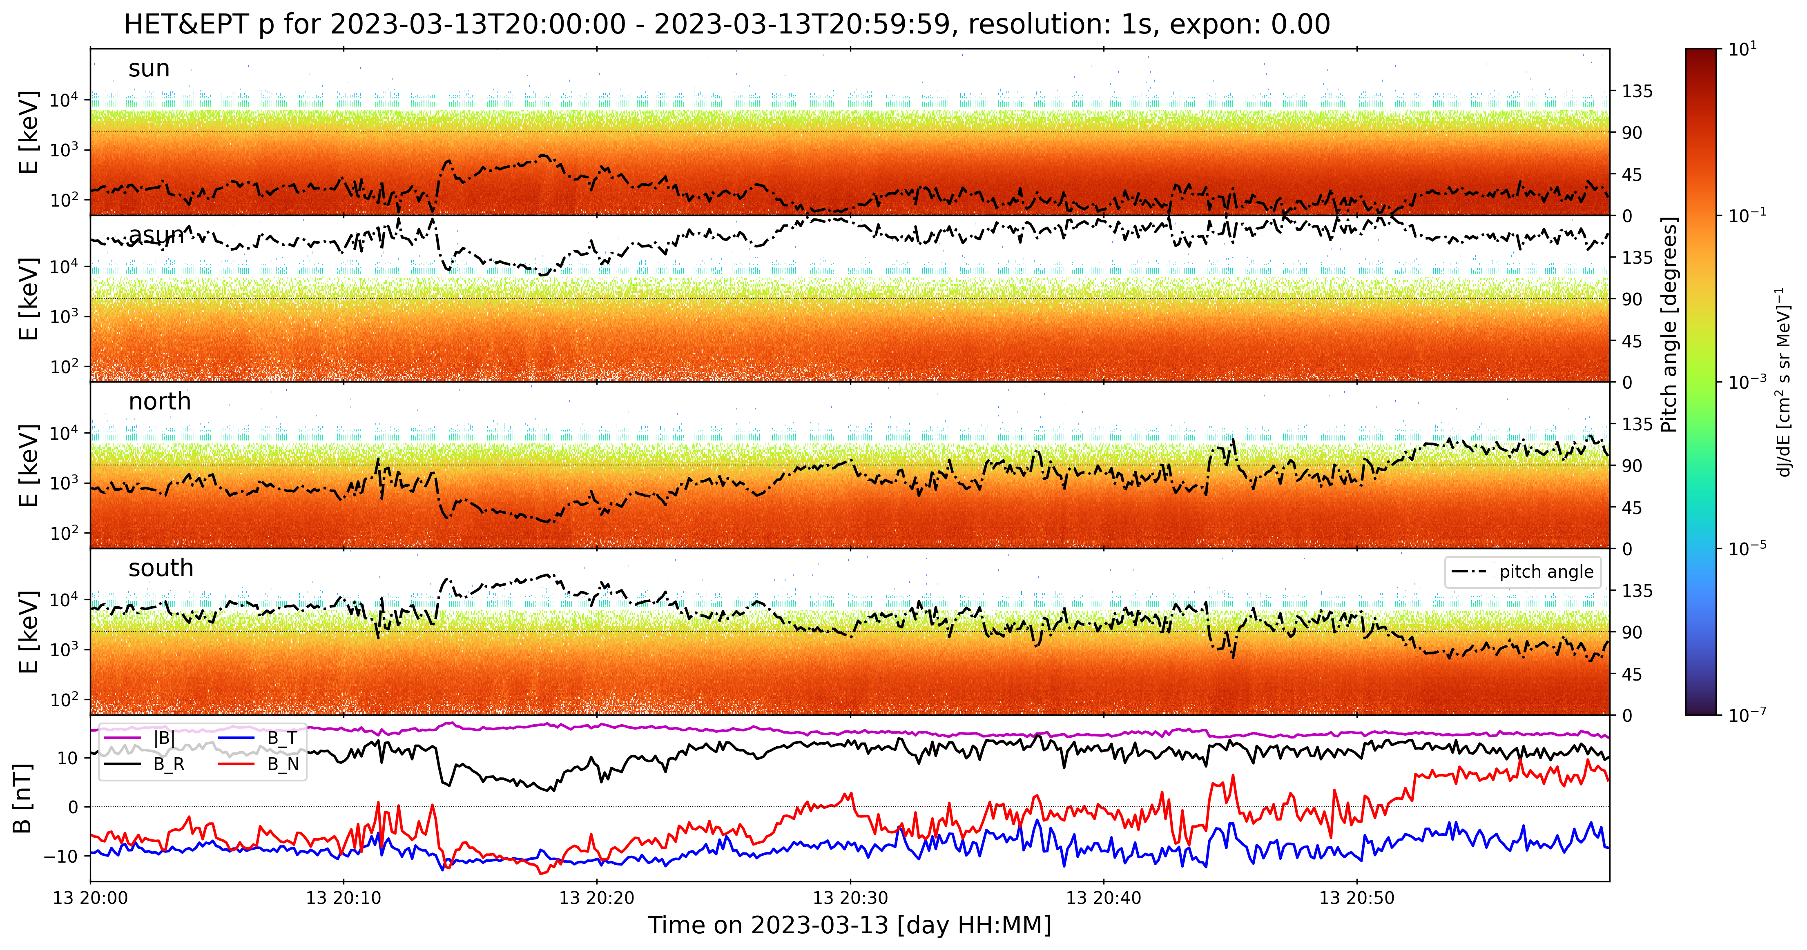

Slide 28
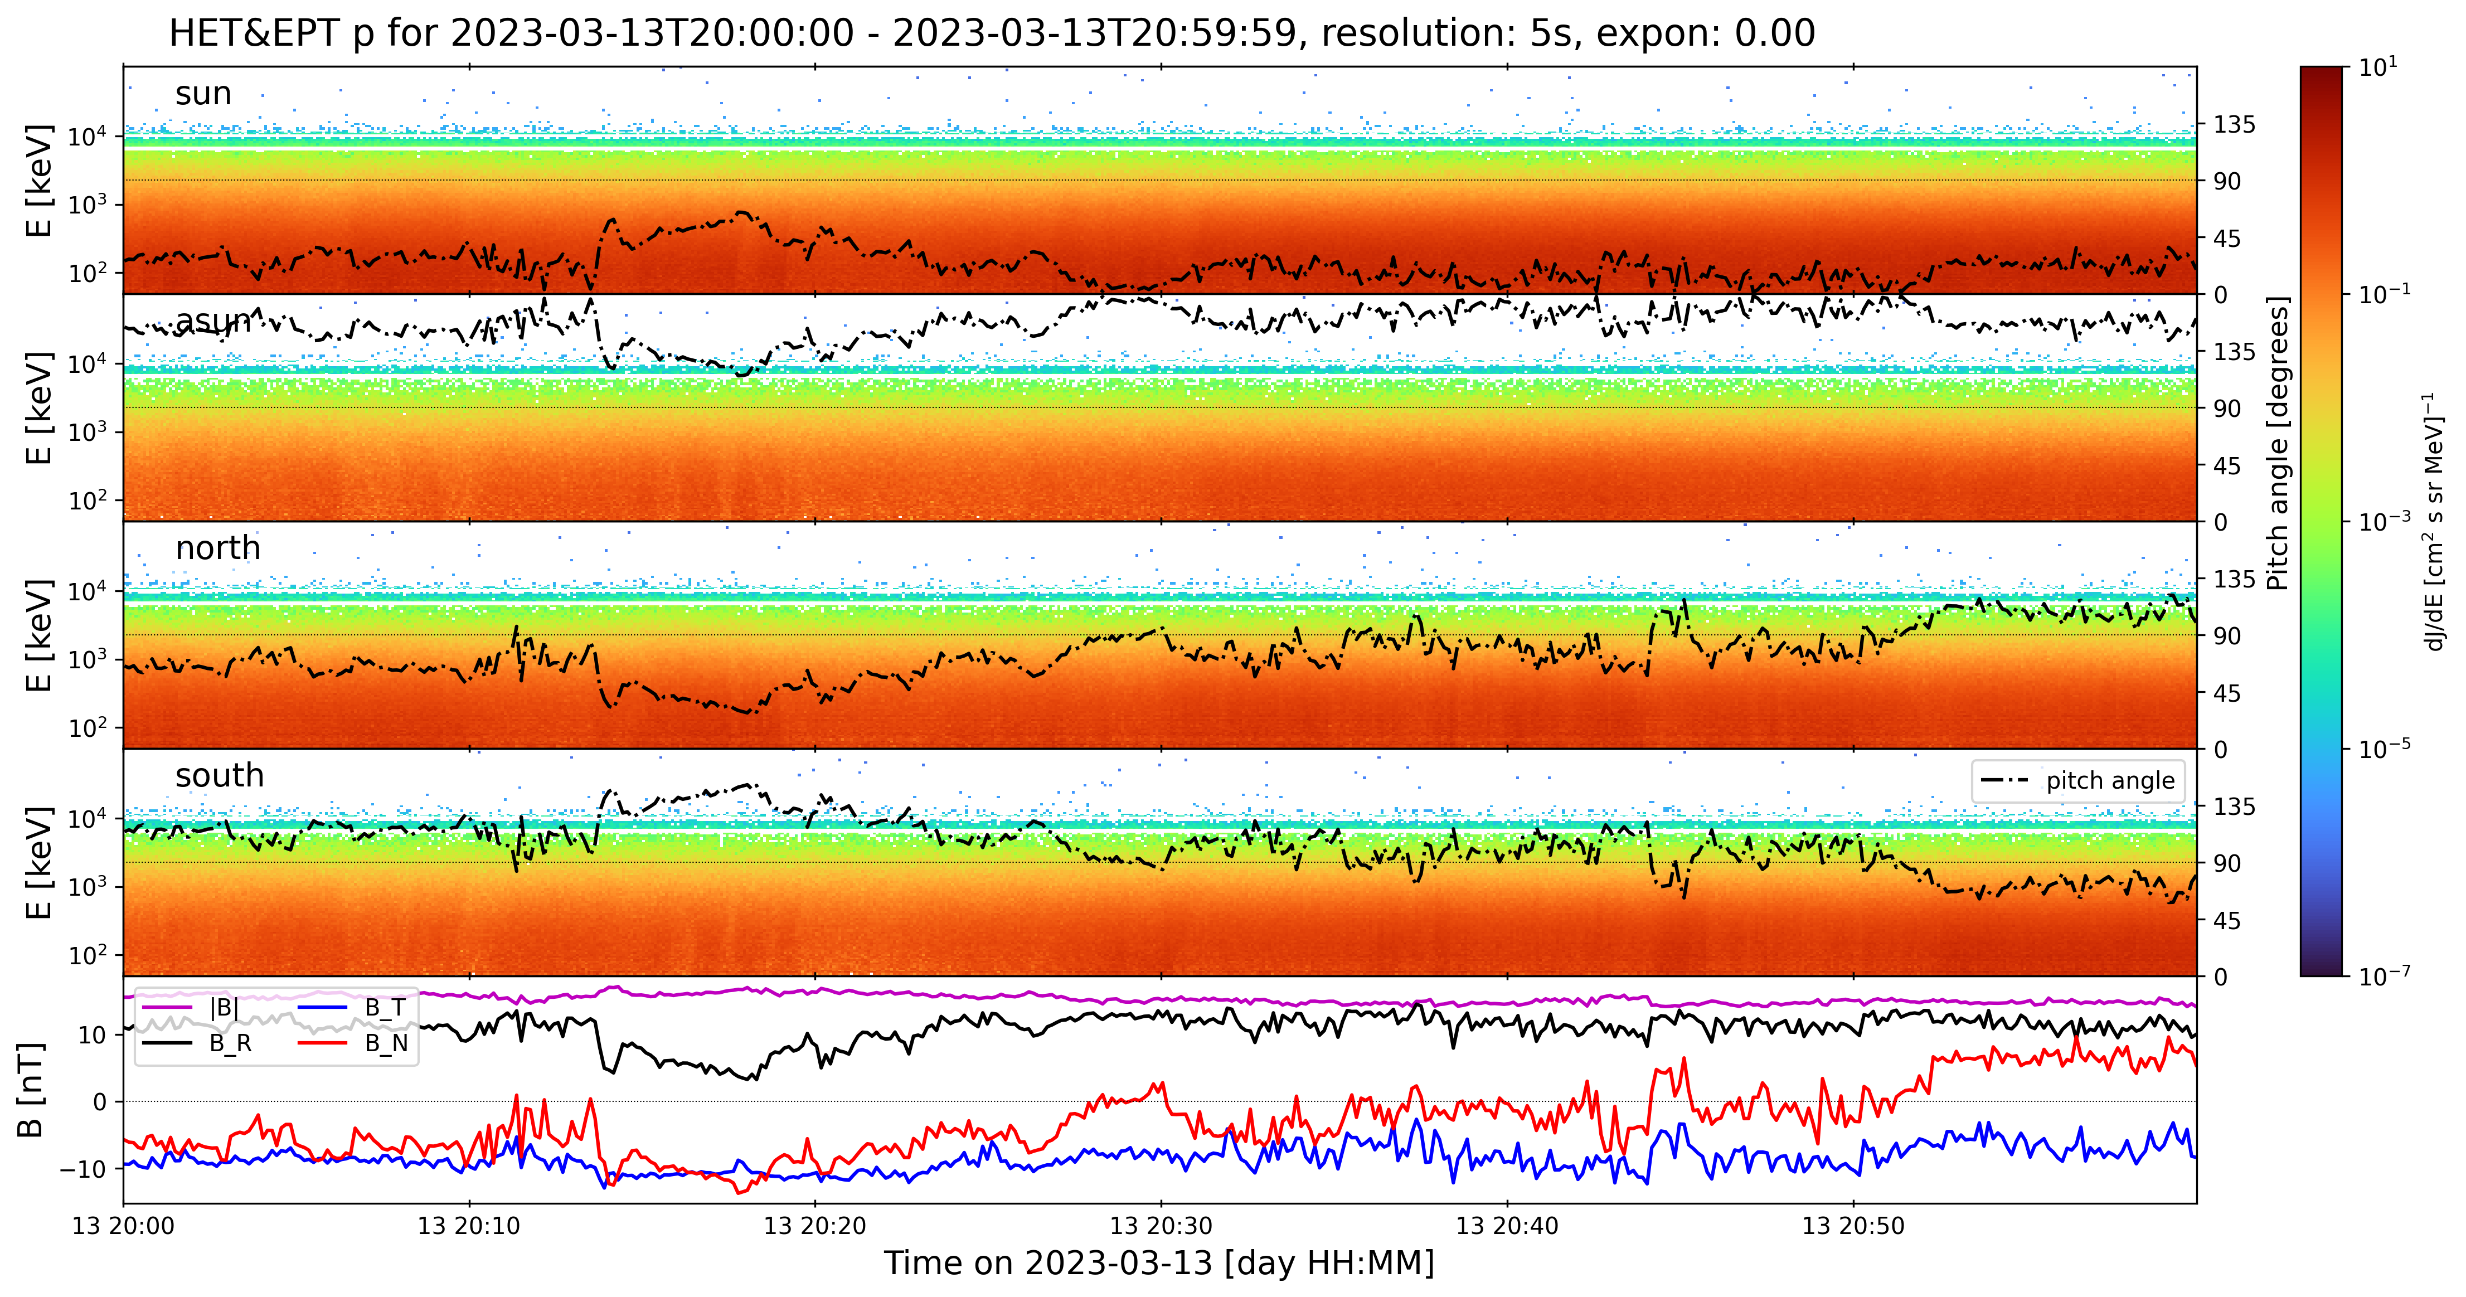

Slide 29
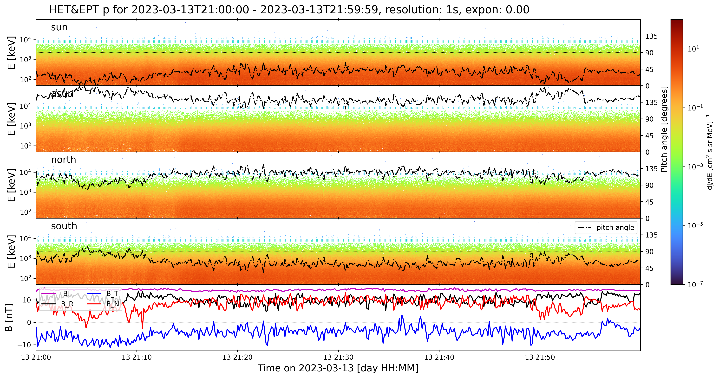

Slide 30
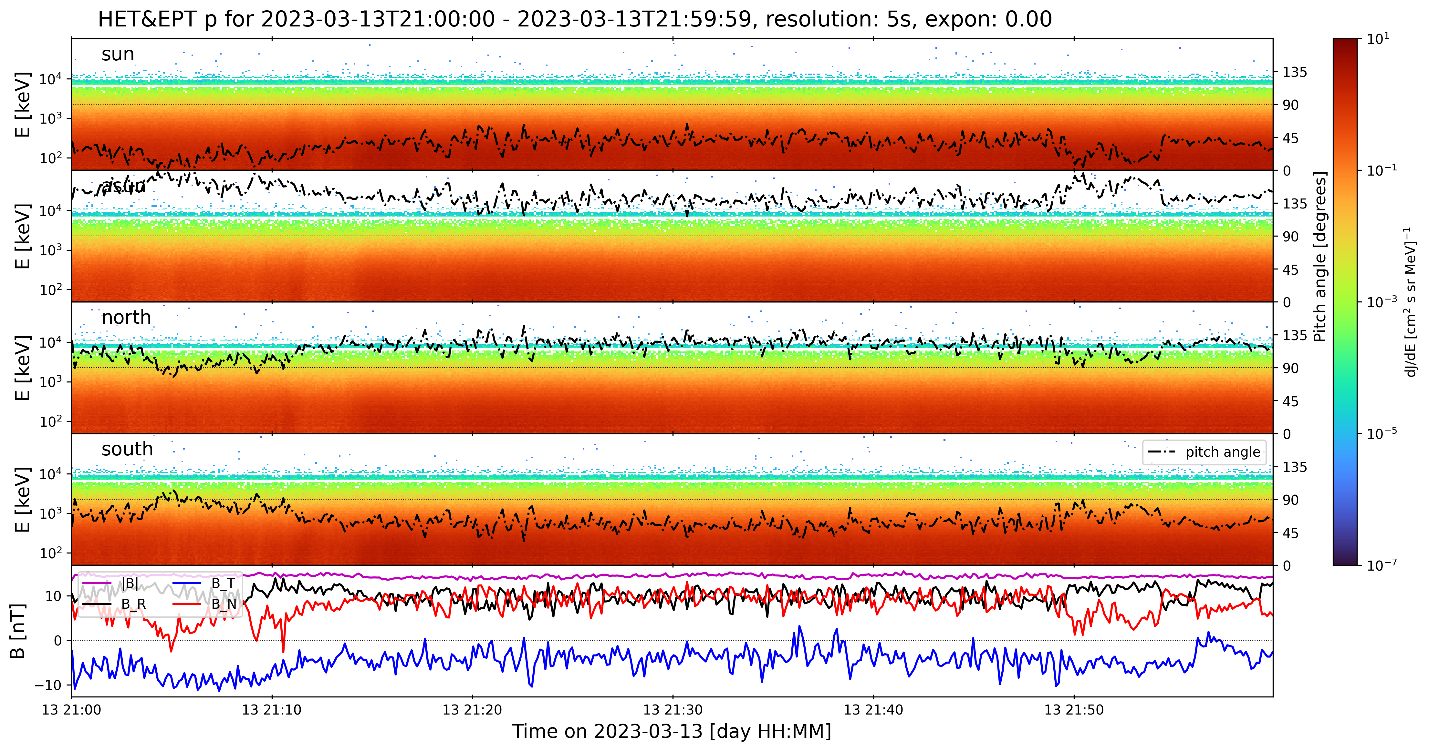

Slide 31
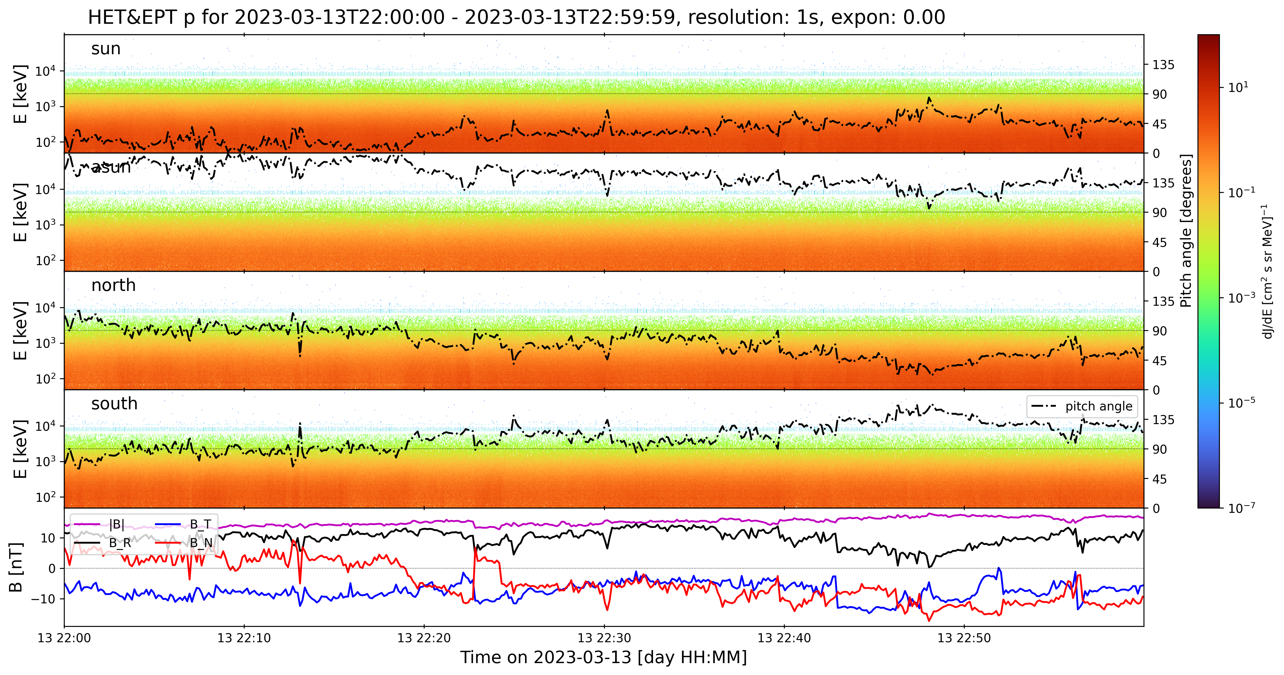

Slide 32
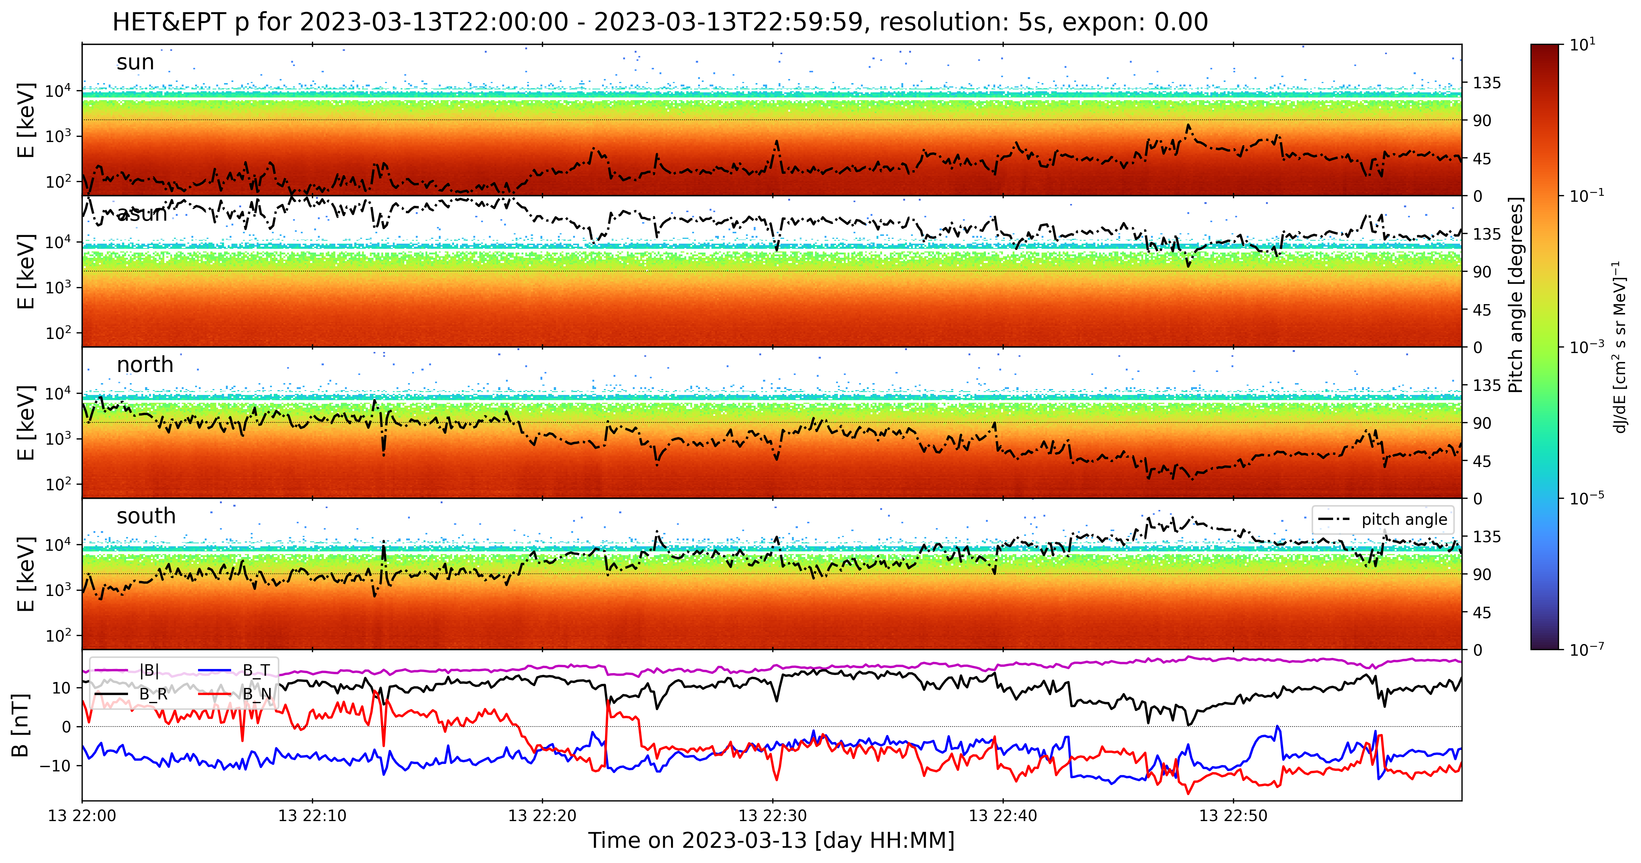

Slide 33
Some interesting time periods

Slide 34
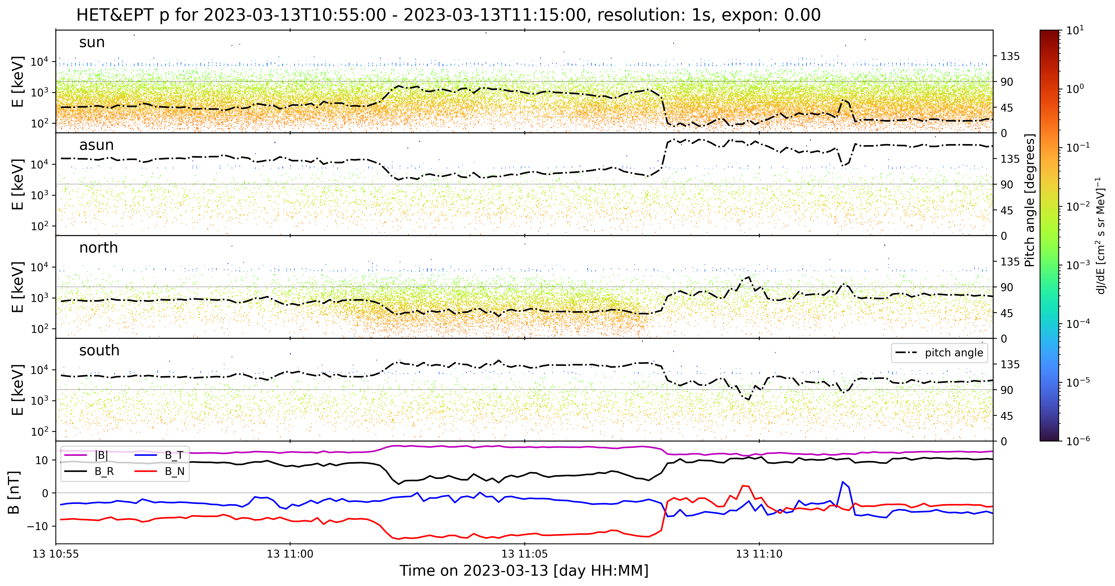
Increased intensity w/o change of pitch angle?
Is this slanted?

Slide 35
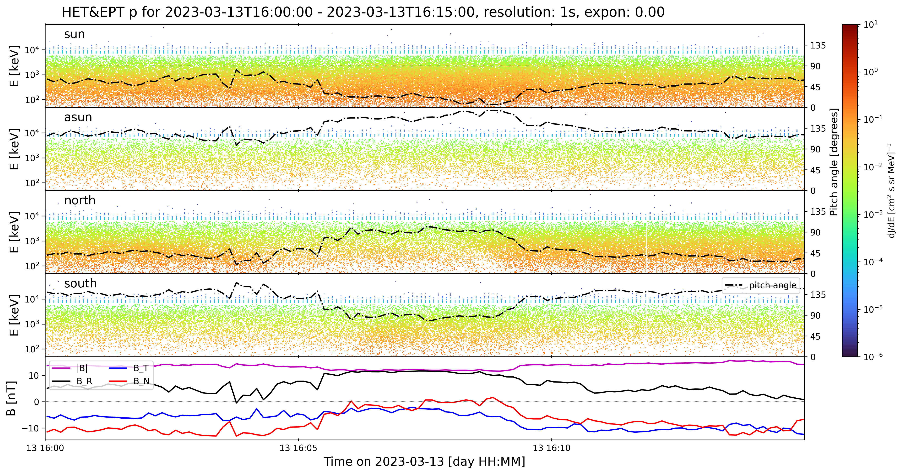
90° pitch angle
But different behavior
90° pitch angle

Slide 36
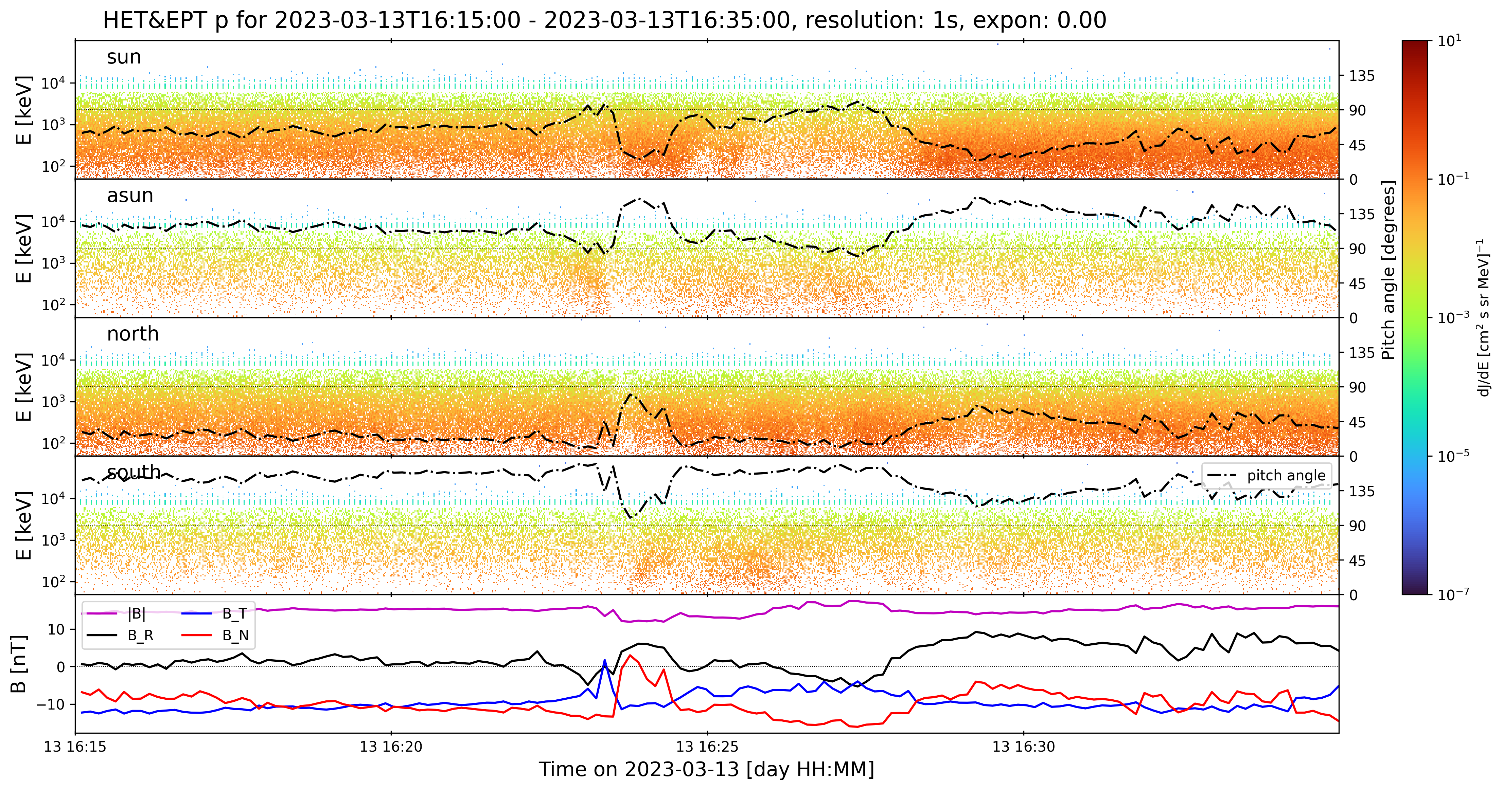

Slide 37
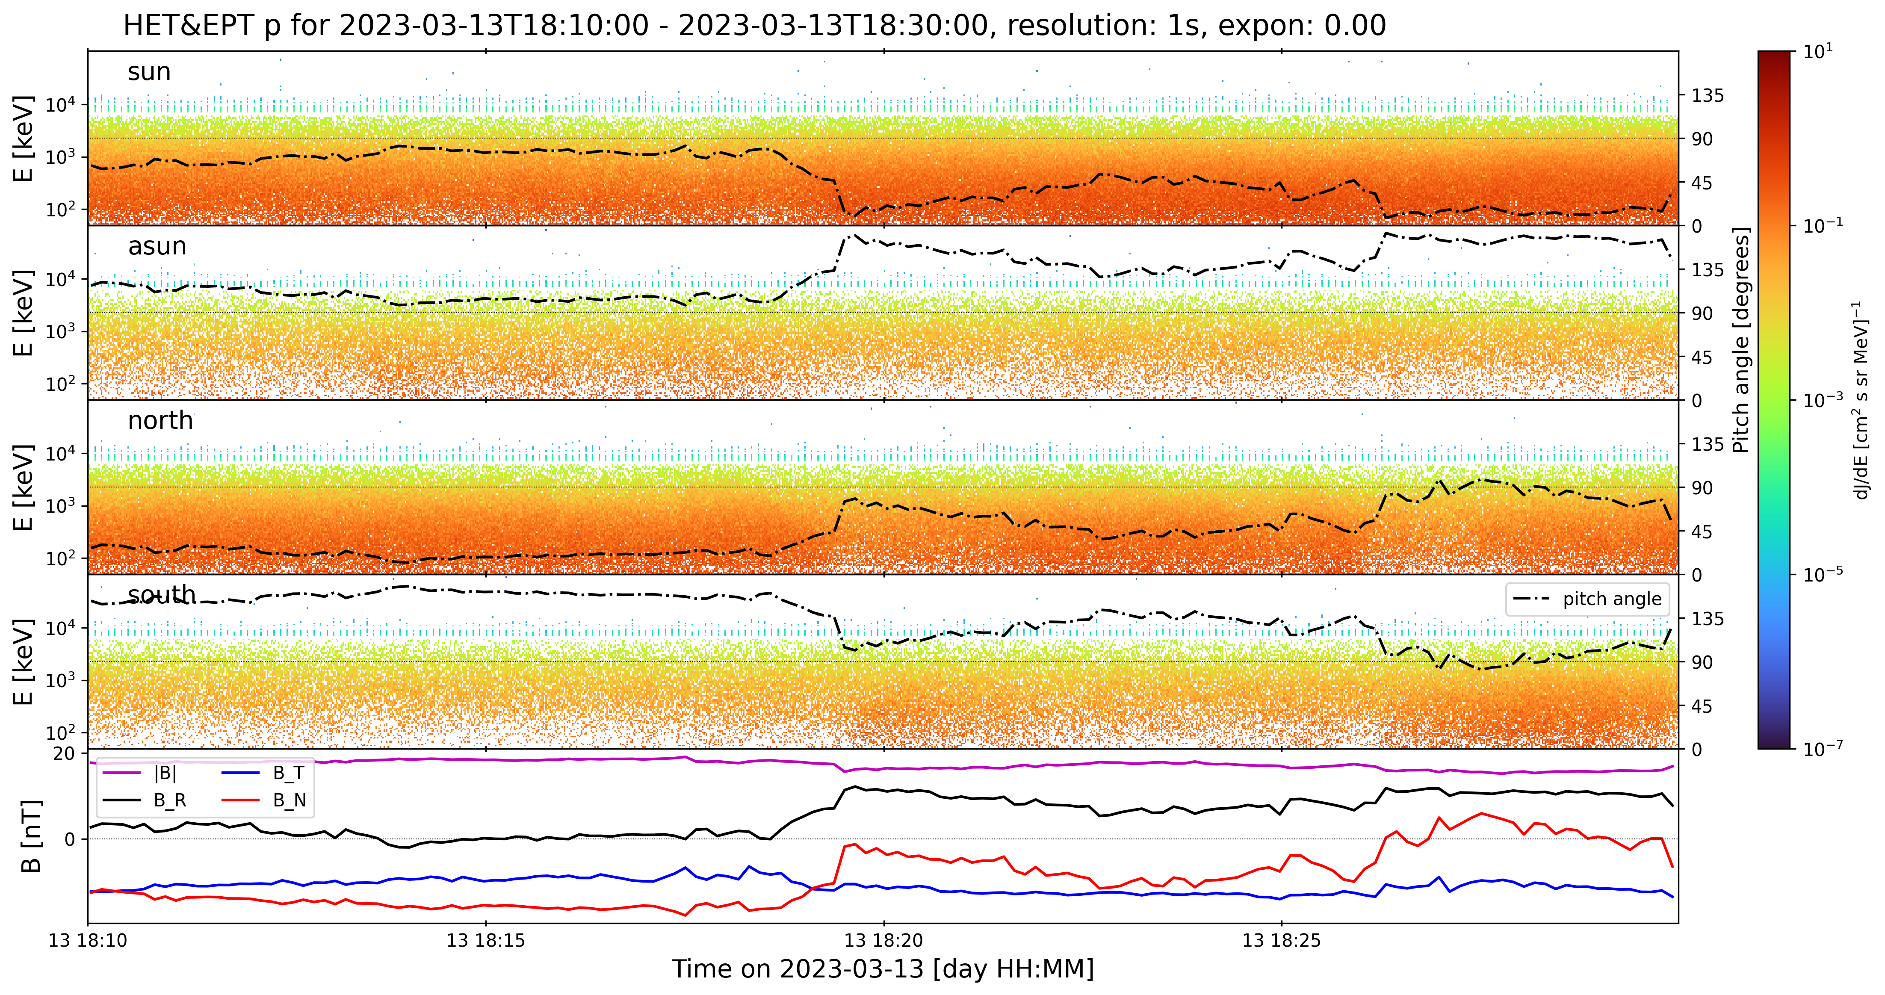
Large change in pitch angle w/o significant change in intensity
Similar intensity as north
Lower intensity than sun
Similar intensity as sun
Lower intensity than sun
Limited pitch-angle scattering across 90 degrees?

Slide 38
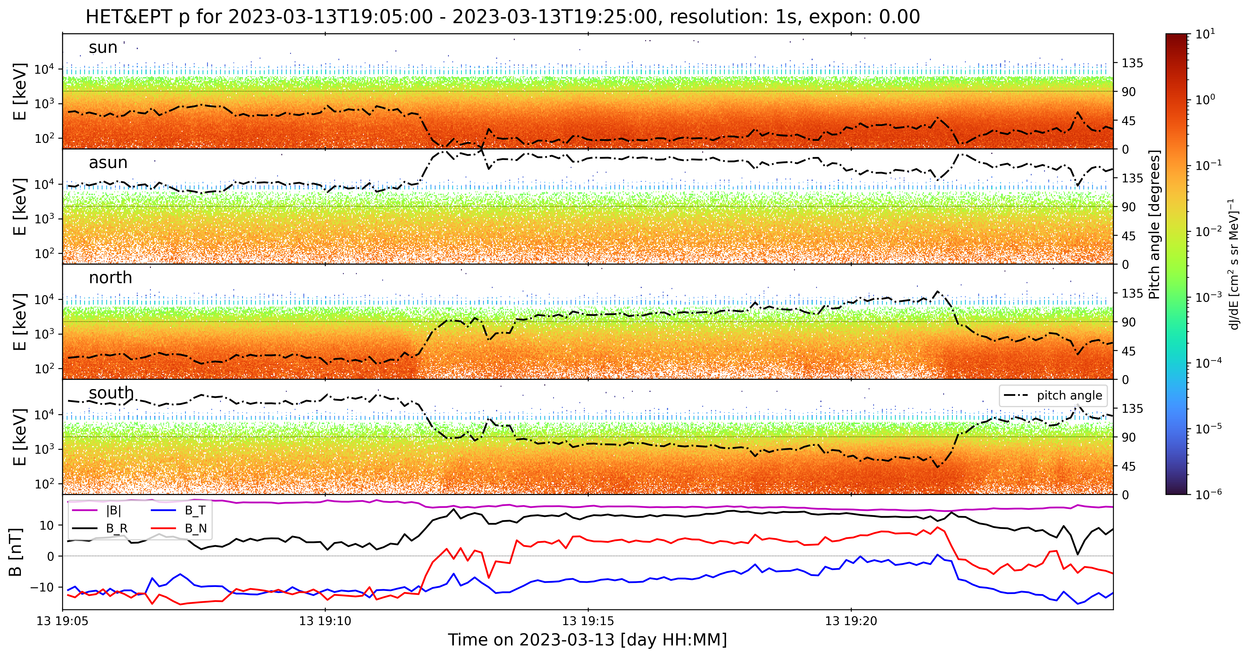
Limited pitch-angle scattering across 90 degrees?

Slide 39
Was this a lesson in apophenia?
Apophenia describes the human habit to unreasonably look for and recognize patterns in random information.
This can also occur in Solar Orbiter data from EPD.
Most weird patterns are explained by variations in pitch angle and probably by limited counting statistics. How probable is it to see a “line” or any pattern in randomly distributed data?
Need to compute the probability of seeing “something like this”, but then: (see next page)

Slide 40
