Slide 1





First data from Solar Orbiter‘s Energetic Particle Detector (EPD)
Robert F. Wimmer Schweingruber¹, Javier Rodríguez-Pacheco², George Ho³, Daniel Pacheco¹, Lars Berger¹, Johan Lauritz Freiherr von Forstner¹, Raul Gomez-Herrero², Glenn M. Mason³, Sandra Eldrum¹, Alexander Kollhoff¹, Zigong Xu¹, Robert Colby Allen³ on behalf of the Solar Orbiter EPD Team
& Helen O'Brien⁴, Vincent Evans⁴, Virginia Angelini⁴ & Tim Horbury⁴ for the MAG team
¹University of Kiel, Institute for Experimental and Applied Physics, Kiel, Germany, ²University of Alcalá, Space Research Group, Alcalá de Henares, Spain, ³Johns Hopkins University Applied Physics Laboratory, Laurel, MD, United States, VImperial College, London, UK
Notes:
1

Slide 2
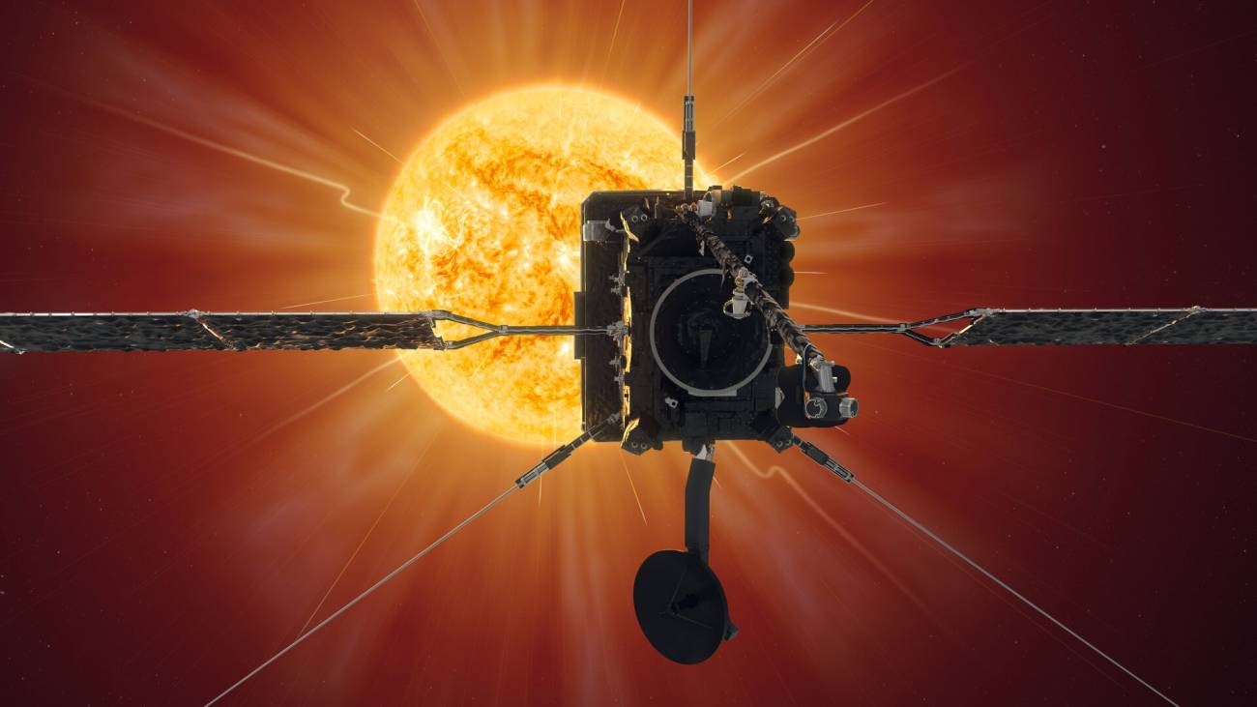
SEPs key science questions
How do solar eruptions produce energetic particle radiation that fills the heliosphere?
What do we need?
  Get close to the Sun
  Comprehensive energetic particle instrumentation with:
    Broad energy range and composition coverage (including suprathermal particles)
    High time resolution
    Directional (pitch-angle) information
  Supplementary remote sensing measurements
This can be broken down
into three topics:
  SEP seed populations
  Injection, acceleration and
release processes of SEPs
  SEP transport
AGU 2020
1
Notes:
1

Slide 3
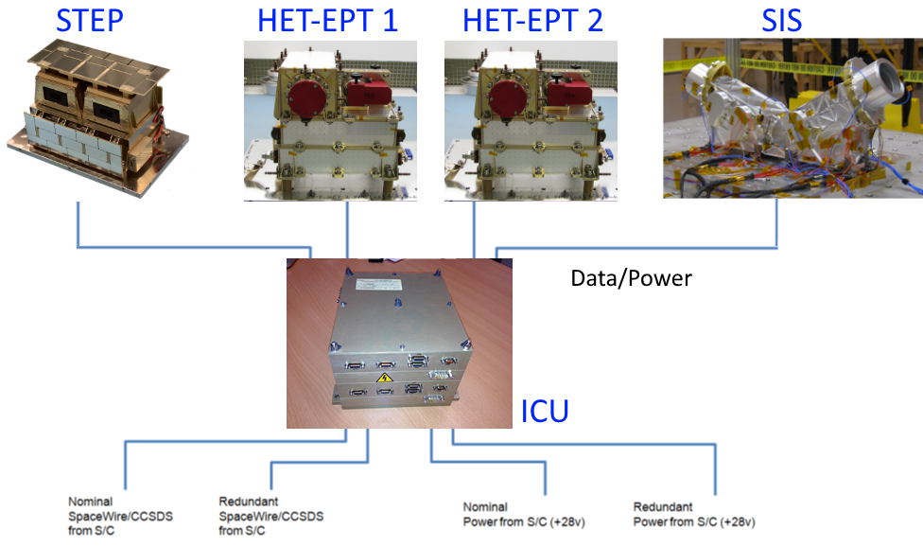
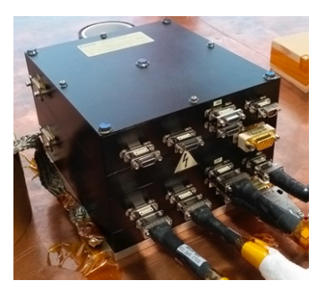
EPD System Architecture
STEP: SupraThermal Electrons and Protons.
SIS: Suprathermal Ion Spectrograph.
EPT/HET: Electron Proton Telescope/High Energy Telescope.
ICU: Instrument Control Unit
AGU 2020
1
Notes:
1

Slide 4
EPD System Architecture
SH039-05, SH049-0004
SH036-0008
SH039-04
SH035-09, SH035-10, SH036-0006
SH036-0007,
SH039-06
SH036-0009
STEP: SupraThermal Electrons and Protons.
SIS: Suprathermal Ion Spectrograph.
EPT/HET: Electron Proton Telescope/High Energy Telescope.
ICU: Instrument Control Unit
SH036-0010
AGU 2020
1
Notes:
1

Slide 5
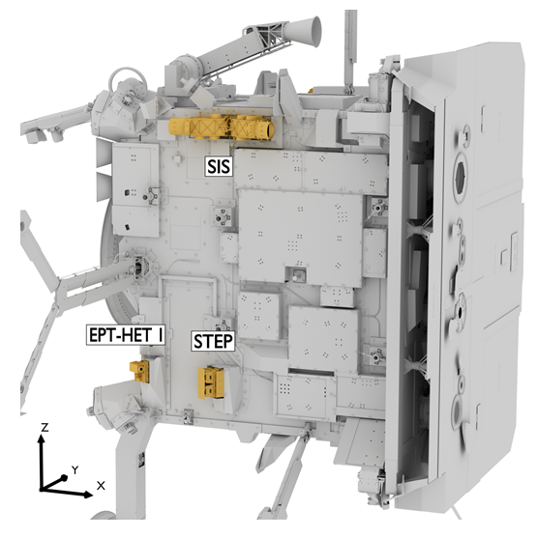
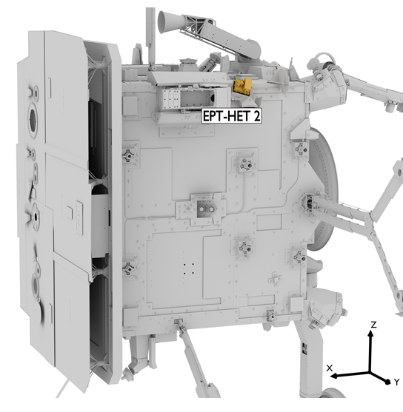
EPD Accommodation on the Spacecraft:
Time resolution:
STEP: SupraThermal Electrons and Protons. Up to 1s
SIS: Suprathermal Ion Spectrograph. Up to 3s
EPT/HET: Electron Proton Telescope/High Energy Telescope. Up to 1s
AGU 2020
1
Notes:
1

Slide 6
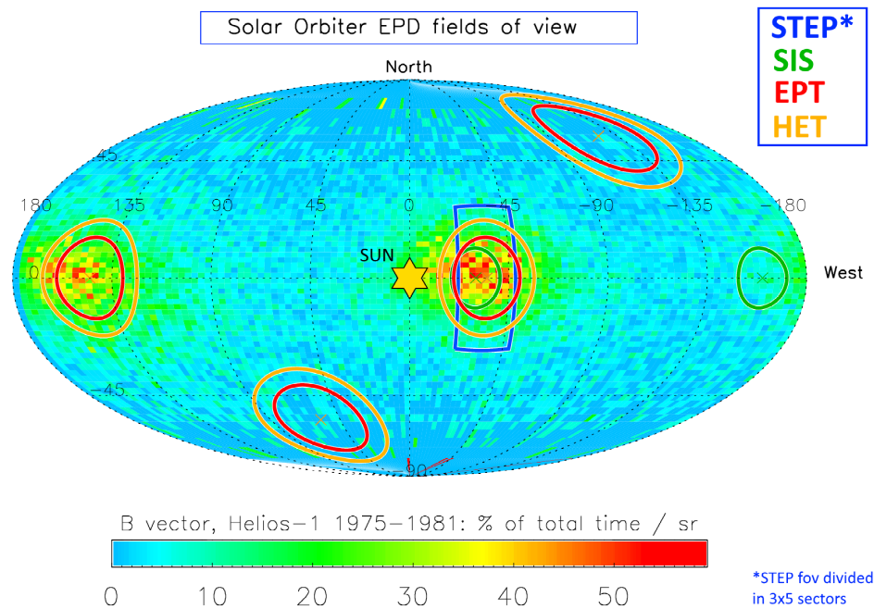
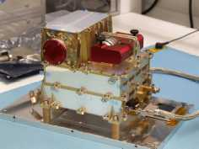
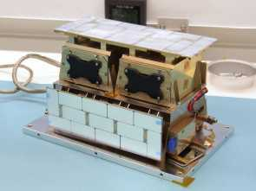
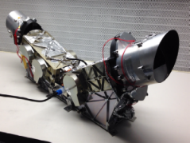
EPD Fields of View
EPT-HET-2
STEP
SIS
EPT-HET-1
AGU 2020
1
Notes:
1

Slide 7
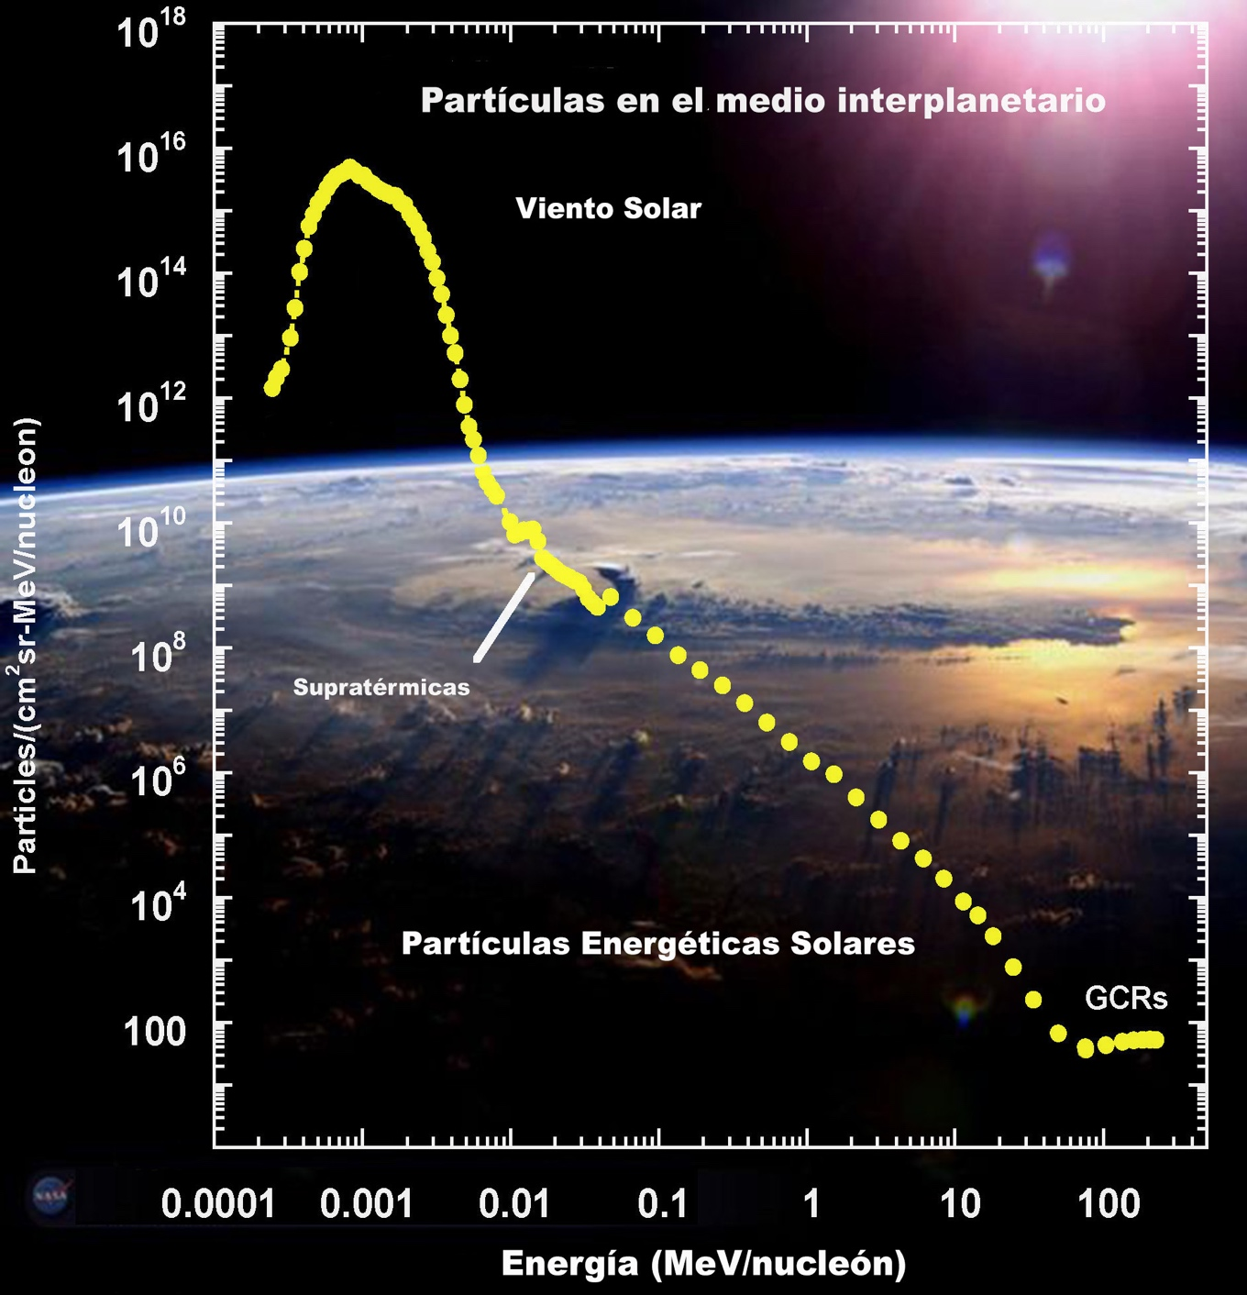
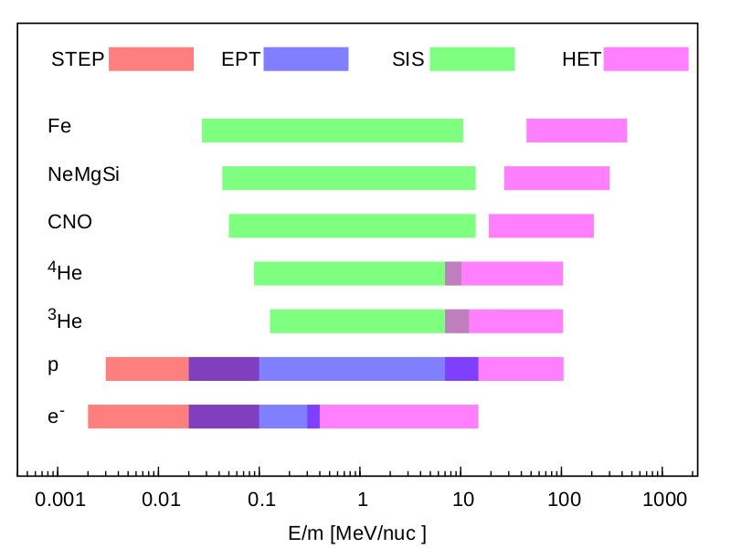
EPD Energy Range
Wide energy/composition coverage to study different heliospheric particle populations
AGU 2020
1
Notes:
1

Slide 8
SEPs key science questions
How do solar eruptions produce energetic particle radiation that fills the heliosphere?
What do we need?
  Get close to the Sun ✔
  Comprehensive energetic particle instrumentation with:
    Broad energy range and composition coverage (including suprathermal particles) ✔
    High time resolution ✔
    Directional (pitch-angle) information ✔
  Supplementary remote sensing measurements ✔
This can be broken down
into three topics:
  SEP seed populations
  Injection, acceleration and
release processes of SEPs
  SEP transport
STIX synoptic measurements
AGU 2020
1
Notes:
1

Slide 9
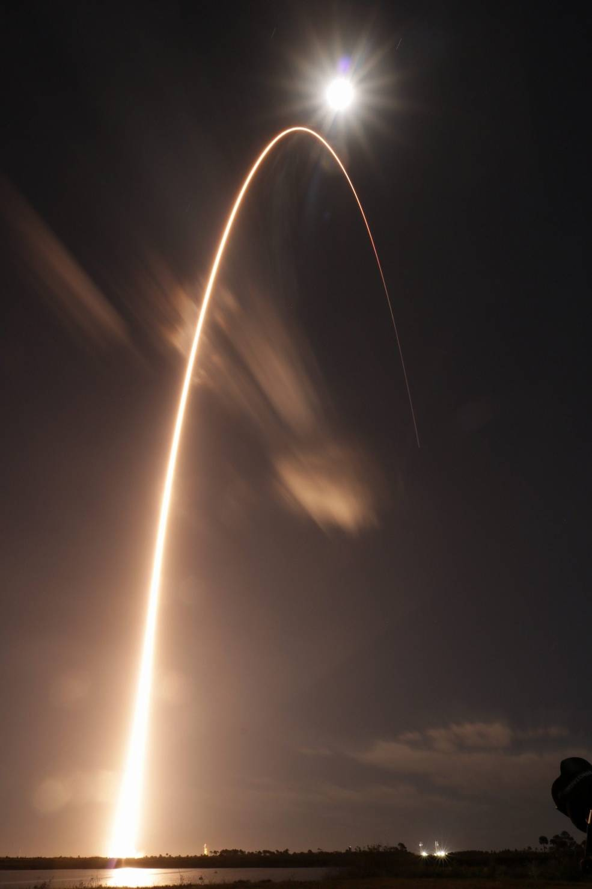
Solar Orbiter
Launched February 10, 2020 @ 04:03 UT
Ten instruments: 6 remote and 4 in situ
Closest perihelion 0.28 au
Out of the ecliptic measurements
Cruise phase until Nov. 2021
Only in situ instruments are currently switched on during cruise phase (but STIX will be fully operative soon)
AGU 2020
1
Notes:
1

Slide 10
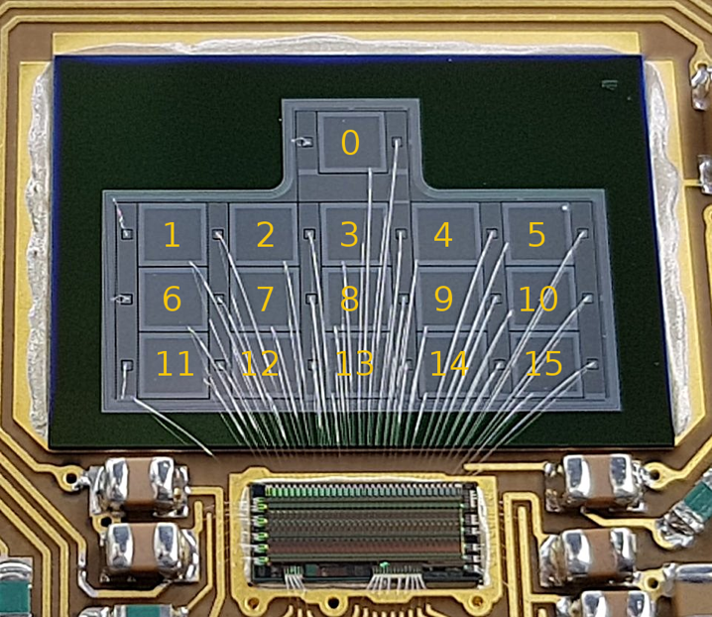
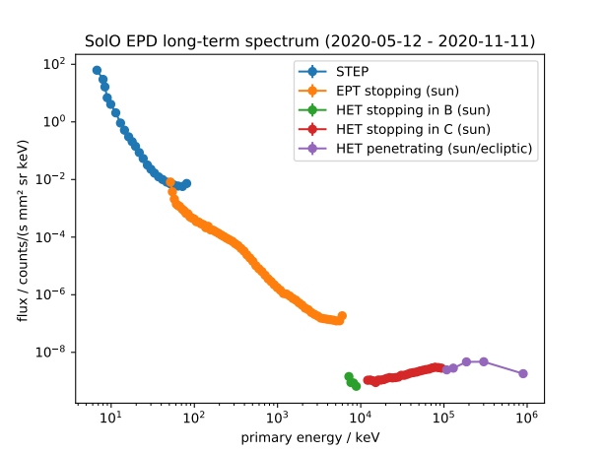
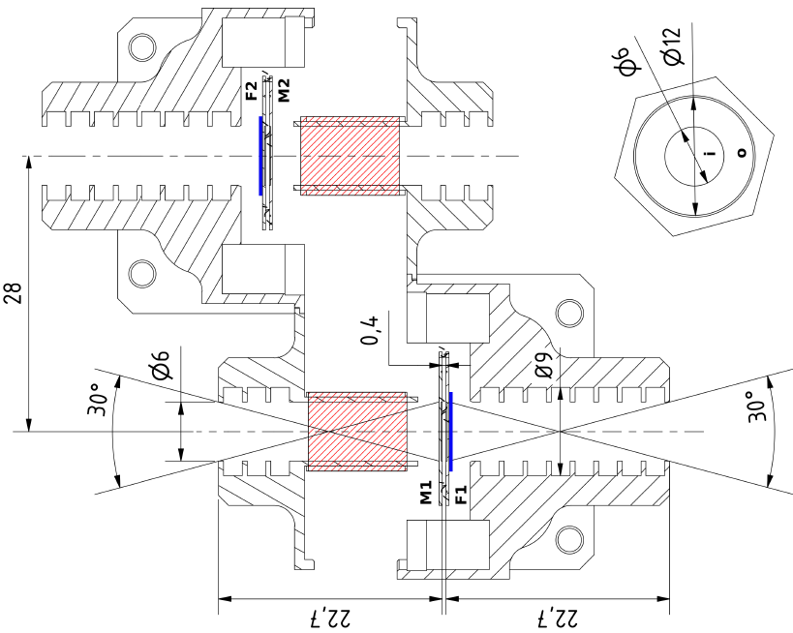
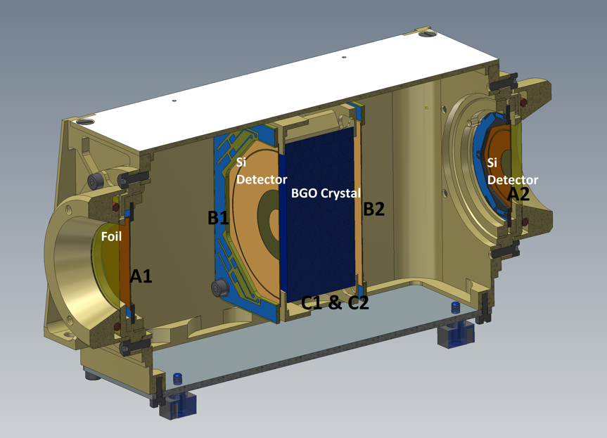
EPD long-term spectrum
Long-term spectrum dominated by GCR background
AGU 2020
1
Notes:
1

Slide 11
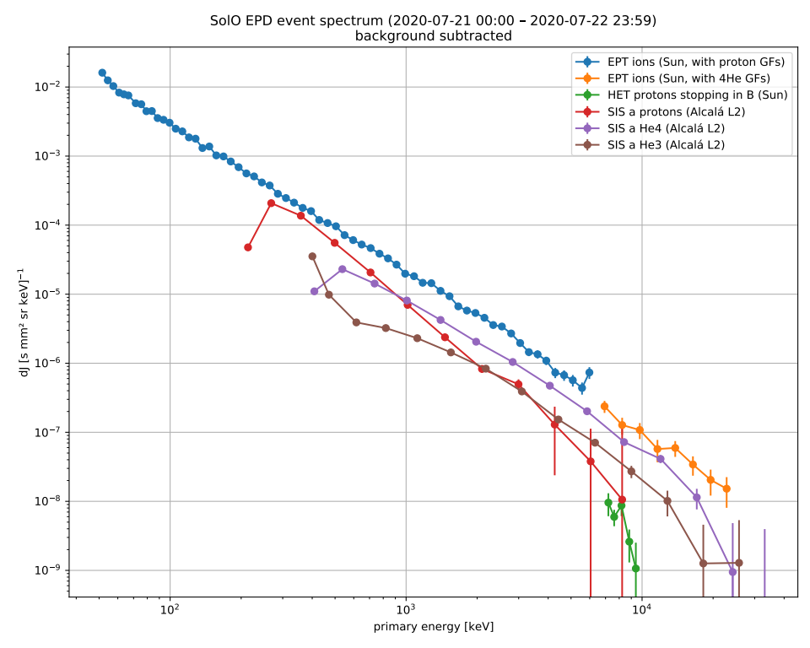
EPD long-term spectrum
Long-term spectrum dominated by GCR background
STEP bkgnd: single detector, small pixels
EPT bkgnd: comparable to SEPT on STEREO
EPT penetrating DPs don‘t match up with HET
HET/EPT: do spectra line up“?
SH036-0009
SH036-0007, SH035-10, SH036-0006
AGU 2020
1
Notes:
1

Slide 12
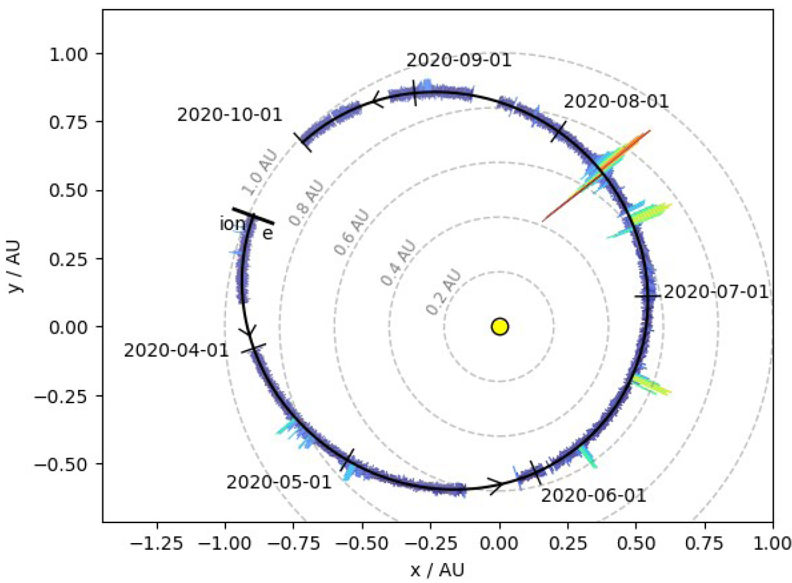
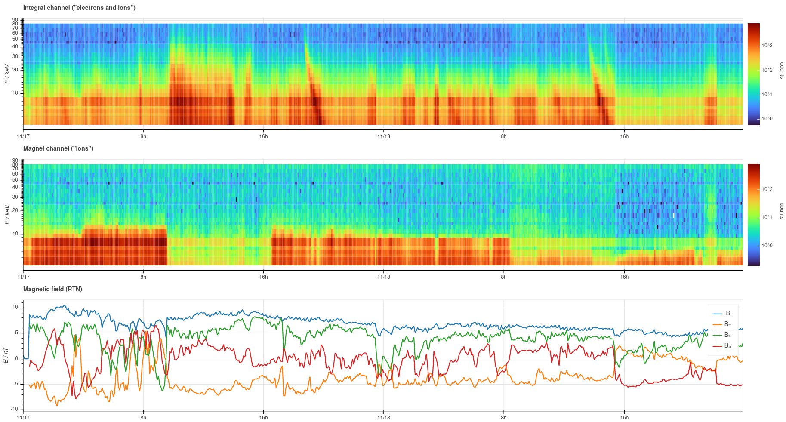
EPD proton (ion) and electron observations March 1 – September 30 and beyond...
High variability of suprathermal ions below 20 keV
Some ion increases from several tens to several hundreds of keV (some associated with SIRs, few SEPs, other events under study)
SH036-0008
AGU 2020
1
Notes:
1

Slide 13
EPD proton (ion) and electron observations March 1 – September 30 and beyond...
November 17 & 18
Ion dropouts: IMF!
Electrons:
Injections
Velocity dispersion
Dropouts
AGU 2020
1
Notes:
<number>

Slide 14
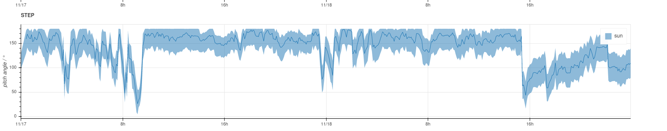
EPD proton (ion) and electron observations March 1 – September 30 and beyond...
November 17 & 18
Ion dropouts: IMF!
Electrons:
Injections
Velocity dispersion
Dropouts
STEP pitch-angle
coverage
AGU 2020
1
Notes:
<number>

Slide 15
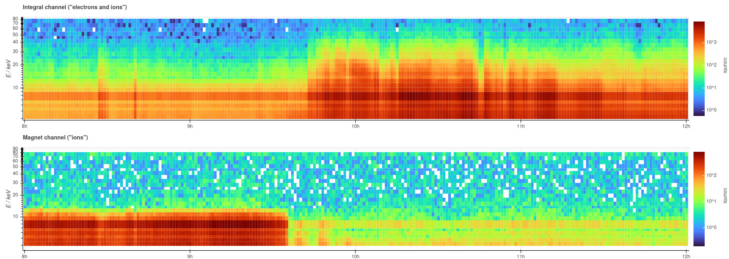
EPD proton (ion) and electron observations March 1 – September 30 and beyond...
November 18
Very sharp ion dropout @ 1 minute time resolution
(low-latency data)
AGU 2020
1
Notes:
<number>

Slide 16
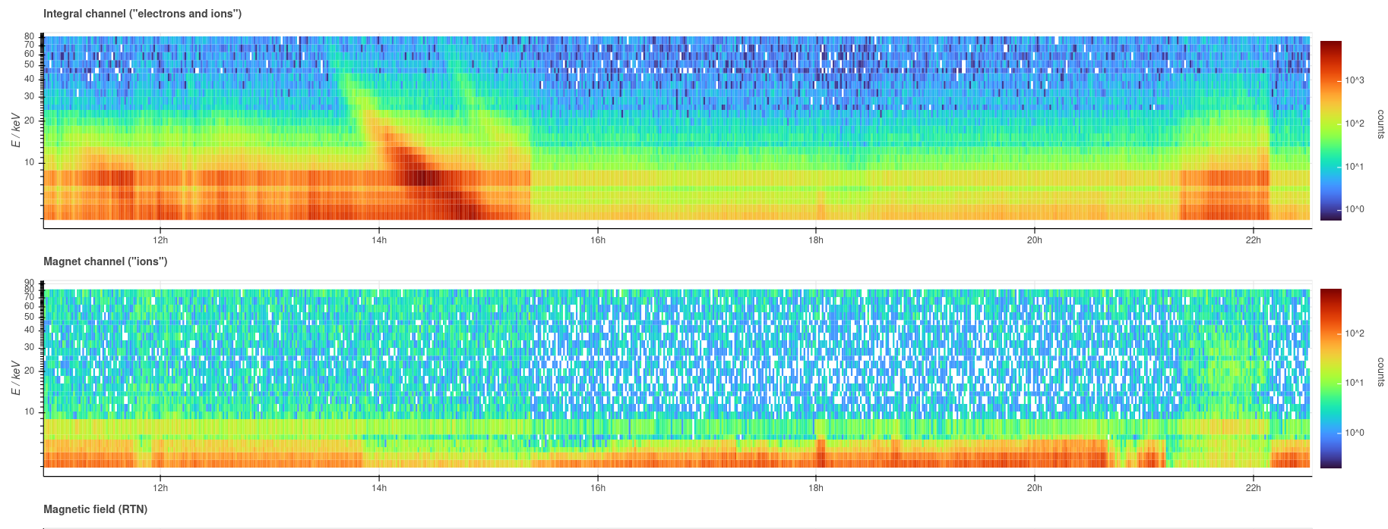
EPD proton (ion) and electron observations March 1 – September 30 and beyond...
November 18
Very sharp electron dropout @ 1 minute time resolution
(low-latency data)
AGU 2020
1
Notes:
<number>

Slide 17
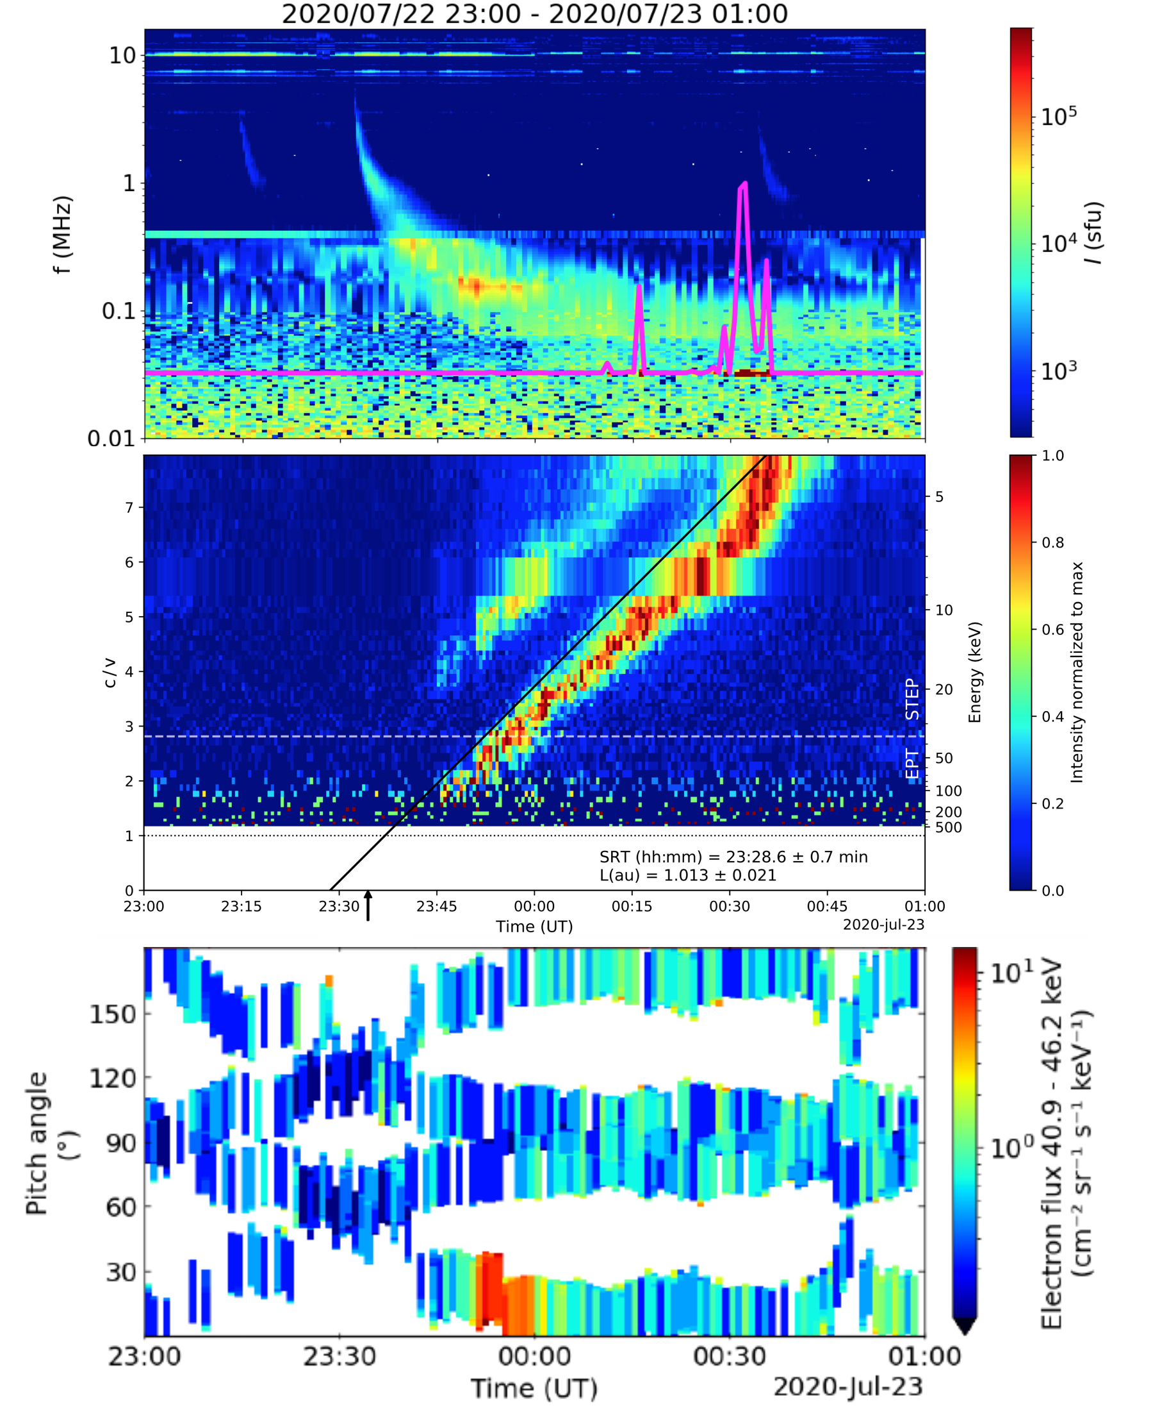
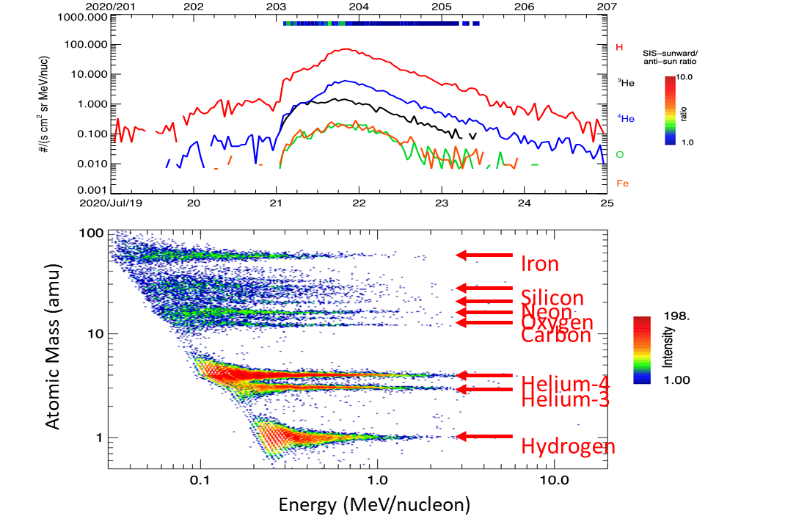
EPD heavy ion and electron observations – July events
SH036-0008
Mason G. et al., A&A Lett., accepted f. publ.
Gómez-Herrero R. et al., submitted to A&A Lett
AGU 2020
1
Notes:
<number>

Slide 18
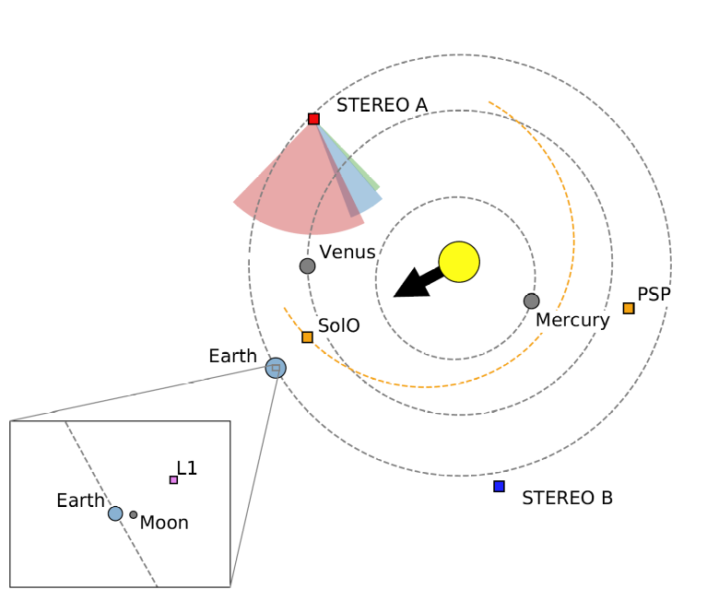
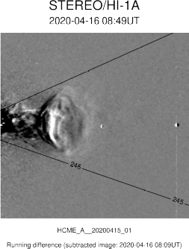
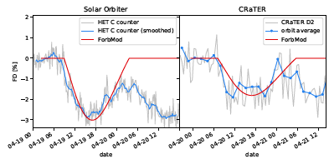
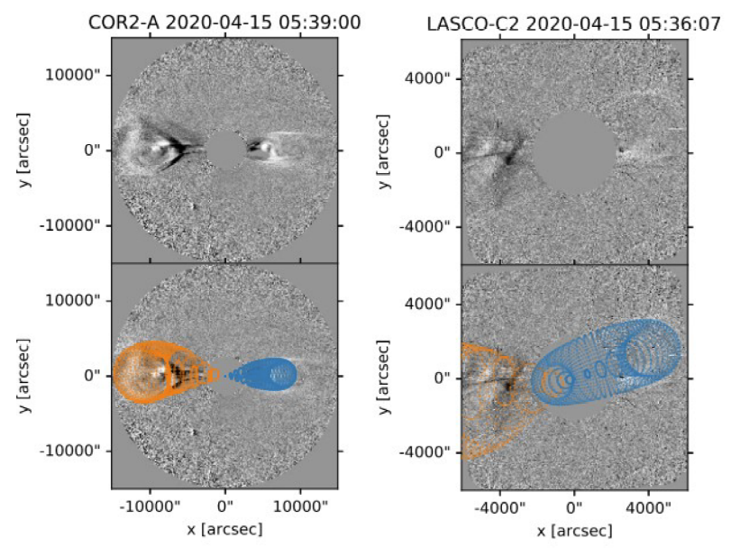
Radial Evolution of Forbush Decrease between 0.8 – 1.0 au
April 19, 2020 CME @ Solo,
also seen @ Earth
1st CME seen by Solo
Imaged by STEREO-A
Not imaged from Earth
ForbMod / Observations:
CME compressed by SIR
Freiherr v. Forstner et al., submitted to A&A
SH039-04
AGU 2020
1
Notes:
<number>

Slide 19
SIS observations of SIRs inside 1 au
SH039-05
SH049-0004
Allen R. et al., submitted to A&A Lett
AGU 2020
1

Slide 20
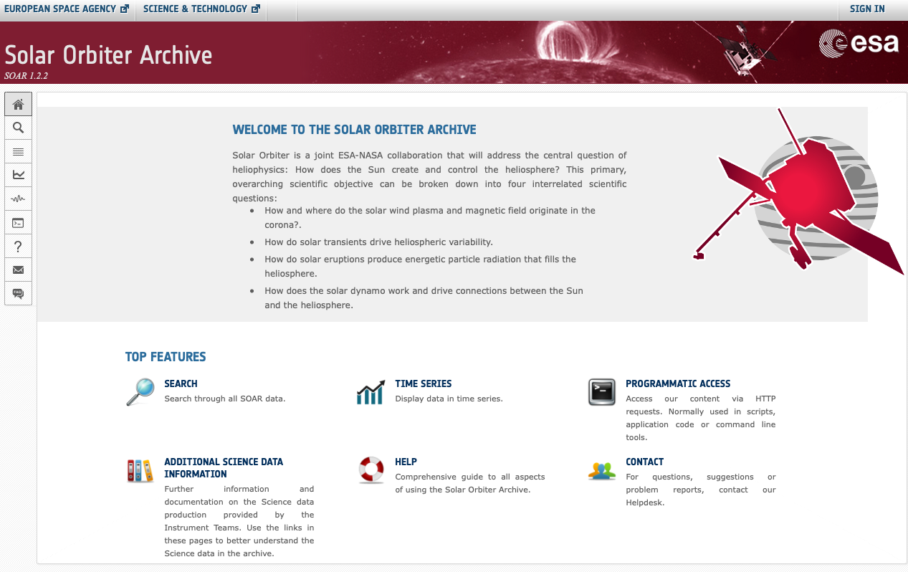
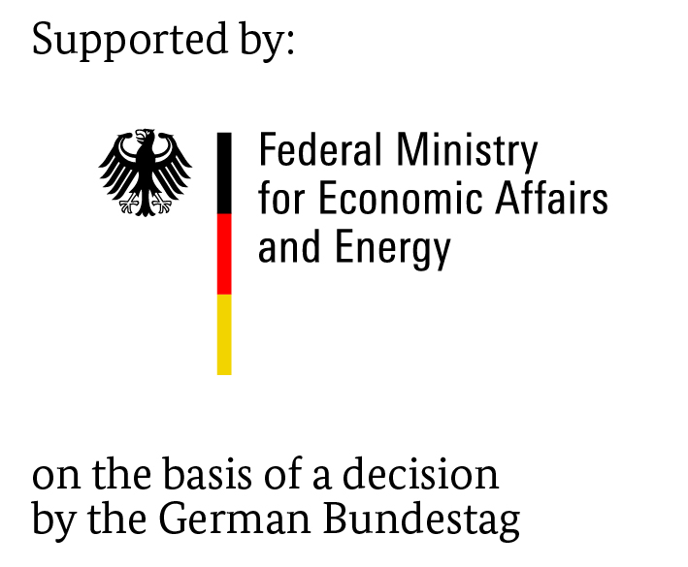



EPD SOAR: http://soar.esac.esa.int/soar/
EPD data at SOAR:
    From June 14th to August 31st 2020
    Monthly updates
    90 days after receipt on ground
Thanks:
1
AGU 2020
1
Notes:
<number>

