Slide 1






EPD status report to in situ WG
January 2023
January 26, 2023
<number>

Slide 2
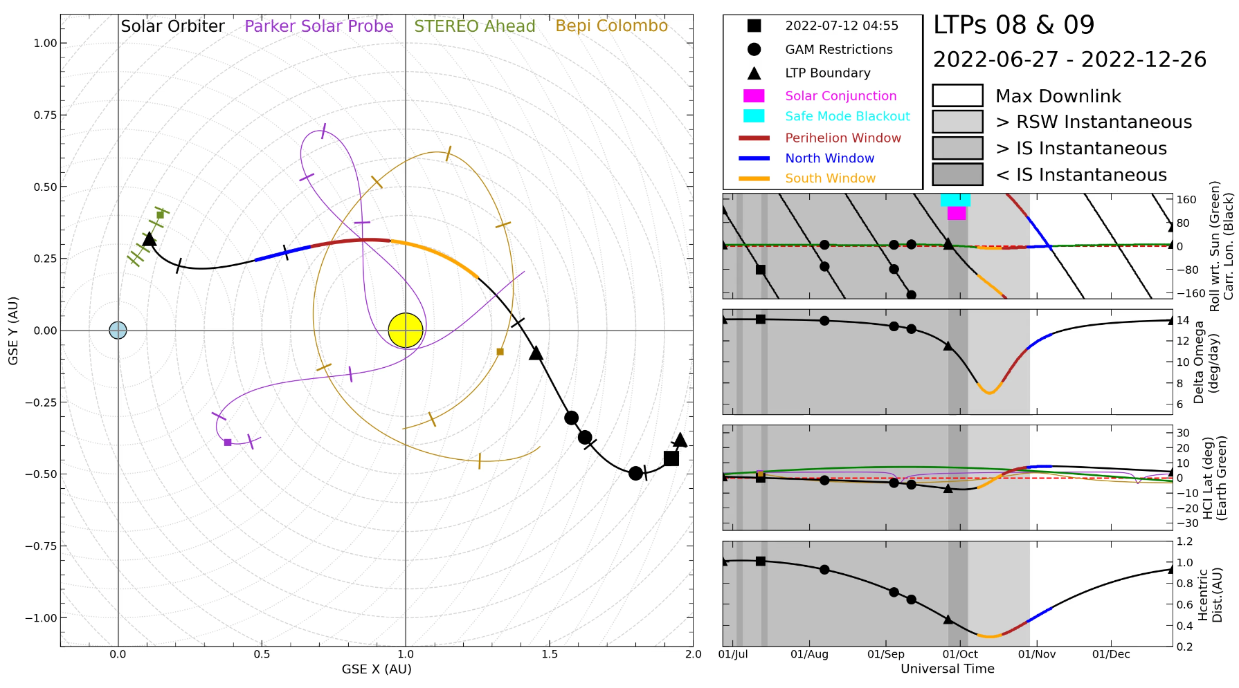
Status
Status:
  All the units are working nominally
  One-second cadence
  Excellent energy resolution
Data Availability:
  Data in the SOAR up to end August 2022
  More to follow soon
Several nice particle events seen:
  Next slides
Solar Orbiter was far away last summer/fall.
Large data latency lasted until November 2023.
<number>
Notes:
2

Slide 3
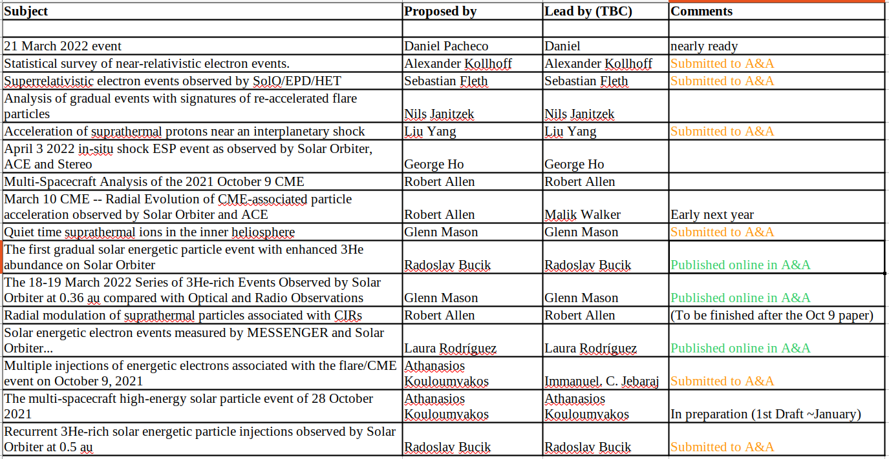
A&A special issue publications
2

Slide 4
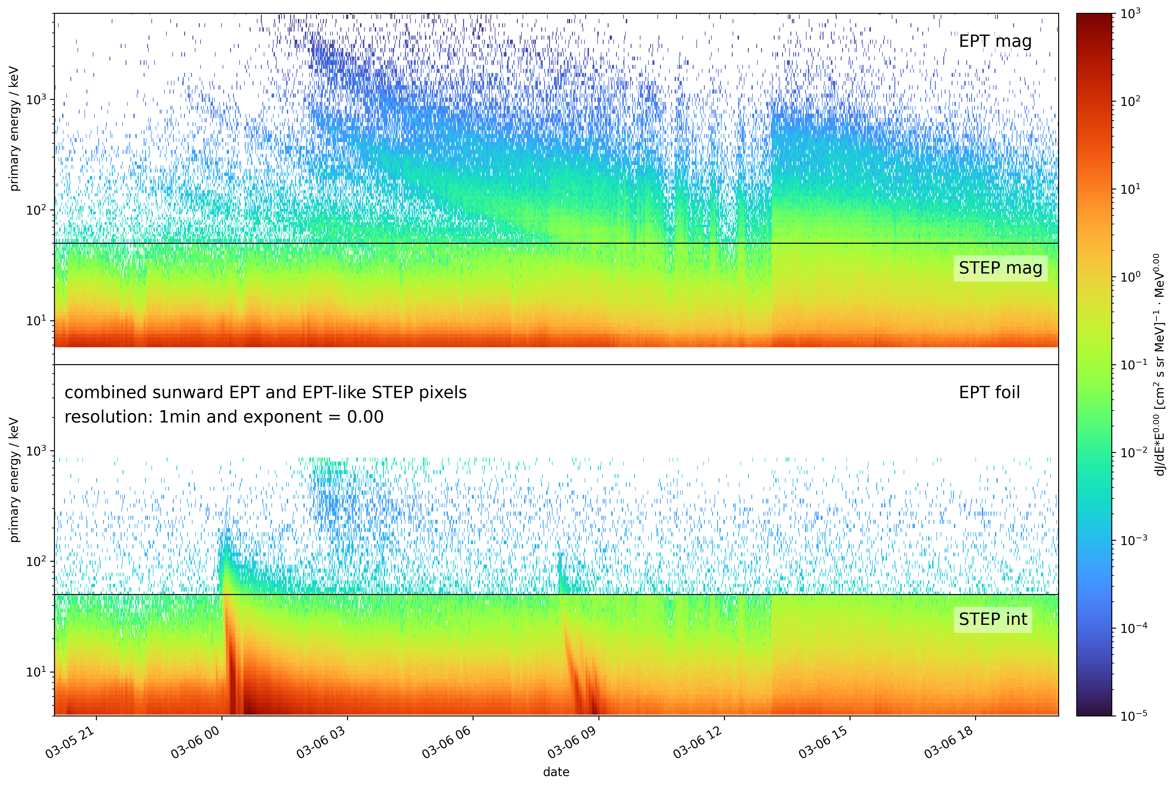
One Day (24 h) in the Life of EPD
Solar particle event of March 6, 2022.
Time resolution: 1 minute
Two injections
EPT does not distinguish between ions.
Plot shows 24 hours worth of data.
Flux dropouts seen in ions.
Zoom in to narrow rectangle
2

Slide 5
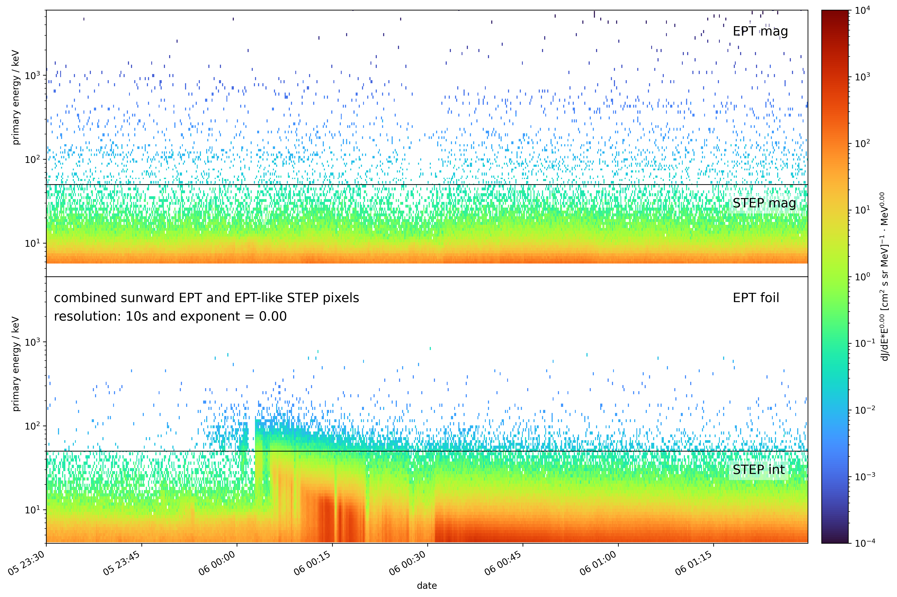
Two hours worth of data
Scatter-free ion tracks (hard to see at this time resolution (10 seconds)).
Strong variability seen in suprathermal electrons.
Does this continue at finer time scales?
2

Slide 6
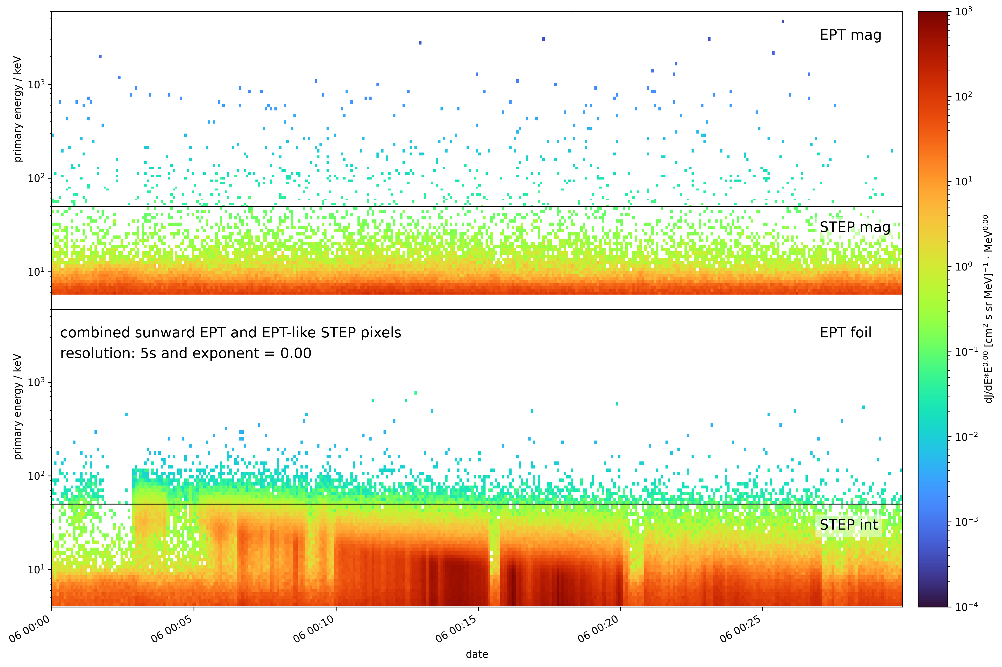
Half an hour worth of data
Ion tracks barely visible, too few counts.
But:
Strong variability seen in suprathermal electrons even at this high time resolution of 5 seconds.
2

Slide 7
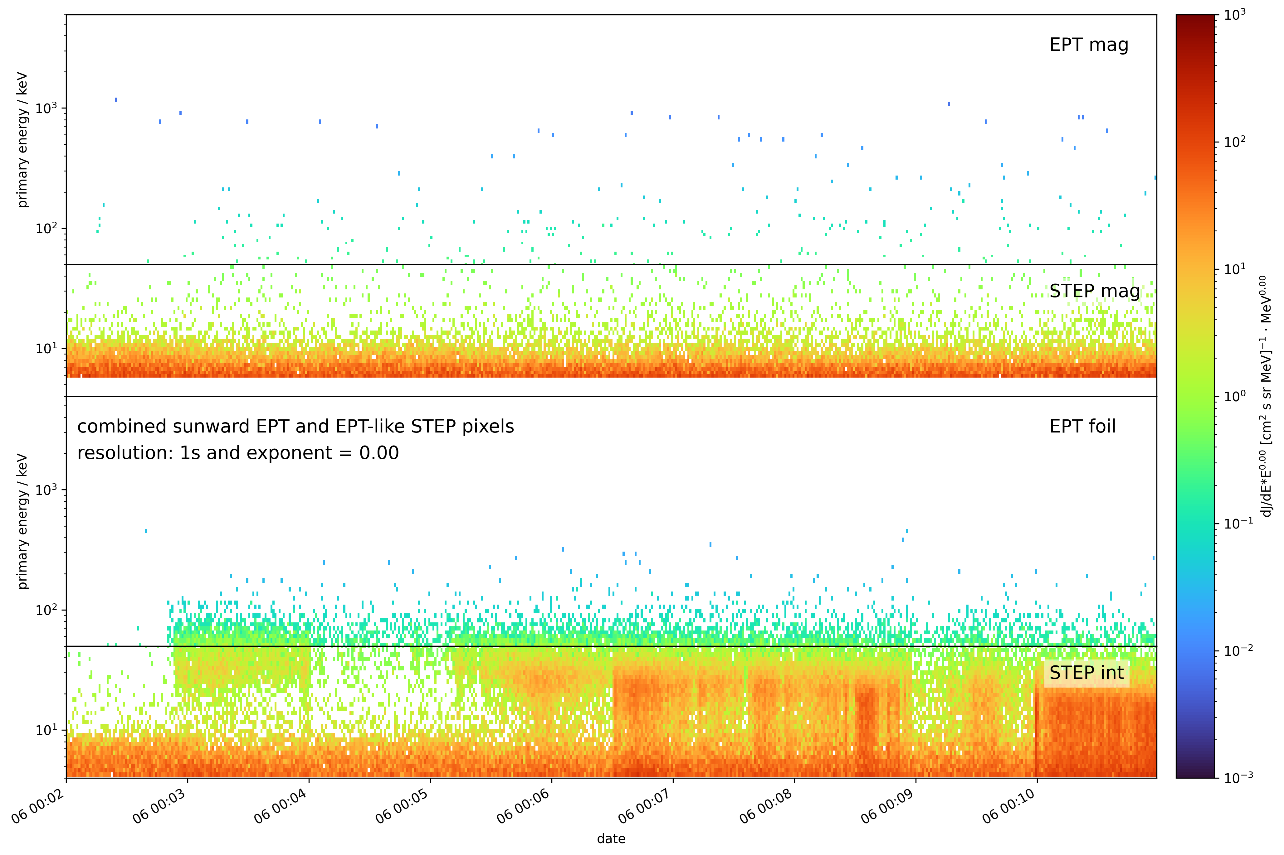
Nine minutes worth of data
Ion tracks barely visible, too few counts.
But:
Strong variability seen in suprathermal electrons even at this high time resolution of a second.
Take a closer look at angular variations.
2

Slide 8
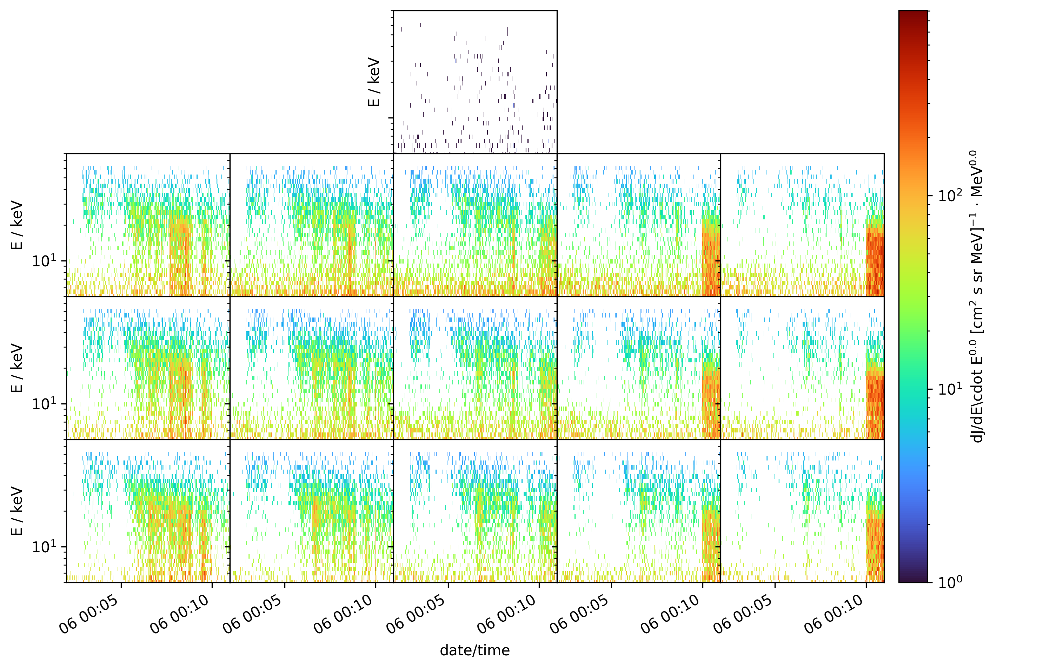
Nine minutes worth of STEP data
Individual STEP pixels show:
highly anisotropic electron distribution
clear velocity dispersion
rapid temporal changes
Zoom in to interesting time period.
2

Slide 9
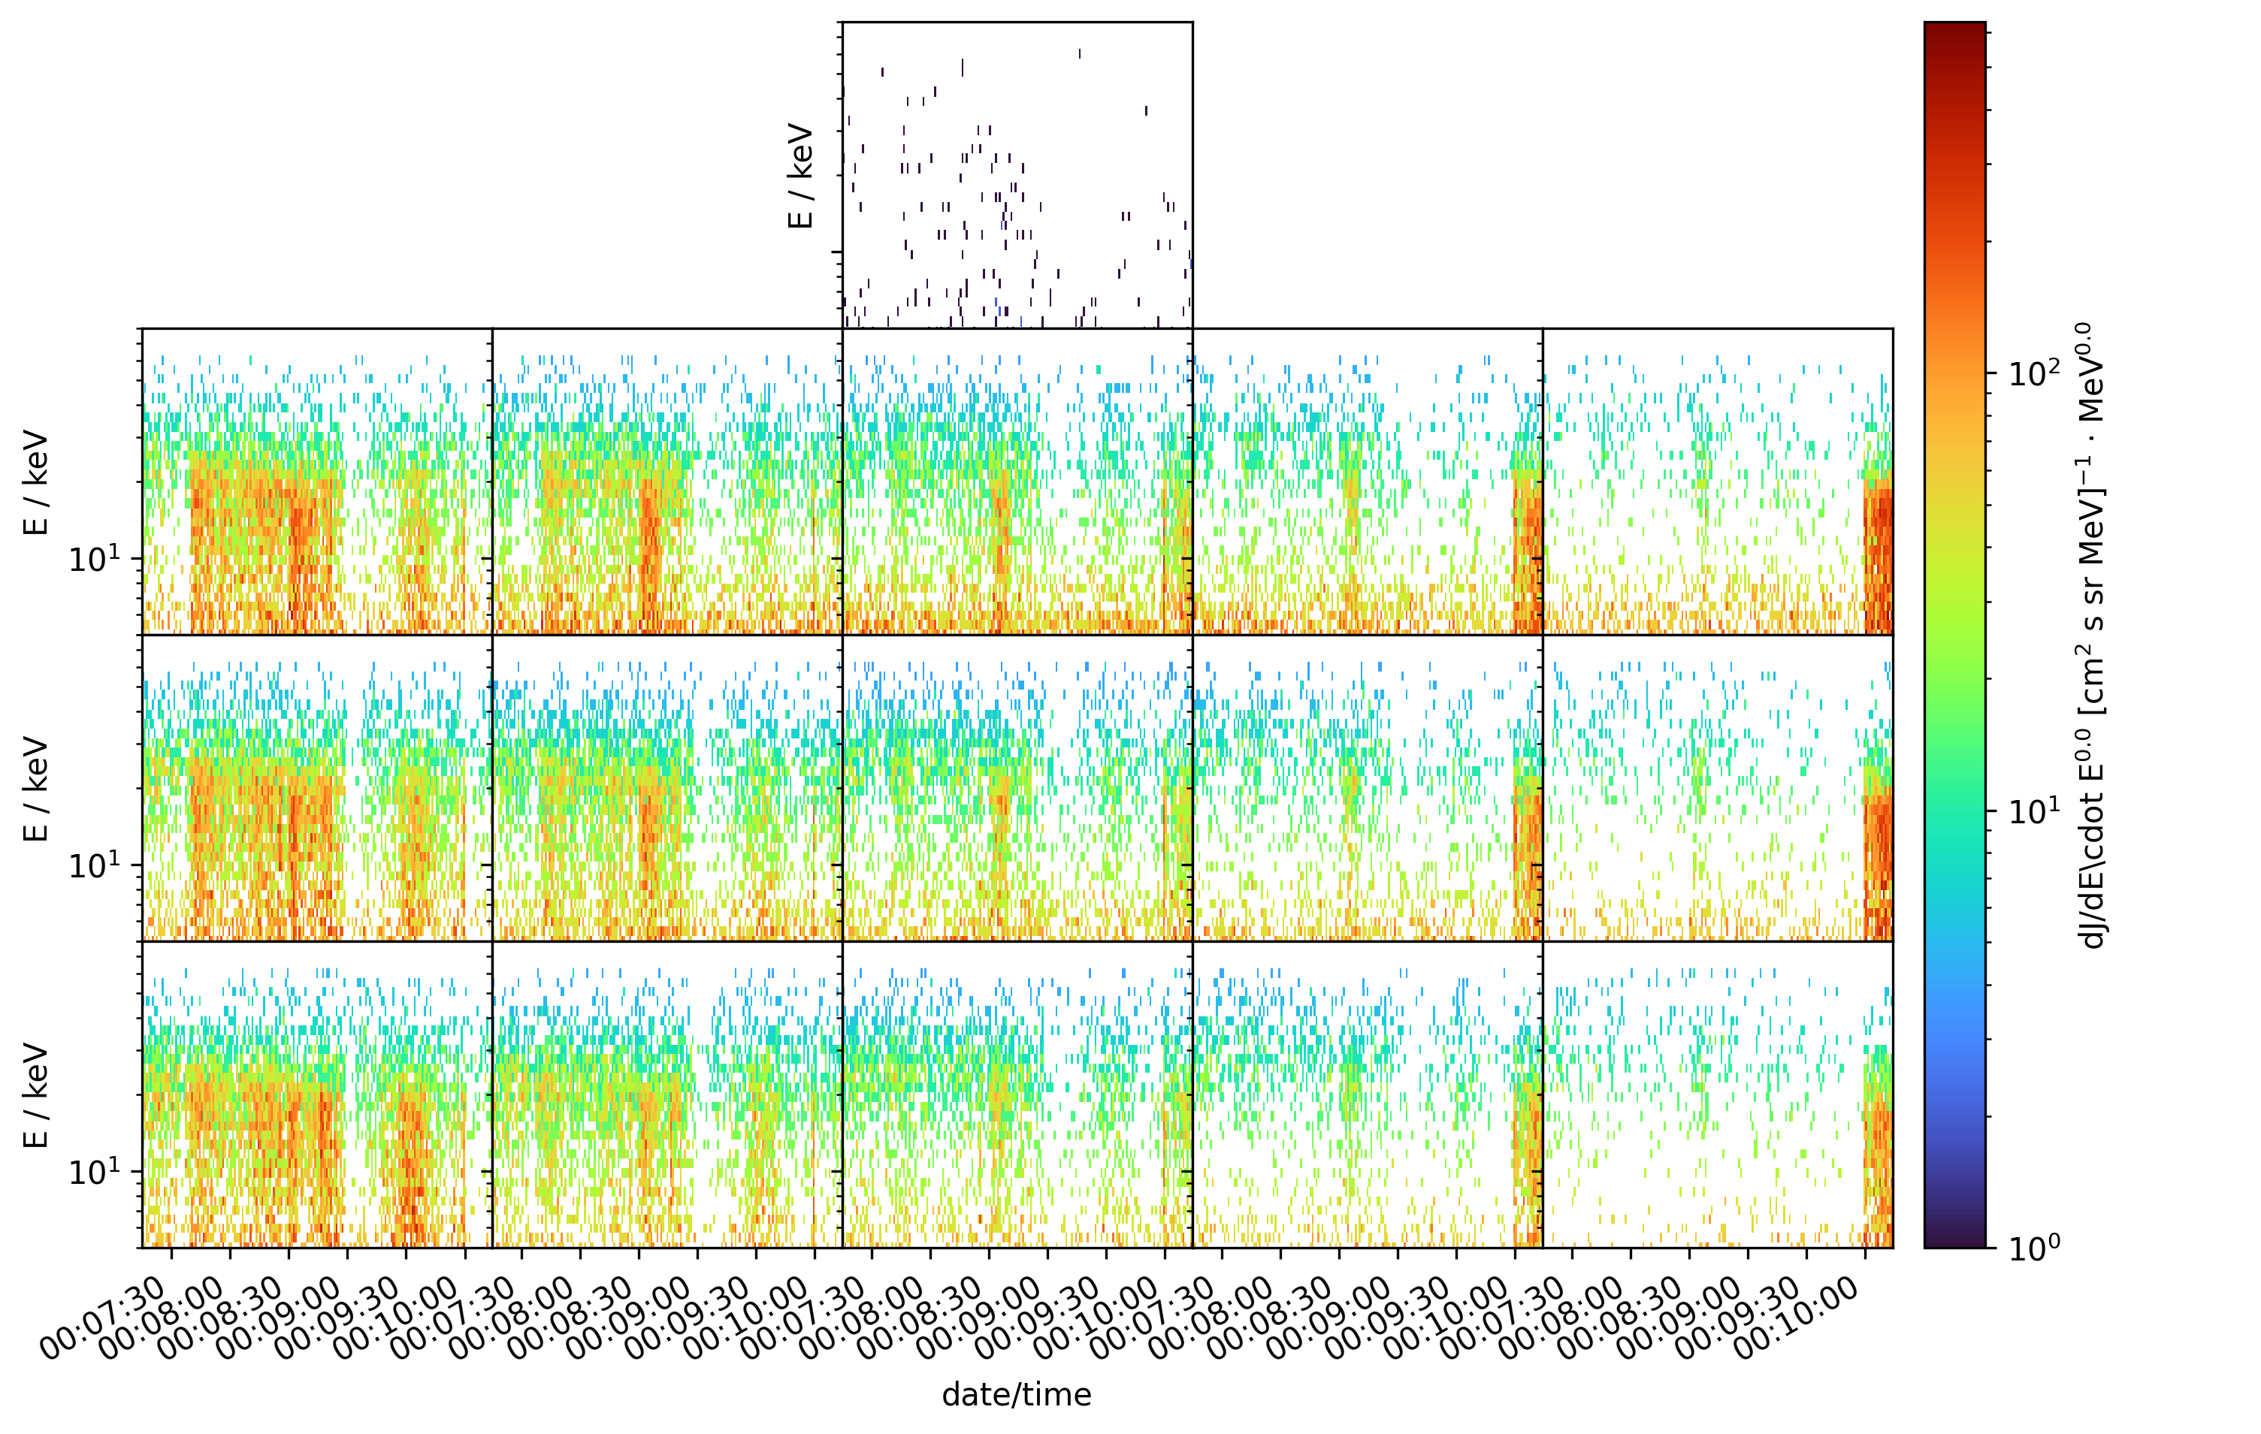
Three minutes worth of STEP data
Even on a time scale of seconds individual STEP pixels show:
highly anisotropic electron distribution
clear velocity dispersion
rapid temporal changes
2

Slide 10
EPD data are pretty cool
Very high time resolution
Very high angular resolution
Very good energy resolution
There’s a lot to be found in the data
Available 90 days after receipt on the ground.
The End
2

Slide 11
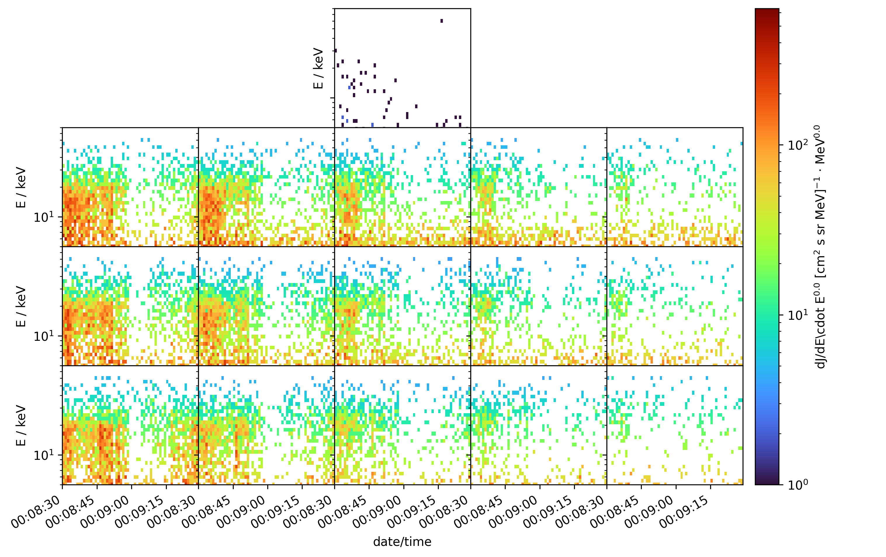
One minute worth of STEP data
Very high time resolution
Very high angular resolution
Very good energy resolution
There’s a lot to be found in the data
Available 90 days after receipt on the ground.
2

