Slide 1
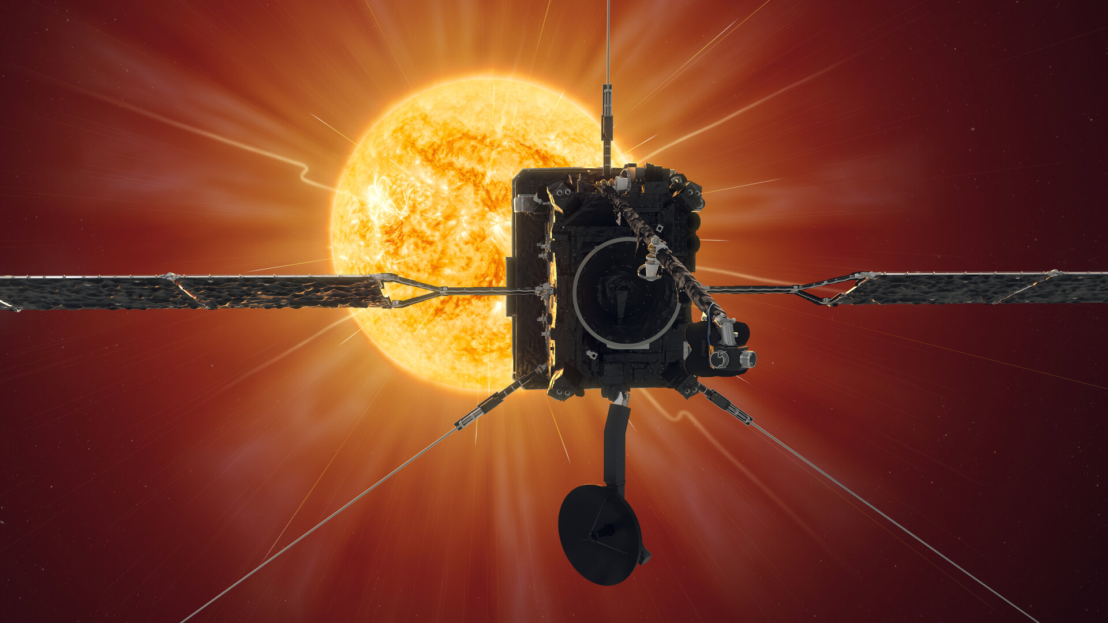

Advances in energetic particle physics with Solar Orbiter
Robert F. Wimmer-Schweingruber¹, Javier Rodriguez-Pacheco²,
George C. Ho³, and the Solar Orbiter & EPD-Team
¹Institute of Experimental & Applied Physics, Kiel University, Kiel, Germany
²Space Research Group, Universidad de Alcalá, Spain
³Johns Hopkins University Applied Physics Laboratory, Laurel, MD, USA

Slide 2
How does the sun create and control the heliosphere – and why does solar activity change with time?
What drives the solar wind and where does the coronal magnetic field originate?
How do solar transients drive heliospheric variability?
How do solar eruptions produce energetic particle radiation that fills the heliosphere?
How does the solar dynamo work and drive connections between the sun and heliosphere?

Slide 3
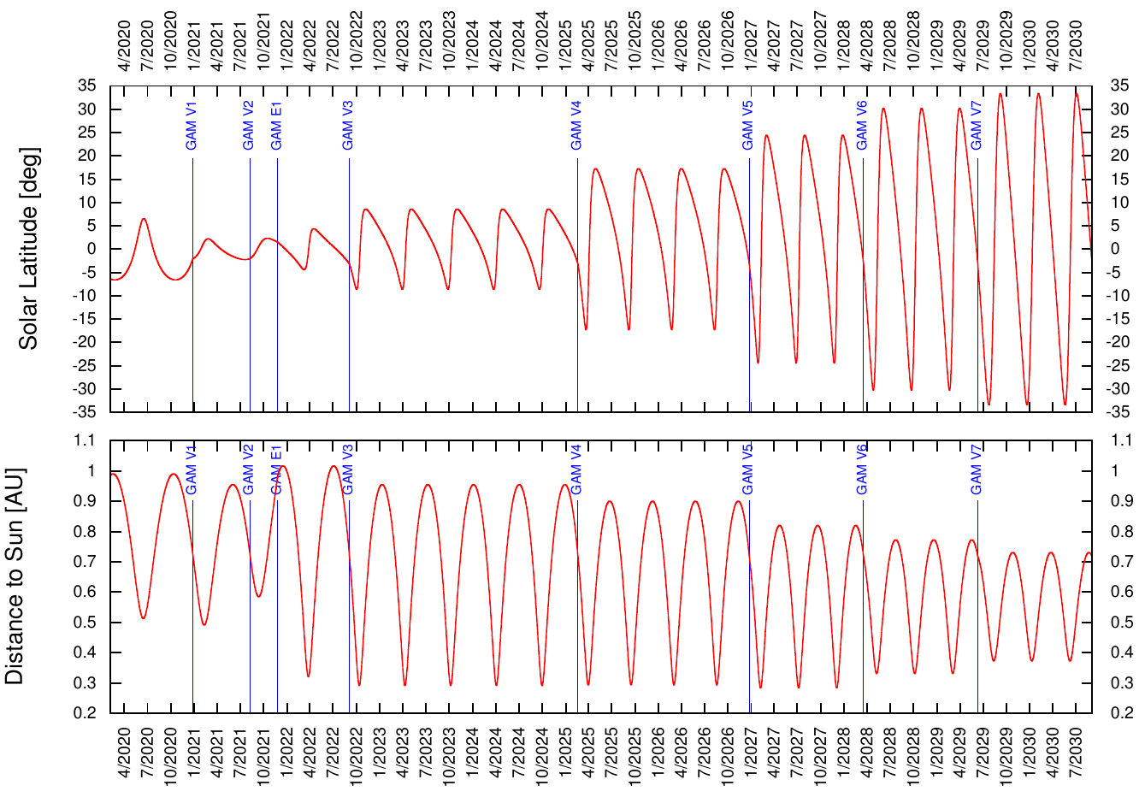
Solar Orbiter:
Launch: 10 February 2020
Mission duration:
7 years (nominal)
3 years (extended)
Orbital period: 168 d
Perihelion: 0.28 au
Highest lat.: 34 deg

Slide 4
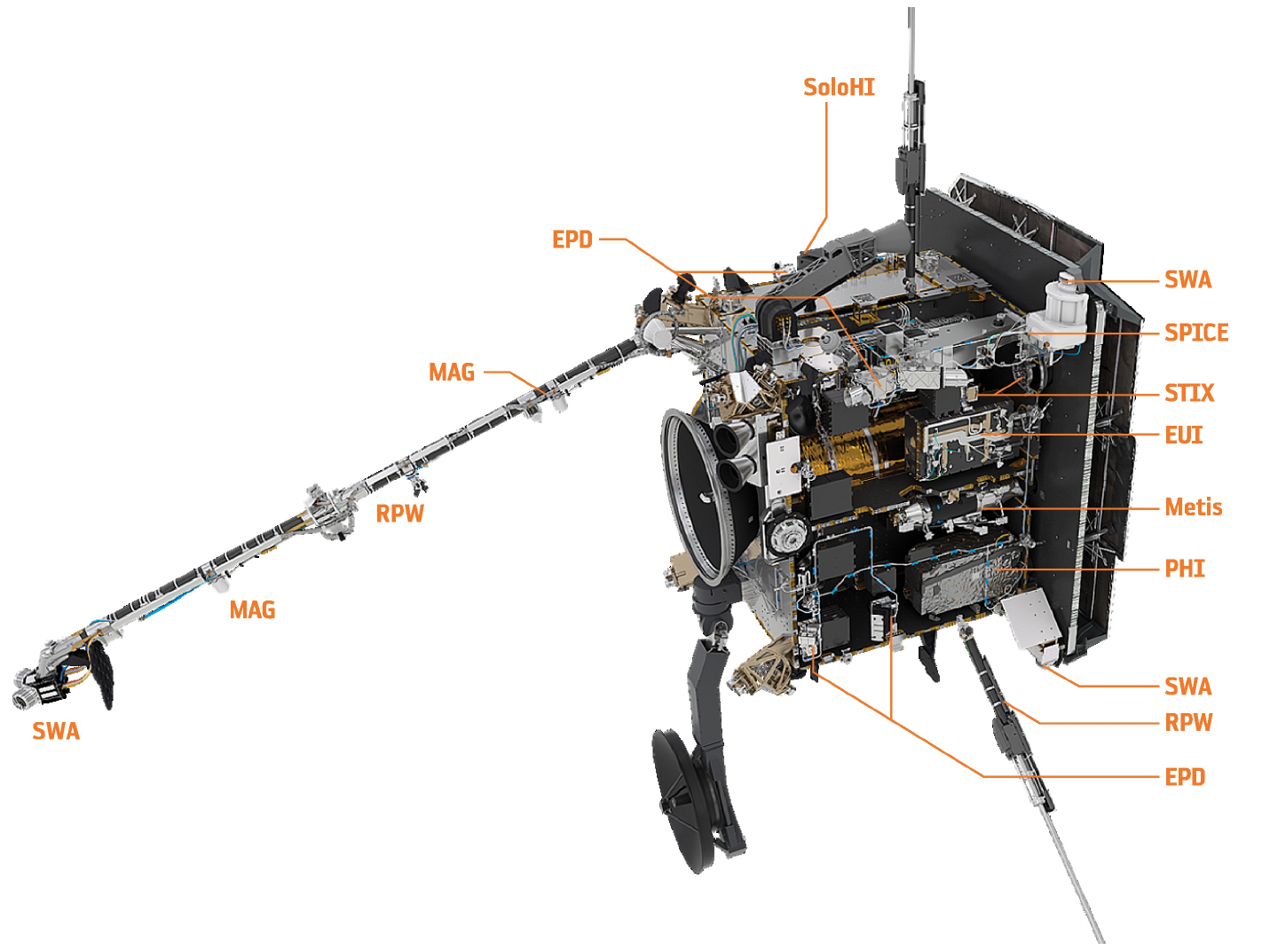
Heat shield (13 S_{ʘ})
HGA
Mission, Science, and Instrument descriptions:
https://www.aanda.org/component/toc/?task=topic&id=1082

Slide 5
How does the sun create and control the heliosphere – and why does solar activity change with time?
What drives the solar wind and where does the coronal magnetic field originate?
How do solar transients drive heliospheric variability?
How do solar eruptions produce energetic particle radiation that fills the heliosphere?
How does the solar dynamo work and drive connections between the sun and heliosphere?

Slide 6

How do solar eruptions produce energetic particle radiation that fills the heliosphere?
This can be broken down into three topics:
SEP seed populations
Injection, acceleration, and release processes of SEPs
SEP transport
AGU 2020
<number>

Slide 7
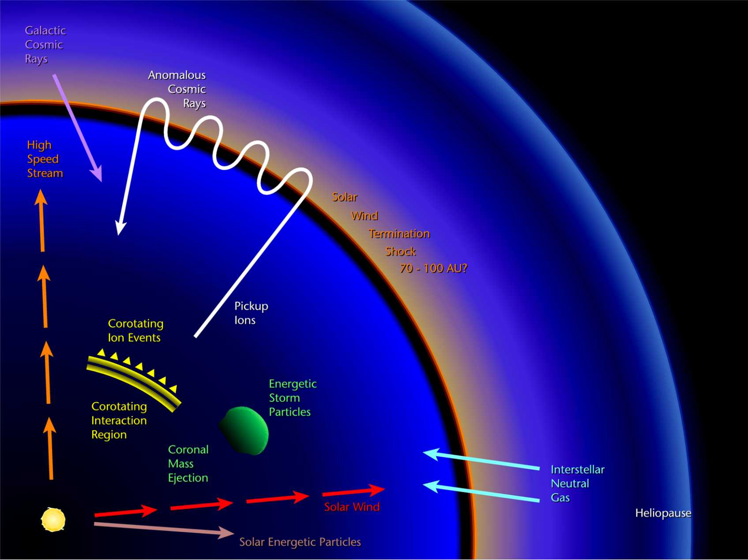
Particle Populations in the Heliosphere

Slide 8
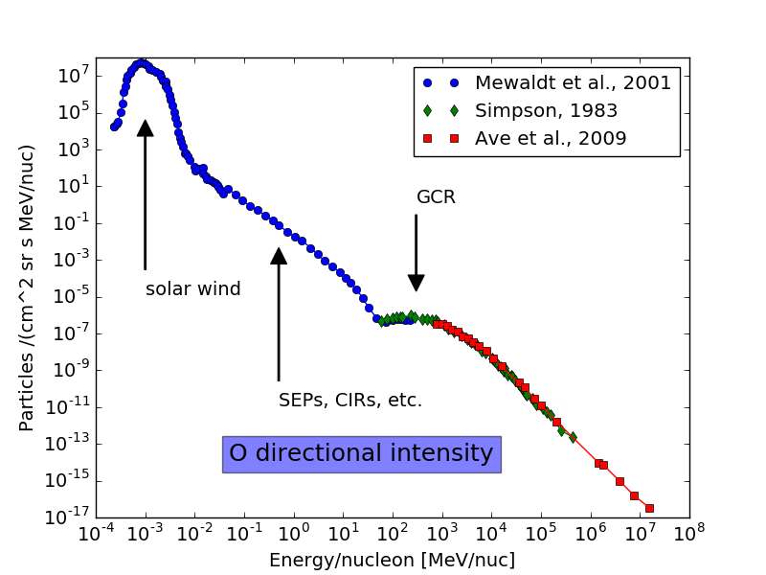
Particle Populations in the Heliosphere

Slide 9
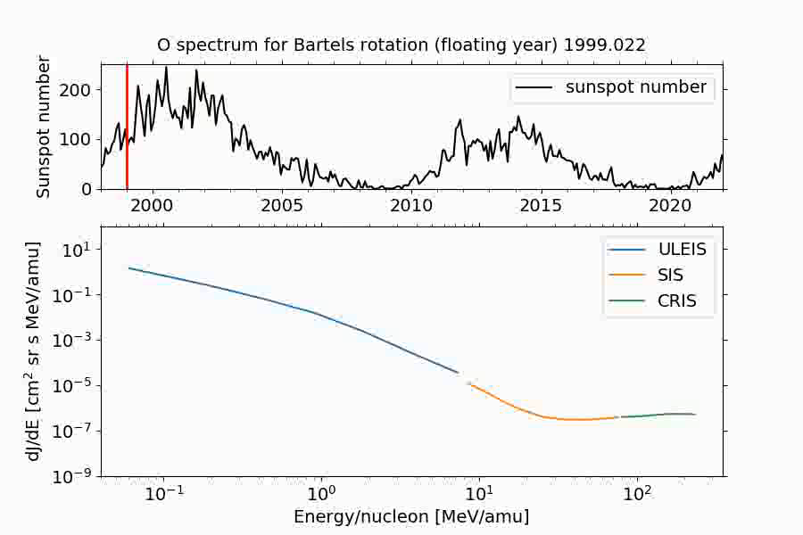
Particle Populations in the Heliosphere

Slide 10
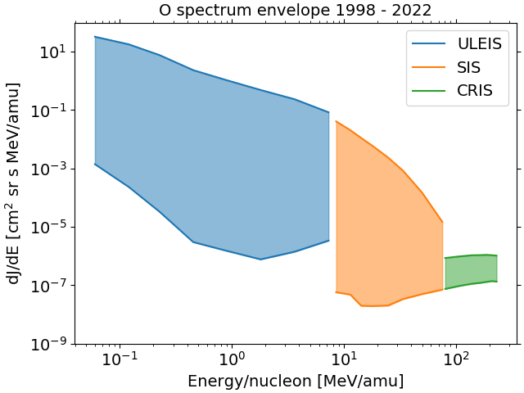
Particle Populations in the Heliosphere

Slide 11
Particle Populations in the Heliosphere
EPD

Slide 12
How do solar eruptions produce energetic particle radiation that fills the heliosphere?
This can be broken down into three topics:
SEP seed populations
Injection, acceleration, and release processes of SEPs
SEP transport
What do we need?
  Get close to the Sun
  Comprehensive energetic particle instrumentation with:
    Broad energy range and composition coverage (including suprathermal particles)
    High time resolution
    Directional (pitch-angle) information
  Supplementary remote sensing measurements
AGU 2020
<number>

Slide 13
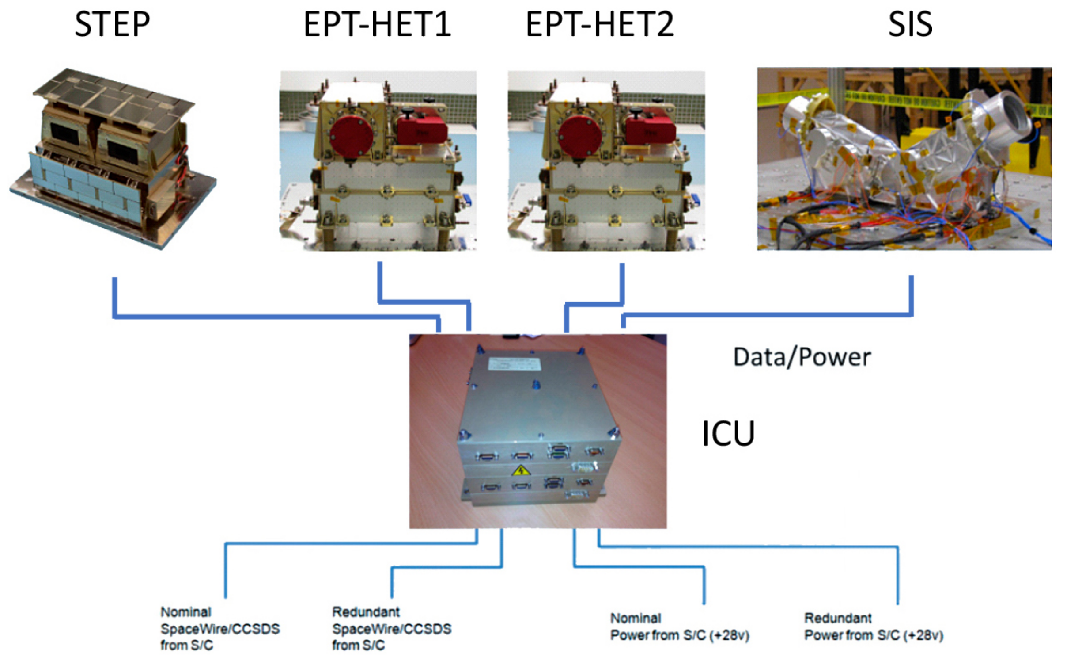
The EPD instrument suite: System architecture
Rodríguez-Pacheco et al., A&A (2021)

Slide 14
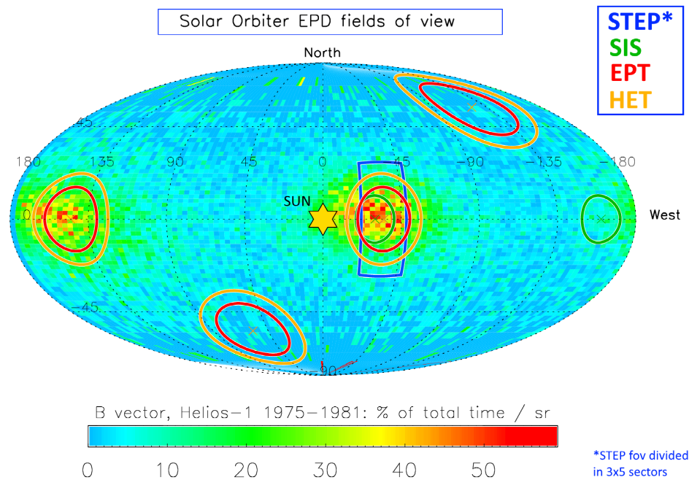
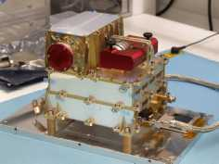
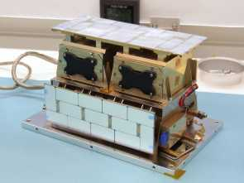
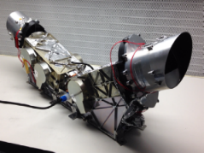
The EPD instrument suite: Fields of view, viewing directions
EPT-HET-2
STEP
SIS
EPT-HET-1

Slide 15
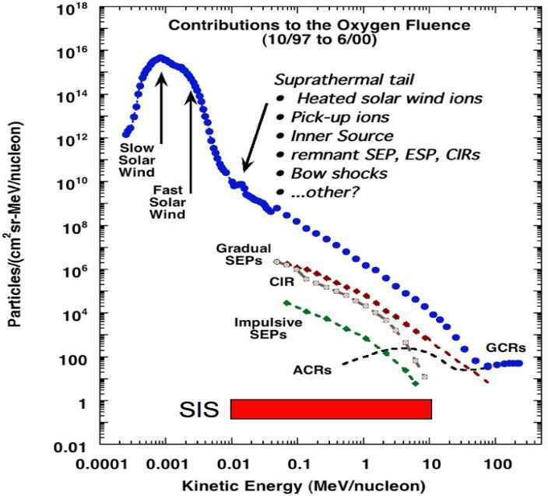
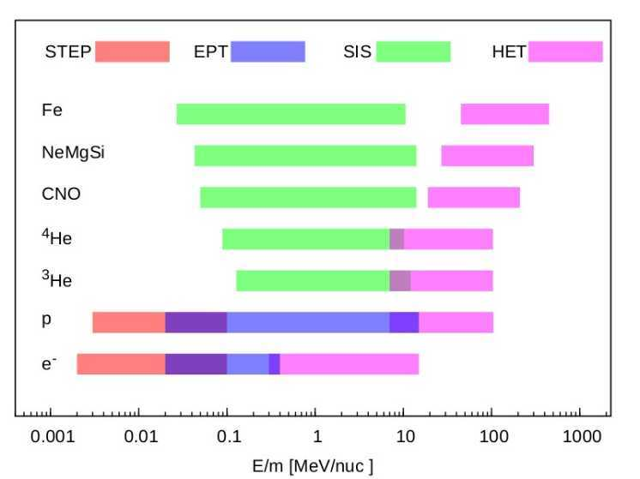
The EPD instrument suite: Energy coverage
EPD

Slide 16
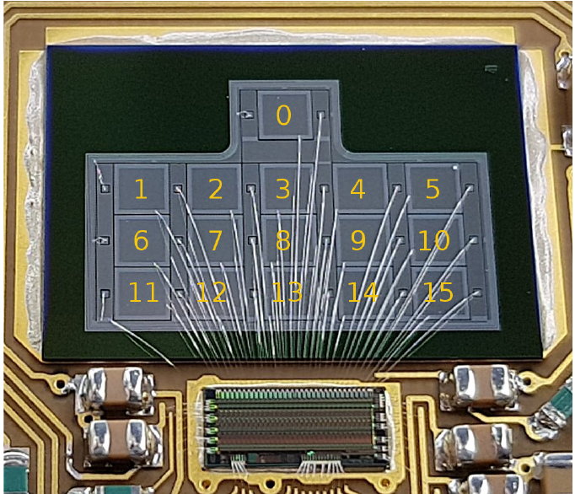
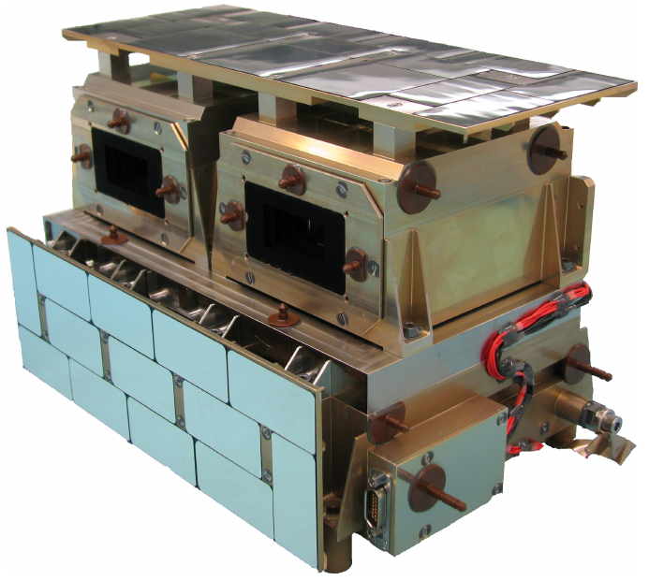
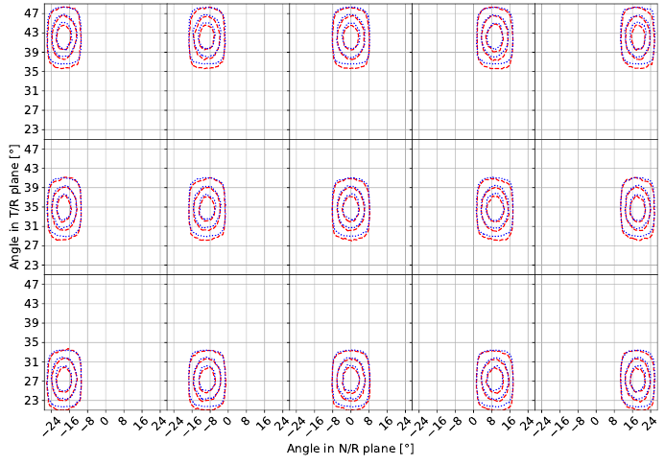
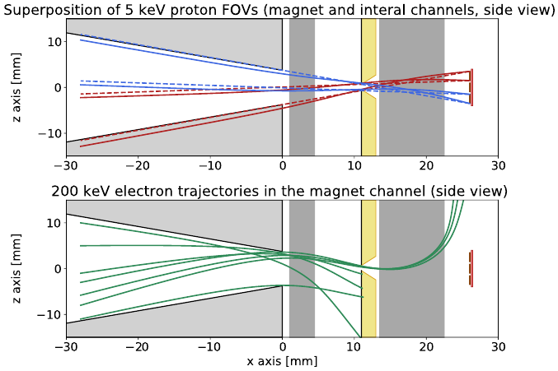
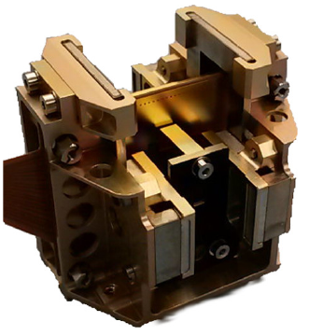
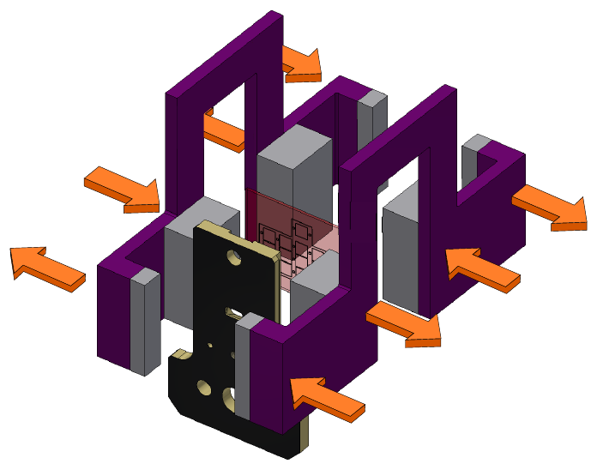
EPD: SupraThermal Electrons & Protons (STEP)
Ions
Electrons & Ions: 2 – 100 keV
Cadence: 1 or 5 seconds
Pin-hole camera with 1 pixels:
→ 15 viewing directions!
GF: 8·10⁻³ cm² sr

Slide 17
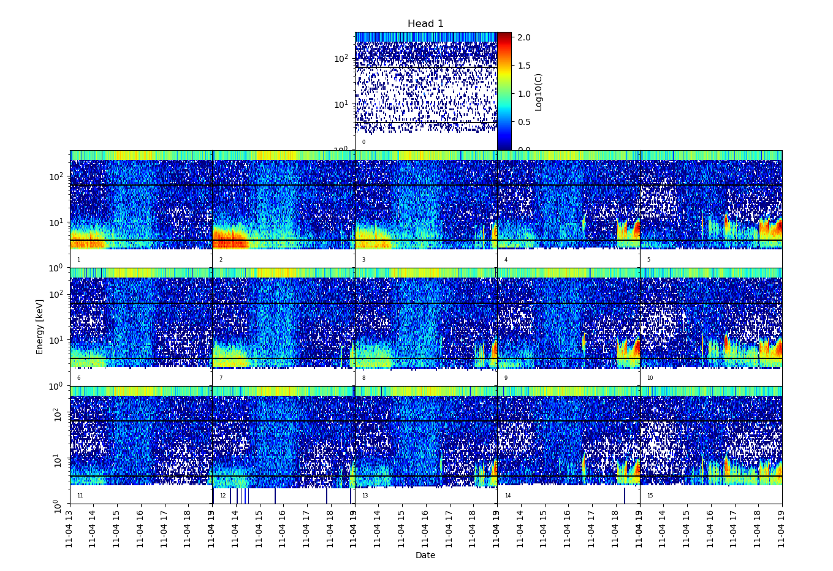
EPD: SupraThermal Electrons & Protons (STEP)
Ions
Data shown here are rebinned to a cadence of one minute.
Data are available in 32 energy bins at a cadence of one or five seconds.

Slide 18
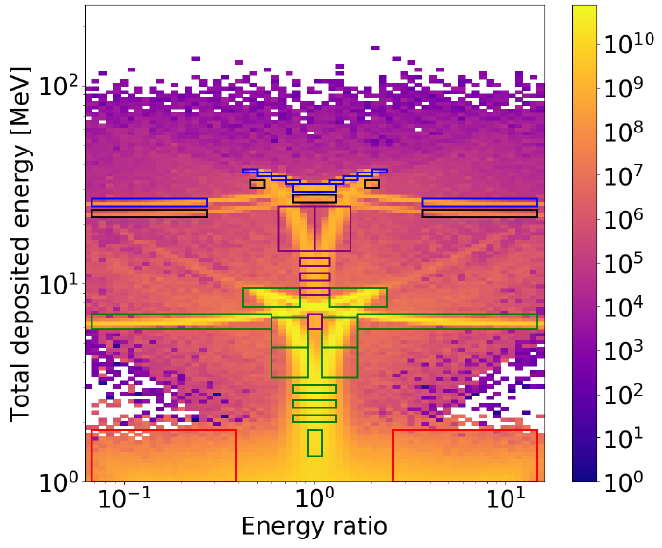
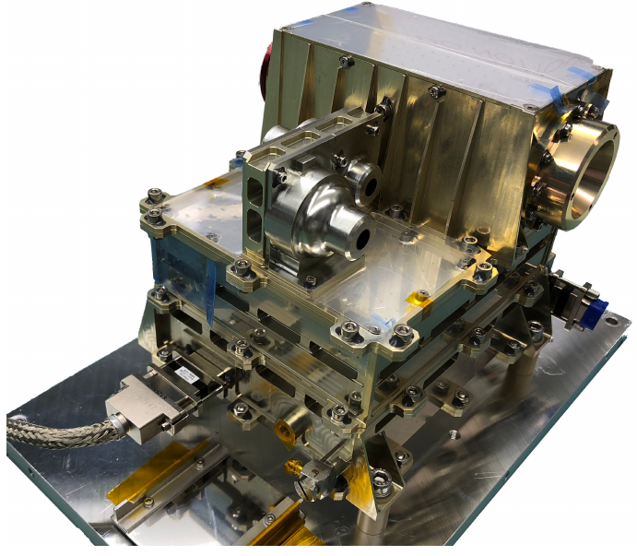
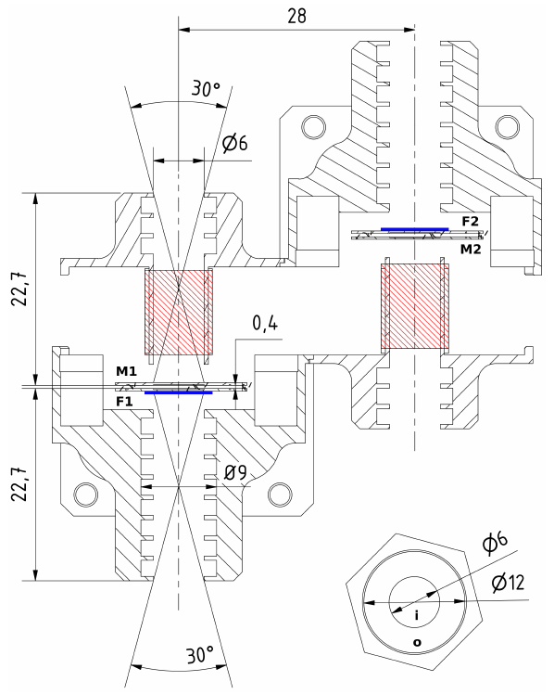
EPT: Electron-Proton Telescope (EPT)
Ion
2x
Electrons: 25 – 475 keV
p: 25 keV – 6.7 MeV
α: 1.6 – 6.7 MeV/nuc
Cadence: 1 or 5 seconds
Four viewing directions (2x2)
GF: 0.01 cm² sr each

Slide 19
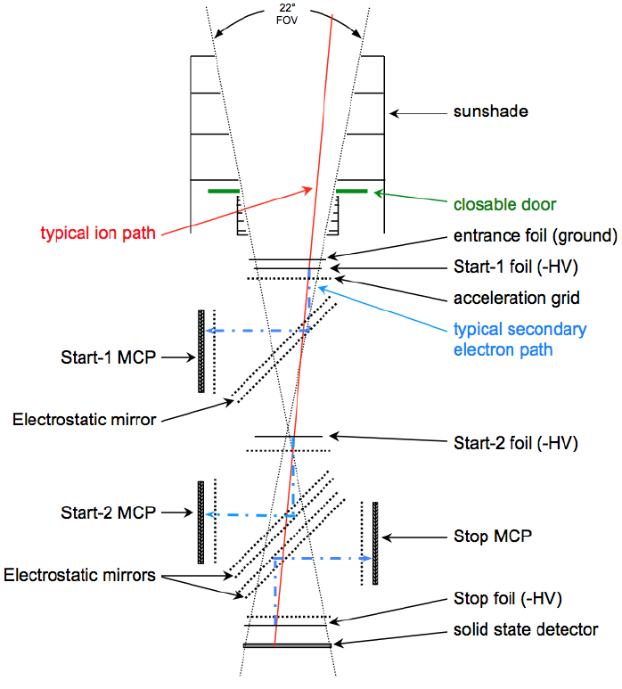
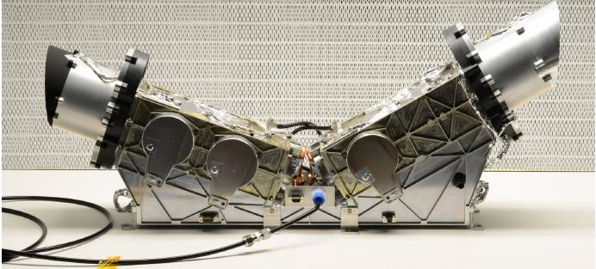
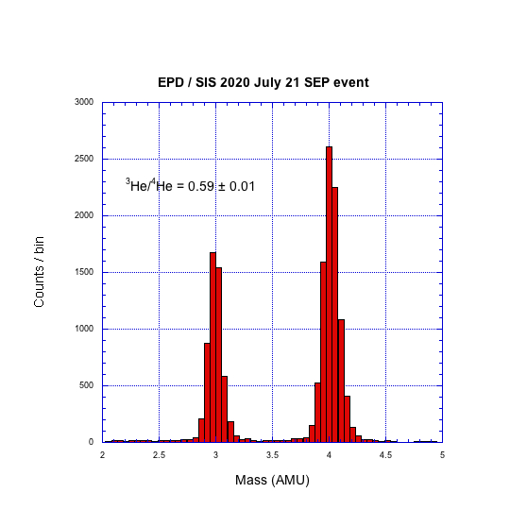
EPD: Suprathermal Ion Spectrograph (SIS)
Ions/isotopes:
14 keV/nuc – 20.5 MeV/nuc
Cadence: 3 or 30 seconds
Two viewing directions
GF: ~ 0.2 cm² sr each
(reduction to 0.002 cm² sr
possible during active periods)

Slide 20
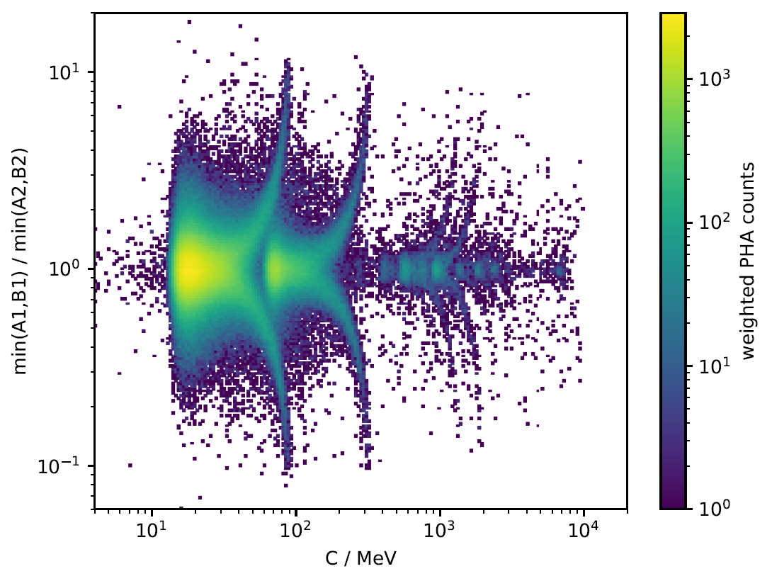

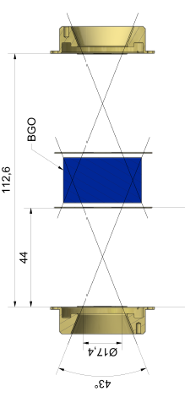
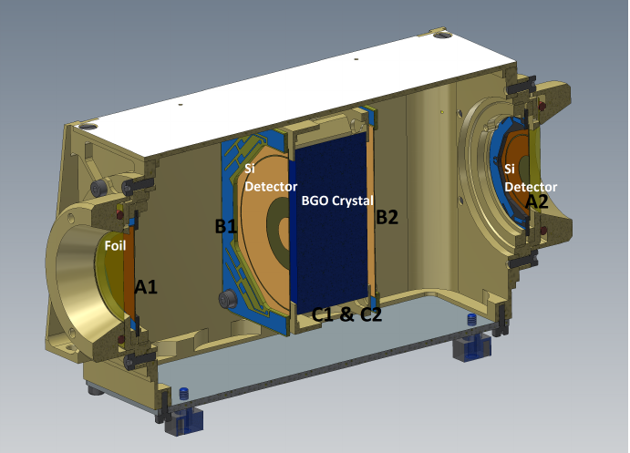
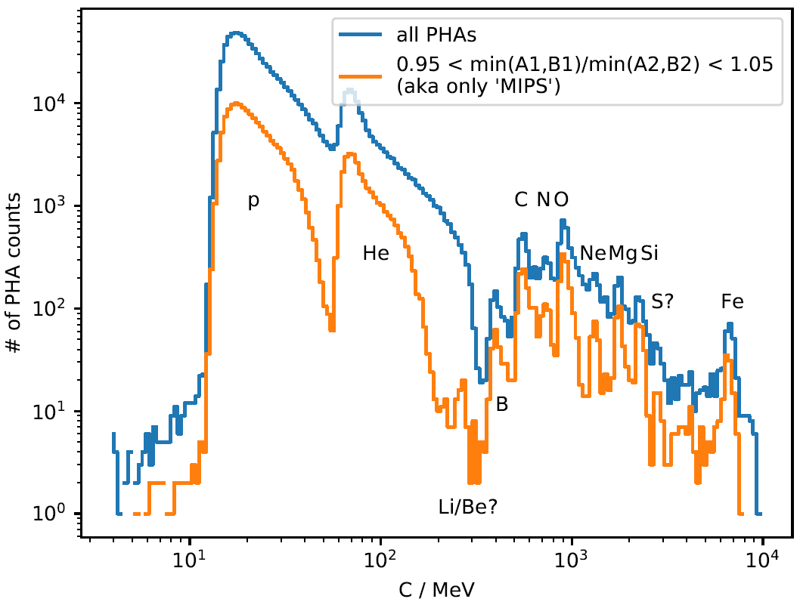
EPD: High Energy Telescope (HET)
2x
Particle
A1
Particle looses less energy in A1/B1 than in B2/A2
Can discriminate direction also for some penetrating particles
‘Fish diagram’ extends energy range.
B1
C
B2
A2
2x2 FoVs, e: 0.3 – 30 MeV, ions: variable
Cadence: 1 or 5 s, GF: 0.27 cm² sr each

Slide 21
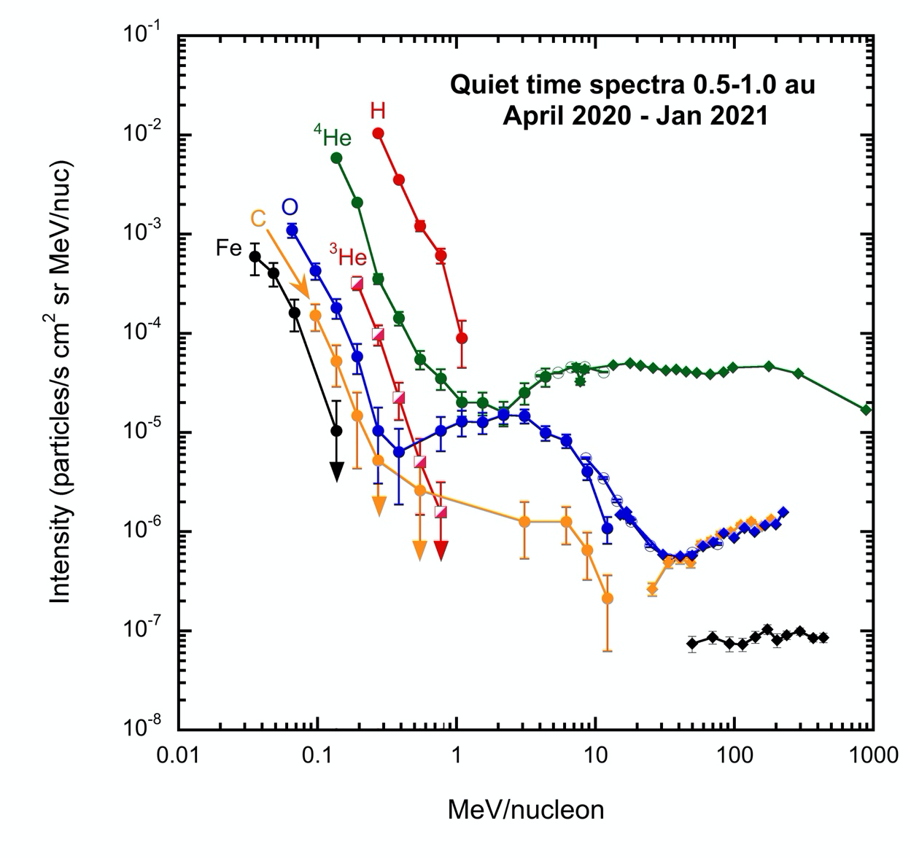
EPD: SIS & HET

Slide 22
Solar Orbiter!
The Grand Heliospheric Observatory

Slide 23
The Grand Heliospheric Observatory

Slide 24
Data!

Slide 25
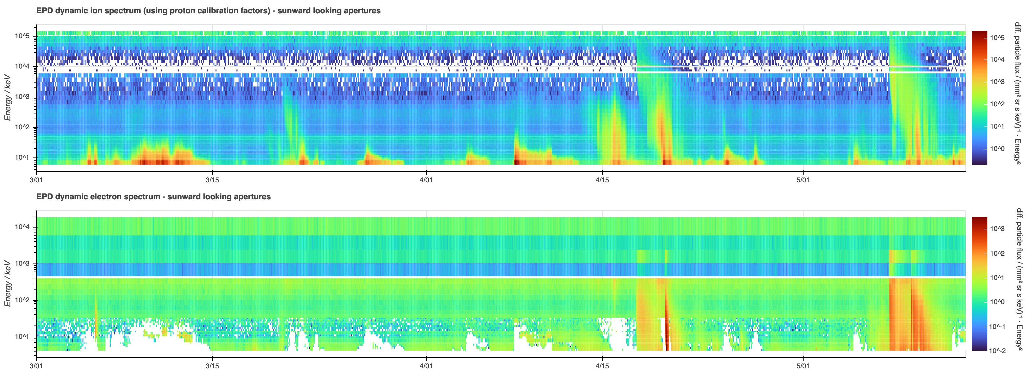
EPD: Comparison of March – May 2021 and 2022
March – May 2021

Slide 26
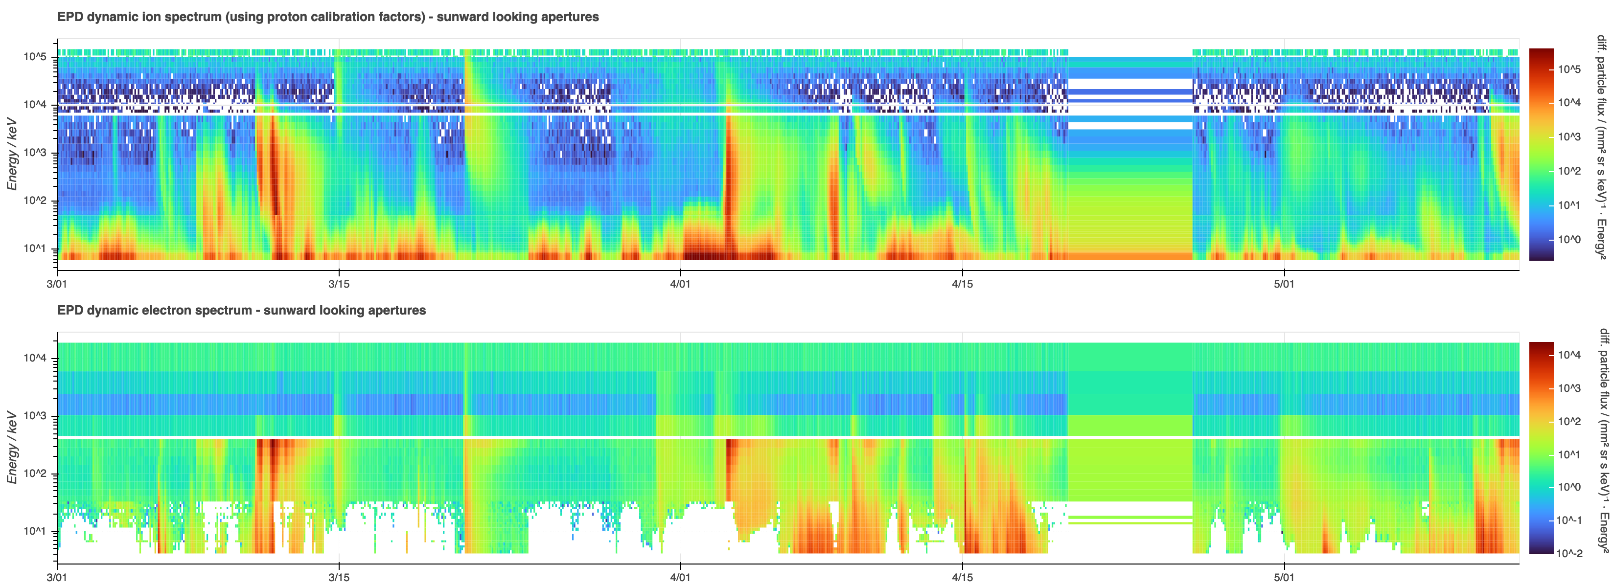
EPD: Comparison of March – May 2021 and 2022
March – May 2022
March – May 2021

Slide 27
First Results!
A&A special issue:
Astron. & Astrophys., 656, (2021)
53 papers, of which 16 with EPD
https://www.aanda.org/component/toc/?task=topic&id=1340

Slide 28
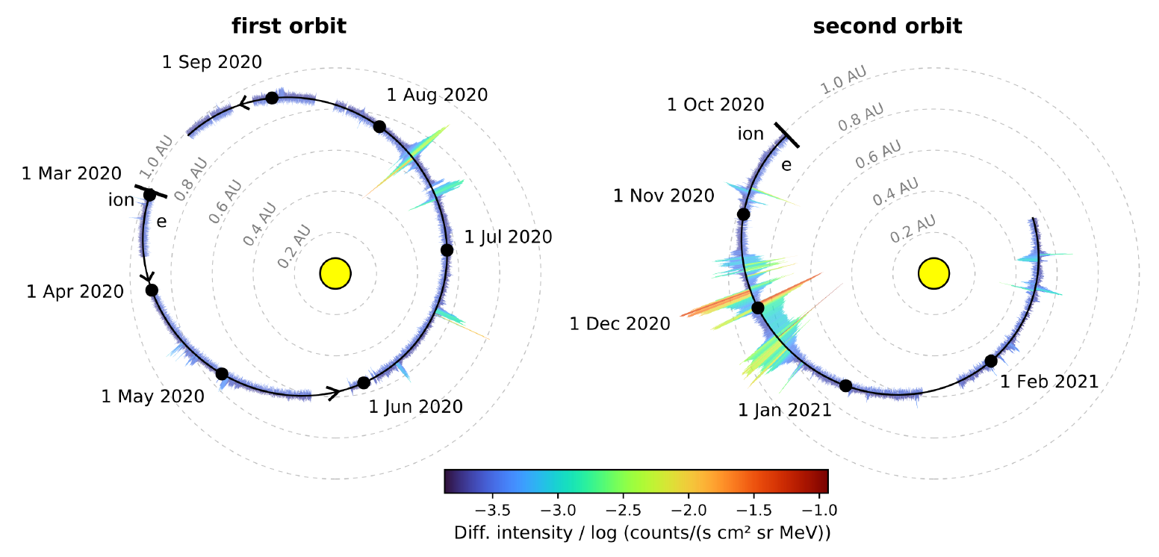
The first year of energetic particle measurements in the inner heliosphere with Solar Orbiter‘s Energetic Particle Detector
Wimmer-Schweingruber et al., A&A
x-cal
example

Slide 29
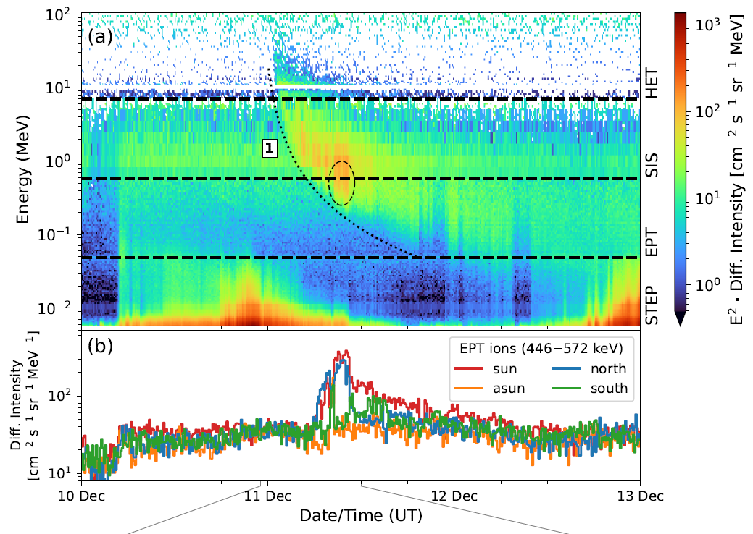
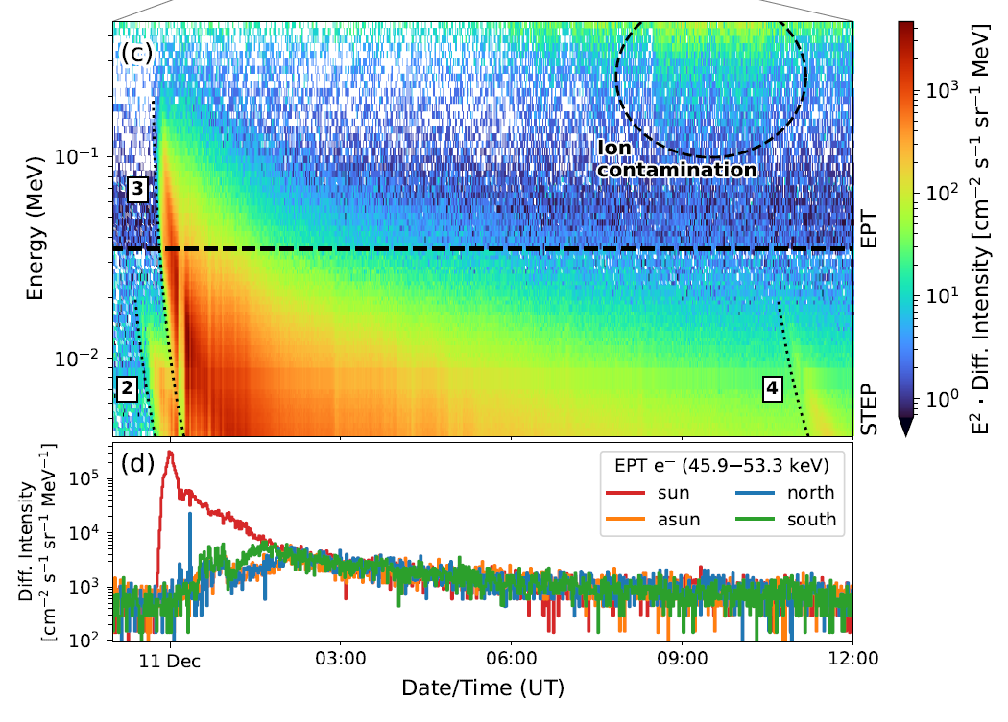
The first year of energetic particle measurements in the inner heliosphere with Solar Orbiter‘s Energetic Particle Detector
Wimmer-Schweingruber et al., A&A

Slide 30
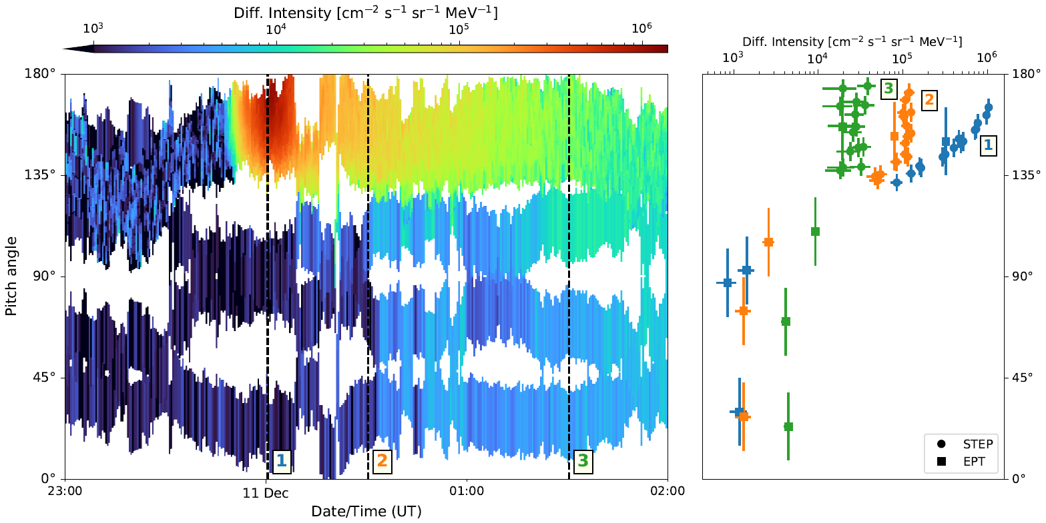
The first year of energetic particle measurements in the inner heliosphere with Solar Orbiter‘s Energetic Particle Detector
Wimmer-Schweingruber et al., A&A

Slide 31
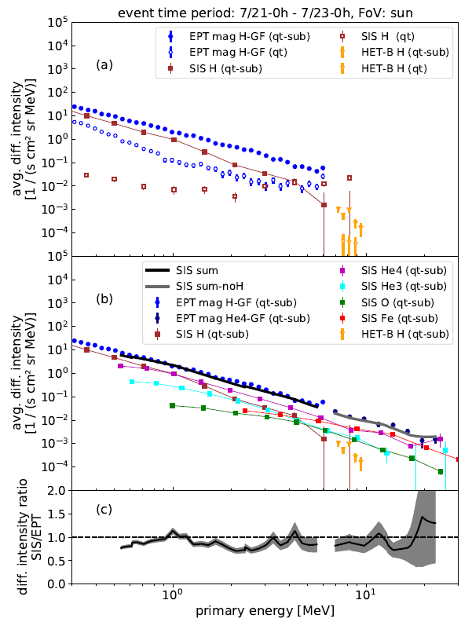
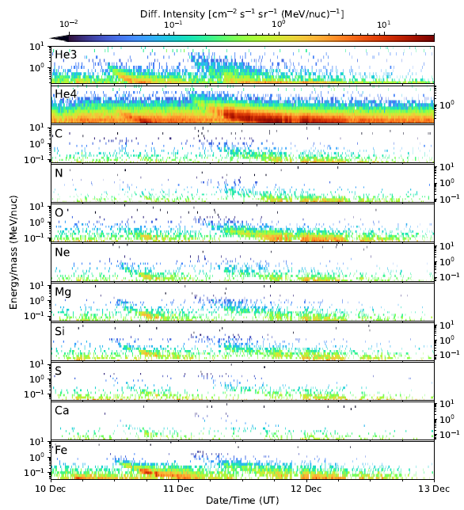
The first year of energetic particle measurements in the inner heliosphere with Solar Orbiter‘s Energetic Particle Detector
Wimmer-Schweingruber et al., A&A

Slide 32
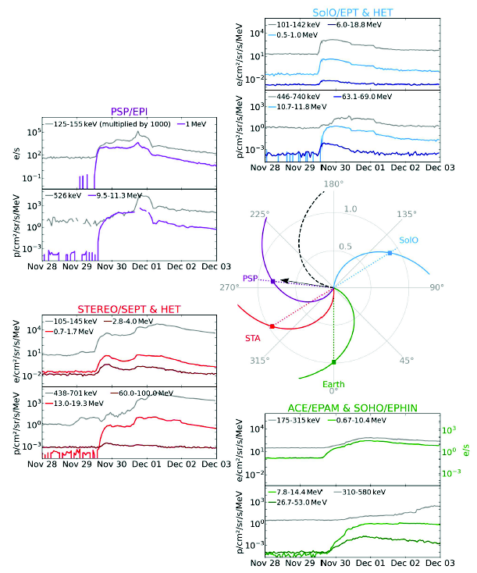
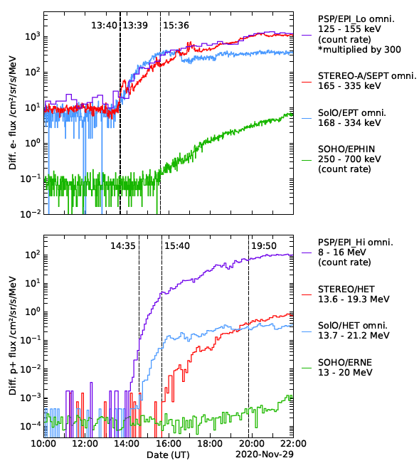
The first wide-spread solar energetic particle event observed by Solar Orbiter on 2020 November 29, Kollhoff et al., A&A
EUV waves are not the likley accelerators of energetic particles.
Very wide (>230°) event poses difficulties to perp. diffuction too.

Slide 33
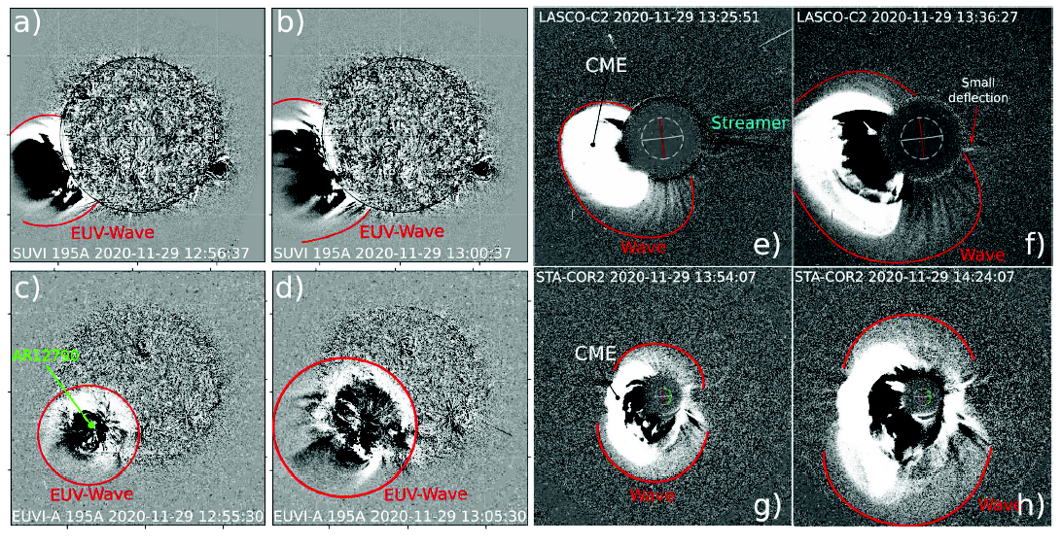
The first wide-spread solar energetic particle event observed by Solar Orbiter on 2020 November 29, Kollhoff et al., A&A

Slide 34
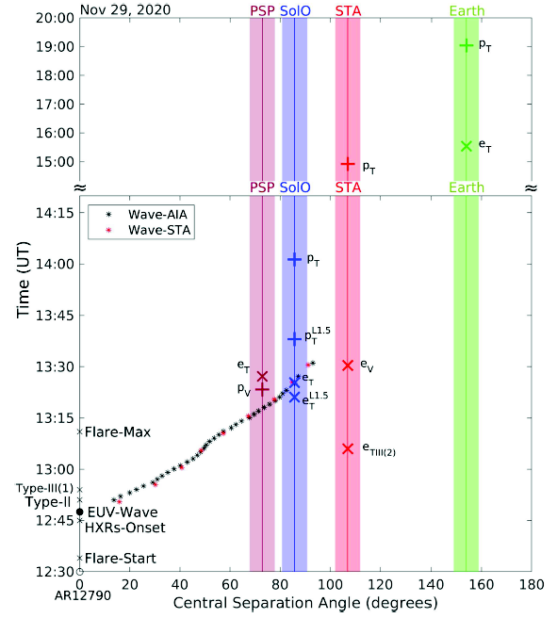
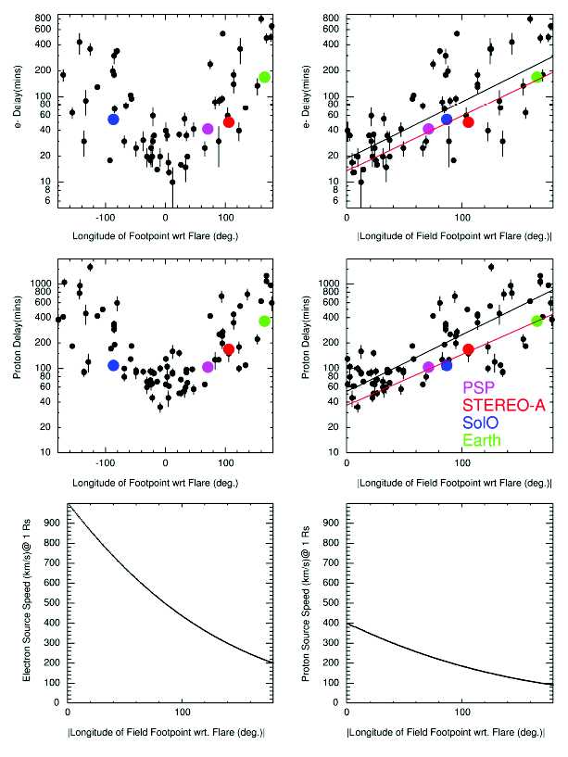
The first wide-spread solar energetic particle event observed by Solar Orbiter on 2020 November 29, Kollhoff et al., A&A

Slide 35
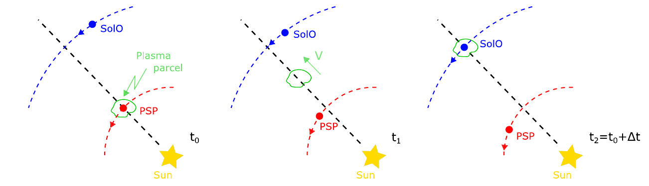
Evolution of Solar Wind Turbulence from 01. to 1 au during the First Parker Solar Probe – Solar Orbiter Radial Alignment
(Telloni et al., 2021, ApJ)

Slide 36
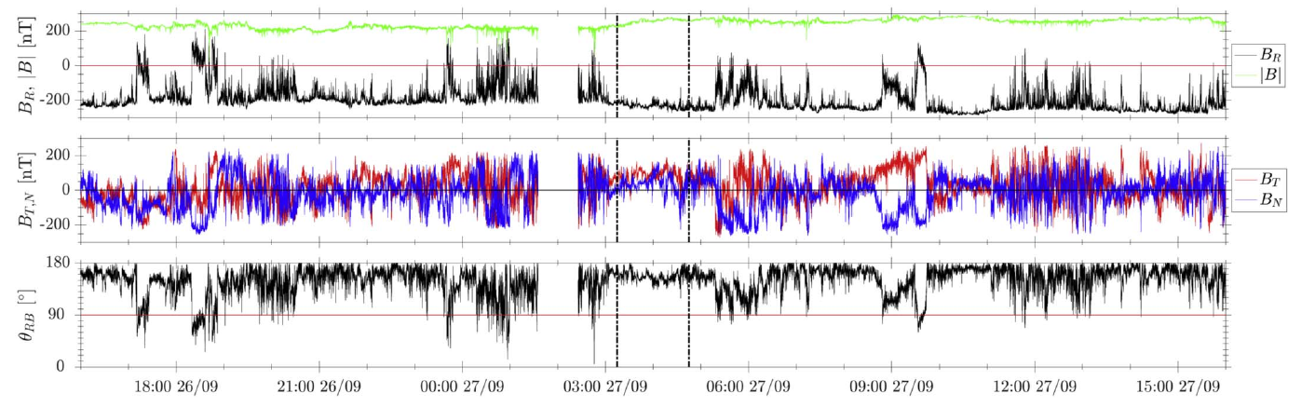
Evolution of Solar Wind Turbulence from 01. to 1 au during the First Parker Solar Probe – Solar Orbiter Radial Alignment (Telloni et al., 2021, ApJ)

Slide 37
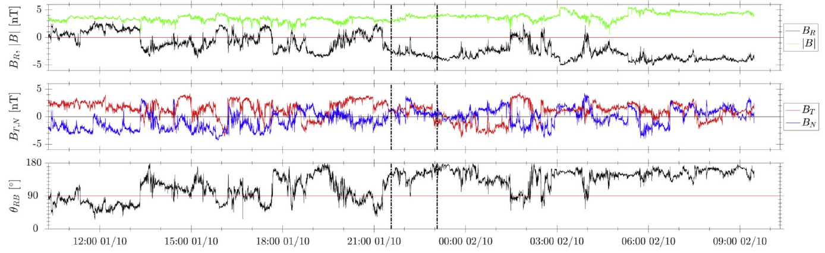
Evolution of Solar Wind Turbulence from 01. to 1 au during the First Parker Solar Probe – Solar Orbiter Radial Alignment (Telloni et al., 2021, ApJ)

Slide 38
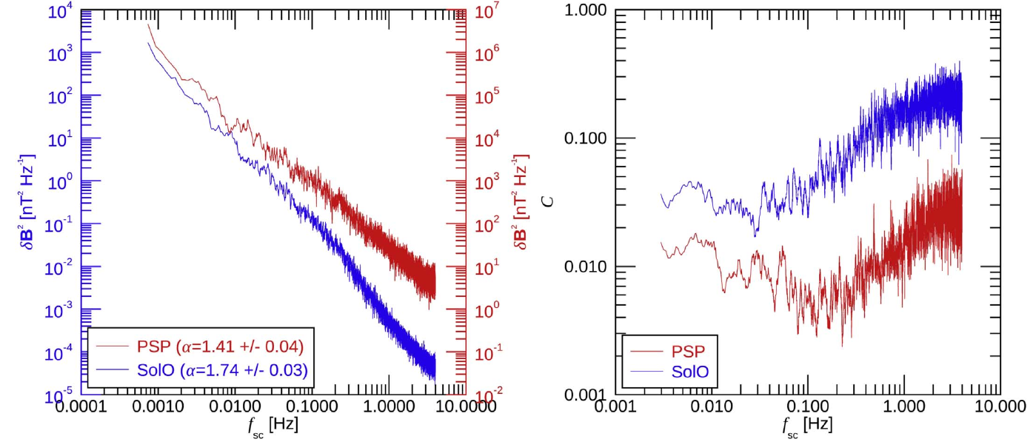
Evolution of Solar Wind Turbulence from 01. to 1 au during the First Parker Solar Probe – Solar Orbiter Radial Alignment (Telloni et al., 2021, ApJ)
Trace of δB²
Compressibility
PSP (0.1 au):
highly Alfvénic, less developed turbulence
SolO (1 au):
Fully developed, intermittent turbulence

Slide 39
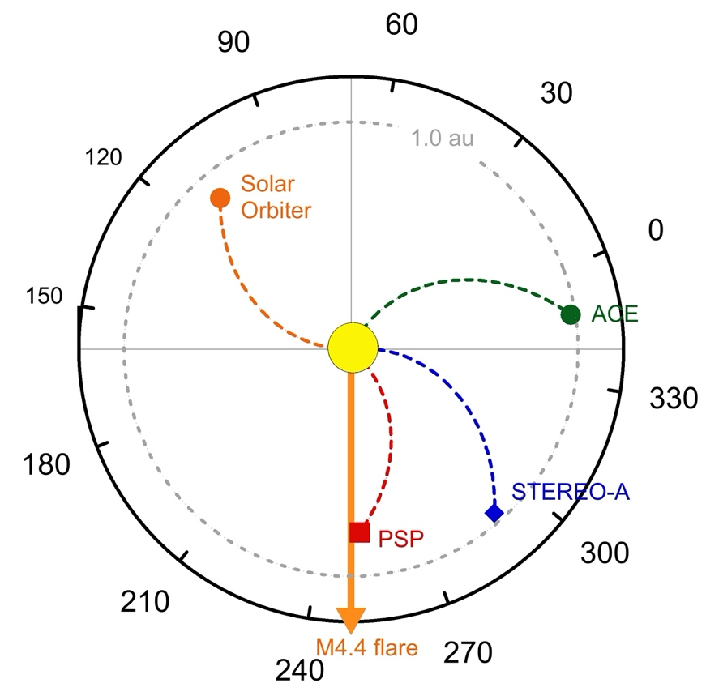

Solar Energetic Particles Heavy Ion Properties in the Widespread Event of 2020 November 29, Mason et al., A&A
„Heavy ions as tracers of the acceleration process“

Slide 40

First near-relativistic solar electron events observed by EPD onboard Solar Orbiter Gomez-Herrero et al., A&A
1
1
Also observed at Wind
Strong anisotropies at both S/C
Separation 107 degrees!
<number>

Slide 41

First near-relativistic solar electron events observed by EPD onboard Solar Orbiter Gomez-Herrero et al., A&A,
5
5
<number>

Slide 42


First near-relativistic solar electron events observed by EPD onboard Solar Orbiter Gomez-Herrero et al., A&A,
But SolO foot- point was >30° behind east limb!
How did electrons reach Solo in this non-radial coronal field configuration?
<number>

Slide 43



The long period of 3He-rich solar energetic particles measured by Solar Orbiter on 2020 November 17 – 23 Bucik et al., A&A

Slide 44



3He-rich solar energetic particle events observed on the first perihelion pass of Solar Orbiter Mason et al., (2020), A&A, https://doi.org/10.1051/0004-6361/202039752
First SolO science paper
accepted for publication

Slide 45


Quiet-time low energy ion spectra observed on
Solar Orbiter during solar minimum, Mason et al., (2020), A&A
Is there a remnant flare population?
2386 hours Apr. 2020 – Jan 2021
192 hours

Slide 46

Evidence for local particle acceleration in the first recurrent Galactic Cosmic Ray depression observed by Solar Orbiter
The ion event of 19 June 2020, Aran et al., A&A
Strong ion event without electrons
Same CIR as observed by Allen et al. shows decreased GCR counts (Forbush decrease) while low-energy ions are accelerated in-situ by stochastic acceleration.

Slide 47


Evidence for local particle acceleration in the first recurrent Galactic Cosmic Ray depression observed by Solar Orbiter
The ion event of 19 June 2020, Aran et al. A&A

Slide 48
Suprathermal particles from corotating interaction regions during
the first perihelion pass of Solar Orbiter, Allen et al., (2020), A&A

Slide 49


Suprathermal particles from corotating interaction regions during
the first perihelion pass of Solar Orbiter, Allen et al., (2020), A&A

Slide 50

Suprathermal particles from corotating interaction regions during
the first perihelion pass of Solar Orbiter, Allen et al., (2020), A&A
0.9 – 2.2 MeV H+
226 – 320 keV/nuc ⁴He

Slide 51

Extreme-UV quiet Sun brightenings observed by the Solar Orbiter/EUI Berghmans et al., (2021), A&A

Slide 52

Extreme-UV quiet Sun brightenings observed by the Solar Orbiter/EUI Berghmans et al., A&A
Size distribution of these flares? Expect power law, as normal in nature.

Slide 53

Extreme-UV quiet Sun brightenings observed by the Solar Orbiter/EUI Berghmans et al., A&A
Example of an elongated campfire observed by both AIA (bottom) and EUI (top).

Slide 54


Extreme-UV quiet Sun brightenings observed by the Solar Orbiter/EUI Berghmans et al., A&A
Subsample of 16
campfires also observed
with SDO/AIA allows
triangulation.
1000 – 5000 km above
photosphere
i.e., located above
chromospheric
network
Expected for semi-circular loop.
Loops are elongated in height.

Slide 55


Extreme-UV quiet Sun brightenings observed by the Solar Orbiter/EUI Berghmans et al., A&A
One single pixel (excluded)
Single exposure (excluded)

Slide 56

Extreme-UV quiet Sun brightenings observed by the Solar Orbiter/EUI Berghmans et al., A&A
9800 campfire pixels
1.1 x 10⁸ pixels total
1000 – 5000 km above
photosphere
Located above
chromospheric
network

Slide 57
Summary & Conclusions
We’ve launched!
Science starting to pour out
    deadline for next A&A special issue: Dec 1, 2022!
Data freely available 90 days after receipt on the ground (or quicker)
    See SOAR: https://soar.esac.esa.int/soar/
The future is multi-point with the “Grand Heliospheric Observatory”
The inner heliosphere is exciting:
    seed population, injection, acceleration, and transport all in action

Slide 58





EPD SOAR: http://soar.esac.esa.int/soar/
EPD data at the SOAR:
From launch up to 90 days after receipt on ground
Monthly updates
Thanks:
<number>

Slide 59
Particle Populations in the Heliosphere

