Slide 1

Heliospheric physics and solar wind
Robert F. Wimmer-Schweingruber
“Bob Wimmer“
Institute of Experimental and Applied Physics
Christian-Albrechts-University of Kiel, Germany
Email: wimmer@physik.uni-kiel.de
2022 USTC Summer School, August 1, 2022

Slide 2
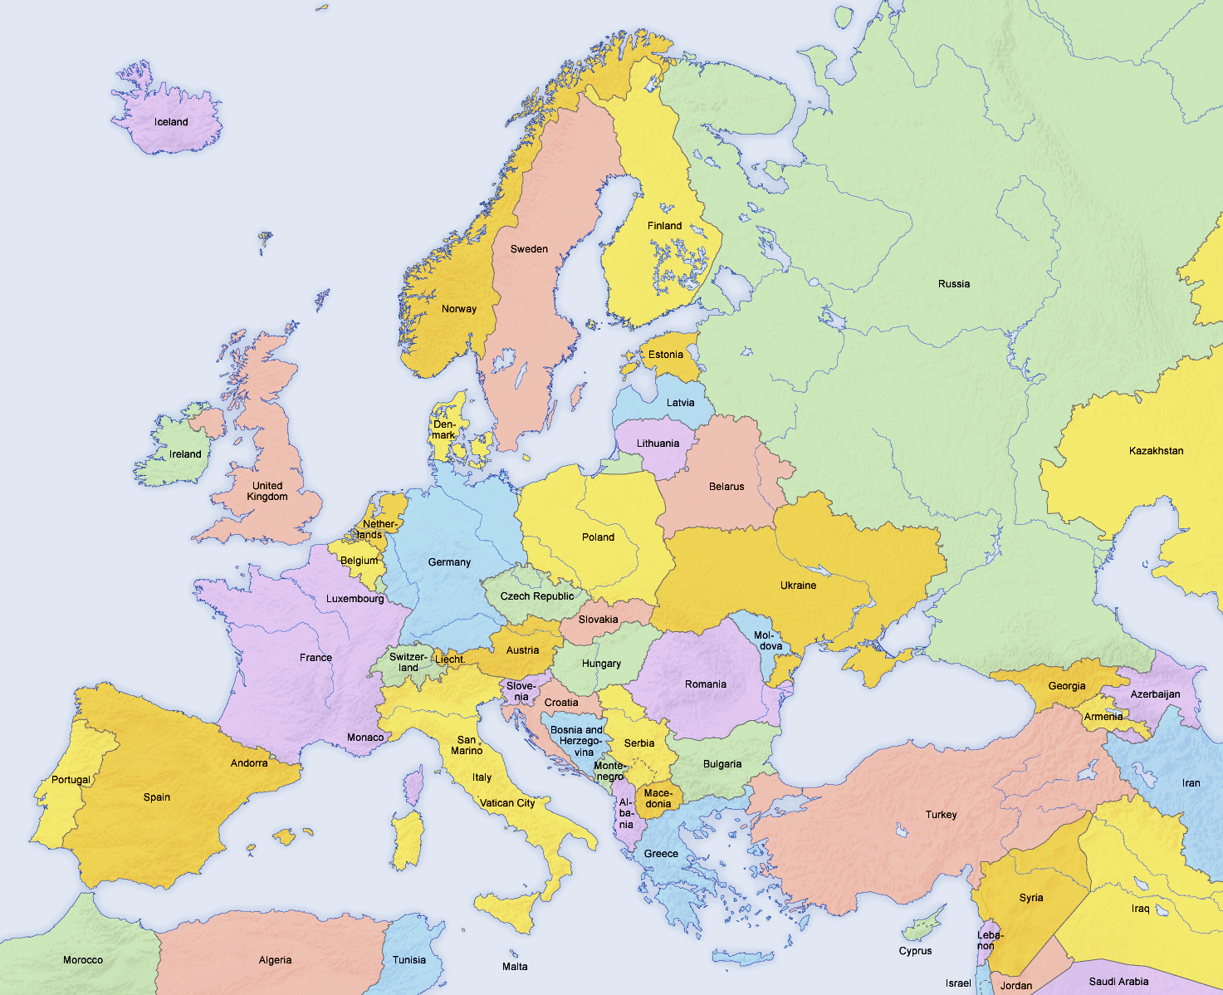
Kiel

Slide 3
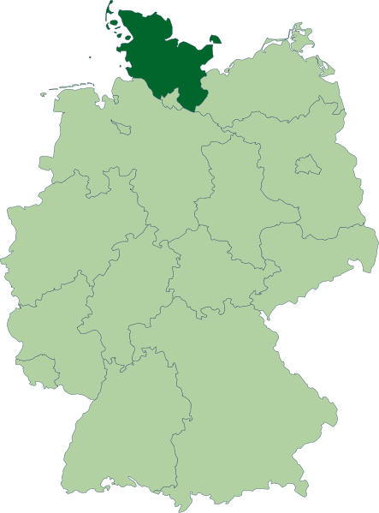
Schleswig-Holstein in a nutshell
“Land between two Seas”
“Prettiest Bundesland in the World”
“To live where others go on vacation”
Small state populationwise (~2.8 million)
Used to be the poorest state before reunificaton. Still poor,....
Geologically formed as end moraines of the Scandinavian glaciers
Vivid Viking history and even from the stone-age. Vikings used the Schlei near Schleswig to cross from the North Sea to the Baltic.
Historically changed between Denmark, Sweden, & Prussia, which can be seen in many names such as Dänischer Wohld, Schwedeneck, etc. (But no such implication for the “Holsteinische Schweiz”!)

Slide 4
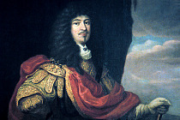

The Christian-Albrechts-University of Kiel
Founded in 1665 by Christian Albrecht, Duke of Holstein-Gottorp
Currently some 27'000 students of which ~2'000 foreigners
8 colleges (apart from the traditional 7, also a technical college)
2 (3) Centers of Excellence
10 'Sonderforschungsbereiche'
College of Mathematical and Natural Sciences has some 5'700
students, in near-perfect gender balance (!) and roughly 1'200 new students every year. About 150 PhDs per year (50/50 too). One of the highest amounts of third-party funding per professor in Germany.

Slide 5
Outline
The heliosphere: a plasma bubble in the interstellar medium
The solar wind
Solar wind interaction with planets and moons
Suprathermal and Solar Energetic Particles
Solar Energetic Particles & Galactic cosmic rays
Implications for exploration of the solar system

Slide 6
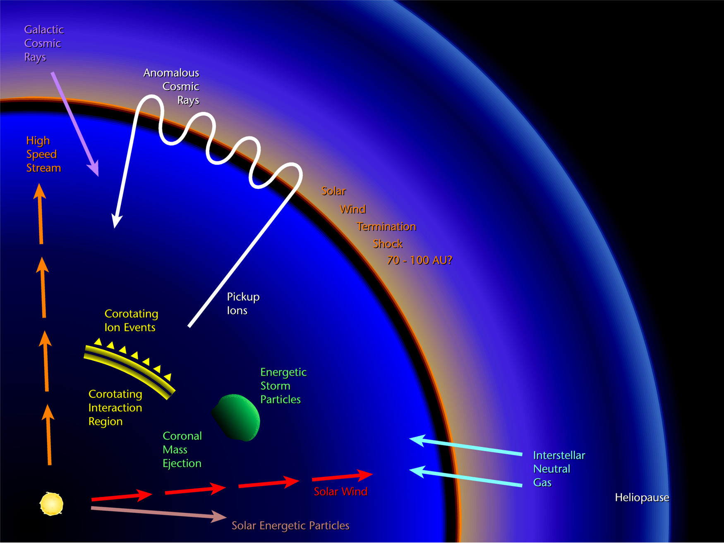
Particles in the Heliosphere: The heliosphere

Slide 7
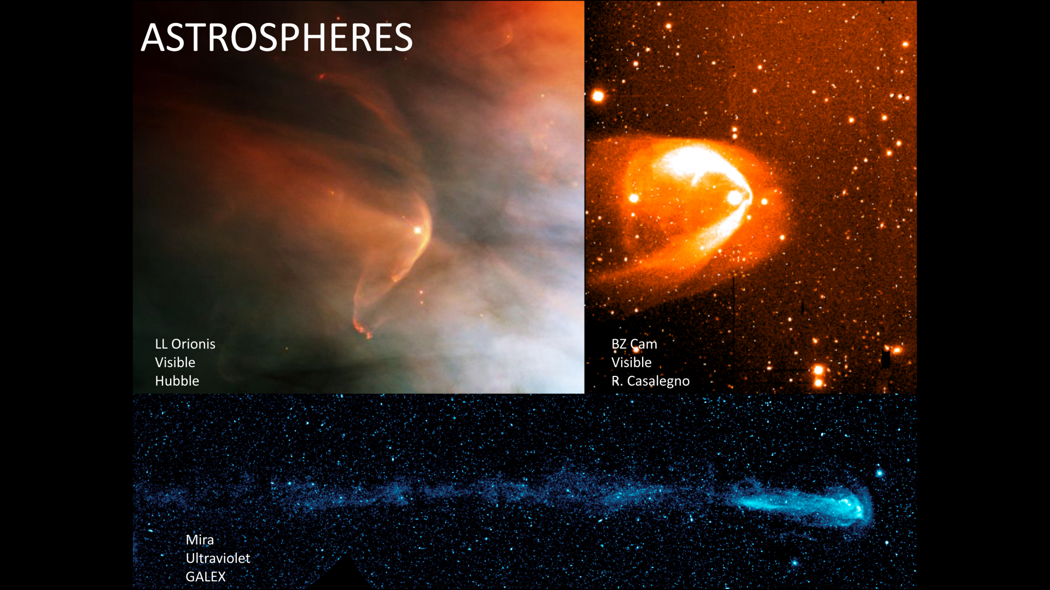

Slide 8
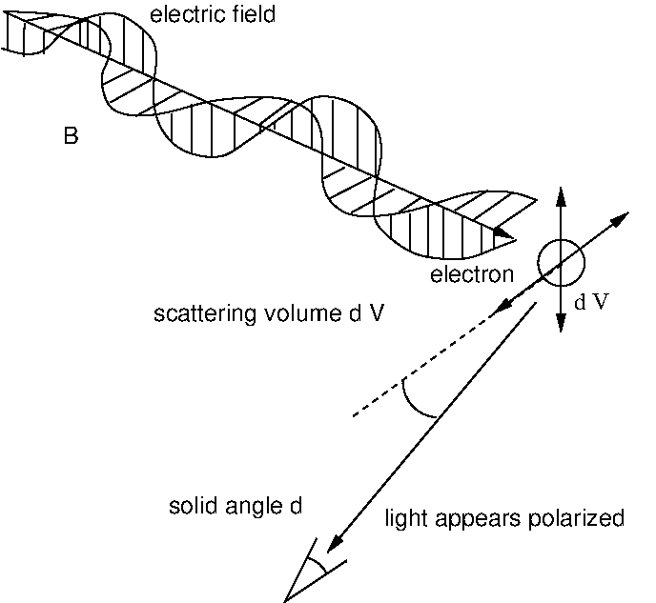
Solar Wind Primer:
E
Ω

Slide 9
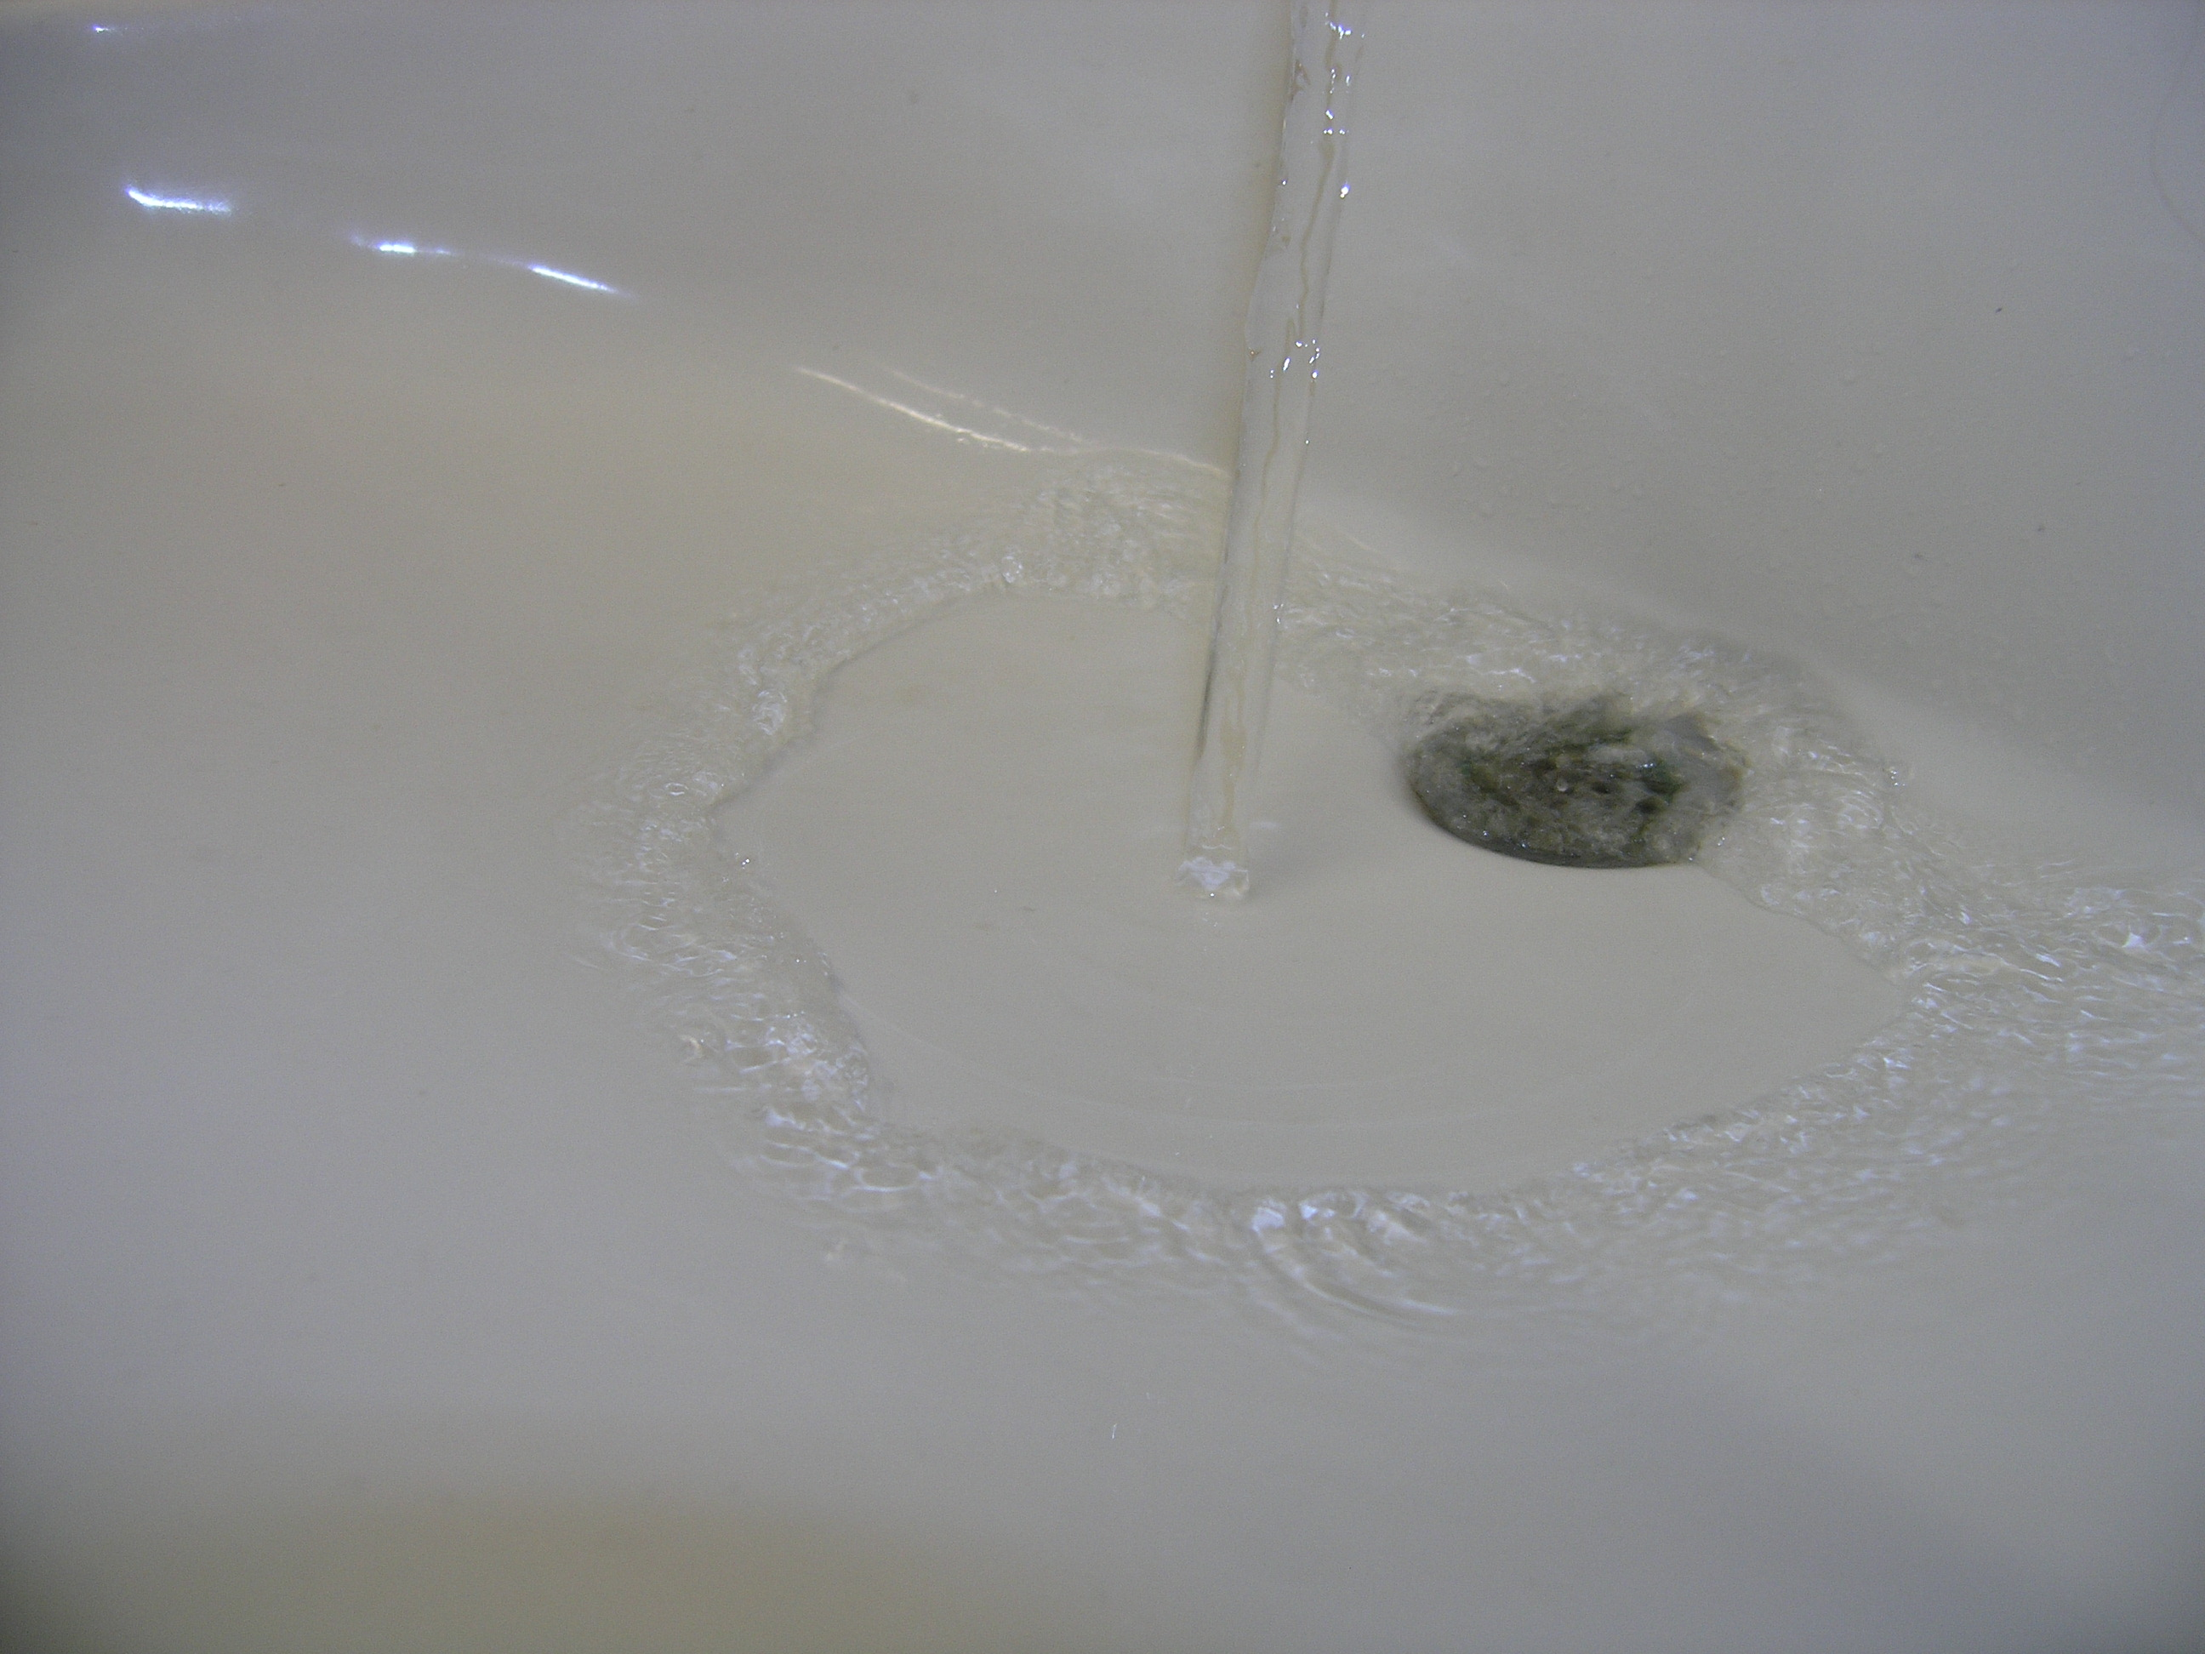
The Sun is in the center

Slide 10
The Sun is in the center and drives the solar wind

Slide 11
Which turns subsonic at about 100 astronomical units

Slide 12
Local interstellar
medium
Sun
Solar wind
Termination
shock
Heliopause
Very simple model of the heliosphere

Slide 13
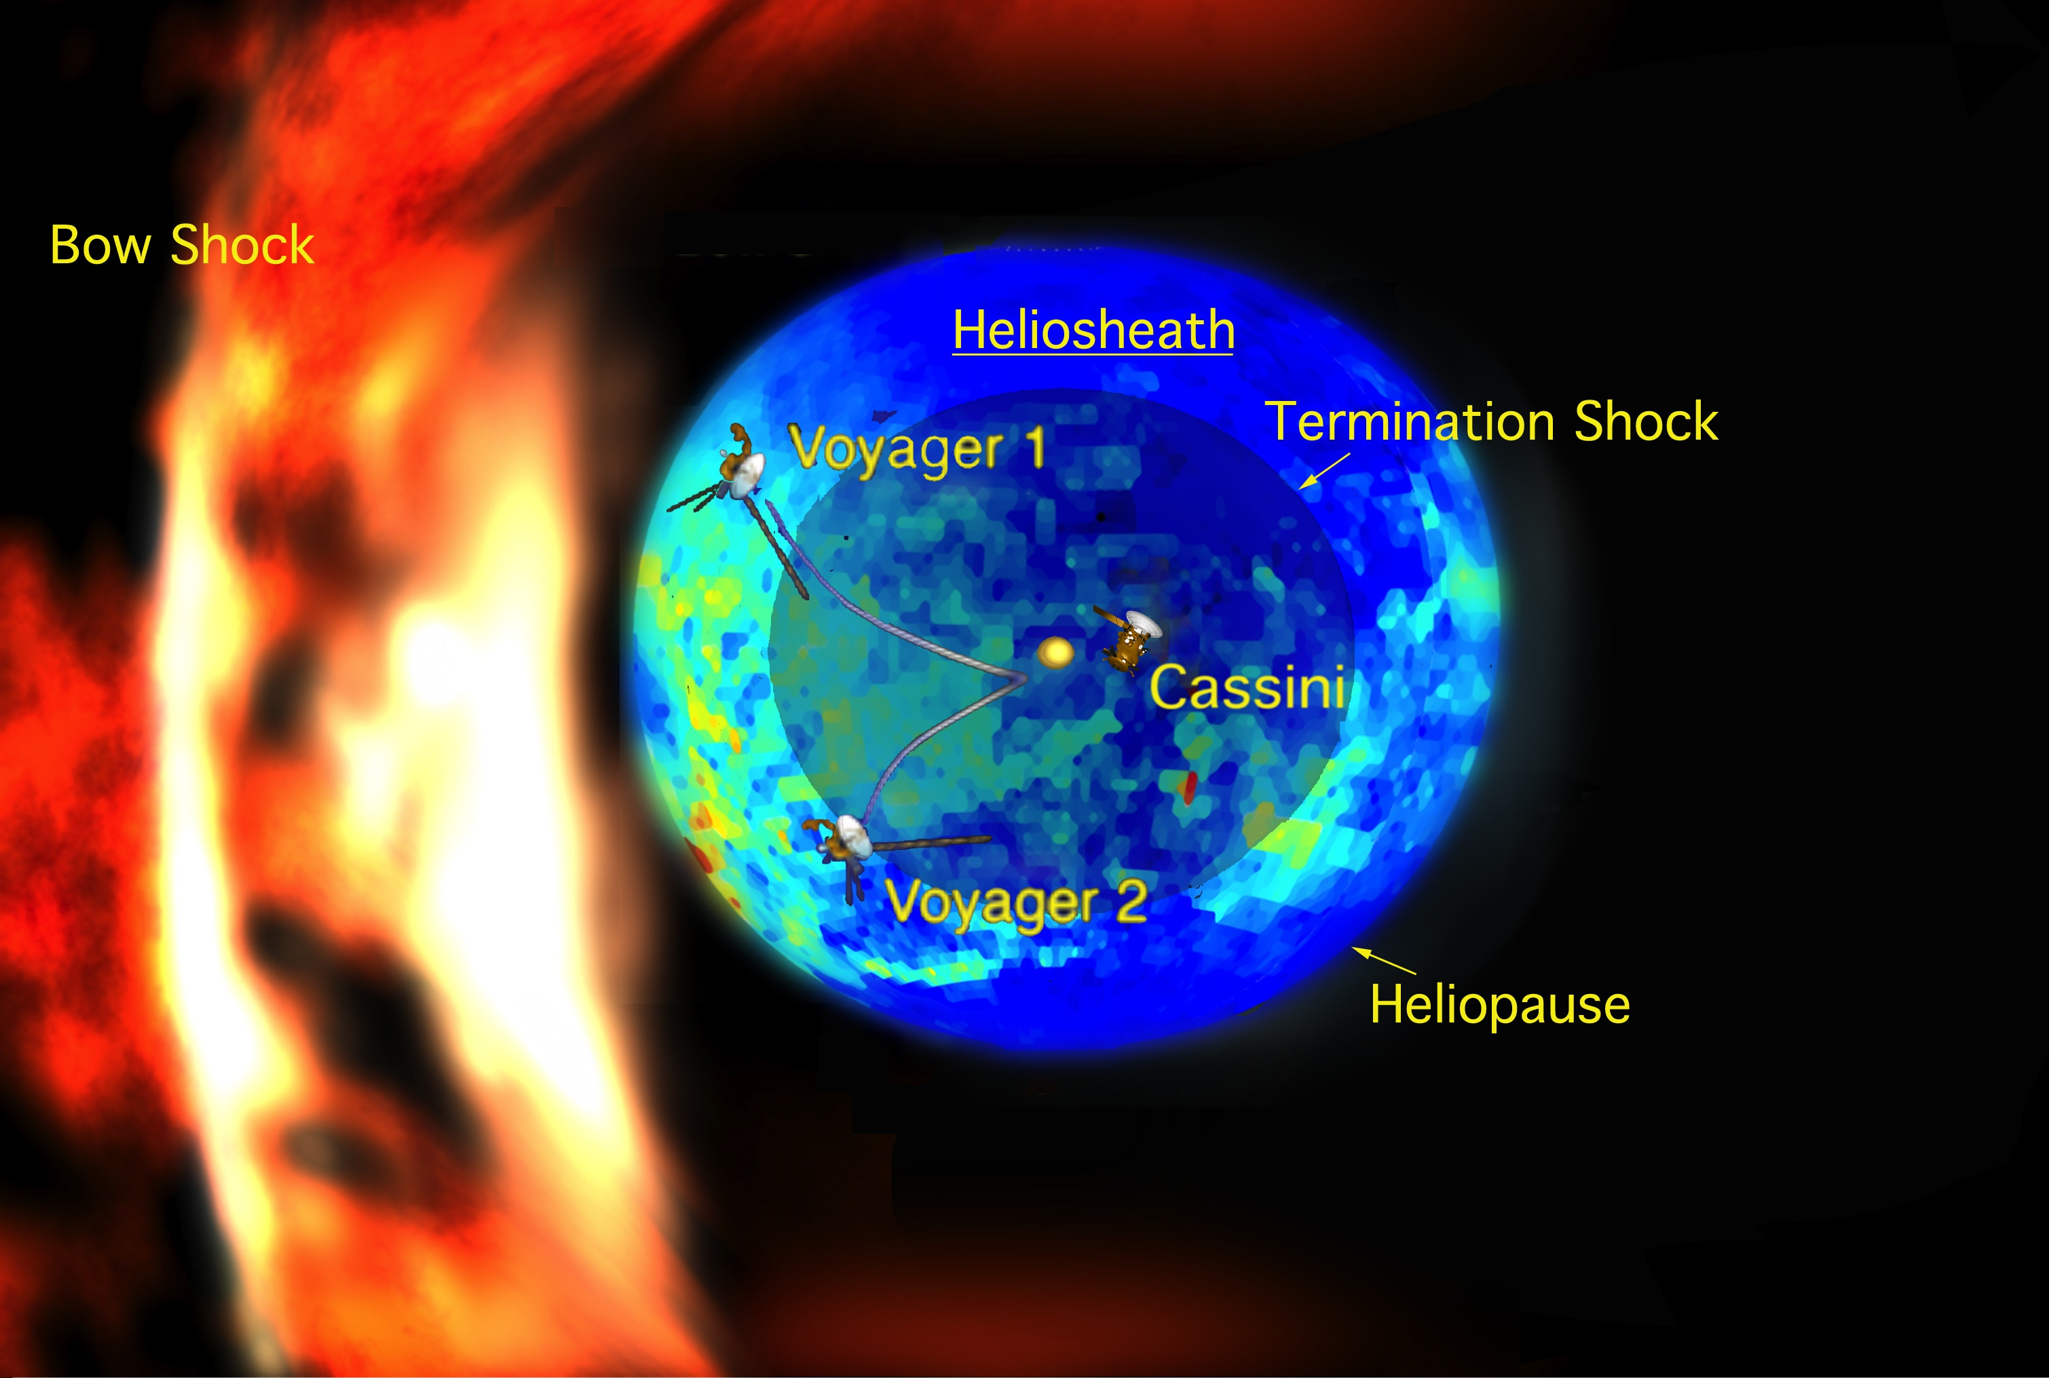
Voyager observations of the termination shock and heliopause

Slide 14
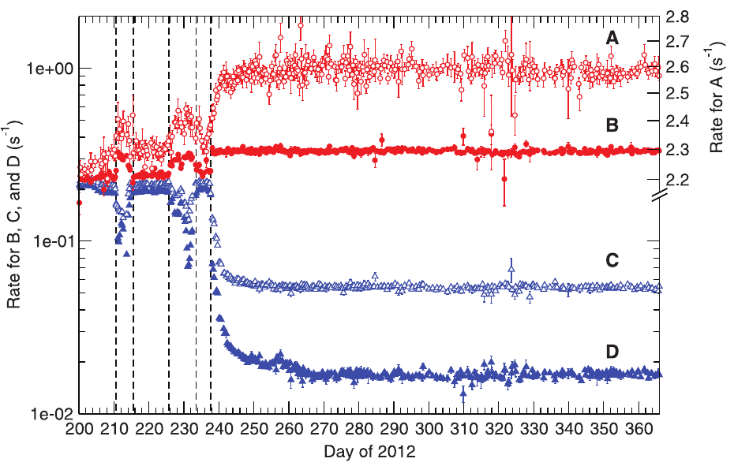
Voyager observations of the termination shock and heliopause
(Stone et al., 2013)

Slide 15
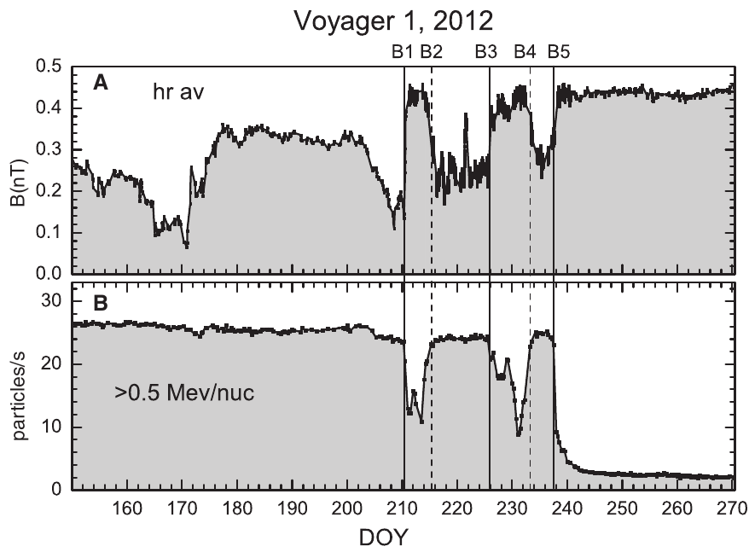
Voyager observations of the termination shock and heliopause
(Burlaga et al., 2013)

Slide 16
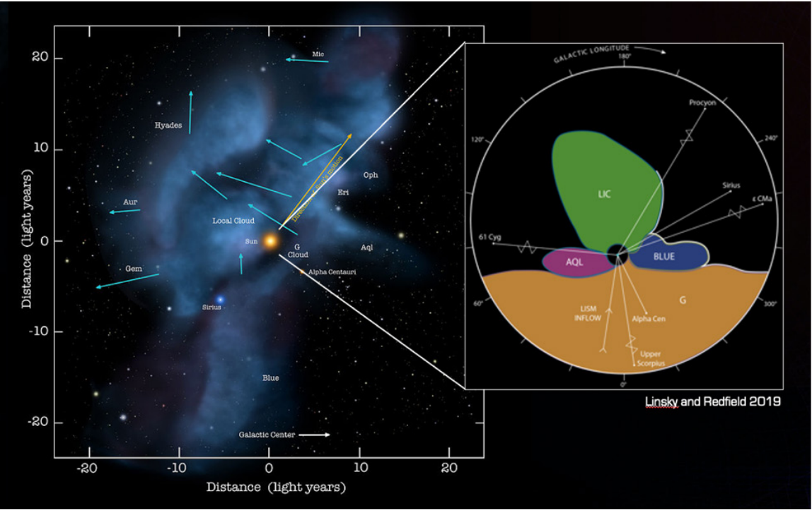
The interstellar medium
We may be about to leave the local interstellar cloud, … in the next few 1000 years!
(Adler Planetrium)

Slide 17
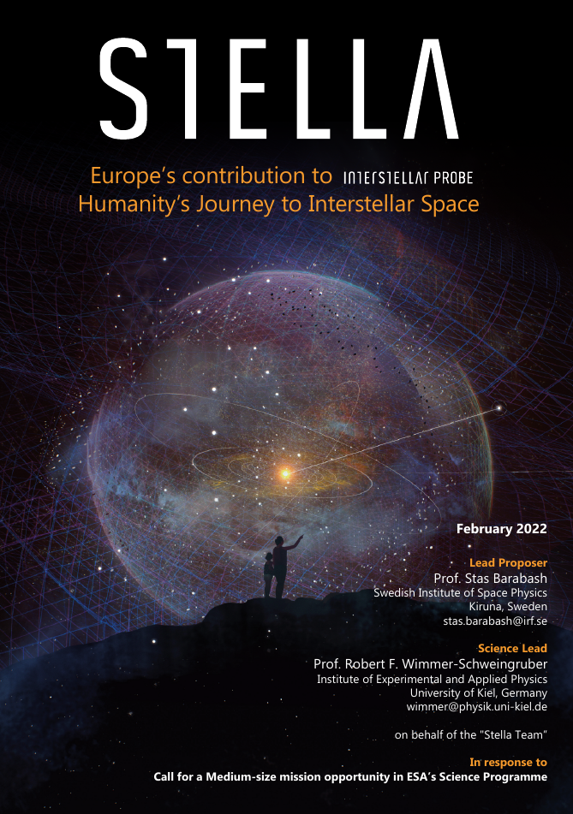
Interstellar Probe
Voyagers were not equipped to measure termination shock, heliosheath, heliopause, LISM.
Voyager‘s power will soon cease.
The interesting part lies beyond Voager‘s reach.
An interstellar probe should:
- reach at least 300 au
- carry appropriate instruments
Would be a multi-generation mission (50+ years).
https://interstellarprobe.jhuapl.edu/

Slide 18
Particles in the Heliosphere: The solar wind

Slide 19
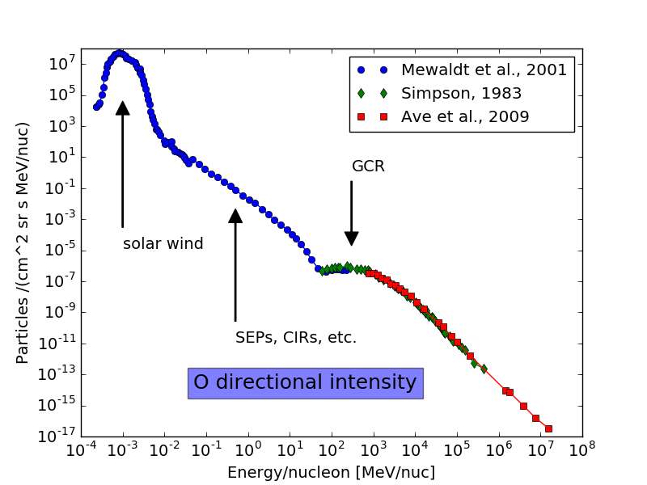
Long-term average particle spectrum
suprathermal
energetic
Proton rest mass
(thermal)
Very high energy

Slide 20
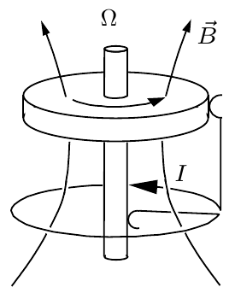


The solar dynamo – origin of the solar magnetic field
Simplest possible illustration: Bullard‘s dynamo.
Every dynamo must show differential rotation!
There is no axially symmetric dynamo!
(Cowling‘s theorem)
solution
Simplest possible dipole is tilted with respect to the solar rotation axis!
But solar magnetic field varies with time (and not exponentially)!
Need more complex model.

Slide 21
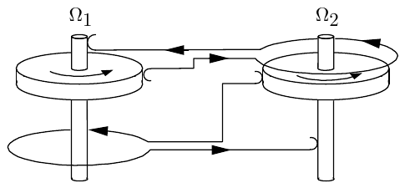
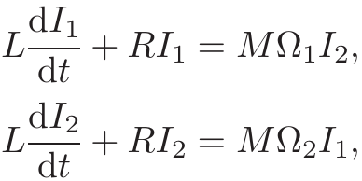
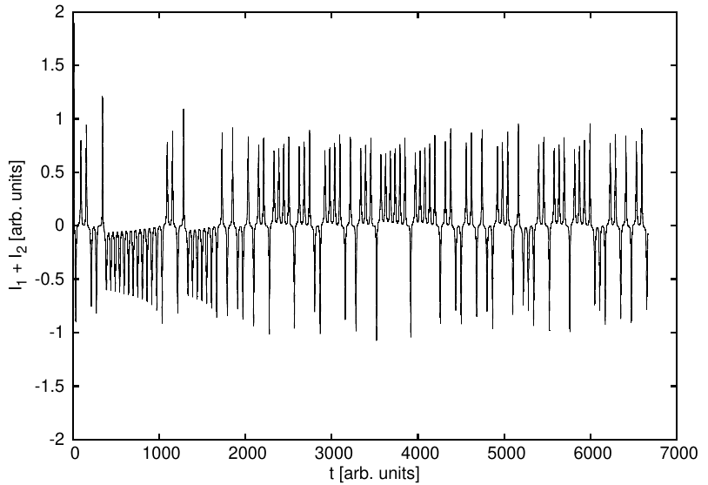
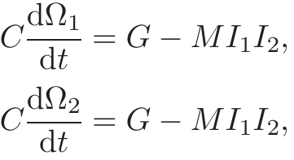
The solar dynamo – origin of the solar magnetic field
Rikitake‘s geodynamo model is chaotic and can reproduce some important features of the geodynamo and by inference of the solar dynamo.
and

Slide 22
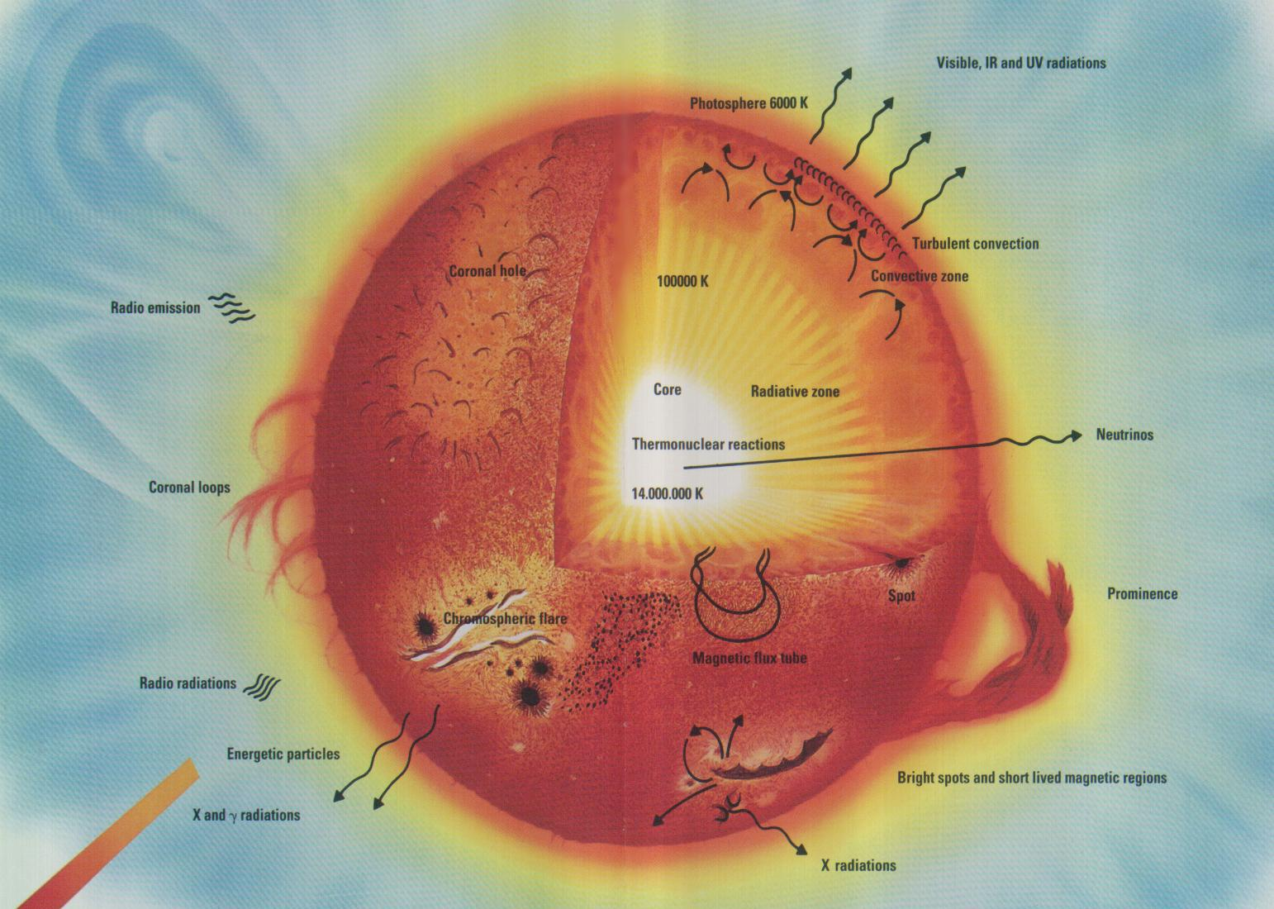
Internal structure of the Sun & dynamo

Slide 23
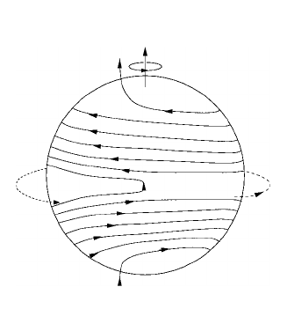
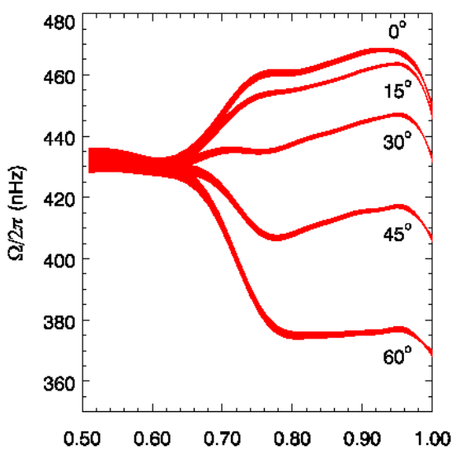
Differential rotation and sunspots
The Sun rotates differentially. Slow rotation at the poles, faster at the equator.
This „wraps up“ magnetic field lines. Magnetic buoancy leads to sunspots.

Slide 24
Sunspots and corona
The photospheric magnetic field (left) extends to coronal loops (right) that are very dynamic.

Slide 25
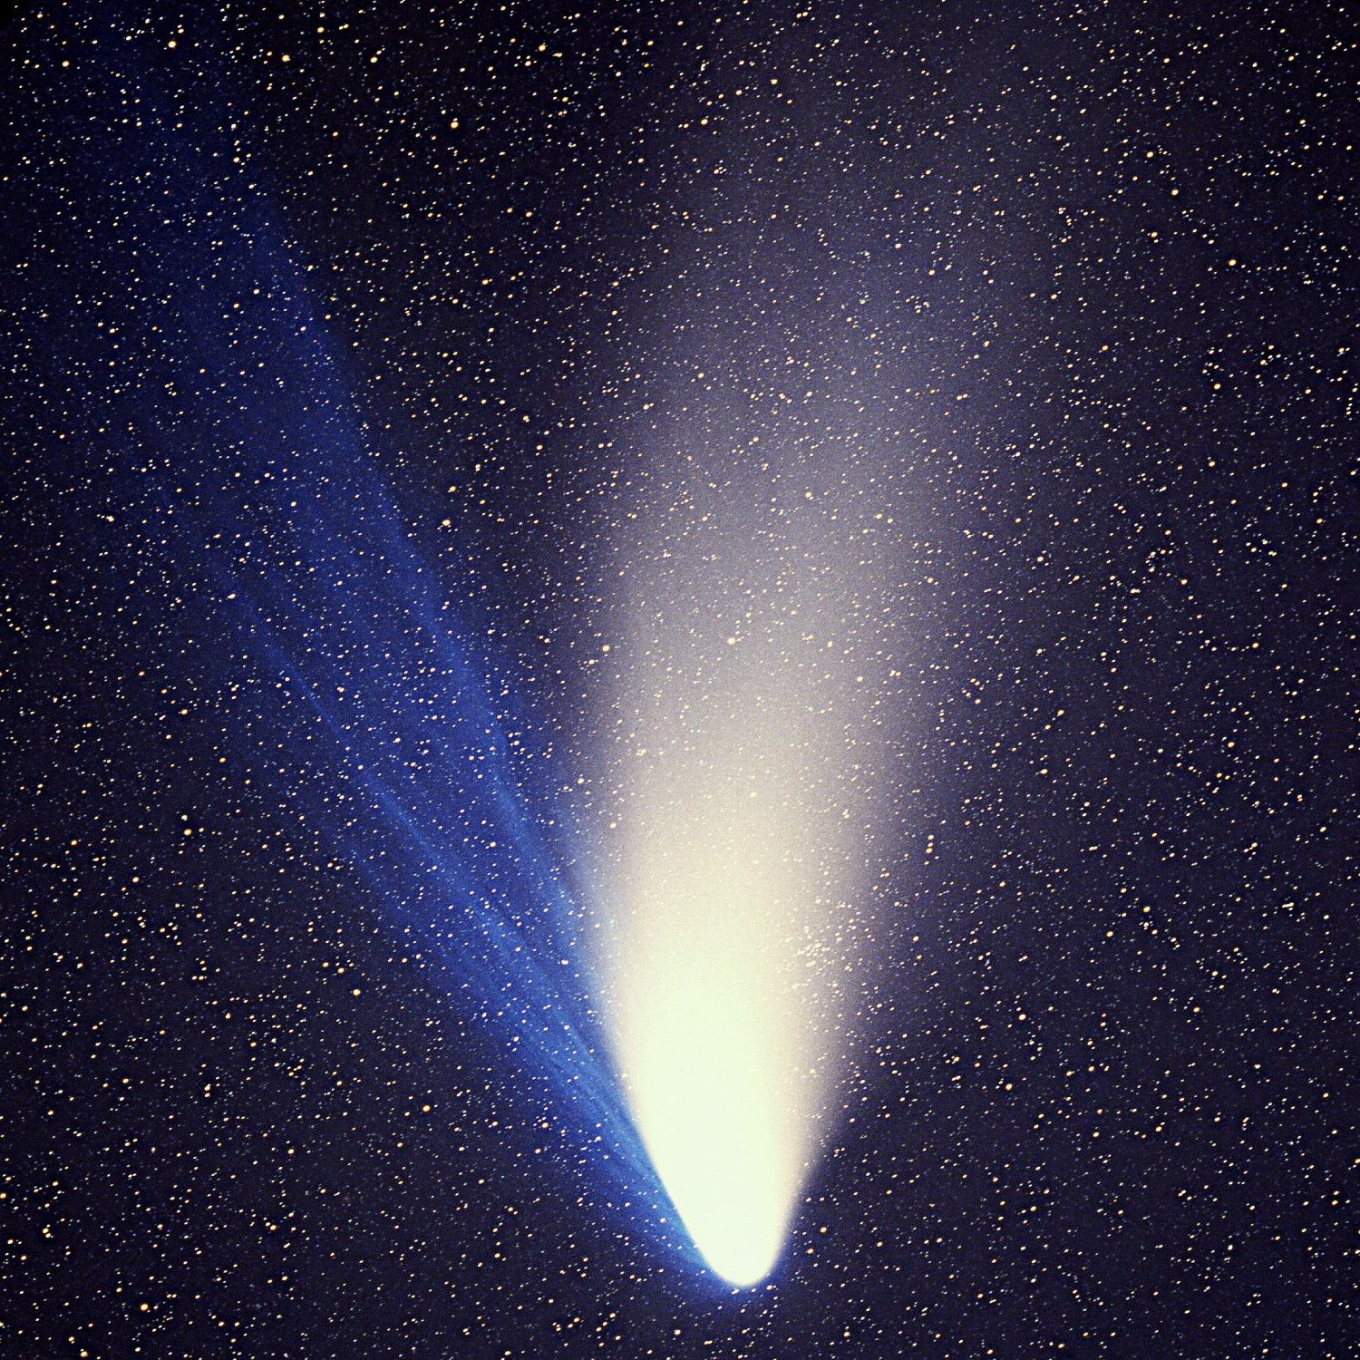
The solar wind – Introduction
Fast solar wind
Slow solar wind
Coronal Mass Ejections
Dust tail
Towards the Sun
Ion tail

Slide 26
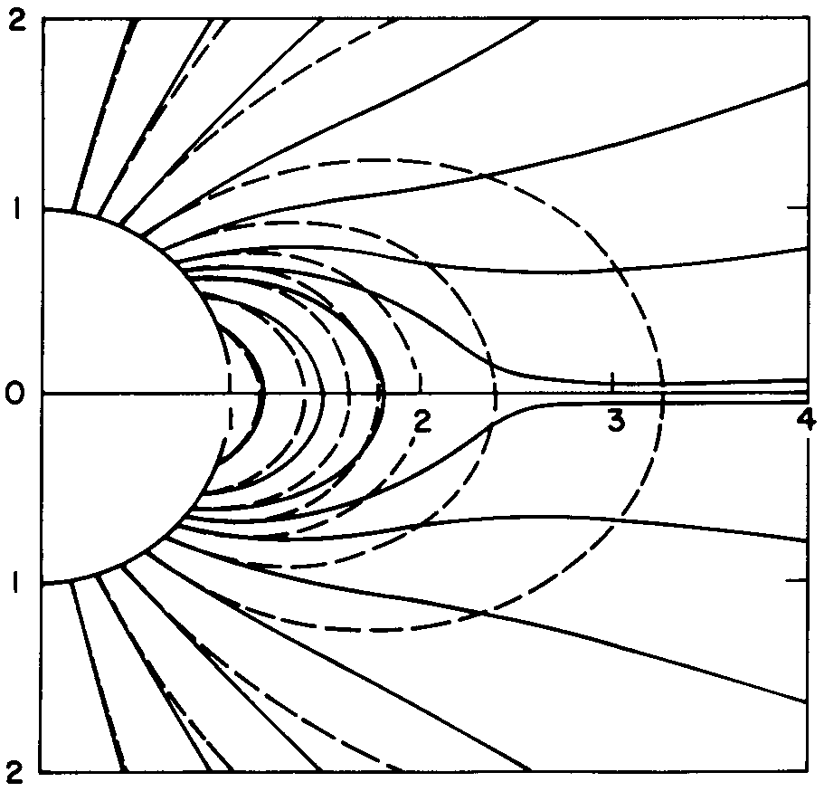
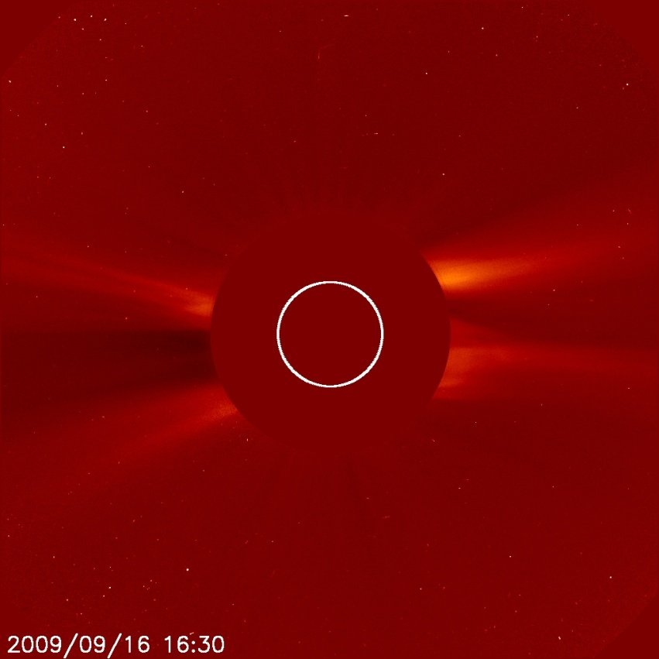
Formation of the solar wind
How does the solar magnetic field expand and fill the heliosphere?
The solar magnetic field is deformed and carried outwards by the expanding solar wind.
Simple model looks similar to oberved coronal structures.
(Pneumann and Kopp, 1971)

Slide 27
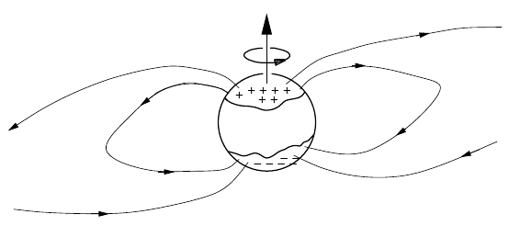
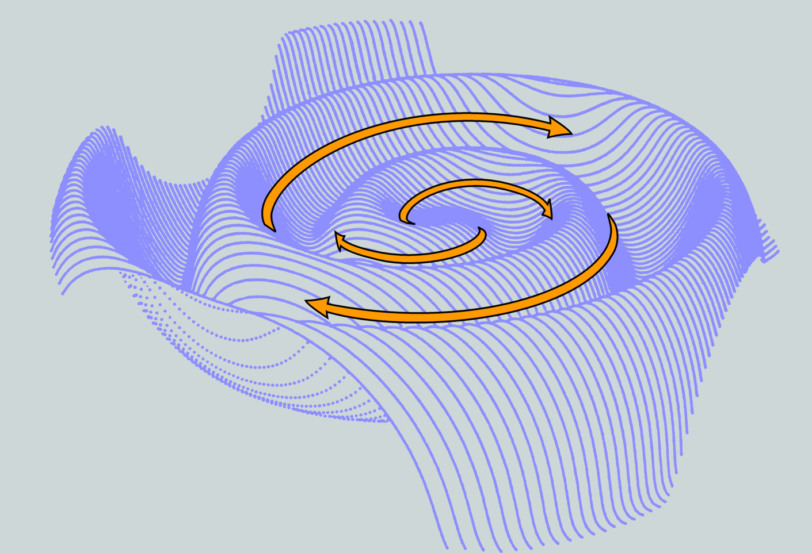
The Heliospheric Current Sheet
Because the Sun's rotation axis is tilted by 7.25 degrees wrt. the ecliptic, and the dynamo‘s dipole axis is tilted wrt. the solar rotation axis (Cowling!) a warped current sheet forms. This was coined the „ballerina skirt“ by Alfvén.

Slide 28
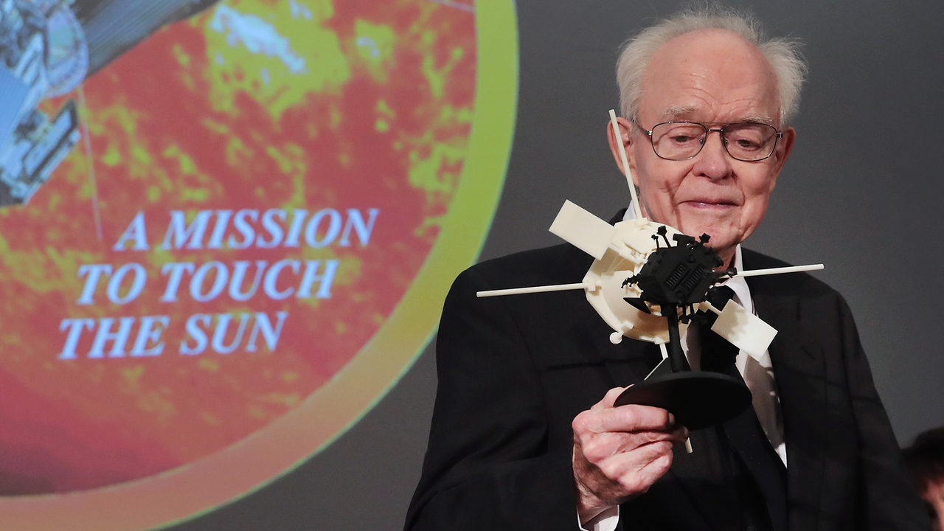
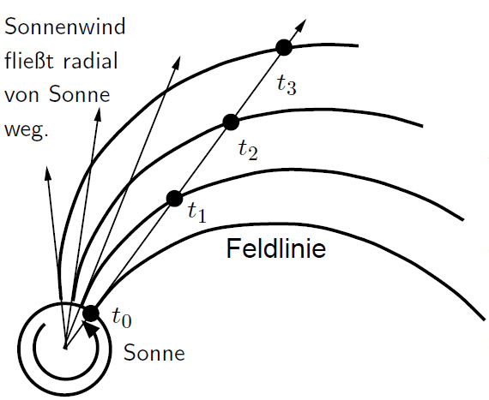
The Heliospheric Magnetic Field – Parker spiral
Solar wind flows radially away from the Sun.
Radially expanding solar wind pulls along the frozen-in magnetic field.
This results in the formation of an Archimedean spiral.
In honor of Eugene Parker this is called the Parker spiral.

Slide 29
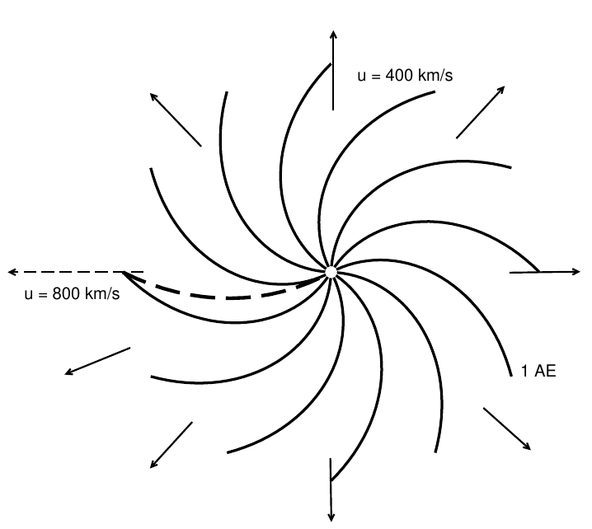
The Heliospheric Magnetic Field – Parker spiral seen from „above“
Some quick questions:
Which way is the Sun rotating here?
Why are the field lines bent this way?
Why are they less bent for the fast solar wind?

Slide 30
Discoveries of the solar wind
Birkeland, Fitzgerald, and Lodge posited that the Sun had to emit a continuous particle stream to explain comet tails and magnetic disturbances & aurorae at Earth.
These ideas were forgotten…
… and picked up by Ludwig Biermann in the early 1950s.
It was measured for the first time about a decade later.
Ion tail
Dust tail
Towards the Sun

Slide 31
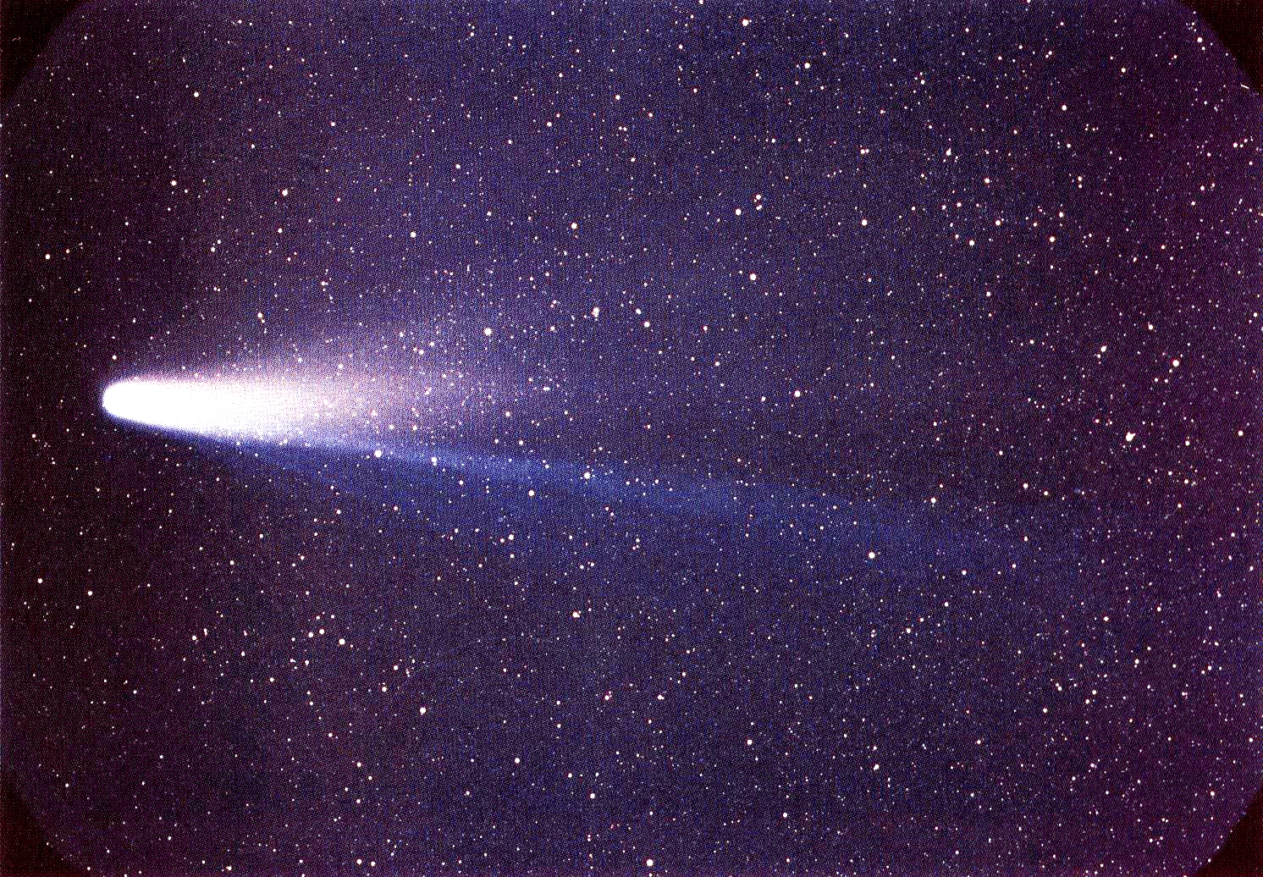
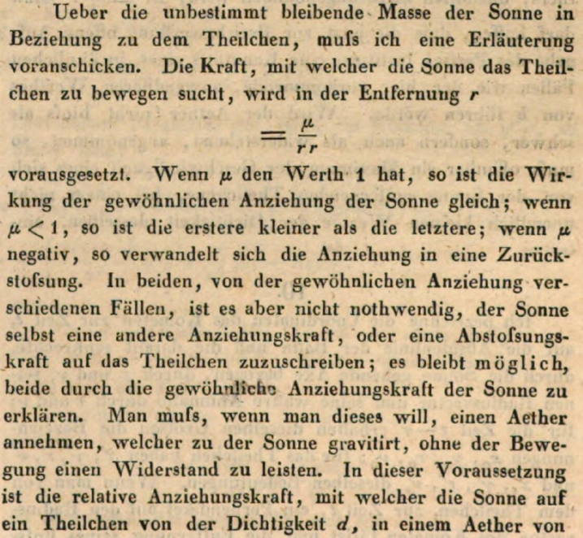
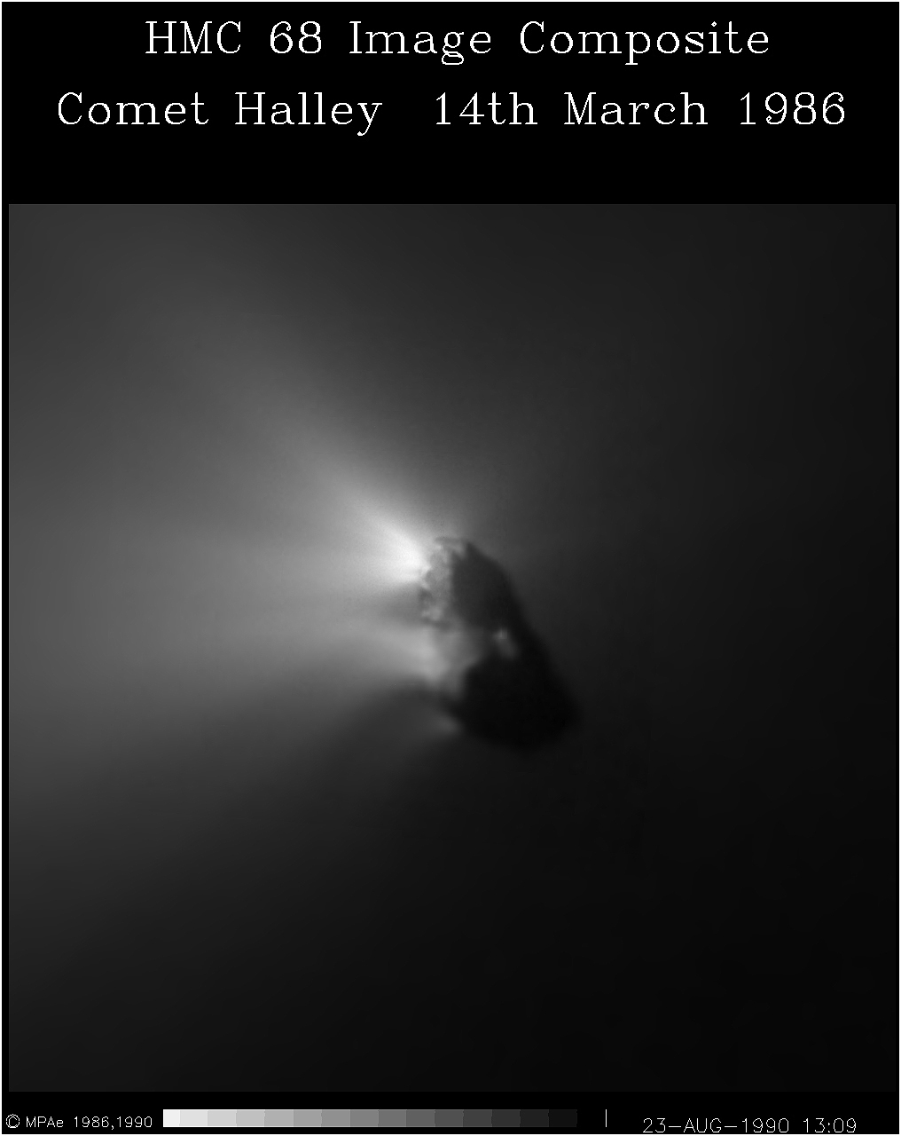
Discoveries of the solar wind
In fact, those ideas were even older and had already been hinted at by Bessel and discussed by Bredichin (discussing Halley‘s comet).
(Bessel, Astron.Nachr., 13, 1836, 299)

Slide 32
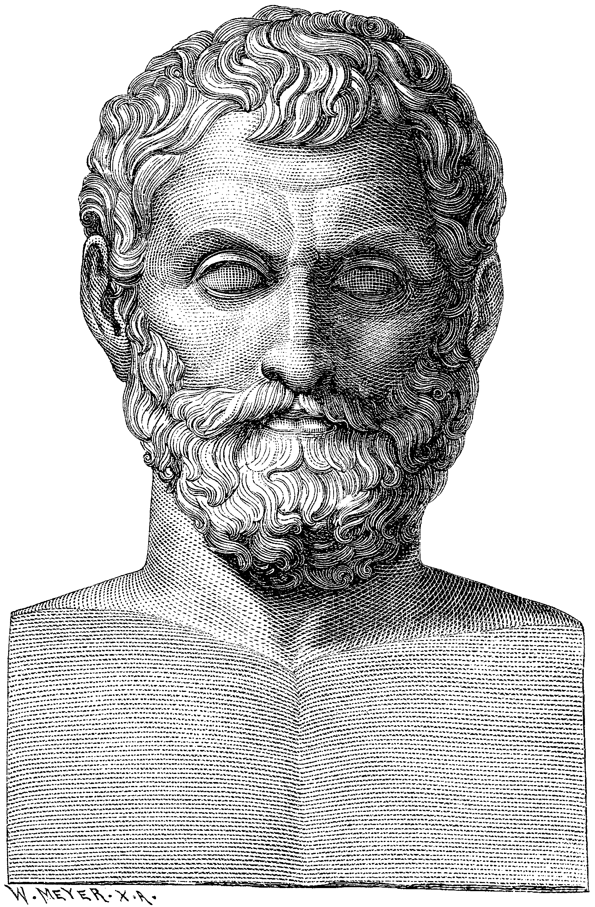
Three kinds of solar wind: slow, fast, ICMEs
E
Ω
Don‘t forget:
Thales of Miletus

Slide 33
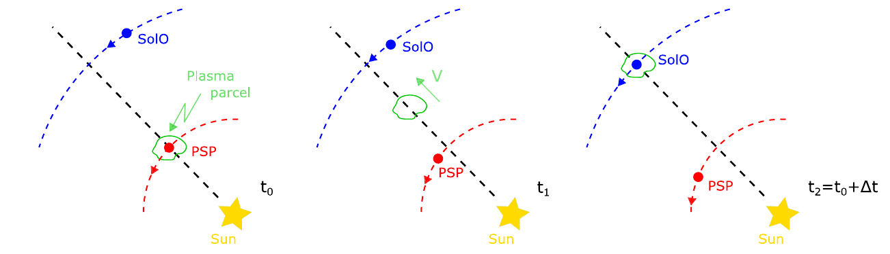
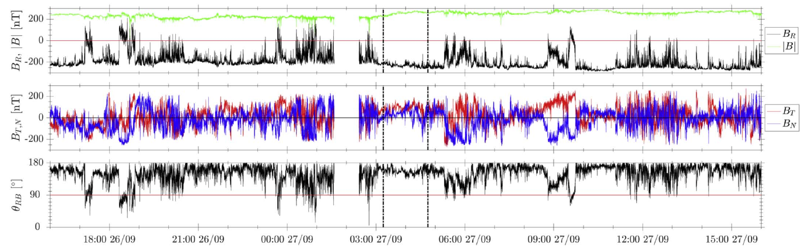
Radial evolution of the solar wind
(Telloni et al., ApJ, (2021))

Slide 34
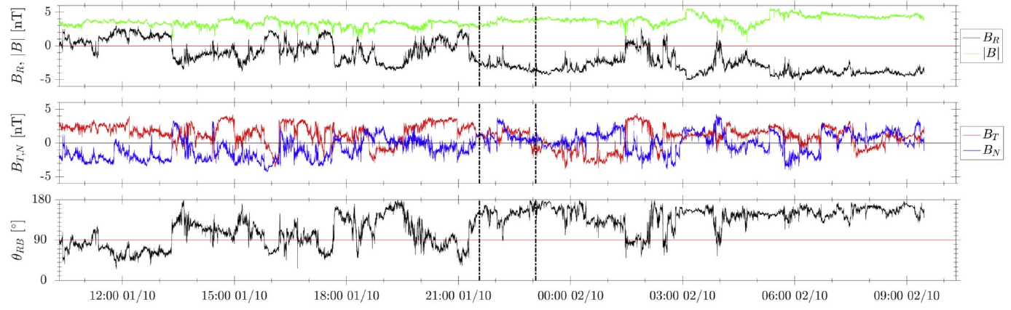
Radial evolution of the solar wind

Slide 35
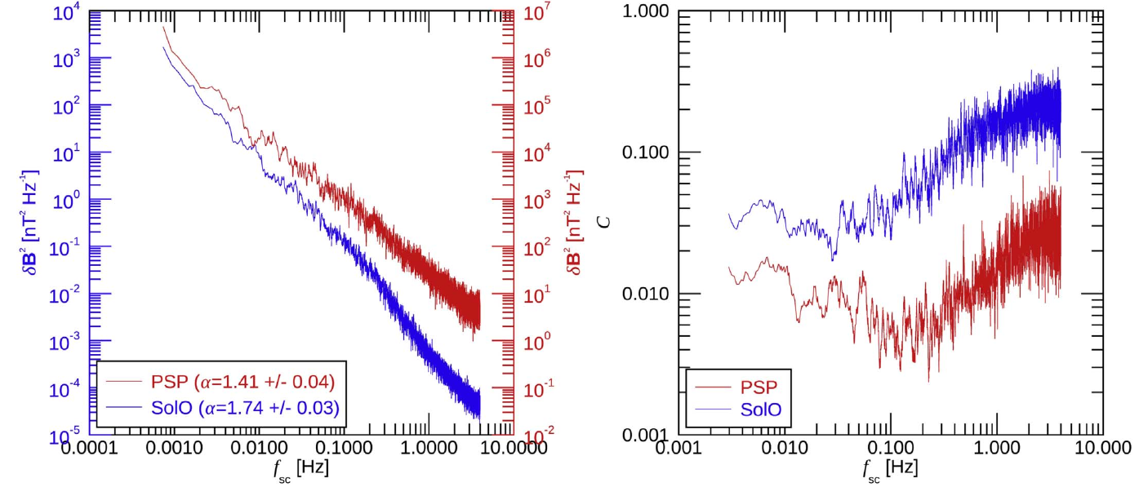
Radial evolution of the solar wind
Trace of δB²
Compressibility
PSP (0.1 au):
highly Alfvénic, less developed turbulence
SolO (1 au):
Fully developed, intermittent turbulence

Slide 36
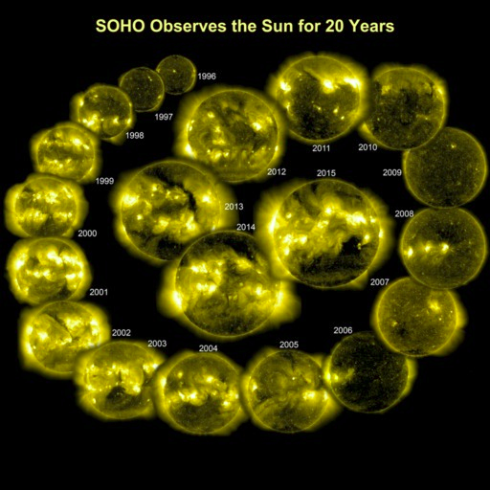
Solar Wind Primer:
Fast solar wind (> 450 km/s) from coronal holes
Fairly uniform but strong turbulence, dynamically „young“ SW
Slow solar wind (< 450 km/s) from unknown regions in streamer belt
Highly variable, dynamically „old“
Active regions, interchange reconnection, S-web
(Interplanetary) Coronal Mass Ejections (I)CMEs, highly variable but very low turbulence
Stream interaction regions develop as fast wind catches up with slow
wind. Shocks develop beyond ~2 AU.

Slide 37
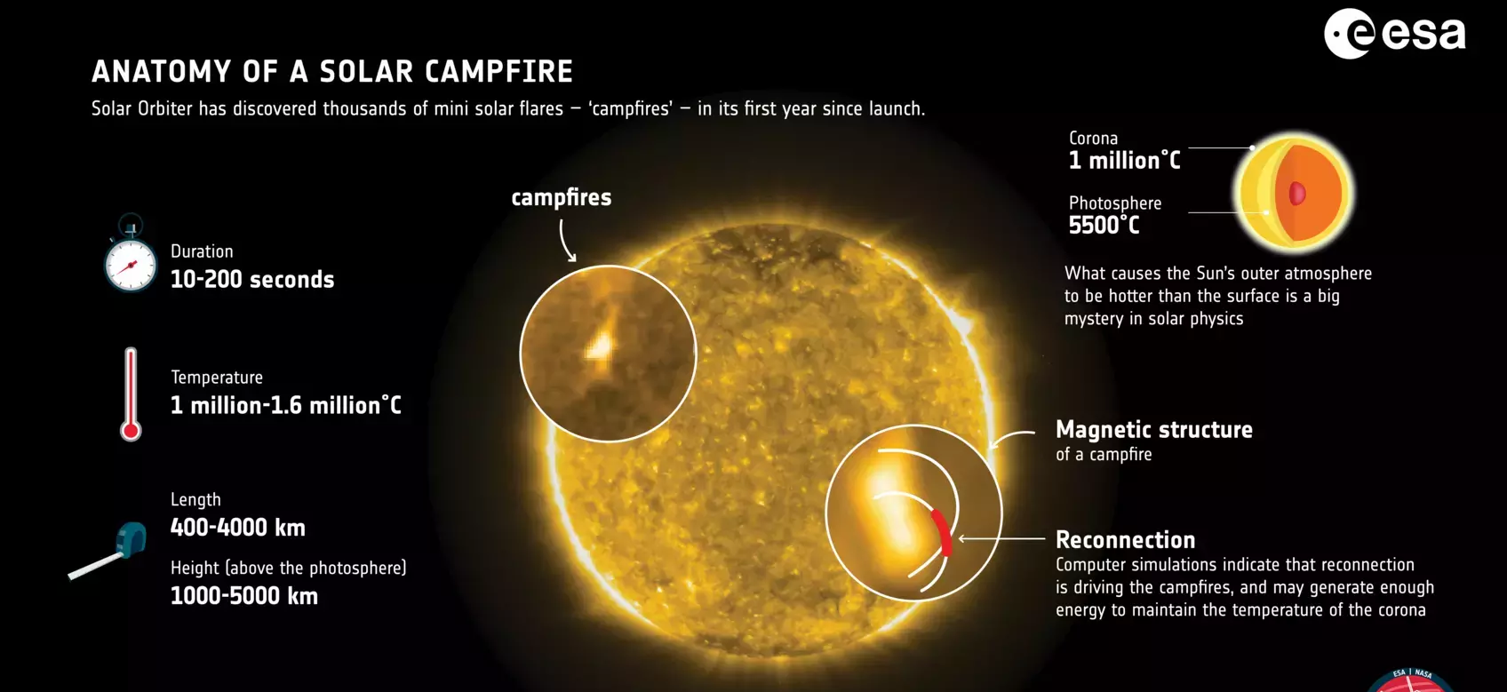
Energy source for the solar wind
Long-standing problem:
What drives the solar wind?
Solar Orbiter: Berghmans et al., A&A, (2021), https://doi.org/10.1051/0004-6361/202140380

Slide 38
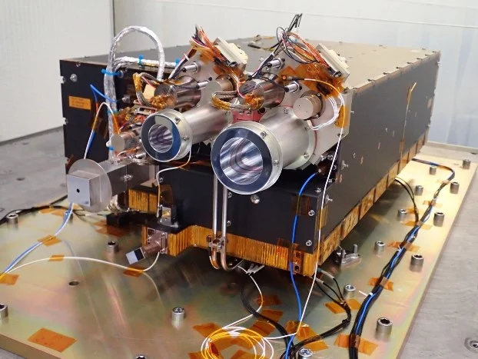
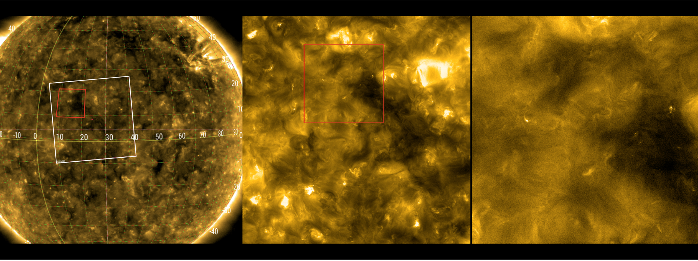
Energy source for the solar wind
Long-standing problem:
What drives the solar wind?
Solar Orbiter: Berghmans et al., A&A, (2021), https://doi.org/10.1051/0004-6361/202140380

Slide 39
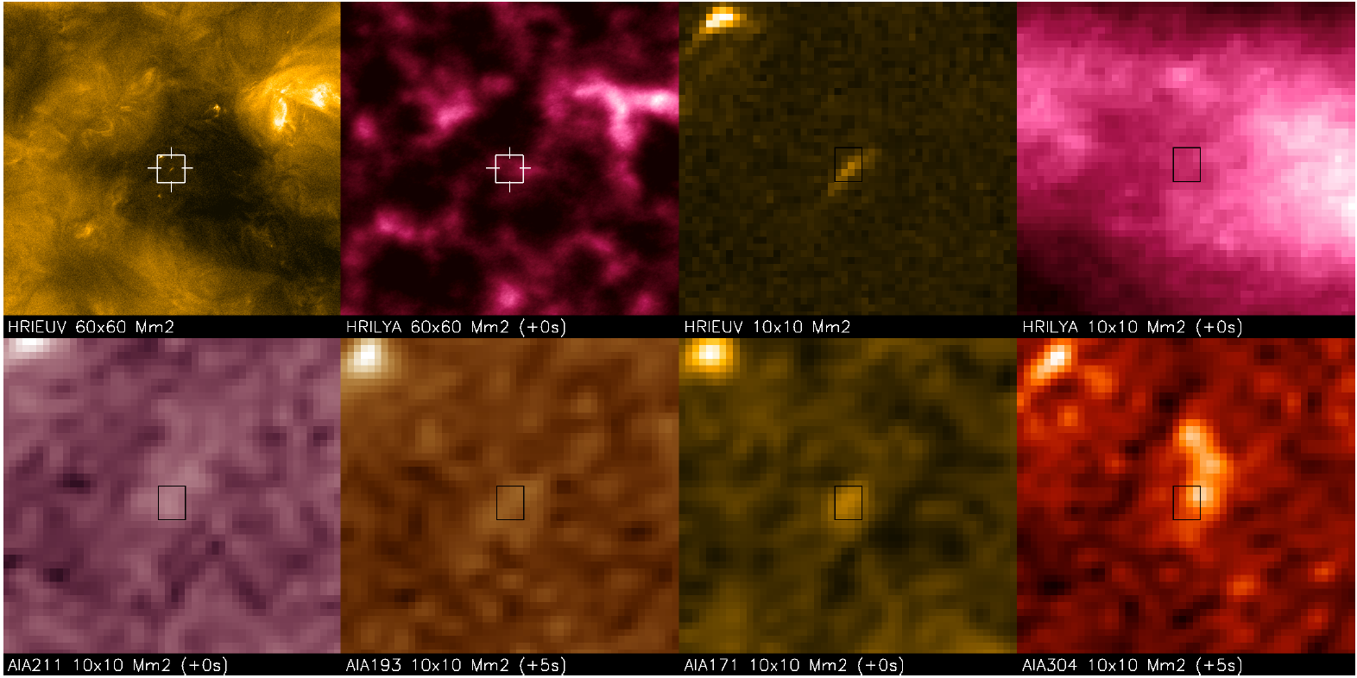
Energy source for the solar wind
Long-standing problem:
What drives the solar wind?
Solar Orbiter: Berghmans et al., A&A, (2021), https://doi.org/10.1051/0004-6361/202140380
Solar
Orbiter
EUI
SDO
AIA

Slide 40
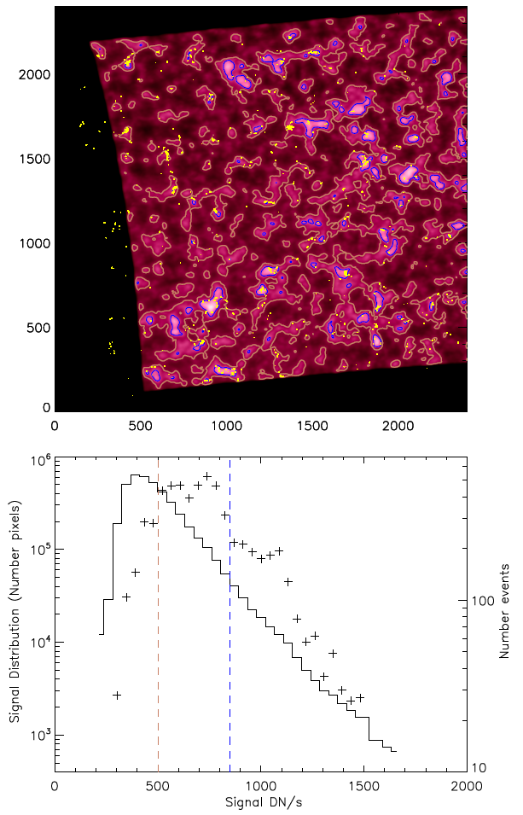
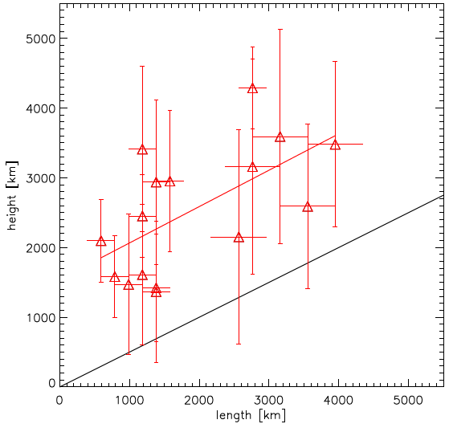
Energy source for the solar wind
Solar Orbiter: Berghmans et al., A&A, (2021), https://doi.org/10.1051/0004-6361/202140380
Subsample of 16
campfires also observed
with SDO/AIA allows
triangulation.
1000 – 5000 km above
photosphere
i.e., located above
chromospheric
network
Expected for semi-circular loop.
Loops are elongated in height.

Slide 41
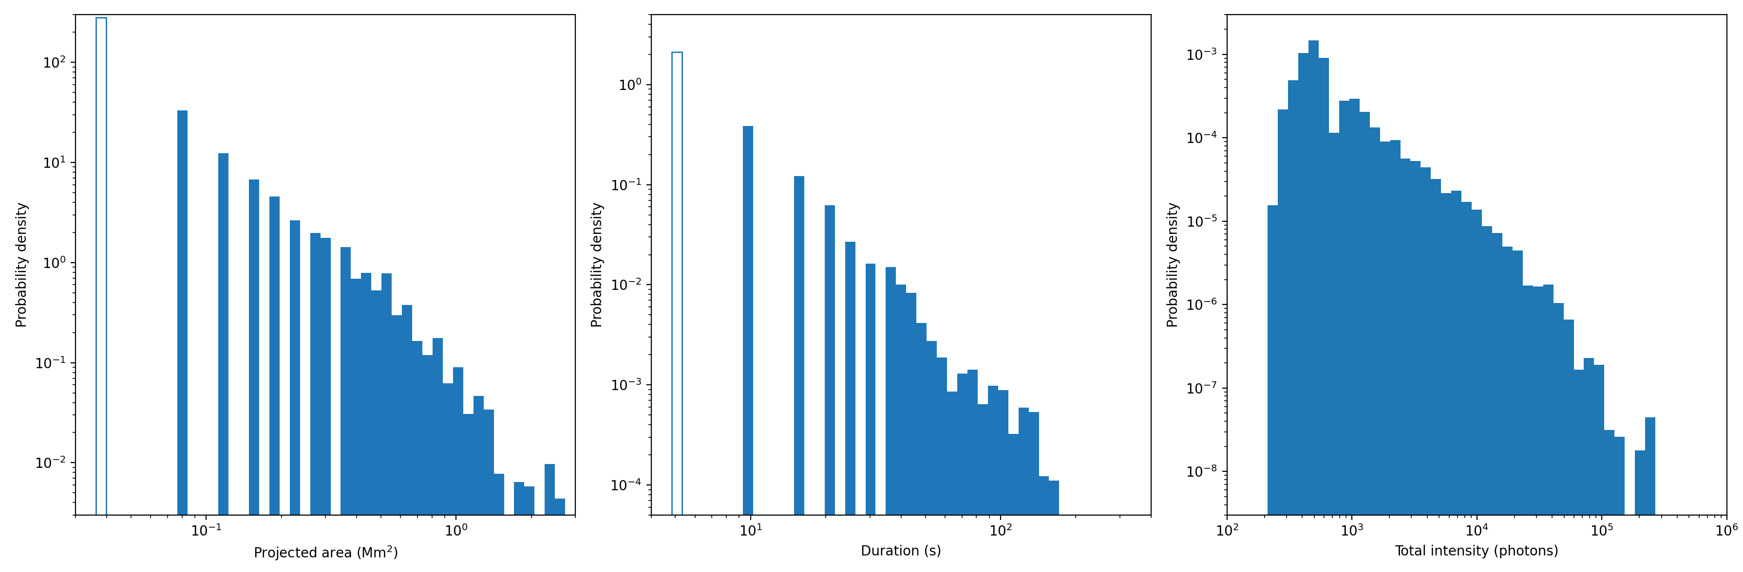
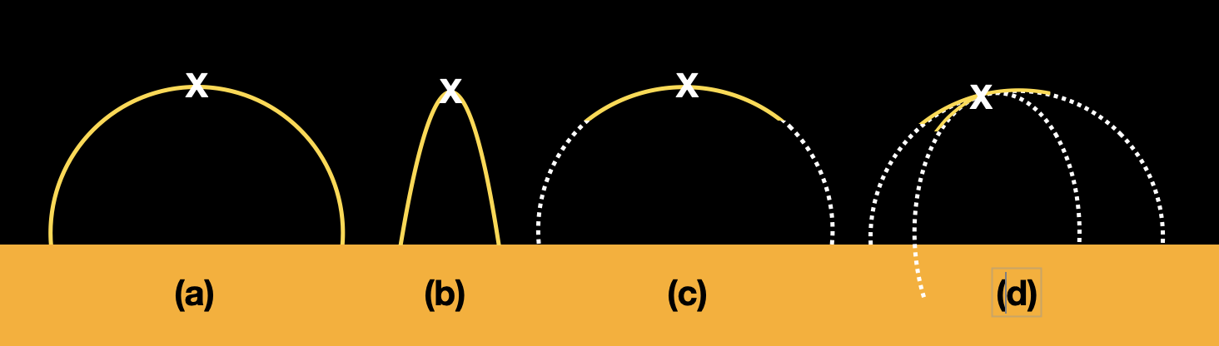
Energy source for the solar wind
Solar Orbiter: Berghmans et al., A&A, (2021), https://doi.org/10.1051/0004-6361/202140380
One single pixel (excluded)
Single exposure (excluded)

Slide 42
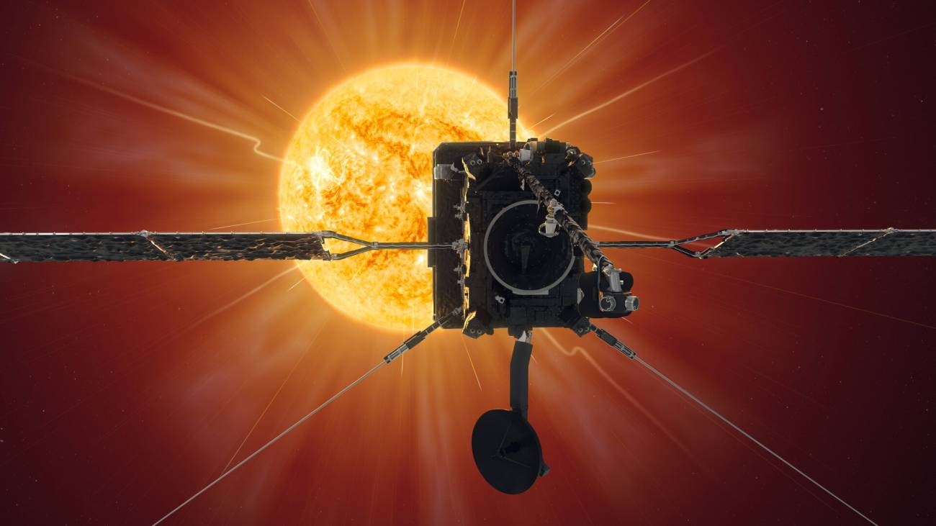
Solar Orbiter

Slide 43
Solar Orbiter
How does the Sun create and control the heliosphere – and why does solar activity change with time?
What drives the solar wind and where does the coronal magnetic field originate?
How do solar transients drive heliospheric variability?
How do solar eruptions produce energetic particle radiation that fills the heliosphere?
How does the solar dynamo work and drive connections between the sun and heliosphere?

Slide 44

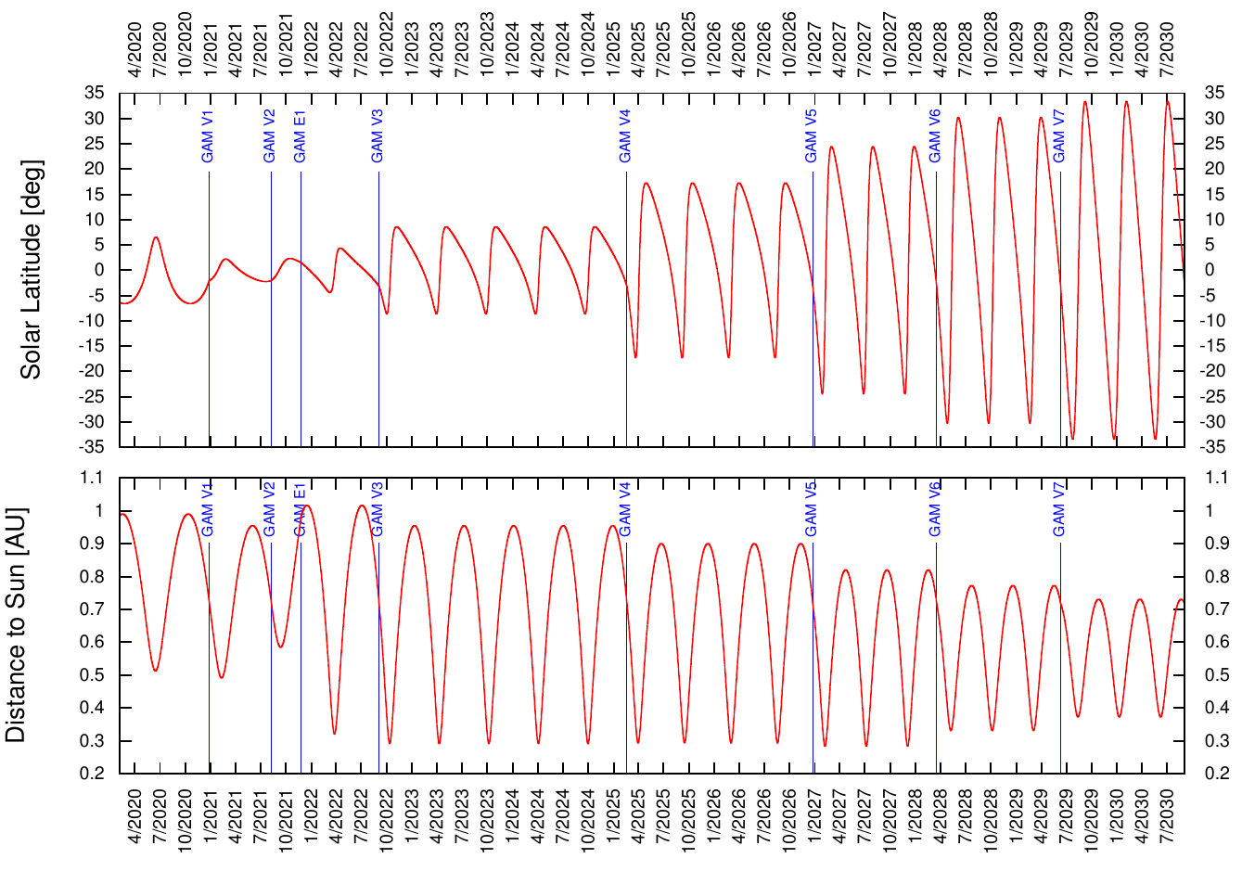
Solar Orbiter
Solar Orbiter:
Launch: 10 February 2020
Mission duration:
7 years (nominal)
3 years (extended)
Orbital period: 168 d
Perihelion: 0.28 au
Highest lat.: 34 deg

Slide 45
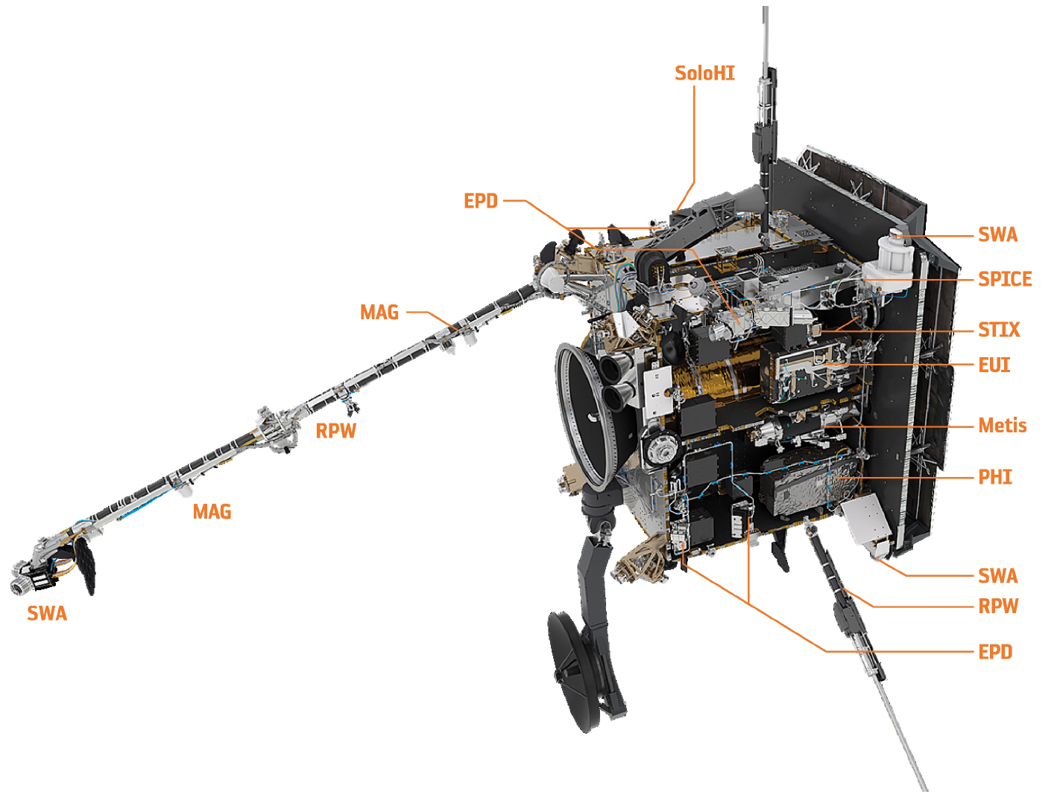
Solar Orbiter
Heat shield (13 S_{ʘ})
HGA
Mission, science, and instrument descriptions:
https://www.aanda.org/component/toc/?task=topic&id=1082

Slide 46
Solar wind interaction with planets and moons

Slide 47
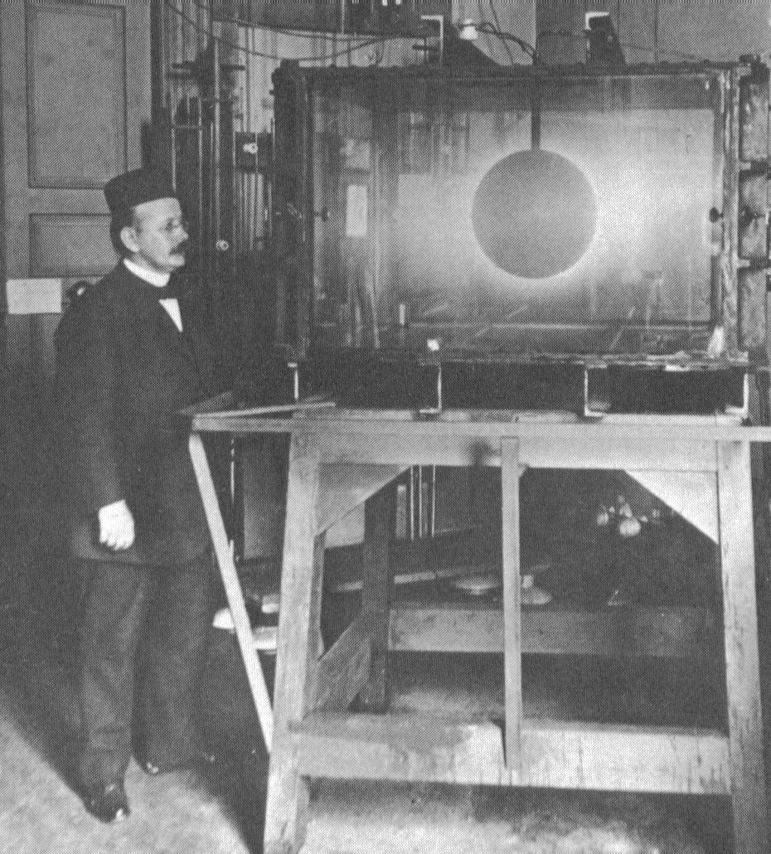
Plasma interactions with planets and moons
Kristian Birkeland (1867 - 1917)
Studied „space weather“
Terella – plasma interaction
Expeditions to northern Norway to study aurorae
Solar electrons influence the Earth‘s magnetosphere!

Slide 48

Plasma interactions with planets and moons
Interaction of solar wind (a plasma) with the magnetic field of planets (and moons) leads to formation of magnetospheres.

Slide 49

Plasma interactions with planets and moons
Interaction of solar wind (a plasma) with the magnetic field of planets (and moons) leads to formation of magnetospheres.
Sun
Earth
Mercury

Slide 50
Plasma interactions with planets and moons
Interaction of solar wind (a plasma) with the magnetic field of planets (and moons) leads to formation of magnetospheres.

Slide 51

Plasma interactions with planets and moons
Comparison of the Moon and Jupiter‘s mangetosphere if it were visible from Earth.

Slide 52

Plasma interactions with planets and moons

Slide 53


Plasma interactions with planets and moons
Mars
Mars has no intrinsic magnetic field. So it only has an induced magneto-sphere. That is also why it has lost most of its atmosphere!

Slide 54

No magnetosphere at Mars: Space radiation reaches Mars surface

Slide 55
Particles in the Heliosphere: Suprathermals

Slide 56
Long-term average particle spectrum
suprathermal
energetic
Proton rest mass
(thermal)
Very high energy

Slide 57
Variability of suprathermal particle flux

Slide 58

Variability of suprathermal particle flux

Slide 59

Solar Energetic Particles (SEPs)
Solar activity has picked up again, we are now in solar activity cycle 25.
Sunspots are a manifestation of solar magnetism. Large sunspot numbers go with enhanced solar activity.

Slide 60
Solar Energetic Particles (SEPs)
Solar activity has picked up again, we are now in solar activity cycle 25.
Sunspots are a manifestation of solar magnetism. Large sunspot numbers go with enhanced solar activity.

Slide 61
Particles in the Heliosphere: SEPs and GCRs

Slide 62
Long-term average particle spectrum
suprathermal
energetic
Proton rest mass
(thermal)
Very high energy

Slide 63
Interaction of charged radiation with matter
„Ionizing radiation“:
      Collisions with electrons
Other interactions (not necessarily ionizing):
      Collisions with nuclei
      Nuclear reactions
      Excitation of phonons
Reactions need to be described by cross sections, but
some analytic approximations are sometimes helpful.
The most important is the one by Bethe, Bloch,
Lindhard, and Schjott.

Slide 64



Energy loss of charged particles in matter:
Deposition profile – The Bragg Peak
Bethe-Bloch eqn.
where
Because a particle looses more energy when it has less energy, it looses most of its energy at the end of its trajectory.
5 MeV α particle only penetrates few cm of air.

Slide 65


Implications for astronauts
Apollo 16:
16 April 1972, 17:54 launch
21 April 1972, 02:23 landed on moon
Inbetween:
An enormous solar explosion!
Apollo 17:
7 Dez. 1972, 05:33 launch
11 Dez 1972, 19:55 landed on moon

Slide 66

Implications for astronauts
Apollo 16:
16 April 1972, 17:54 launch
21 April 1972, 02:23 landed on moon
Inbetween:
An enormous solar explosion!
Lockwood & Hapgood, 2007
Apollo 17:
7 Dez. 1972, 05:33 launch
11 Dez 1972, 19:55 landed on moon

Slide 67

Radiation – a major risk to astronauts

Slide 68



Space radiation is a health risk
Radiation is the long-term risk for astronauts. Damage can appear long after the stay in space.
Personal dosimeters
Phantom experiment MATROSHKA
(Photos: G. Reitz)

Slide 69

Effects of (charged) ionizing radiation
Radiation ionizes → free radicals!
Radiation breaks molecular bonds

Slide 70


Space radiation: sources and risks
Galactic cosmic radiation:
Very high energies, H to U
Highly penetrating
Solar modulation, predictable
Solar energetic radiation:
High energies
Shielding possible
High variability of dose rate (~10.000)
Solar activity, not predictable
Earth‘s radiation belts:
Very high eneries, protons, electrons
Highly penetrating
Very high dose rate

Slide 71

Radiation exposure: Dose comparison
Measurements show:
The dose exposure for a flight to Mars and back is
Flight: 662 +/- 108 mSv
Mars: 320 +/- 50 mSv
Total ~ 1000 mSv
180 days on the Moon:
250 mSv (shielded by space suit)
For comparison:
6 months ISS: 75-90 mSv
Radiation worker: 20 mSv/y
CT-scan: 8 mSv
180 days on the Moon
(Zeitlin et al., Science, 2013
Zhang et al., 2020)

Slide 72







Summary & Conclusions
The heliosphere: a plasma bubble in the interstellar medium
The solar wind
Solar wind interaction with planets and moons
Suprathermal and Solar Energetic Particles
Solar Energetic Particle & Galactic cosmic rays
Implications for exploration of the solar system

Slide 73
Appendix with details about points I could not cover but which may be of interest to some.

Slide 74
Derivation of the angle of the Parker spiral

Slide 75




Then the behavior of the
heliospheric field is determined
by the flow of the solar wind.
In a frame co-rotating with the Sun:
because the solar wind flows
radially outwards from the Sun.
The Parker Spiral
The so-called Parker-angle, ,
is the angle between the radial
and the magnetic field directions.
(typically about 45° at 1 AU)

Slide 76
Why is the IMF frozen in to the solar wind?

Slide 77






The Magnetic Field in the Solar Wind
We define a fieldline as an entity for which
We define a flux tube as an entity for which the enclosed magnetic flux is conserved.
(*)
Because =0 for surface S,
But
vanishes, which proves (*).

Slide 78




The Frozen-in Magnetic Field
For the well-conducting solar wind, the MHD induction equation,
,
turns into
which means
that the flux through C does not change.
There are two ways in which the flux through C could change:
The field, B, within C changes,
The curve C moves with respect to B
For the first possibility we get
over

Slide 79




The Frozen-in Magnetic Field II
For the second case, we consider the infinitesimal displacement of curve C. The infinitesimal change in the flux is
The full change in flux is obtained by integration along C. Using the identity
we get
Using Stokes' theorem, we have the induction equation in integral, so
QED

Slide 80
Interaction of charged radiation with matter

Slide 81






Interaction of charged radiation with matter
Force on electron is
Momentum transfer is:
Use Gauß' law
and obtain momentum and energy transfer.

Slide 82


Ionizing energy loss of charged particles in matter:
Bethe-Bloch
where
Energy loss goes with:
Square of projectile charge
1/v² (or ~ E/m) of projectile
Target electron density

Slide 83

Ionizing energy loss of charged particles in matter:
Bethe-Bloch
where
You can calculate the stopping power at NIST for all sorts of combinations of projectile and target materials.
MIPs
See:
http://www.nist.gov/pml/data/star/index.cfm

Slide 84
Energy loss of charged particles in matter
So energy loss is given as MeV/(g/cm²).
What does that mean?
Multiply by density, ρ= g/cm3 to obtain
dE/dx in units of MeV/cm.
Air: 1kg/m³ = 1mg/cm³
So 10³ MeV/(g/cm²) = 1 MeV/cm. Compare this to binding energy of N₂ molecules of 15.6 eV. In fact, ions will also loose energy to nuclei, so 37 eV is the correct number to be used for <E_{B}>.
Ionizing radiation ionizes air!

Slide 85

Radiation effects on humans

Slide 86
Gyro radius and other micro-physical quantities

Slide 87






Gyro-radius, gyro-period, and pitch-angle
Particles bound to B
Gyro-radius, r_{c}
Pitch angle α
Gyrofrequency Ω
where
For a 1 keV proton,
r_{c} is only 30 km at 1 au
Rigidity

